Slide 1
Succession Management Implementation Guide
Four Steps for Building high-impact succession plans.

Slide 2
Identify future leadership gaps
Create plans for a small number of positions
Prioritize those that have high retirement risk and strategic importance. Both are equally important.
Focus on those likely to retire in the next 2 years.
Focus on the critical – hard to fill positions.
Special technical talents or those requiring more experience to be successful in the role.

Slide 3
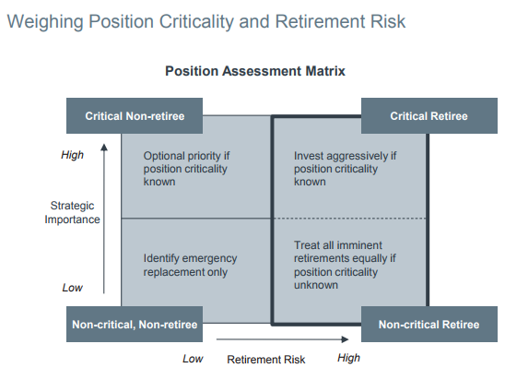
Weighing Position Criticality & Retirement Risk

Slide 4
Succession Intervention Evaluation Tool
Step-by-Step Instructions
Calculate the average age by job title
Sort titles in descending order of age
Pick the top 2 or 3 titles
Interview these employees to determine likelihood of retirement in 2 years
Determine percentage likely to retire

Slide 5
Determine if Succession Planning is Necessary
Are multiple individuals with the same title retiring in the same time frame?
Are there already strong internal staff at a junior level?
Are there enough junior level people to fill the pipeline?
Does HR need to take measures to target new labor pools?
Will this role be more or less important in the future.
For remaining titles, develop customized retention plans for each employee while grooming successors.

Slide 6
Identify Top Talent Leadership Potential Diagnostic
Employee profiles commonly mistaken for High Potential:
“Mini-Me” Younger versions of current manager -May not have leadership qualities needed for the future or the desire
“Old Faithful” Long time loyal employees despite deep institutional knowledge, may never be able to perform at a higher level even with additional development
“Ivy League” Highly intelligent, may hold several degrees, accreditations. May not possess business and political savvy required at higher levels

Slide 7
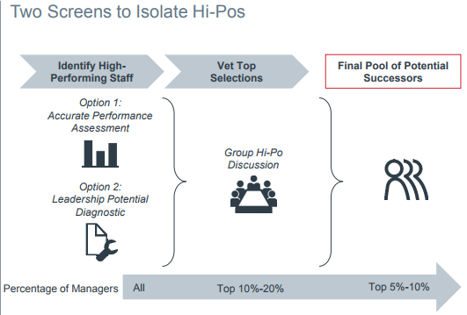
How to isolate the high potential individuals

Slide 8
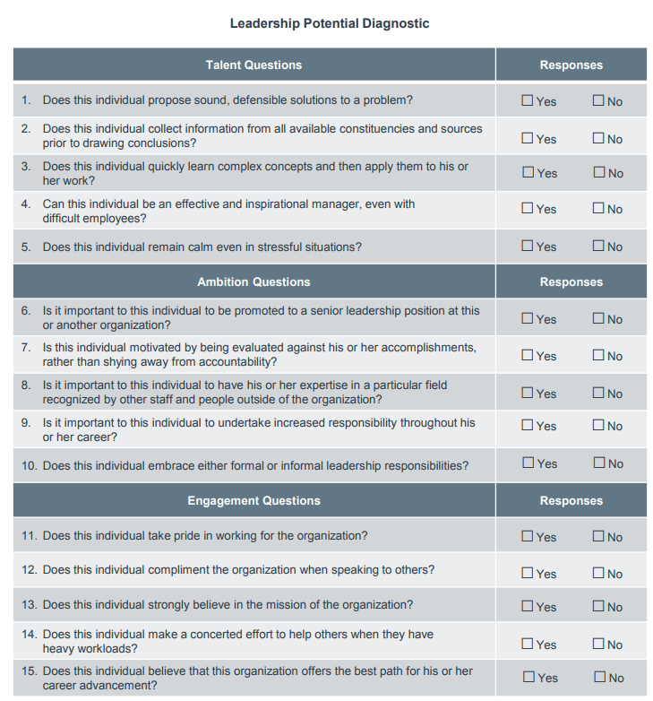
Leadership Potential Diagnostic

Slide 9
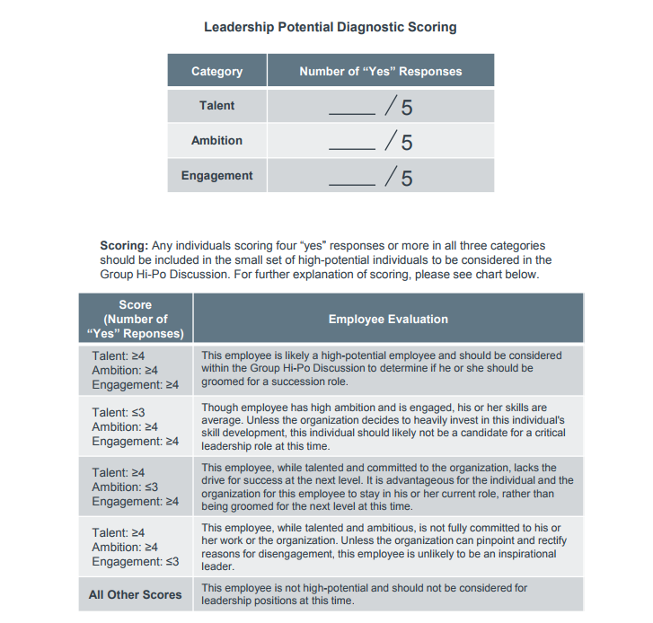
Leadership Potential Diagnostic (cont.)

Slide 10
Identify Top Talent
1. Eager to learn about self others and ideas Y N | 7. Shows willingness to learn form feedback& experience; can change behaviors or viewpoints as a result Y N
2. Frequently volunteers for additional opportunities or expanded responsibilities Y N | 8. Quickly incorporates new skills in to repertoire Y N
3. Actively seeks opportunities to improve oneself Y N | 9. Collaborates with others & builds mutual respect beneficial to the organization Y N
4. Stays informed about major strategic initiatives both within & outside the department Y N | 10. Individual models the organizations values Y N
5. Enjoys complex problems and challenges Y N | 11. Enables others to achieve their full potential Y N
6. Consistently performs well under first-time conditions Y N | 12. Uses skills & abilities beyond those commonly held by others in similar roles. Y N

Slide 11
Personality

Slide 12
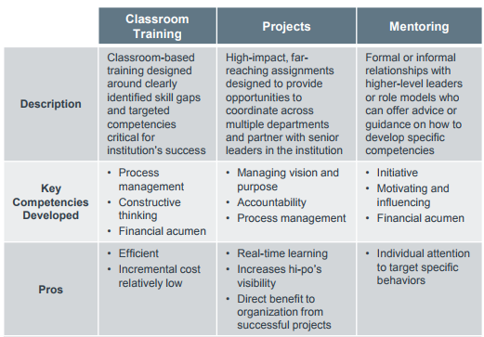
Developing High Potential Staff

Slide 13
Develop Specific Work Experiences
Construct and present the case for a new piece of equipment including budget
Develop and provide a continuing education program for the staff
Design and lead a process improvement initiative or employee engagement task force
Identify a cost savings initiative and track results

Slide 14
Mentoring Information
 | Mentoring | Shadowing
Description | Relationship with higher-level leaders or role models who can offer advice or guidance on how to develop specific competencies. | Time-limited, direct observation of higher level leaders, other functions, or competency role models.
Key Competency Developed | Initiative Motivating and influencing Financial acumen Process Management Communicating effectively Giving Feedback Developing and retaining talent | Constructive thinking Communicating effectively Prioritizing and delegating Service orientation and customer focus Managing vision and purpose Building and strengthening relationships Upward management
Pros | Individual attention allows for precise targeting of specific behaviors Interactions with experts or veterans allows leader to avoid pitfalls by learning from others’ experience | Limited disruption to work schedule for both Direct exposure to advanced decision-making and/or day to day responsibilities
Cons | Difficult to make a match that results in a –productive relationship Difficult to find leaders who are both willing and capable of mentoring effectively | Observation method does not require shadowee to practice competencies or learn from own mistakes or successes
Critical Success Factors | Deliberately match participants based on competency & compatibility, not self-selection Ensure mentor has expertise in specific area in which mentee requires assistance & can effectively communicate that knowledge Secure a long time commitment from the mentor and mentee | Ensure shadowing occurs around meetings, or settings where opportunity exists to observe competencies needing development (for example, strategic planning sessions for new equipment, changing operations, shared responsibilities between lab and another department

Slide 15
Create a Personalized Onboarding Plan for Internal Promotions
Create personalized 180 day plan
Meet with onboarding team
Review 180 day accomplishments
Gather custom team intelligence
Pre-transition
Day 1
Day 90
Day 180
Assemble onboarding team
Share onboarding plan with mentee
Evaluate performance via stakeholder feedback

Slide 16
Personalized Onboarding Plan
Activity | Participants | Purpose | Date
Project Design Instrument Validation Team Assignments Gantt Chart
Designing Work Schedule Matching workload to staffing Appropriate staffing mix
Quality Improvement Project Identify Opportunity Identify team members Conduct PDSA Measure success and realign plan as needed.
Participate on an Interdepartmental Team Preparation for the meeting Represent lab’s and patient’ interests Report necessary actions and expected outcomes back to lab section

Slide 17
Next Steps
Action Item | Due Date
1. Determine retirement risk and strategic importance for 2018 and 2019 using Weighing Position Criticality & Retirement Risk Tool | 2-16-18
2. Identify top talent & run leadership potential diagnostic for each person selected. | 2-23-18
3. Vet the top selections in a leadership meeting and select top 1 to 3 | 3-2-18
4. Discuss with employee to make sure they are committed to the work required of them to be considered for advancement. | 3-9-18
5. Design personalized developmental plan for each employee for the advanced position | 3-23-18
6. Share onboarding plan with mentee | 3-30-18
7. Review progress and seek input from each mentee regarding their desire to continue the process. | 5-30-18

