Slide 1
Medical Laboratory Scientist (MLS)

Slide 2
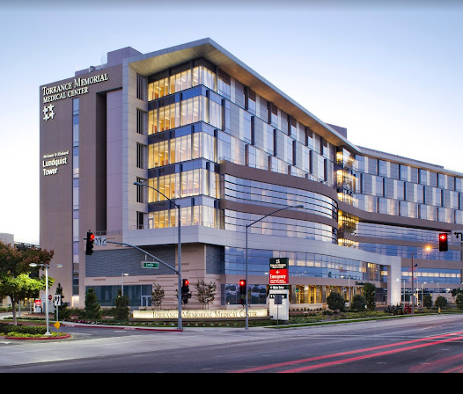
Who are we?
512-bed, nonprofit Medical Center located in Torrance, CA
  # 1 Hospital in the South Bay
  # 5 in Los Angeles
  # 11 in California
90,000 ED visits annually
Department of Pathology and Clinical Lab
  Approximately 200 employees (5 Pathologists, 8 Managers )
  12 million tests Annually
  8 outreach draw stations
  Blood Donor Facility
  First Leading Lab in the Nations
  Six-Sigma VP Certification
  Accredited by JC and AABB

Slide 3
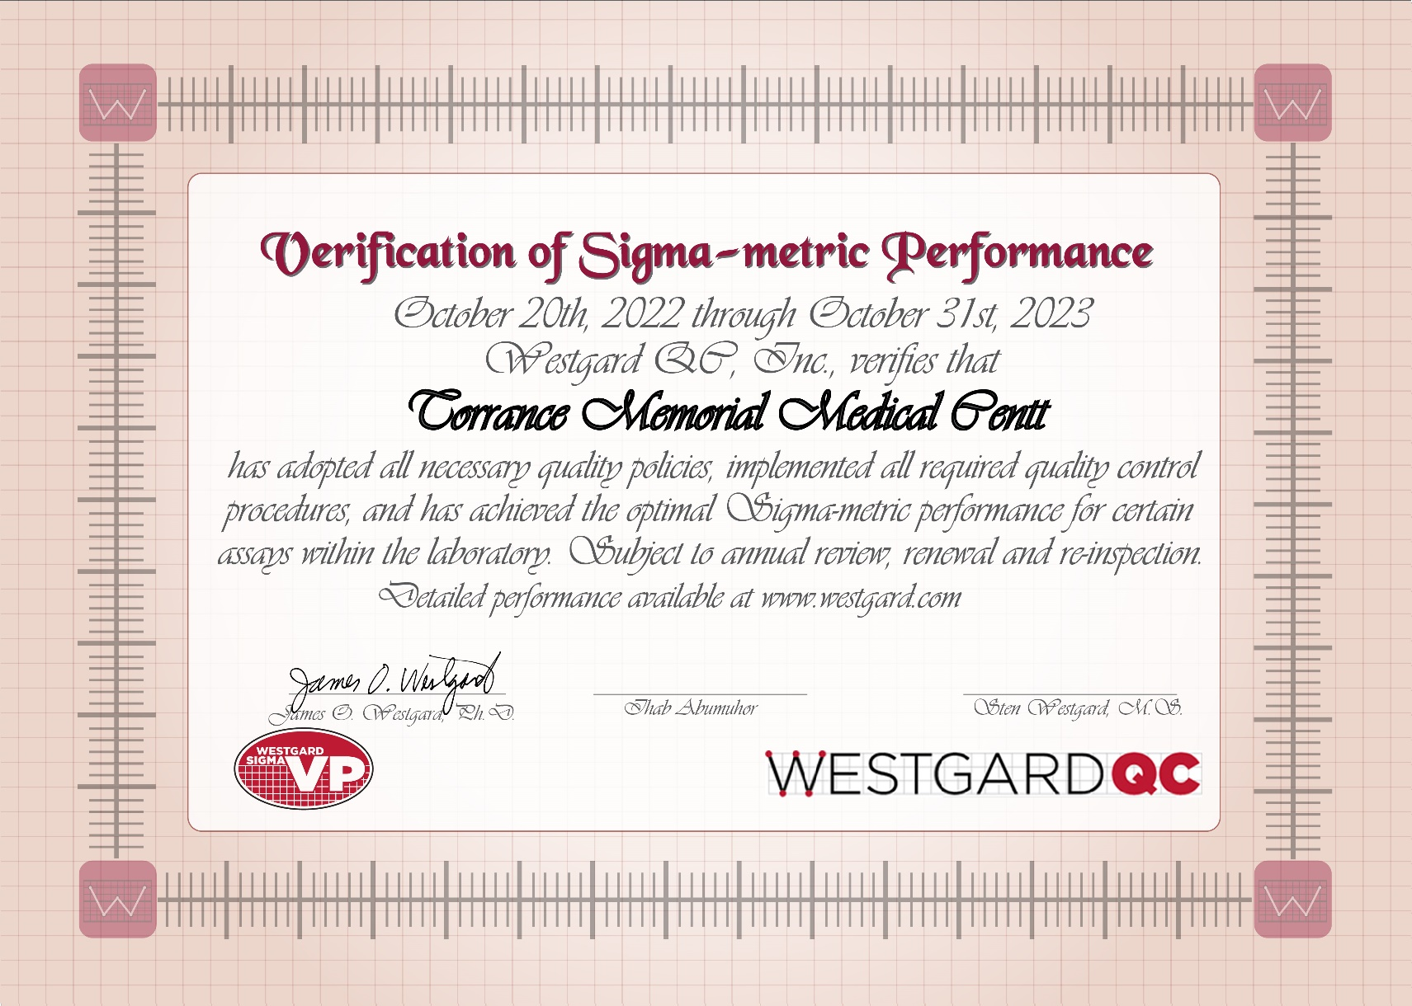
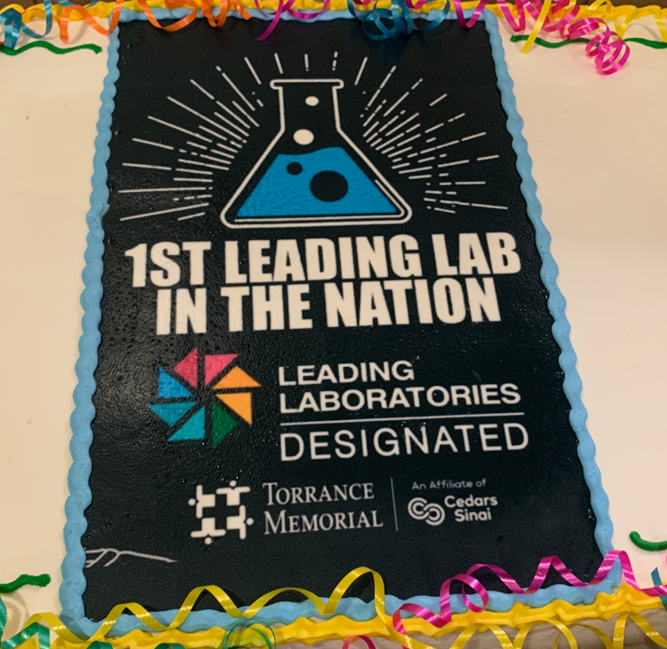
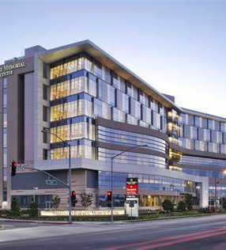
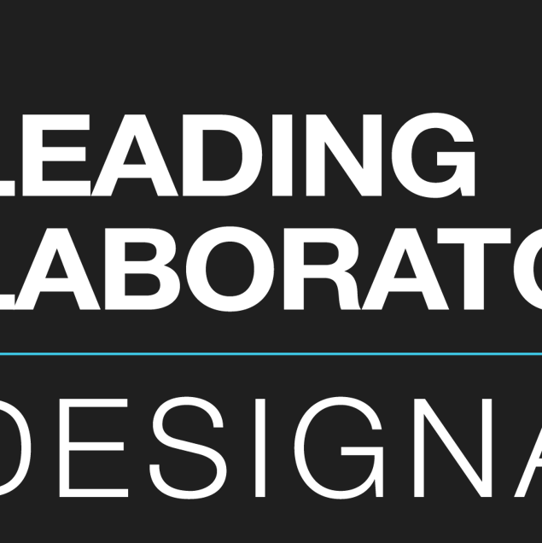
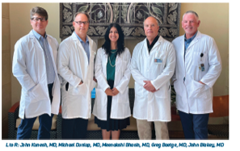
Department of Pathology and Clinical Laboratory

Slide 4

Did You Know?
It is estimated that 70 - 80% of all physician decisions are based on laboratory tests performed by the Medical Laboratory Scientist (MLS). In fact, two-thirds of a patient’s medical records are laboratory tests.
There is currently a shortage of the MLS in the U.S. The American Society of Clinical Pathologists Board of Registry found vacancy rates for the MLS at between 16-20% by 2024 depending on the job type and location.

Slide 5
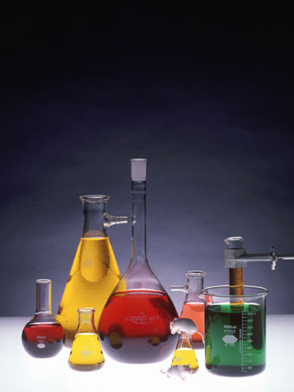
National Shortages
Currently there is a national shortage
of properly trained medical laboratory personnel.
There are many opportunities in this
exciting and fulfilling career
Average starting Salary in Los Angeles 100 K Annually

Slide 6
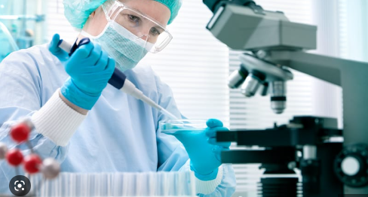
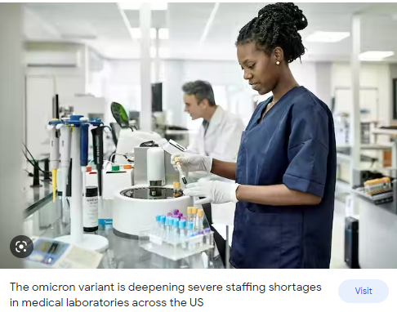
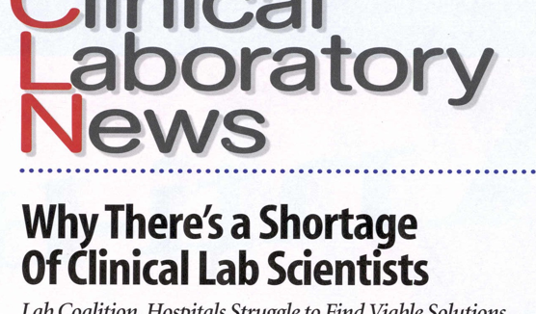
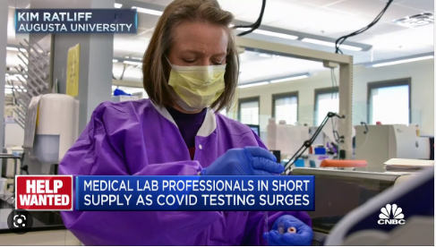
Clinical Laboratory News

Slide 7
Summary & Conclusions
“Overall, the wages for all medical laboratory positions are on
the upswing. The percentage median wage increases are
collectively greater than in any other time in the 12-year
comparison period. Vacancy rates are concurrently continuing
to accelerate for 8 of the 10 positions. Difficulty in filling shifts,
coupled with more staff turnover, presents a challenge for
laboratory directors and managers.”

Slide 8
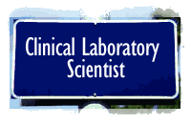
Bureau of Labor Statistics
53,000 new jobs
40,000 vacancies
93,000 positions to be filled
9,000 openings per year
4,990 graduates/year

Slide 9

Listen! Would you like to know…
How you can help doctors diagnose and treat disease?
How you can have an exciting and rewarding career helping others?
How you can join a growing field with flexibility and job security?

Slide 10

A career in the medical laboratory is your answer!

Slide 11
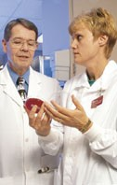
Medical Laboratory Science is a dynamic, exciting profession that continually changes as new
medical knowledge and medical technologies are discovered.

Slide 12

Let’s Talk….
Positions are now available in the medical laboratory !!
Education, preparation and training:
a look at a typical medical laboratory
Career path and options.

Slide 13
MLS
The Medical Laboratory Scientist (MLS)..
Also known as a Medical Technologist …or Clinical Laboratory Science
Needs a Four year Bachelor of Science Degree.
Works in all areas of the medical laboratory:
  Microbiology
  Blood banking and transfusion medicine
  Clinical chemistry
  Hematology
  Molecular diagnostics
Uses microscopes, electronic/robotic equipment and instruments, and computers.
Must provide accurate and reliable results to doctors.

Slide 14
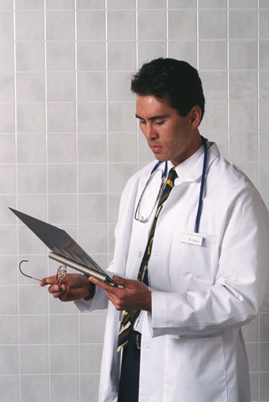
Why Choose to Become a Medical Laboratory Scientist …?
Laboratory tests are extremely valuable
Contribute up to 80% of all medical decisions made by doctors
Modern medicine could not function without laboratory test results.
Demand for laboratory professionals has exceeded the supply to date nationally !!!!!!

Slide 15

Education, Training, Preparation
High School: Solid skills in Math and Sciences; successful College: completion of Basic Health Science courses in chemistry, biology, computer Science, & math. (A,B, and + grades may be acceptable)
Cal State Dominguez Hills (CSUDH) and Cal State LA program: Combo of classes and clinical training.
2 years general studies and science courses,
2 years in the MLS program
1 year internship in an
actual hospital laboratory !

Slide 16

Education, Training, Preparation cont...
“Real life” training directly prepares you for the job.
National Certification Exam is available though the American Society of Clinical Pathologists (ASCP) Board of Certification (BOC)
You are permitted to use these initials after your
name: MLS(BOC)
State Licensure may be required
Masters Degree in Specialties
Many graduates continue on to graduate or professional ( medical, dental, physician assistant) schools

Slide 17
Do You Have What it Takes?
Problem solvers
Enjoy challenge and high levels of responsibility
Enjoy working in laboratories
Focus on accuracy and reliability
Perform many tasks at the same time
High standards and demand quality
Commitment to help others

Slide 18
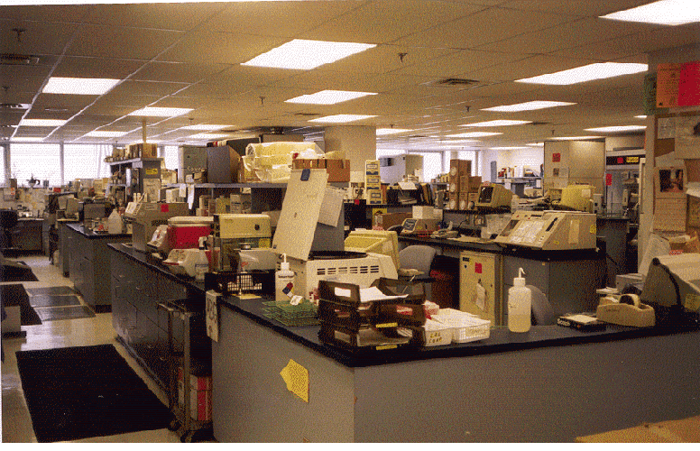
Typical Open Laboratory Configuration

Slide 19
Organization of the Medical Laboratory
Typical (Discipline-Specific)
Microbiology
Blood Banking & Transfusion Medicine
Clinical Chemistry
Hematology/Coagulation
Immunology
Urinalysis
Point of Care Testing
Molecular diagnostics and Esoteric Testing

Slide 20
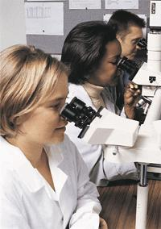
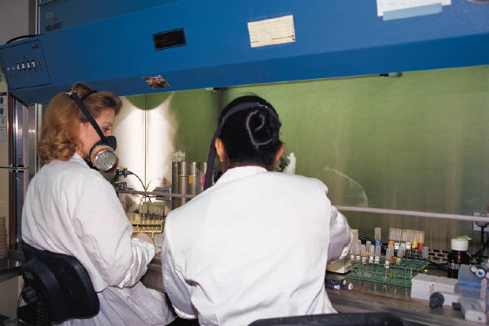
MICROBIOLOGY is:
Bacteriology, mycology, parasitology, virology

Slide 21
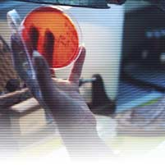
Bacteriology

Slide 22
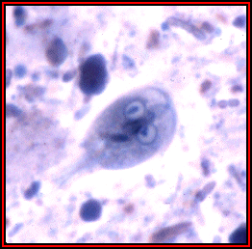
Parasitology

Slide 23
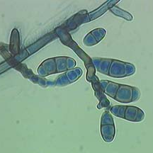
Mycology

Slide 24
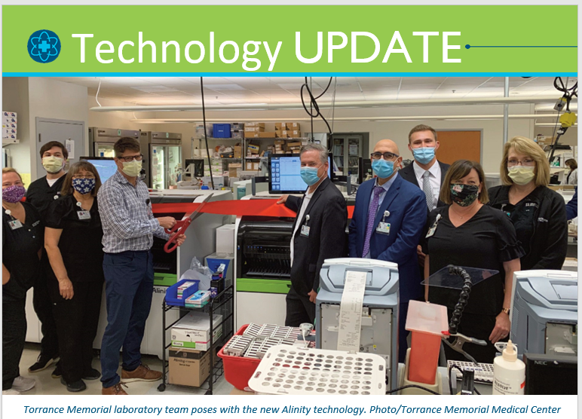
Clinical Chemistry

Slide 25
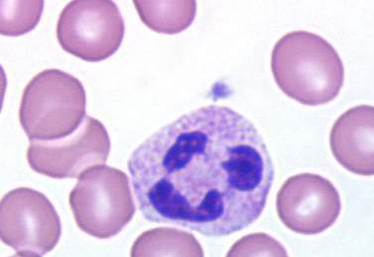
Hematology

Slide 26
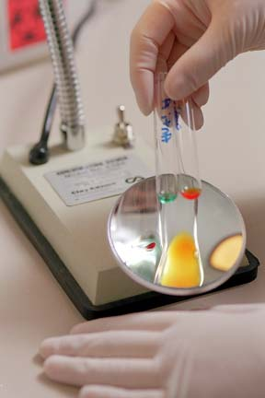
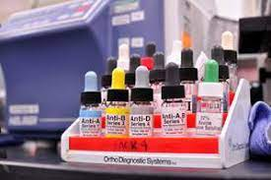
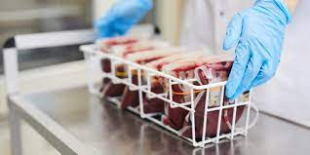
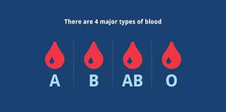
Blood Bank

Slide 27
……. a challenging, rewarding, way to help people.

Slide 28


Finally...
Though we are behind the scenes….
We are the Heroes of the Health Care Team
Solving Today’s Medical Mysteries.

