Slide 1
WELCOME
Culture of Safety
Survey Debrief for Blood Bank

Slide 2
Overview for Today
Introductions
Facilitator
Notetaker
Video Chat Guidelines
2019 COS
Results
Action Items
Feedback
Open, Honest, Confidential
Meaningful Feedback
Next Steps

Slide 3
Purpose
Culture of Safety is the opportunity to share your thoughts on how safety is impacting you and engage in cultural process improvement.

Slide 4
2019 COS Results
Our Strengths
Our Opportunities
Leadership
Improvement Readiness
Communication with other work settings.
Teamwork

Slide 5
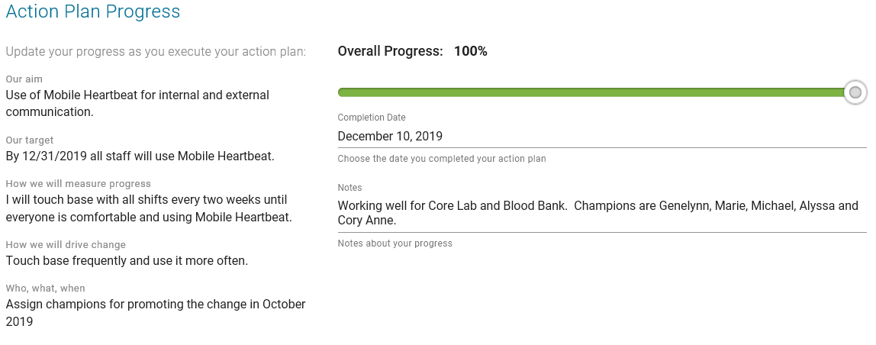
Action Items COS 2019

Slide 6
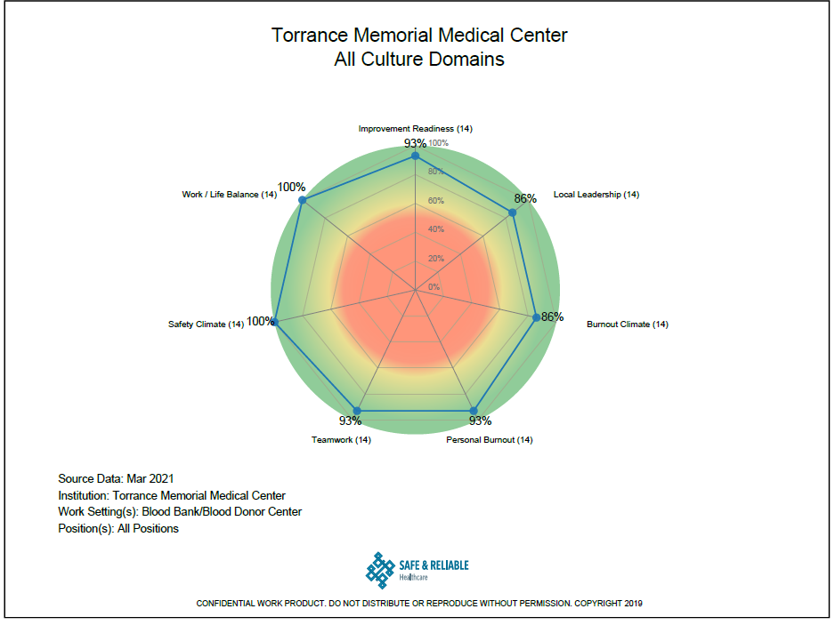
2021 COS Results

Slide 7
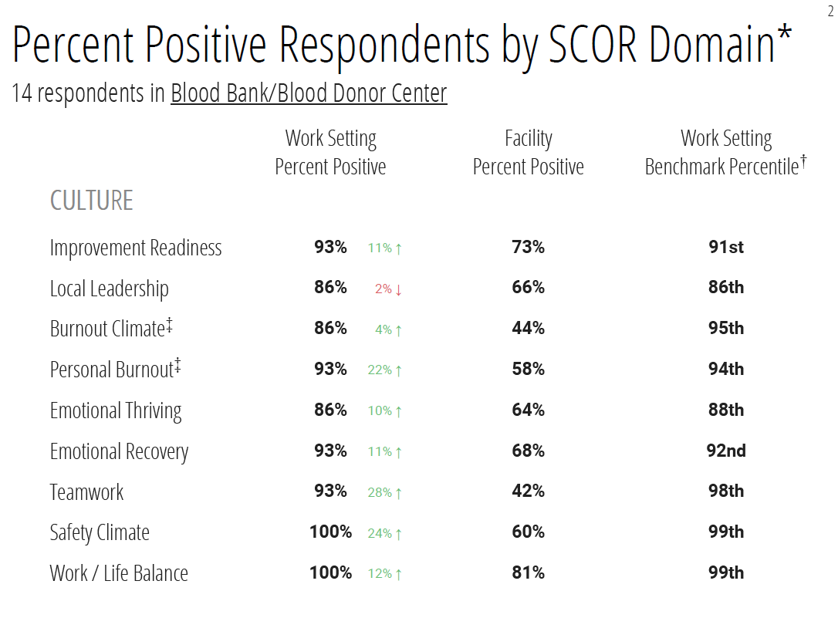
Summary of Results

Slide 8
2021 COS Results
Our Strengths
Our Opportunities
Safety Climate
Improvement Readiness
Teamwork
Local Leadership

Slide 9
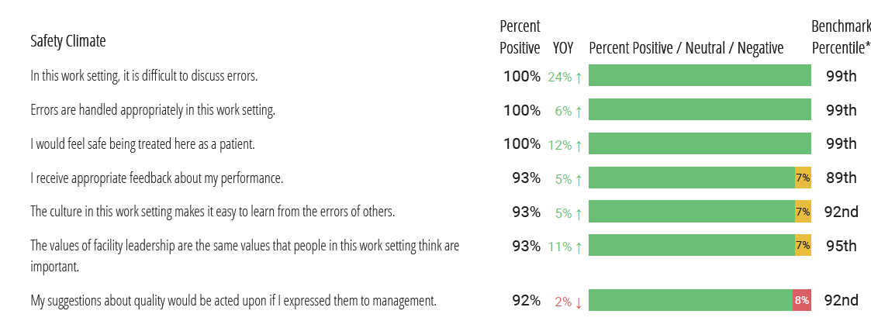
Strengths

Slide 10
Strengths cont.

Slide 11
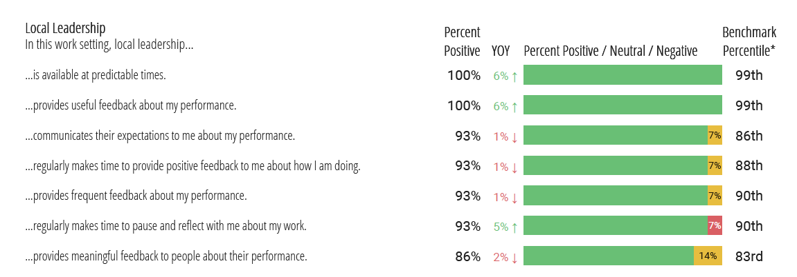
Opportunities

Slide 12
Summary of Feedback
(Insert Bullet points of most important or discussed points from today’s session.)

Slide 13
Next Steps
CONFIDENTIAL DATA SHARED WITH MANAGEMENT
TEAM DEVELOPS ACTION PLANS
IMPLEMENTATION
FEEDBACK

