Slide 1
Elevate and Sustain the Profile of the Lab?

Slide 2
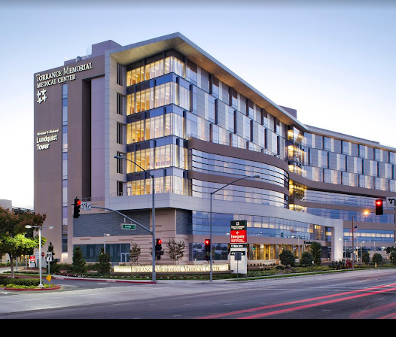
Who are we?
512-bed, nonprofit Medical Center
  # 1 Hospital in the South Bay
  # 5 in Los Angeles
  # 11 in California
90,000 ED visits annually
Department of Pathology and Clinical Lab
  Approximately 200 employees (5 Pathologists, 8 Managers )
  12 million tests Annually
  8 outreach draw stations
  Blood Donor Facility
  First Leading Lab in the Nations
  Six-Sigma VP Certification
  Accredited by JC and AABB

Slide 3
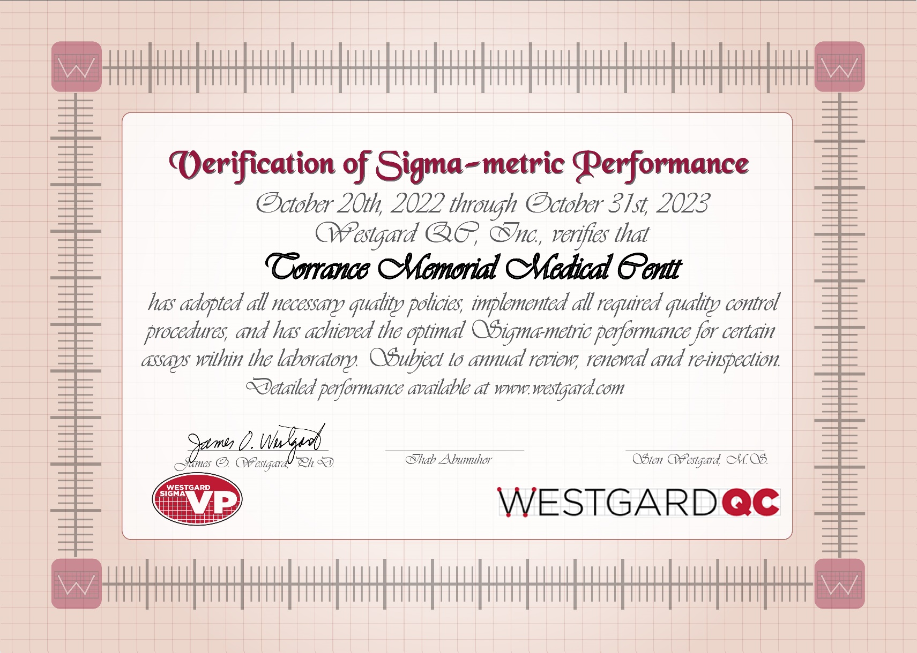
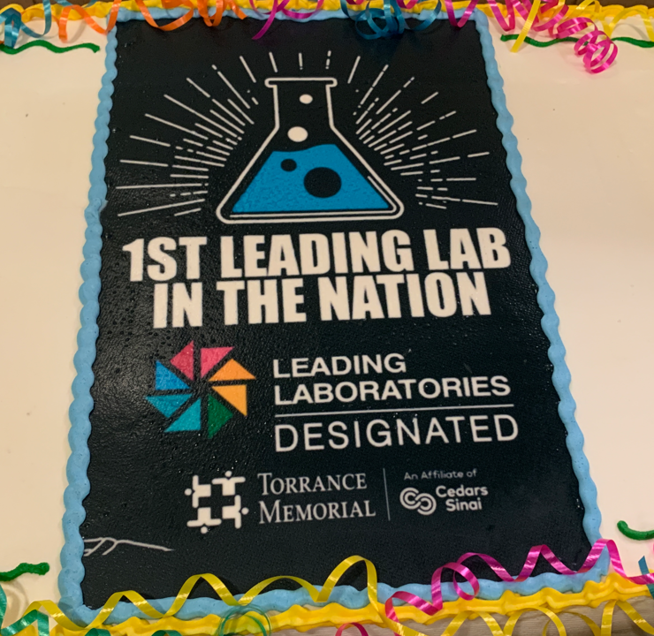
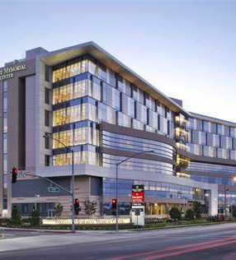

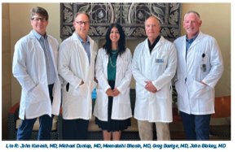
Department of Pathology and Clinical Laboratory

Slide 4
How do I Elevate and Sustain the Profile of the Lab?
How does your Lab add Value to the Health System?
  Value =Quality/Cost
  Growth
  Revenue (Outreach, new testing platforms)
  Savings (Contract Negotiations, reduction in send out testing, Reduction in reagent cost, new suppliers)
  Services Provided
    Health System
    Community (Blood Draw Stations, Blood Donor Center, POC testing)
    Education (CLS School, Manager’s certification, Lean certification )

Slide 5

Define Lab goal and value

Slide 6
Our Goal
Provide innovative, high quality timely and most effective clinical laboratory services
Add services to drive additional hospital and patient value through outreach expansion and clinical test menu

Slide 7



Value of YOUR Lab
$MM revenue¹
  10% all TMMC revenues
  Top 3 revenue centers
$costs¹
  6.7% all TMMC costs
  9:1 Gross Revenue : Cost
20-30% Margin²
250k patient draws
100k outreach visits
24/7 Operation
11.5 MM tests annually
1.7 MM orders
1.2 MM samples
100 K Patients
  4.5 MM Chemistry
  5.5 MM Hematology/COAG/UA
  305 k POC
~80% of EMR based on lab results²
~70% of clinical decisions based on lab tests²
13k units transfused
80k outreach visits
90K ER Visits
Value to System
Value to Operations
Value to Patients
Source: 1 - CMS Cost reporting (data sent by TMMC to CMS as part of governmental reporting)
2 - The Dark Intelligence Group June 8, 2018 “Hospital Lab Outreach Still Effective Revenue Strategy”

Slide 8
Value of your Lab in terms of quality
Accreditation
Quality Metrics and Quality Outcomes
  Health Analytics Dashboards
  Datawarehouse
  Informatics

Slide 9
Where Do I start?
Create a strategic Plan?

Slide 10
Why have a strategic plan??
A roadmap
Provides direction and goals.
Defines priorities: What we do and what we won’t do.
Guides day-to-day decisions, including where we invest resources (time, people, $$).
Framework for evaluating progress and changing approaches.

Slide 11
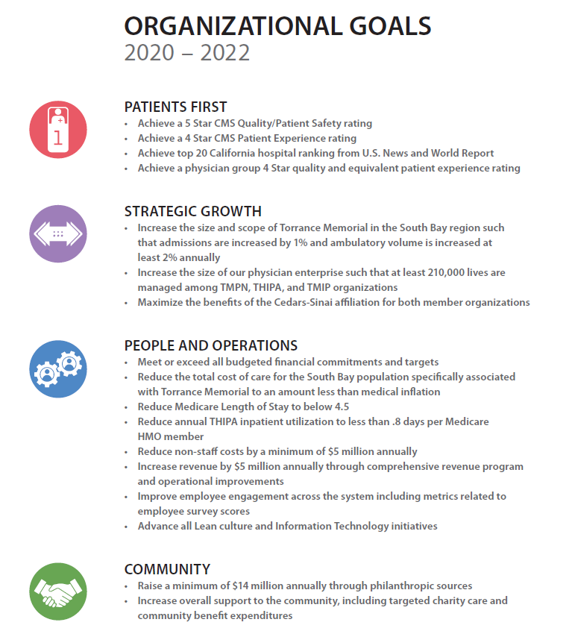
Align Department Goals with the Organizational Goals

Slide 12
The Path and Lab New Strategic Plan: Six Pillars for the Future
People and Culture: Be the best place to work in pathology and laboratory medicine and cultivate diverse life-long learners.
Quality: Strengthen the quality program throughout the department and enhance patient safety.
Financials: Ensure that our overall financial performance continues to keep pace with the operating and capital requirements needed to advance our Divisional and Departmental mission and values.
Innovation: Accelerate Innovation and implement the best cutting- edge technologies throughout the laboratory.
Education: Educate the next generation of Laboratory leaders, supervisors, managers, and Clinical Lab Scientists.
Growth: Increase clinical volume, operational expansion and geographic outreach.

Slide 13








Goal 3:Value added Care/ Financials
Identify, pursue early adoption of lean/value-added process improvements throughout the lab
Implement a high value stream committee to identify potential process improvement and cost savings.
Review all contracts and agreements and find any potential cost savings.
Transition to new vendors, if applicable
Collaborate on process improvement projects outside throughout the Medical Center.
Reduce Blood Utilization and identify a supplemental blood supplier
Increase blood collection in-house
Use outreach services to create new revenue from new clinical clients

Slide 14

Quality
Develop a Quality structure
Build a robust Quality Plan
Develop Meaningful Quality Metrics
Implement Dashboards
Implement business analytics

Slide 15
Quality Metrics
Built a real time Health Analytics dashboards
  AM Draws by 8 AM/9AM (% completed, % resulted…)
  Daily volume, volume by hour, Daily productivity, Productivity by Hour by Shift
  Instrument Capacity
  Turn Around Time Dashboards for Chem, TYSC, Troponin, COAG, HEM
  TAT collection to result, TAT receipt to result
  Rate of Contaminated blood cultures
  Compliance rate of Arm Band Scanning by Phlebotomist and Nurses
COVID, RSV, FLU Testing Dashboards
Timely Reporting of critical results
Hemolyzed, Clotted, QNS by Lab and Nursing
Test Utilization Dashboards-In Progress
  Vitamin D utilization
Blood Utilization Dashboards
  1 unit Vs. 2 units
  RBC, Platelets, Plasma utilization by MD, Location, Specialty

Slide 16
TMMC LABORATORY QUALITY COMMITTEE STRUCTURE
LABORATORY QUALITY COMMITTEE STRUCTURE
Quality Steering Committee (QSC)
Dr. John Kunesh, Dr. Michael Dunlap, Dr. MeenaKshi Bhasin, Dr. John Blakey, Dr. Gregory Baetge
Ihab Abumuhor
Lab Management Advisory Group (LMAG) –
Ihab Abumuhor, Patty Drew, Lorraine Smith, Angie Watters, Veronica Urbano, Rosalinda Catamisan, Shiva Eskandari, Rhonda Heilbron, Frances Davis, Armando Ramos
Outreach
Quality Steering Committee
Angie Waters
Rhonda Heilborn
Pathology Informatics
Michael Jovellana
Anne McCormick
Barry Ritchey
CP
Dr. John Kunesh
Waived Testing
Dr. John Blakey
Lorraine Smith
CP/AP Laboratory QA Committee includes
Quality Steering Committee, LMAG, and Section QA Representatives
AP
Dr. Gregory Baetge
Section QA Representatives
INTERNAL AND EXTERNAL FEEDBACK (EMPLOYEES AND CUSTOMERS)
Rev 06.09.2021

Slide 17





Scheduled QA Meetings
Daily Huddles
Weekly QA Review (CAP Survey Results, Validation Plans, New Tests, …)
Weekly Quality Steering Committee (Operations and Quality)
Quarterly QA Meetings (Divisional Quality Metrics)
Monthly Operations

Slide 18
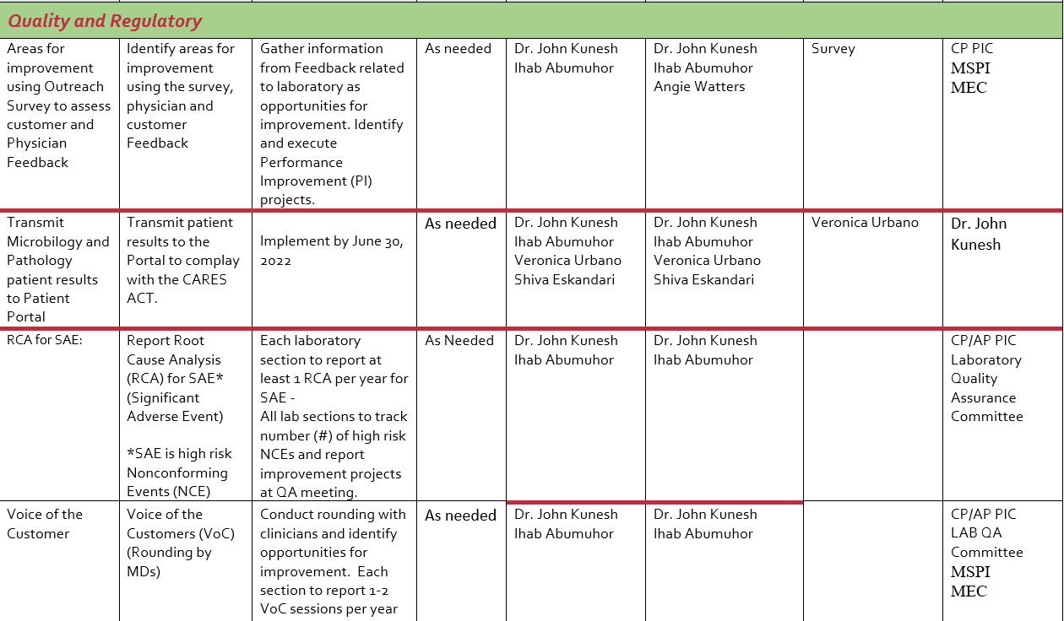
Develop CP/AP Goals

Slide 19
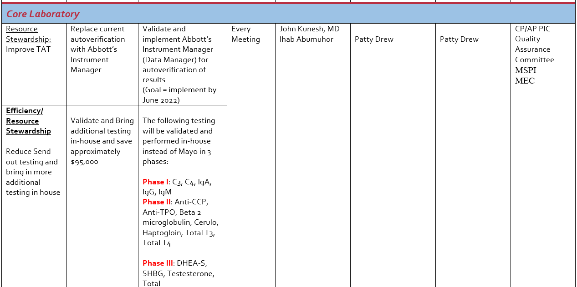
Continued: CP/AP Goals

Slide 20
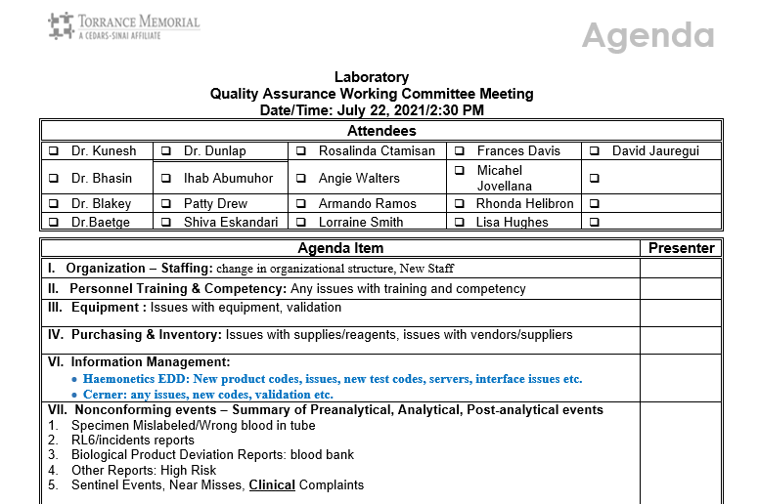
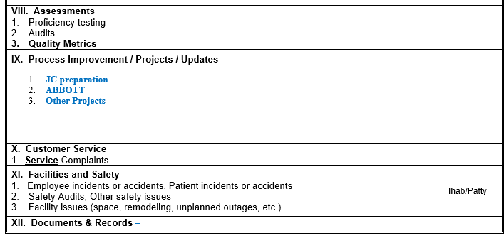
Agenda for the QA meeting

Slide 21
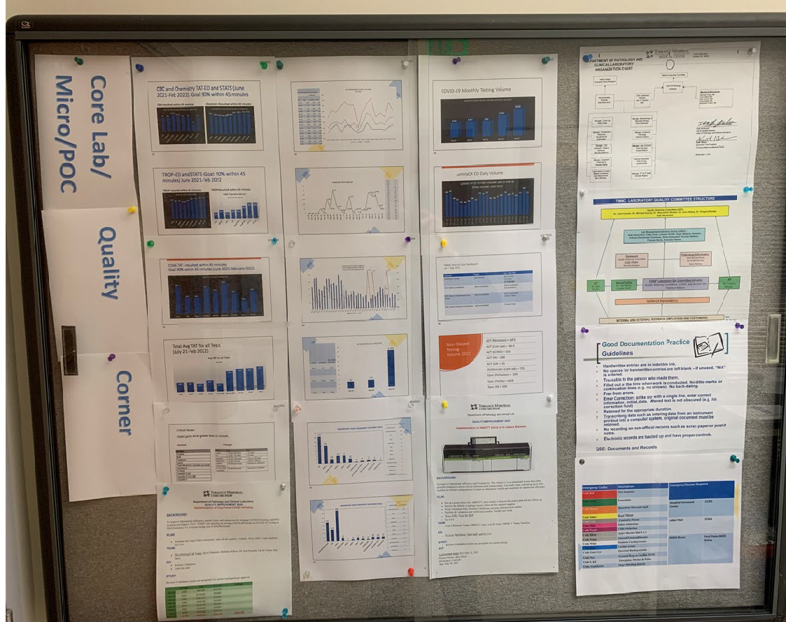
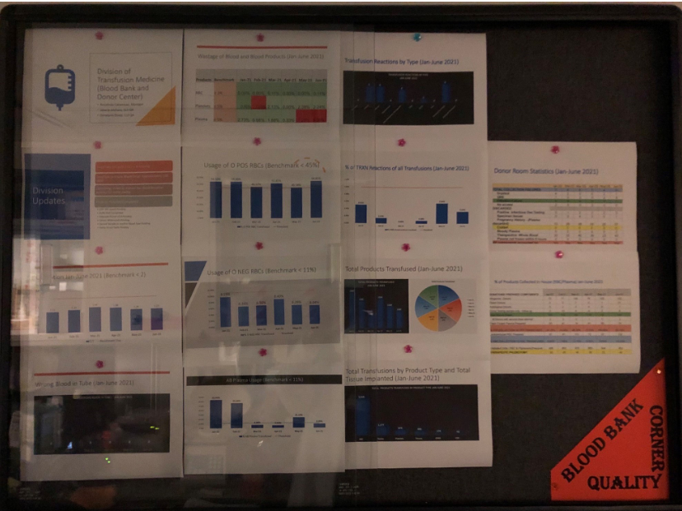
Quality Corner-Each Division

Slide 22
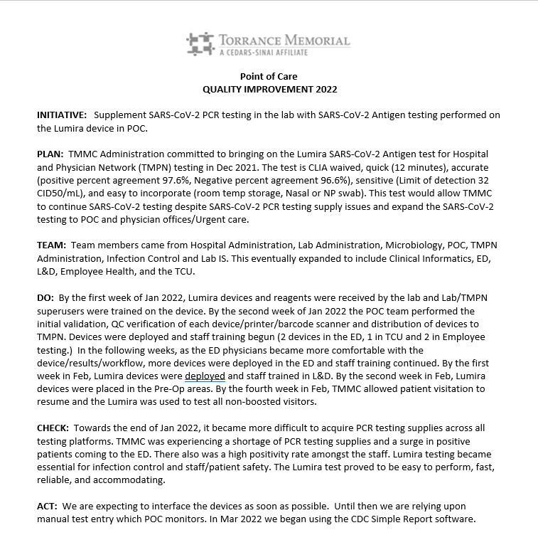
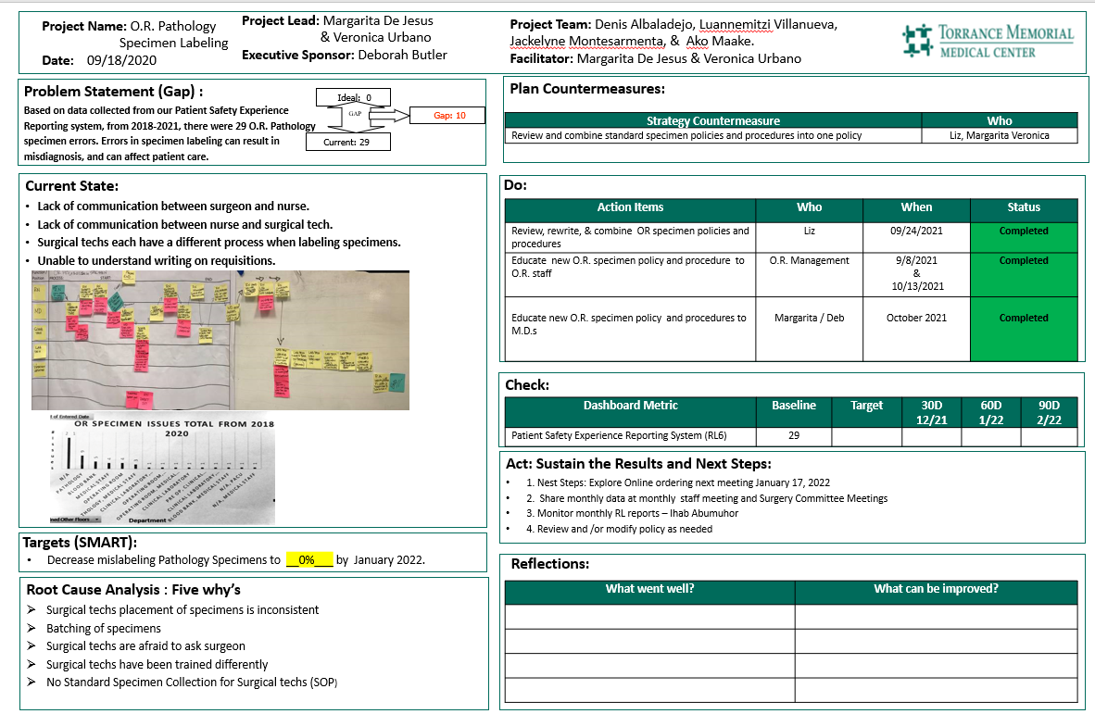
PDCA and/or A3-completed for each process Improvement

Slide 23
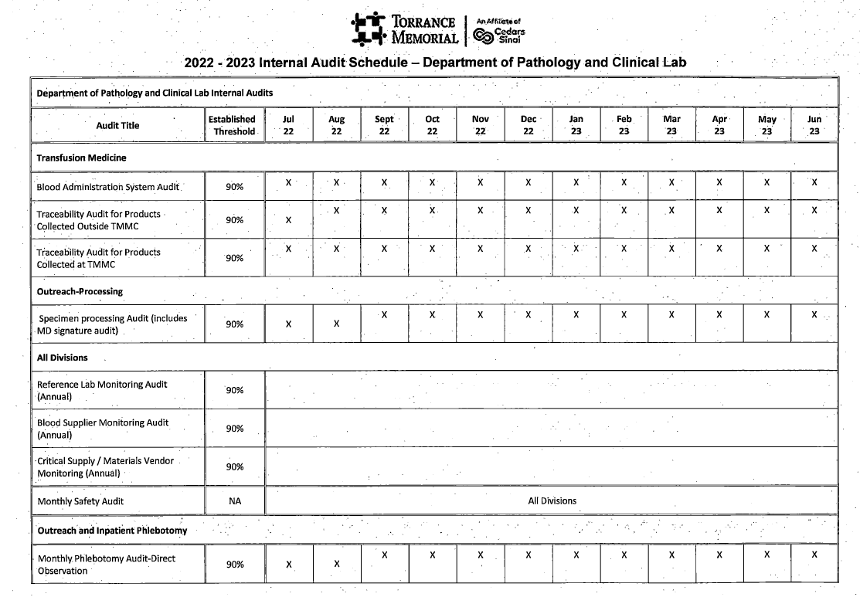
Internal Audits /Audit schedule
Each Division must complete a set of monthly/Quarterly internal audits
Some audits are focused audits based on certain findings

Slide 24
Non-conforming
Events Dashboards
Events entered in an electronic database called RL6
  Lab Specimens
  Pathology
  Blood Bank
  Other Divisions (Micro, Core Lab, Outreach)
Used for reporting internal and external errors or incidents
Trended and shared in Staff and QA meetings

Slide 25
Promoting Lab Visibility
Internally
Externally

Slide 26
Lab
visibility-
Internal
Attend all applicable Committees
  Emergency Department
  Transfusion Committee
  Infection Prevention
  Pharmacy/Antibiotic Stewardship
  FLU/COVID Surge Planning Committee
  Blood Utilization Committee
  Directors’ Meeting
Present
  Applicable metrics
  New Tests/Obsolete tests
  New Technologies
  Changes in reference ranges

Slide 27
Other ideas
Develop Strong relationships with IT and marketing departments
Internal Hospital Newsletter
  lab improvements
  New Certifications
  New Technologies
  Very Important updates (New Tests, changes in methodologies )
Rounding with other managers, directors outside the Lab
Communications with Medical Staff
Communication with the Nursing Education
Screen Savers for certain updates

Slide 28


Internal Visibility
Videos
  Blood Donations
  Process in the Lab (Following a unit from collection to Transfusion)
  Automation
  Leadership Spotlight
Ribbon cutting ceremonies for Go Live
  Invite senior leadership

Slide 29

External
Lab Newsletter
Hospital Community Publications
External Recognition
  Leading Lab
Health Fairs
  Promoting Blood Donations
  Point of Care testing (Cholesterol)
Promoting CLS Career
  High Schools
  YMCA

Slide 30
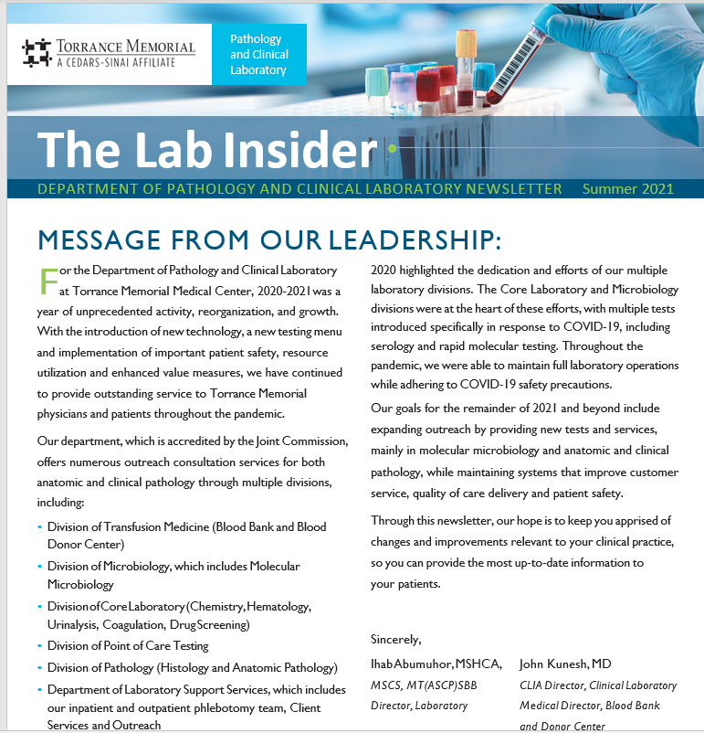
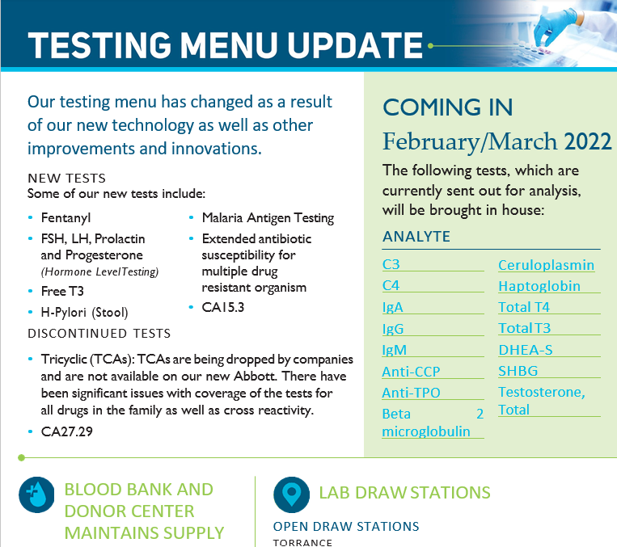
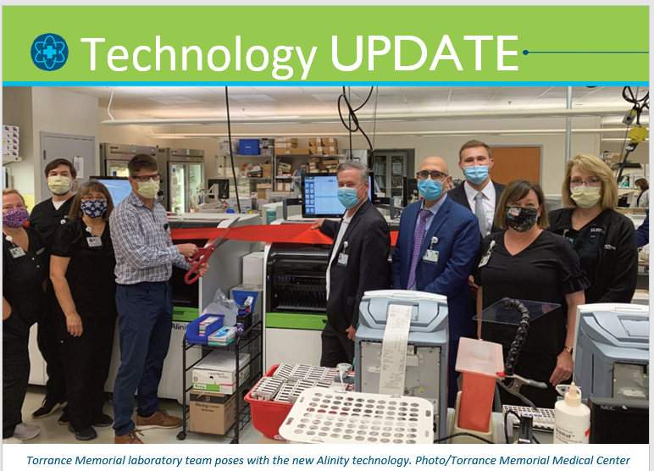
Lab Newsletter

Slide 31
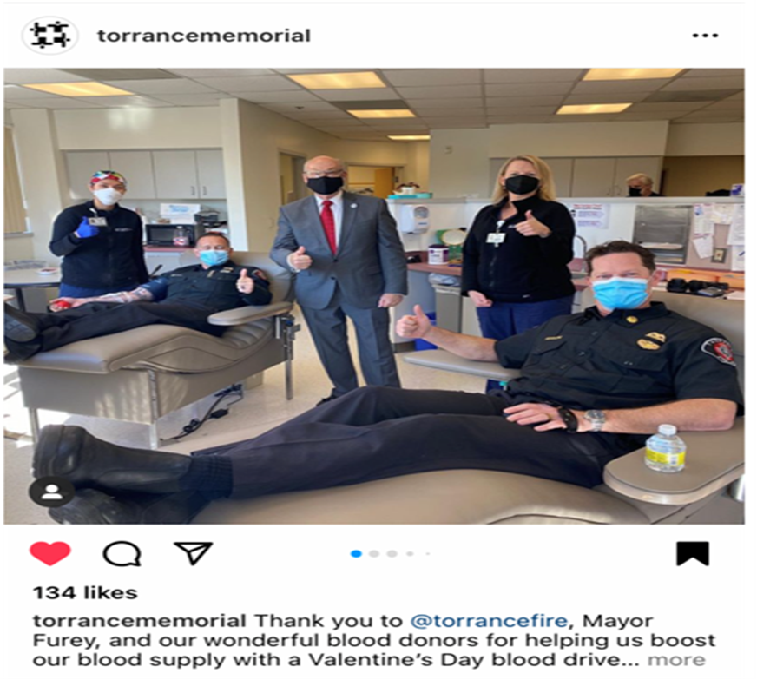
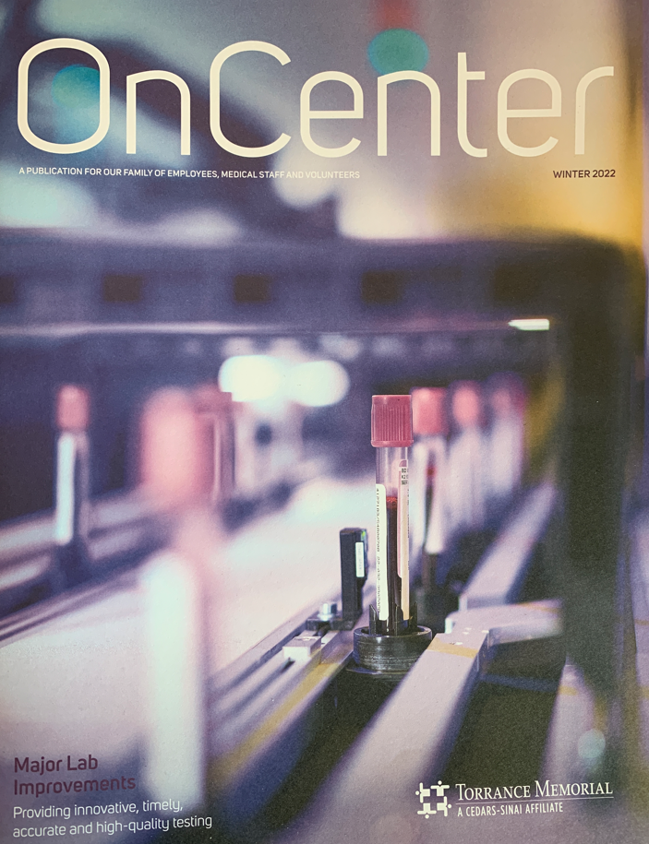
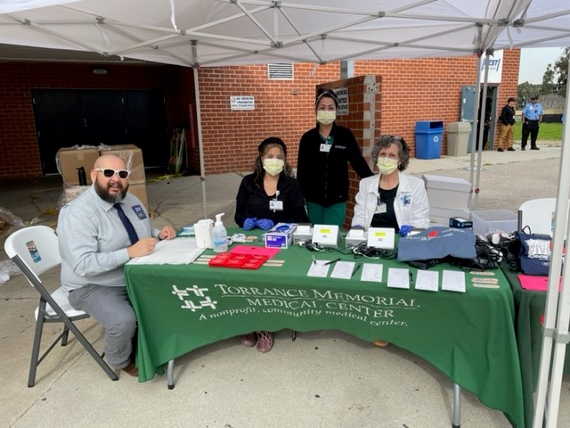
Community Publication and Involvement

Slide 32
Supporting Professional Development
Manager Certification Program-required for all new managers
Lean Certification Program-required for all managers
Promotion Ladder (CLS I, II, III, CLS QA, CLS Lead, Manager…)
Certification Support (SBB, POC,…)
Education support (MS, conferences, continuing education,…)
Mentoring Program
Succession Planning Program
Rounding

Slide 33
Cultivating Trusted Leadership
Implement or improve employee recognition
Improve communication
Foster a motivating work climate
Implement team building exercise
Rewarded positive behavior by promoting staff who exceeded expectations
Offered Spot bonuses and gift certificates to reward positive behaviors
Continue to build trust among staff and place team goals ahead of individual goals.

Slide 34
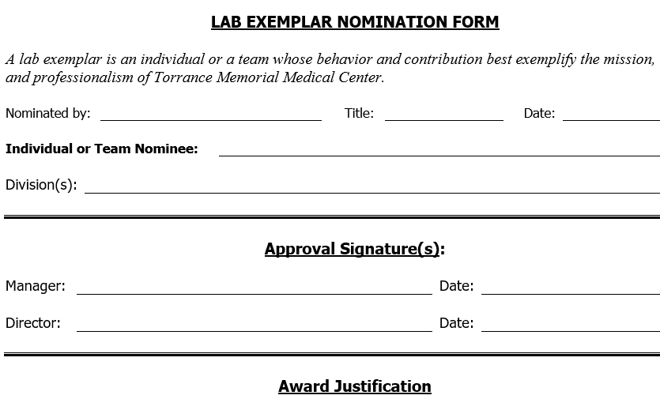
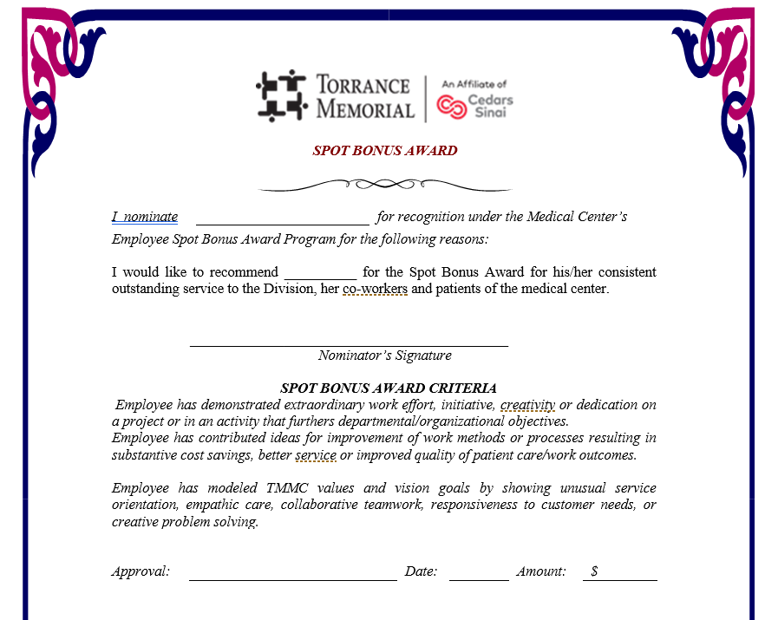
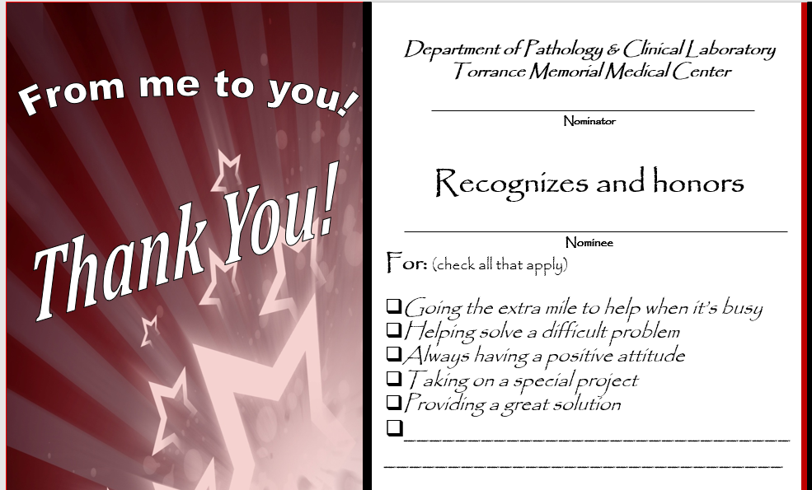
Recognition

Slide 35
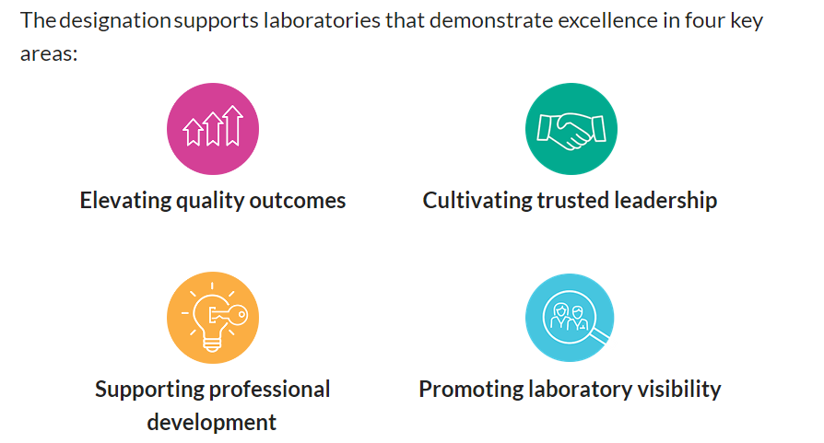
4 Pillars of Leading Lab Certification?

Slide 36
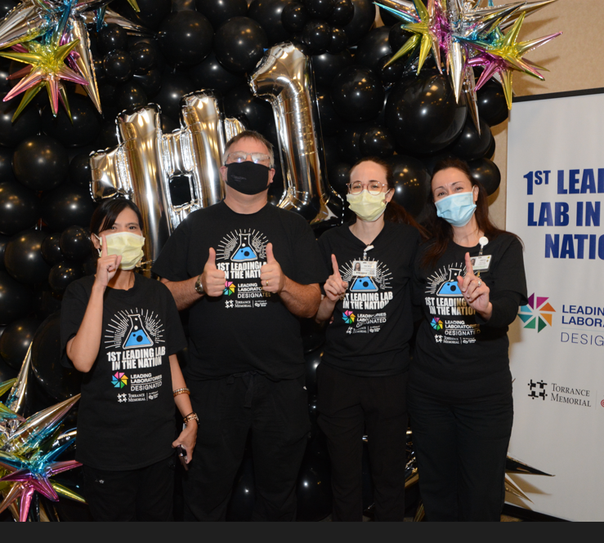
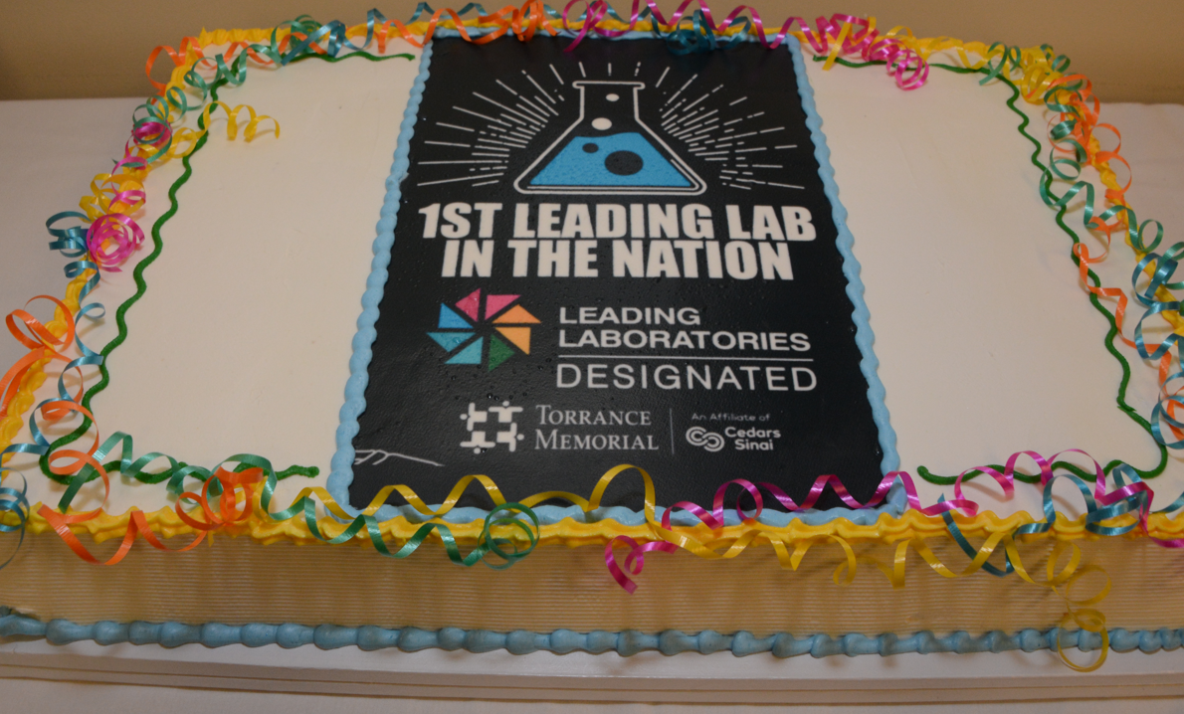
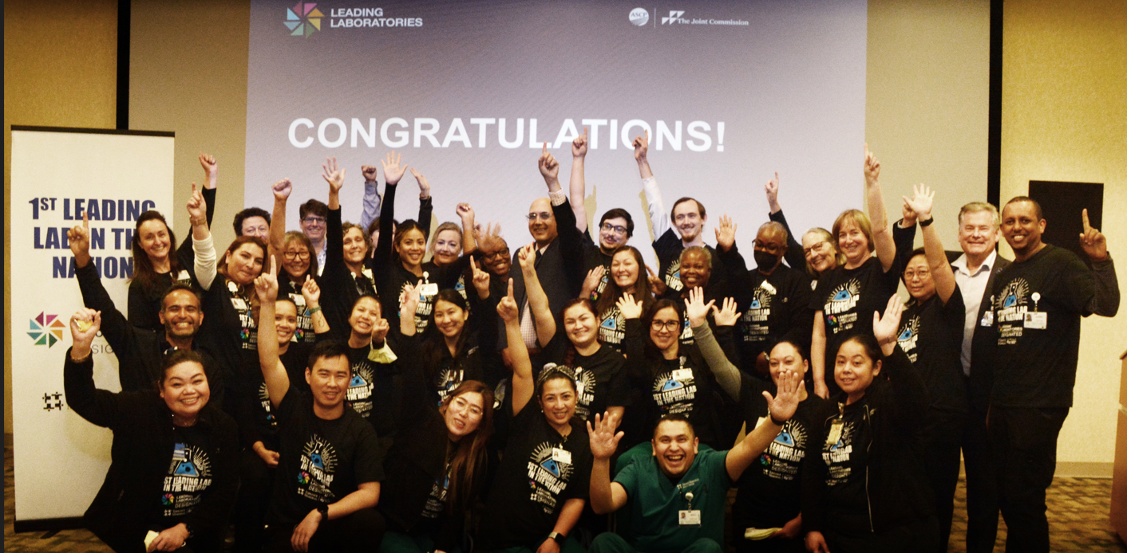
Leading Lab Photos

