Slide 1
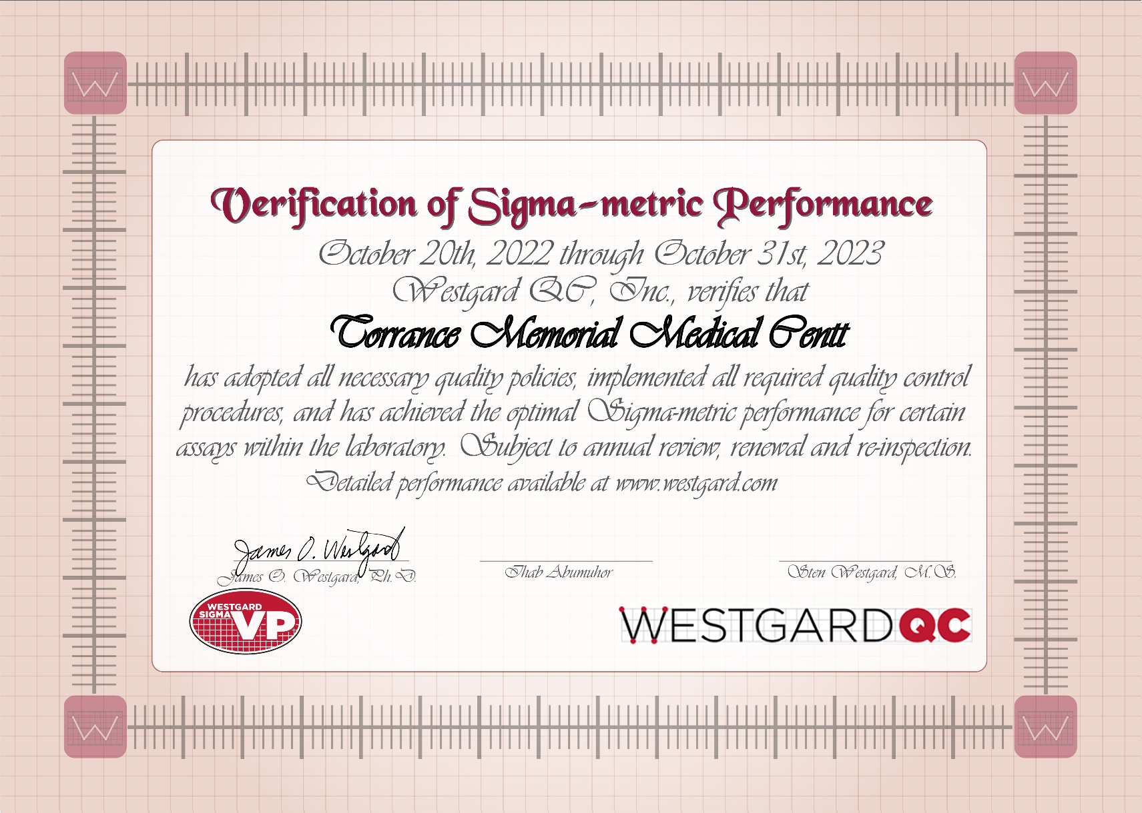
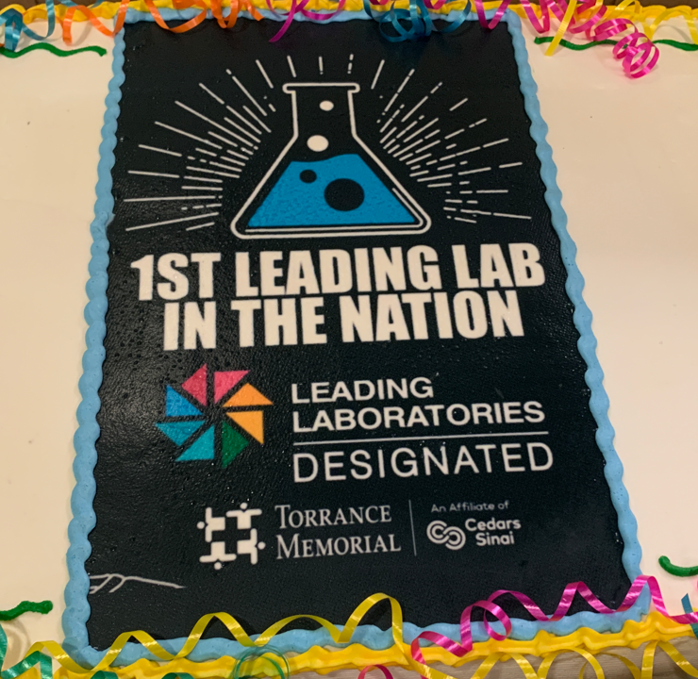
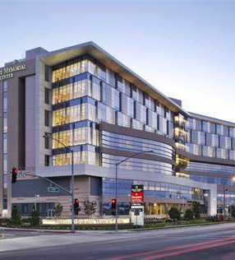
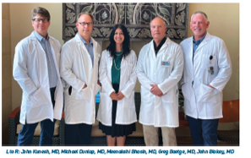
Department of Pathology and Clinical Laboratory

Slide 2
Department of Pathology & Clinical Laboratory
Ihab Abumuhor
January 6th, 2023

Slide 3
Our Goals
Provide innovative, extraordinary quality, timely, and highly effective clinical laboratory services
Add services to drive additional hospital and patient value through outreach expansion and clinical test menu

Slide 4
Value of the Lab
24/7 Operation
11.5 MM tests annually
1.7 MM orders
1.2 MM samples
250k patient draws
85k outreach visits
4.5 MM Chemistry
5.5 MM Hematology/COAG/UA
305 k POC
~80% of EMR based on lab results²
~70% of clinical decisions based on lab tests²
13k units transfused
90K ER Visits
Value to System
Value to Operations
Value to Patients
Source: 1 - CMS Cost reporting (data sent by TMMC to CMS as part of governmental reporting)
2 - The Dark Intelligence Group June 8, 2018 “Hospital Lab Outreach Still Effective Revenue Strategy”

Slide 5
Volume projection for CY 2021 and projected CY 2022 Patients and samples are fastest growing segment
 | 2020 (Jan-Dec) | 2021 (Jan-Dec) | Projected 2022
Patients | 85,000 | 92,859 | 100,000
Samples | 1,087,732 | 1,193,393 | 1,320,258
Panels | 828,672 | 878,795 | 925,004
Orderable Tests | 1,544,684 | 1,671,675 | 1,700,630
Reportable Tests | 10,625,408 | 11,304,197 | 12,000,000

Slide 6
The Lab Team
Approximately 180+ people working to provide quality and timely diagnostics
1 Lab Director
5 pathologists
8 managers
4 Lab IT (2 Full time/2-Per-Diem)
200 employees
Lab Committees
Lab IT Committee
Quality Steering Committee
Transfusion Committee
Lab Safety Committee
Operations Committee

Slide 7
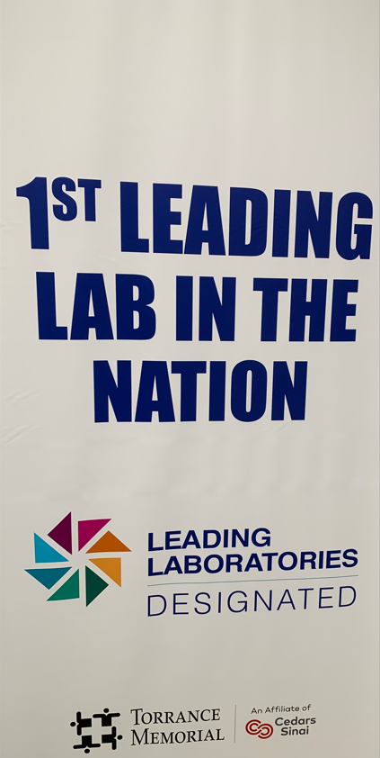
First Leading Lab in the Nation
Medical Center is the first in the nation to receive Leading Laboratories recognition from the American Society for Clinical Pathology (ASCP) and The Joint Commission.
The two-year designation serves as proof of Medical Center’s commitment to laboratory excellence and to help improve patient outcomes.
Medical Center underwent a rigorous application process to receive the recognition, including a review of its outcomes, indicators, metrics and evidence.
The lab demonstrates excellence in four key areas:
Official certification by JC/ASCP on 11/14/2022
elevating quality outcomes
supporting professional development
cultivating trusted leadership
promoting laboratory visibility

Slide 8
Leading Lab Team

Slide 9
Updates to the lab

Slide 10
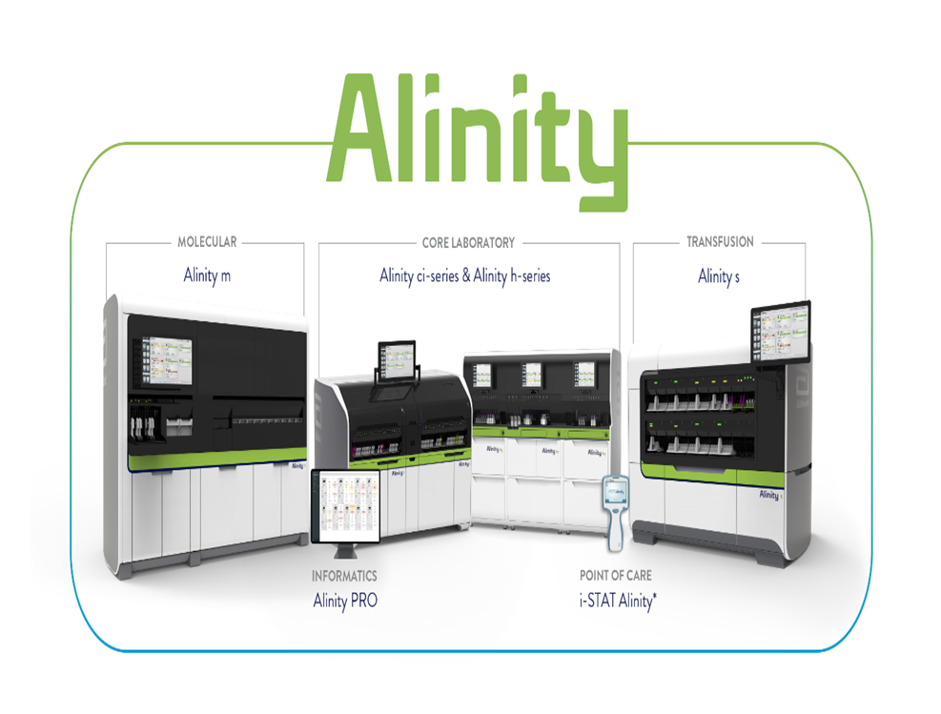
Investment in innovation – New testing platform
Partnership with Abbott Laboratories
1st Alinity Hospital-based Core Lab to go live in CA.
Alinity’s innovative technology allows the lab to provide faster, more accurate results while increasing the capacity of the laboratory and driving down costs — which will help improve physician and patient satisfaction and outcomes.
Removes concerns from high-dose Biotin assay interference found in other platforms
Site restructuring
In conjunction with the new automation, the department commenced a long-planned core laboratory reconstruction project that will overhaul the entire laboratory to provide workflow efficiencies for testing

Slide 11
Biotin Interference – a difference that matters
Biotin Interference
Immunoassay testing performed at MC is not subject to biotin interference, but that is not the case for other laboratories, including large reference laboratories.
Biotin supplements, when taken in high doses, can cause interference with certain immunoassays. Biotin is marketed as an aid to improve the appearance of hair, nails, and skin, and in some cases improve energy. Some supplements have very high levels of biotin, many times the adequate intake.
On November 28, 2017, the FDA issued a safety communication indicating that biotin in specimens from people taking biotin supplements may cause interference with some laboratory assays. Since biotin intake may interfere with certain lab test results, it is important to know if patients are taking biotin, especially in high doses. Ask patients about biotin intake, including supplements, particularly if you are sending patient samples to laboratories other than MC. The biotin elimination half-life will depend on the dose and duration of use. Not all tests are affected by biotin and can vary from manufacturer to manufacturer.
Information for assays affected by biotin is available in the specimen requirements/special instructions section of the online test directory for a laboratory

Slide 12
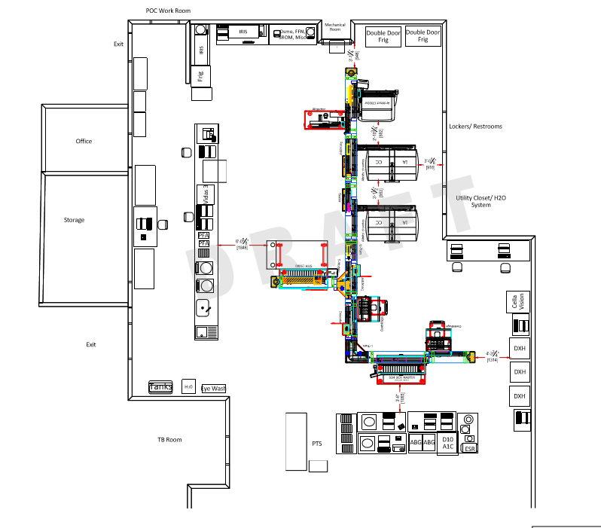
Investment in innovation – New testing platforms
Fully automated track
Go live Nov 16, 2021
Scalable for future growth
Track Connectivity
Large specimen queue WITHOUT PICK AND PLACE ROBOT (less waiting)
Sample does not leave carrier – maintains specimen ID throughout process
Refrigeration Module

Slide 13
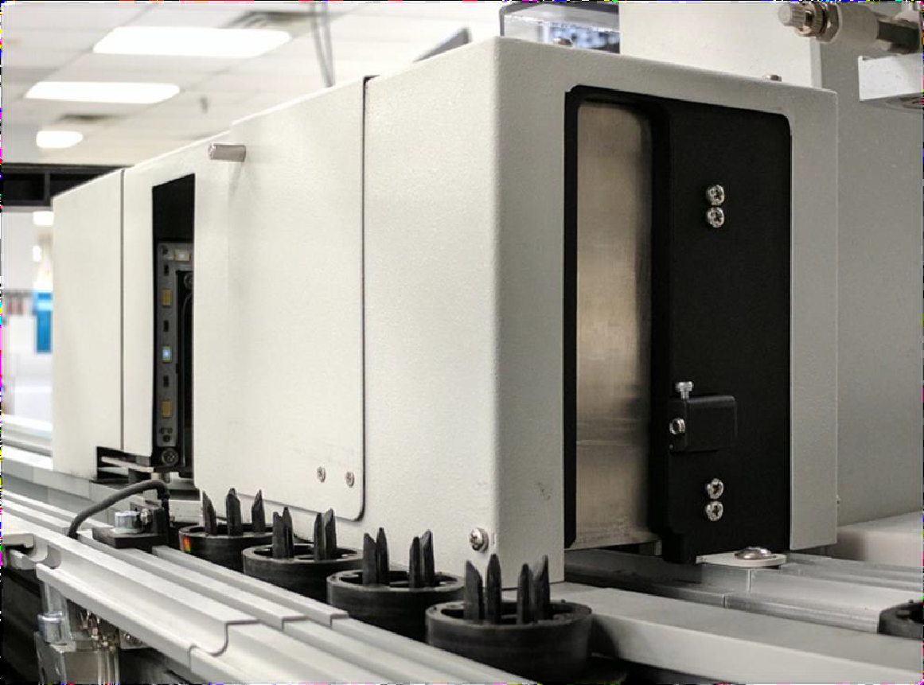
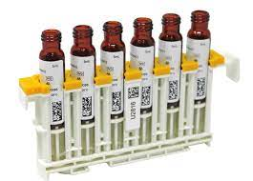
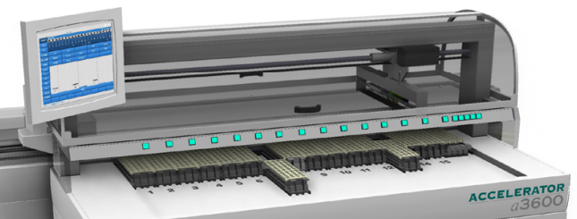
New testing platforms - Investment in innovation
Input Output
STAT testing prioritized throughout processing
Key Features
5 Priority STAT Input/Output Lanes
Output for Errors
15 Routine Input/Output Lanes – input, output, sorting
STATs loaded to Routine Input lanes will upgrade to STAT after barcode read
Tube Identification Module (TIM)
Tube Type
Capped/Uncapped
Sample Sorting
Load EVERYTHING to IOM (input/output Module)
Multiple tube types
Configurable to match the workflow
By Lane (48 tubes) or Column (12 tubes)
”Wait” lanes for repeat/reflex testing

Slide 14
Investment in innovation – Expanded Test Menu
Goals
1. FY 2022 - Reduced Send out by $[XXXK] 2. FY 2023 - Bring in-house the top 10 send out tests by 6/2023, saving XXX in costs to outside vendors

Slide 15
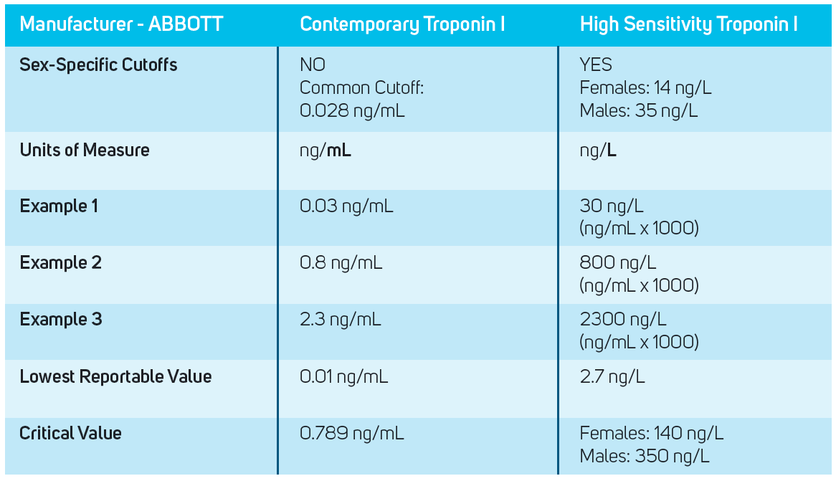
High Sensitivity Troponin
Lab now offers a new high sensitivity Troponin I assay. The new high sensitivity troponin assay makes it possible to detect and report lower levels of troponin and has improved precision enabling detection of true clinical change at low levels

Slide 16
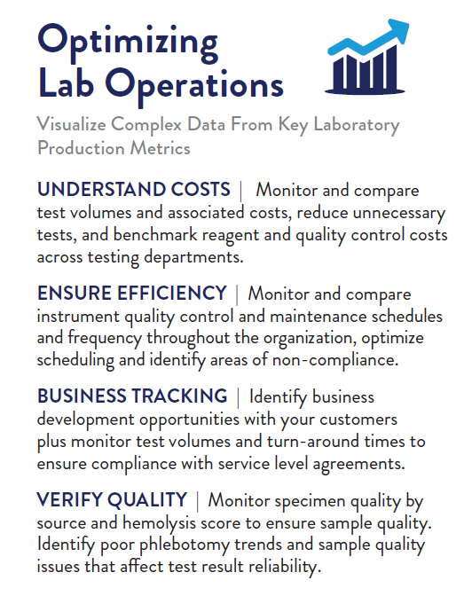
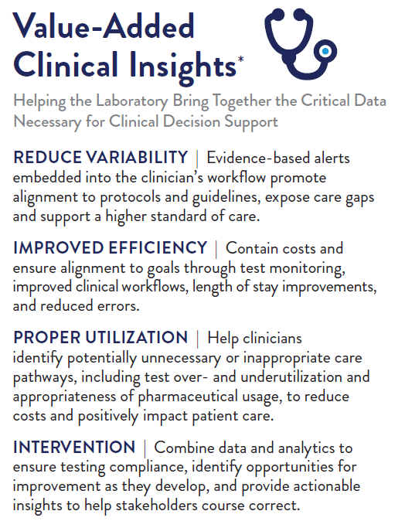
AlinIQ Business Performance

Slide 17
ABBOTT AlinIQ Integrated Platform Real Time Dashboard

Slide 18
ABBOTT Inventory Manager-RFID

Slide 19
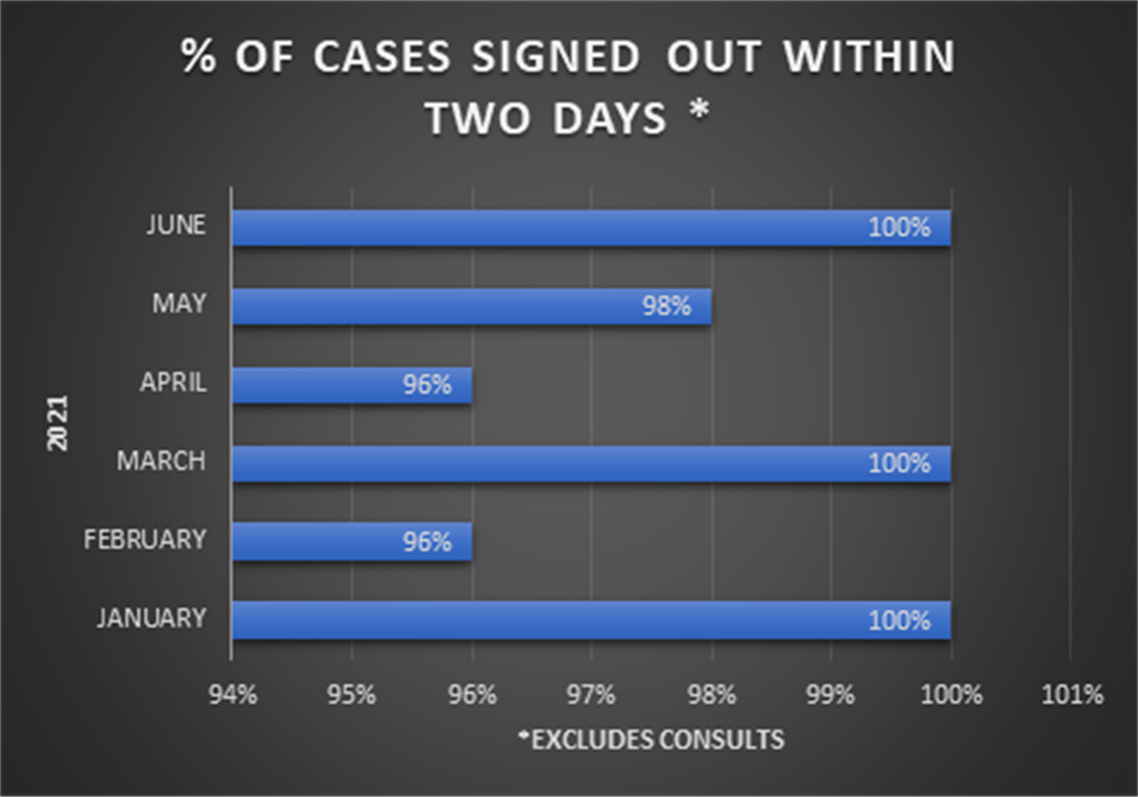
Operational improvements – Turn Around Time (TAT) TAT improvements allows physicians to get tests on time for patient care
Improvements
2 days (max of 3 days) for cases that do not require any further testing - i.e. NGS, outside consults
STAT Turn-around-time for CBC, COAG, Chem panel is less than or equal 45 minutes
Surgical Cases TAT-within 2 days

Slide 20
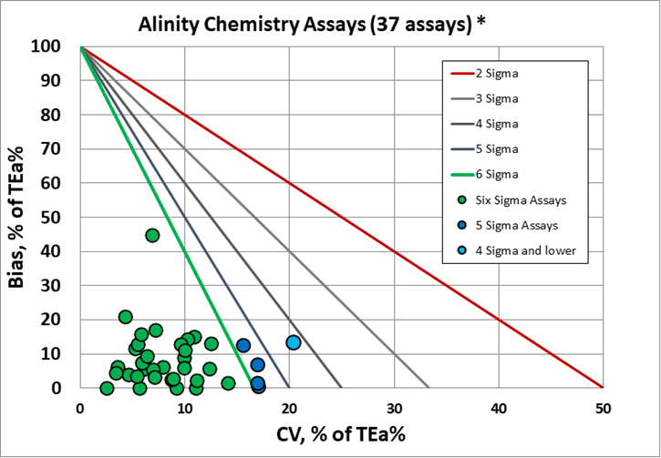
Investment in innovation – New testing platform Improved Quality
6-sigma quality assays – more trust in results and fewer expected reruns
Less than 3.5 defects in one million tests
Less QC performed
Cost and Time Savings
Lab now qualifies for Westgard QC six sigma lab.
c8000 sigma metrics www.westgard.com
www.westgard.com

Slide 21
Six Sigma Lab Certification
MC lab received the Six Sigma Lab Certification on 10/25/22
80th Lab in the World to receive the Certification
Our Quality Results also show that we are the best in Southern California.
In addition to the Lab Certification, 4 of our lead CLS staff received their Six Sigma Certification.
77 essays have been certified as Six Sigma , in the process of converting additional essays.

Slide 22
SIX SIGMA – DEFINES THE SHAPE OF THE TARGET
Defects Per Million (DPM)
Scale of 0 to 6 (Sigma short-term scale)
2
3
3 Sigma is minimum for any business or manufacturing process (66,807 dpm)
4
5
6
World Class Performance (3.4 DPM)
ADD-00060790

Slide 23
PERFORMANCE
Urine Assays | Alinity 1 Verified | Alinity 2 Verified | Alinity 3 Verified
Chloride, U | Six Sigma | Six Sigma | Six Sigma
Creatinine, U | Six Sigma | Six Sigma | Six Sigma
Potassium, U | Six Sigma | Six Sigma | Six Sigma
Sodium, U | Six Sigma | Six Sigma | Six Sigma
Urea N, U | Five Sigma | Six Sigma | -

Slide 24
PERFORMANCE MEASURES
Immunoassays | Alinity 1 Verified
Acetaminophen | Six Sigma
Anti-TPO | -
AFP | Five Sigma
CA 125 | Six Sigma
CA 19-9 | Six Sigma
CEA | Five Sigma
Cortisol | Six Sigma
C-Peptide | -
Digoxin | Six Sigma
Ferritin | -
Folate | Six Sigma
FSH | -
Gentamicin | Five Sigma
hCG | Five Sigma
Hemoglobin A1c | Four Sigma
Insulin | Six Sigma
LH | -
Phenobarbital | -
Phenytoin | -
Prolactin | -
PSA, Total | Five Sigma
iPTH | Six Sigma
Salicylate | Five Sigma
T3, Total | Six Sigma
T4, Free | -
T4, Total | Six Sigma
TSH | Five Sigma
Valproic Acid | -
Vancomycin | Six Sigma
Vitamin B12 | -

Slide 25
VERIFIED ASSAY BREAKDOWN

Slide 26
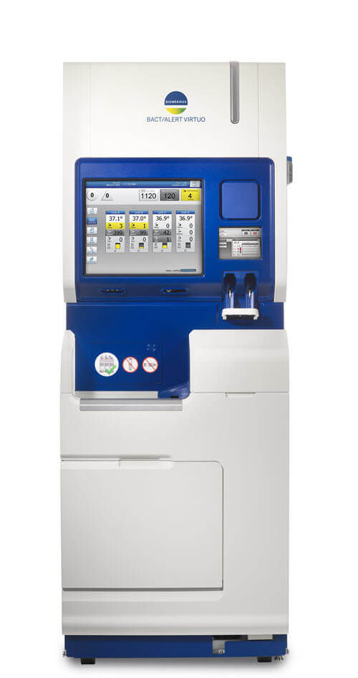
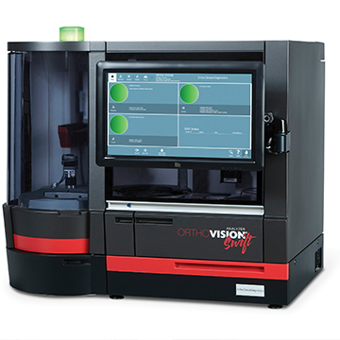
Investment in innovation – Other additions
Virtuo Blood Culture-April 2022
New COAG ACL TOP 550 Blood Bank Ortho Swift

Slide 27
Current Projects Immunology, Allergy and Autoimmune, Molecular
Autoimmune Disease
Allergy Testing
Molecular
Infectious Disease
Serum Proteins
Calprotectin

Slide 28
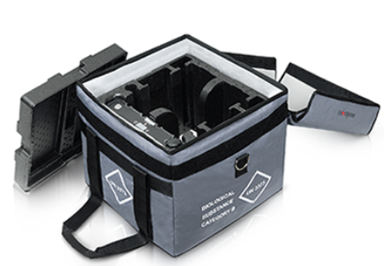
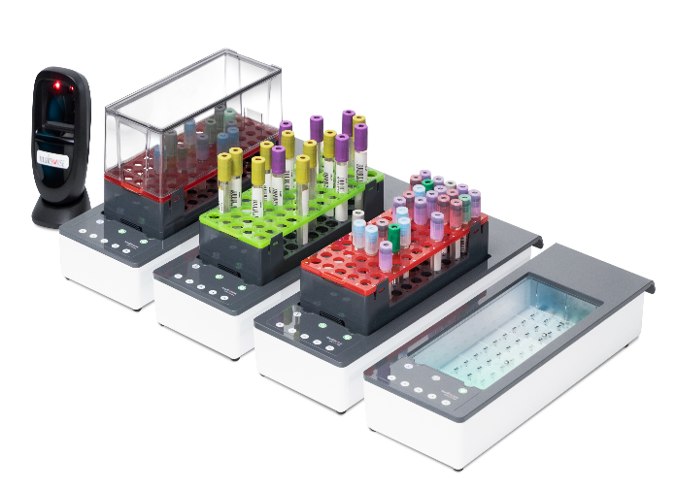
Current Projects-INDEXOR
Automating pre-analytical sample tracking, transport and lab receipt
We recognized that 65% of diagnostic errors happen in pre-analytics and 1 in 1,400 tubes go missing.
The Indexor automates sample tracking and helps trace sample from patient draw to arrival in the lab, monitor key quality indicators, to save time and improve service levels and reduce diagnostic errors and missing tubes.
Department of Pathology and Clinical Laboratory at TMMC recognized the need to reduce plastic usage within the HealthSystem and Indexor has provided the opportunity to implement a plastic bag free transport system.

Slide 29
Lab team

Slide 30
Lab team ribbon ceremony

Slide 31
Thank you
Questions

