Slide 1
How to add Value?

Slide 2
How do I…Add Value?
How does your Lab add Value to the Health System?
Value =Quality/Cost
Growth
Revenue (Outreach, new testing platforms)
Savings (Contract Negotiations, reduction in send out testing, Reduction in reagent cost, new suppliers)
Services Provided
Health System
Community (Blood Draw Stations, Blood Donor Center, POC testing)
Education

Slide 3
Define Lab goal and value

Slide 4
Our Goal
Provide innovative, high quality timely and most effective clinical laboratory services
Add services to drive additional hospital and patient value through outreach expansion and clinical test menu

Slide 5
Value of YOUR Lab
$MM revenue¹
10% all TMMC revenues
Top 3 revenue centers
$costs¹
6.7% all TMMC costs
9:1 Gross Revenue : Cost
20-30% Margin²
250k patient draws
100k outreach visits
24/7 Operation
11.5 MM tests annually
1.7 MM orders
1.2 MM samples
100 K Patients
4.5 MM Chemistry
5.5 MM Hematology/COAG/UA
305 k POC
~80% of EMR based on lab results²
~70% of clinical decisions based on lab tests²
13k units transfused
80k outreach visits
90K ER Visits
Value to System
Value to Operations
Value to Patients
Source: 1 - CMS Cost reporting (data sent by TMMC to CMS as part of governmental reporting)
2 - The Dark Intelligence Group June 8, 2018 “Hospital Lab Outreach Still Effective Revenue Strategy”

Slide 6
Where Do I start?
Create a strategic Plan?

Slide 7
Why have a strategic plan??
A roadmap
Provides direction and goals.
Defines priorities: What we do and what we won’t do.
Guides day-to-day decisions, including where we invest resources (time, people, $$).
Framework for evaluating progress and changing approaches.

Slide 8
Quality
Develop a Quality structure
Build a robust Quality Plan
Develop Meaningful Quality Metrics
Implement Dashboards
Implement business analytics

Slide 9
TMMC LABORATORY QUALITY COMMITTEE STRUCTURE
LABORATORY QUALITY COMMITTEE STRUCTURE
Quality Steering Committee (QSC)
Dr. John Kunesh, Dr. Michael Dunlap, Dr. MeenaKshi Bhasin, Dr. John Blakey, Dr. Gregory Baetge
Ihab Abumuhor
Lab Management Advisory Group (LMAG) –
Ihab Abumuhor, Patty Drew, Lorraine Smith, Angie Watters, Veronica Urbano, Rosalinda Catamisan, Shiva Eskandari, Rhonda Heilbron, Frances Davis, Armando Ramos
Outreach
Quality Steering Committee
Angie Waters
Rhonda Heilborn
Pathology Informatics
Michael Jovellana
Anne McCormick
Barry Ritchey
CP
Dr. John Kunesh
Waived Testing
Dr. John Blakey
Lorraine Smith
CP/AP Laboratory QA Committee includes
Quality Steering Committee, LMAG, and Section QA Representatives
AP
Dr. Gregory Baetge
Section QA Representatives
INTERNAL AND EXTERNAL FEEDBACK (EMPLOYEES AND CUSTOMERS)
Rev 06.09.2021

Slide 10
Scheduled QA Meetings
Daily Huddles
Weekly QA Review (CAP Survey Results, Validation Plans, New Tests, …)
Weekly Quality Steering Committee (Operations and Quality)
Quarterly QA Meetings (Divisional Quality Metrics)
Monthly Operations

Slide 11
Develop CP/AP Goals

Slide 12
Continued: CP/AP Goals

Slide 13
Agenda for the QA meeting

Slide 14
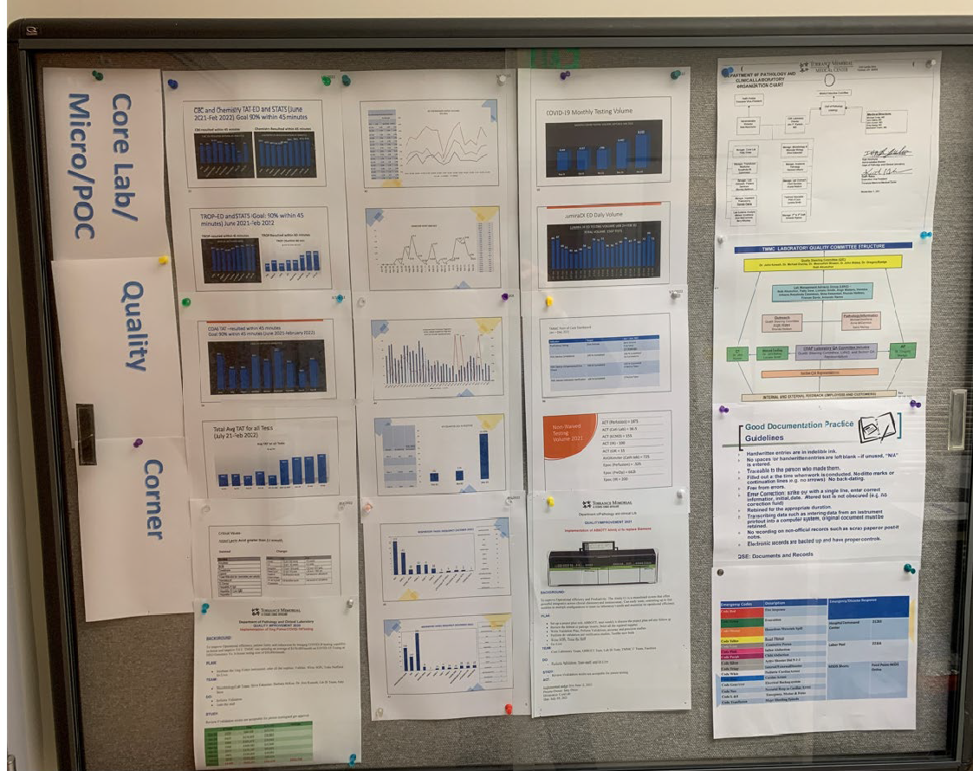
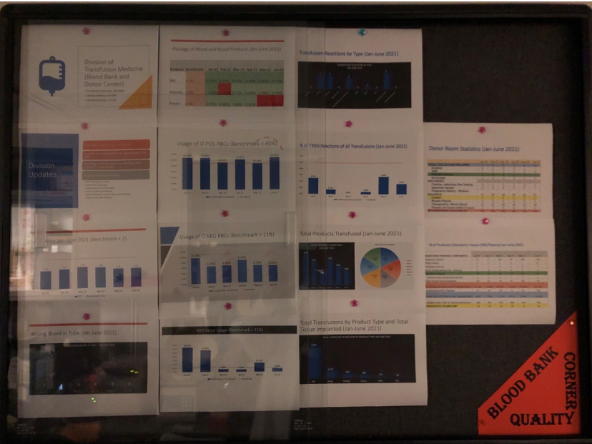
Quality Corner-Each Division

Slide 15
PDCA and/or A3-completed for each process Improvement

Slide 16
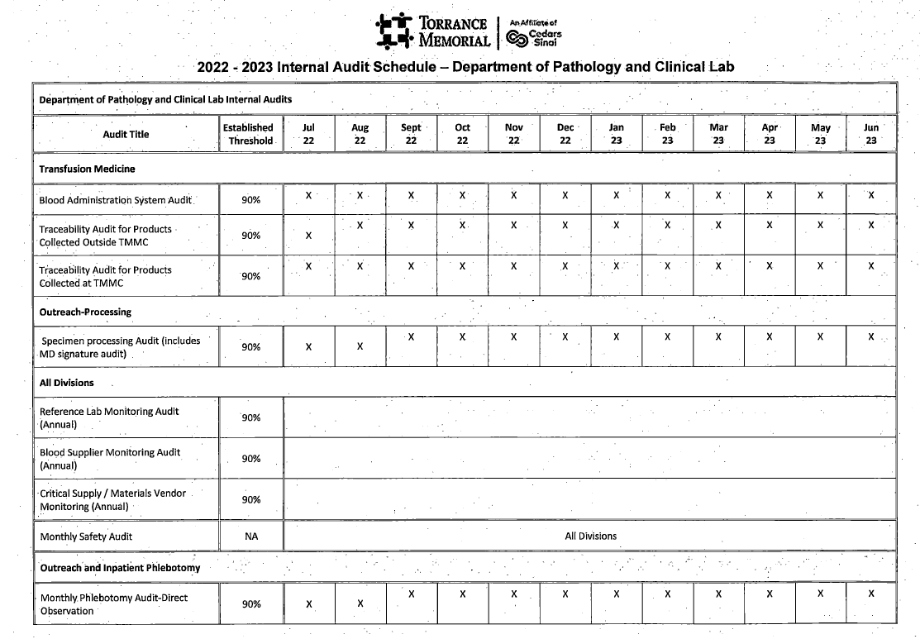
Internal Audits /Audit schedule
Each Division must complete a set of monthly/Quarterly internal audits
Some audits are focused audits based on certain findings

Slide 17
Quality Metrics
Built a real time Health Analytics dashboards
AM Draws by 8 AM/9AM (% completed, % resulted…)
Turn Around Time Dashboards for Chem, TYSC, Troponin, COAG, HEM
Rate of Contaminated blood cultures
Compliance rate of Arm Band Scanning by Phlebotomist
Blood Utilization Dashboards
1 unit Vs. 2 units
RBC, Platelets, Plasma utilization by MD, Location, Specialty
COVID, RSV, FLU Testing Dashboards
Hemolyzed, Clotted, QNS by Lab and Nursing
Test Utilization Dashboards-In Progress
Vitamin D utilization

Slide 18
Non-conforming Events Dashboards
Events entered in an electronic database called RL6
Lab Specimens
Pathology
Blood Bank
Other Divisions (Micro, Core Lab, Outreach)
Used for reporting internal and external errors or incidents
Trended and shared in Staff and QA meetings

