Slide 1
Elevate Lab Visibility

Slide 2
Promoting Lab Visibility
Internally
Externally

Slide 3
Lab visibility-Internal
Attend all applicable Committees
Emergency Department
Transfusion Committee
Infection Prevention
Pharmacy/Antibiotic Stewardship
FLU/COVID Surge Planning Committee
Blood Utilization Committee
Directors’ Meeting
Present
Applicable metrics
New Tests/Obsolete tests
New Technologies
Changes in reference ranges

Slide 4
Other ideas
Internal Hospital Newsletter
lab improvements
New Certifications
Promotions
New Technologies
Very Important updates (New Tests, changes in methodologies )
Rounding with other managers, directors outside the Lab
Communications with Medical Staff
Communication with the Nursing Education
Screen Savers for certain updates
Develop Strong relationships with IT department

Slide 5
Internal Visibility
Videos
Blood Donations
Process in the Lab (Following a unit from collection to Transfusion)
Automation
Leadership Spotlight
Ribbon cutting ceremonies for Go Live
Invite senior leadership

Slide 6
External
Lab Newsletter
Hospital Community Publications
External Recognition
Leading Lab
Health Fairs
Promoting Blood Donations
Point of Care testing (Cholesterol)
Promoting CLS Career
High Schools
YMCA

Slide 7
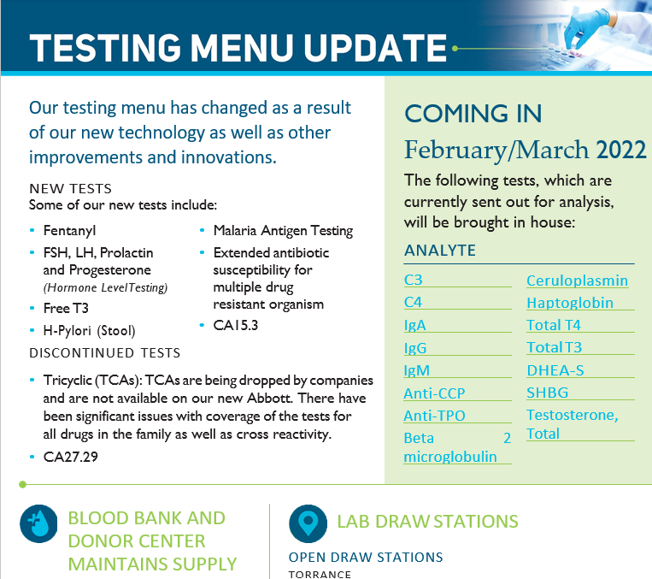
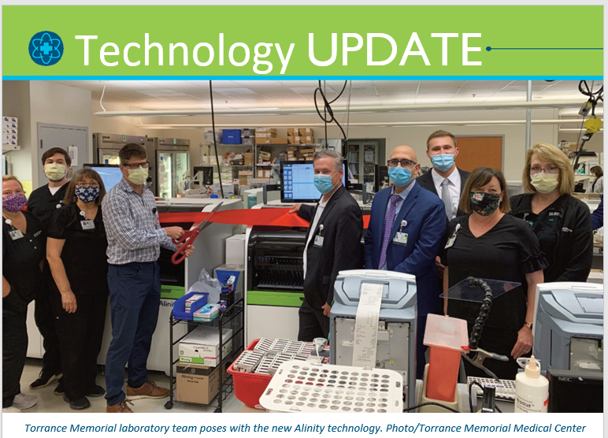
Lab Newsletter

Slide 8
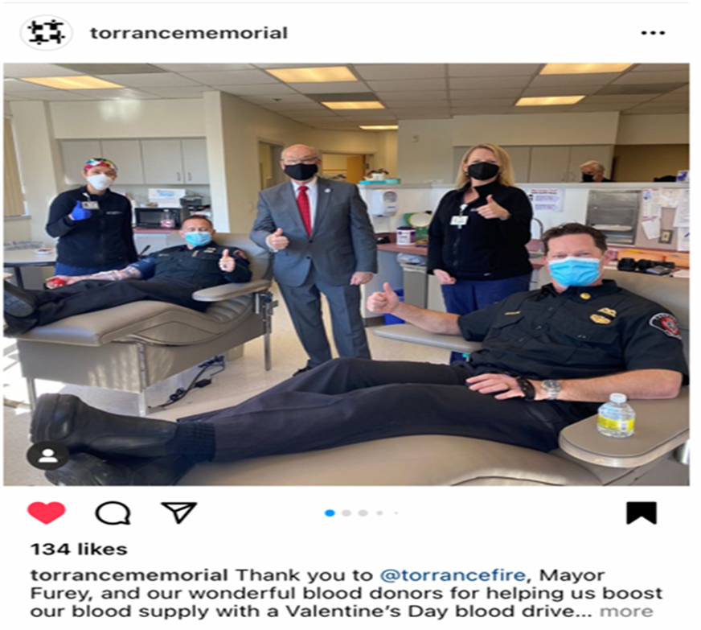
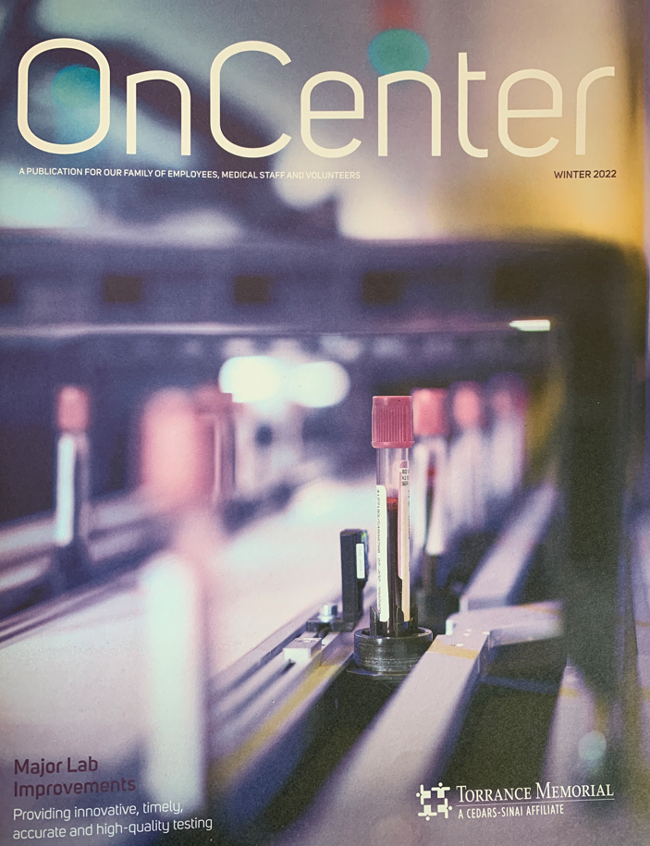
Community Publication and Involvement

Slide 9
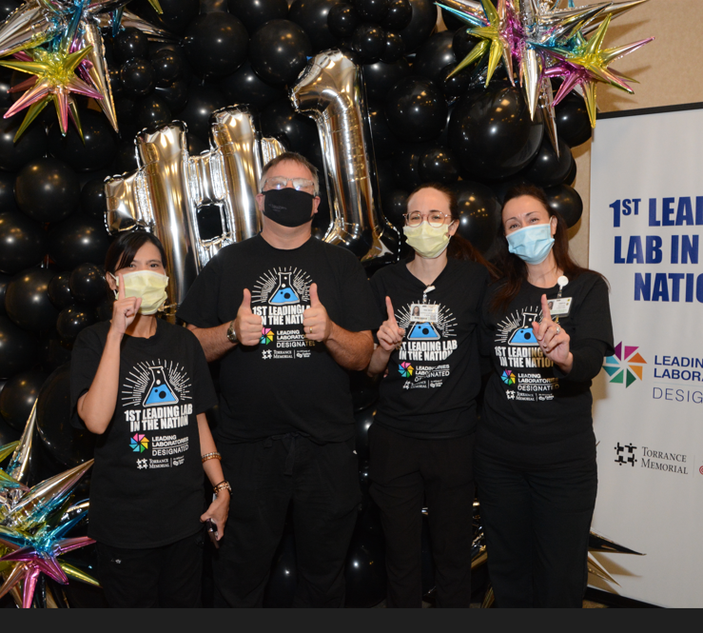
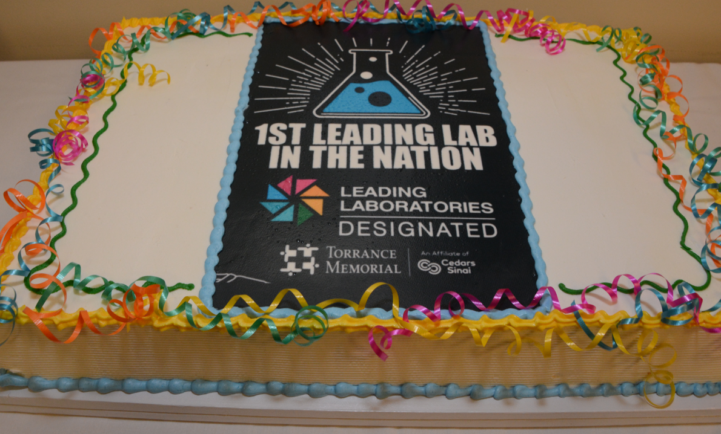
Leading Lab Photos

