Slide 1
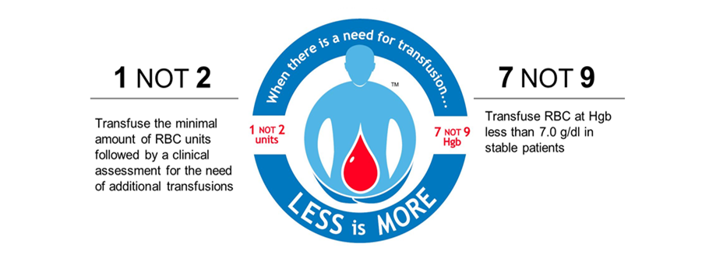
Blood Utilization Campaign

Slide 2
Blood Utilization Campaign coming up
Less is more for transfusions.
The best evidence indicates a more restrictive approach (Hgb trigger <7 g/dl and prophylactic PLT threshold <10K) not only saves blood but also saves lives.
Why give two when one will do!
In the absence of acute hemorrhage, RBC transfusions should be ordered as single units followed by a clinical reassessment prior to any additional transfusions.

