Slide 1
Microbiology Specimen Labeling
[Your Organization Here]

Slide 2
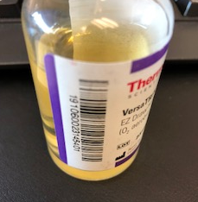
Blood Culture Bottles
Do NOT block/obstruct barcode
Barcode needed to scan in instrument.

Slide 3
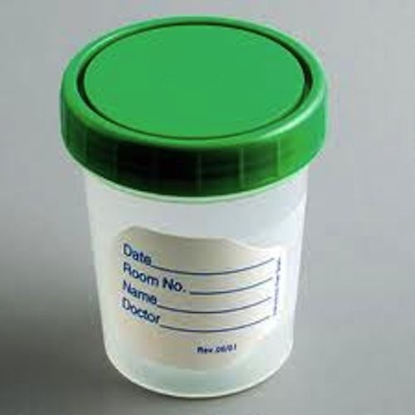
Sterile Containers
Urine – Label actual container, NOT the lid
Make sure the lid is properly closed to prevent leakage
Stools
Other body fluids

Slide 4
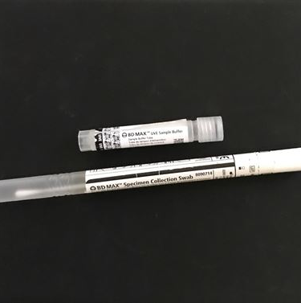
CT/GC
Urine or swab
If sending swab, obtain specimen collection from Microbiology
Use the swab and insert into smaller tube. Send smaller tube with swab to the laboratory.
If urine, send urine to microbiology

Slide 5
Swabs
Flu Swabs – Viral Tests:
FLU/RSV
HSV/VZV
Respiratory Panel
2 Sizes: 3mL and 1 mL (peds)
Add-on orders for Respiratory Panel same as FLU swab

Slide 6
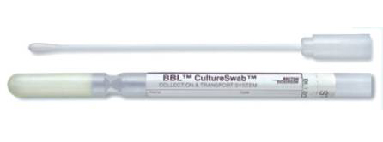
COLLECTION SWABS
Regular swabs for:
Rapid Strep A antigen
Aerobic/Anaerobic cultures
MRSA Surveillance culture
No special labeling requirements.

Slide 7
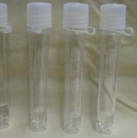
CSF
Label each tube.
Be mindful of tube numbers.

Slide 8
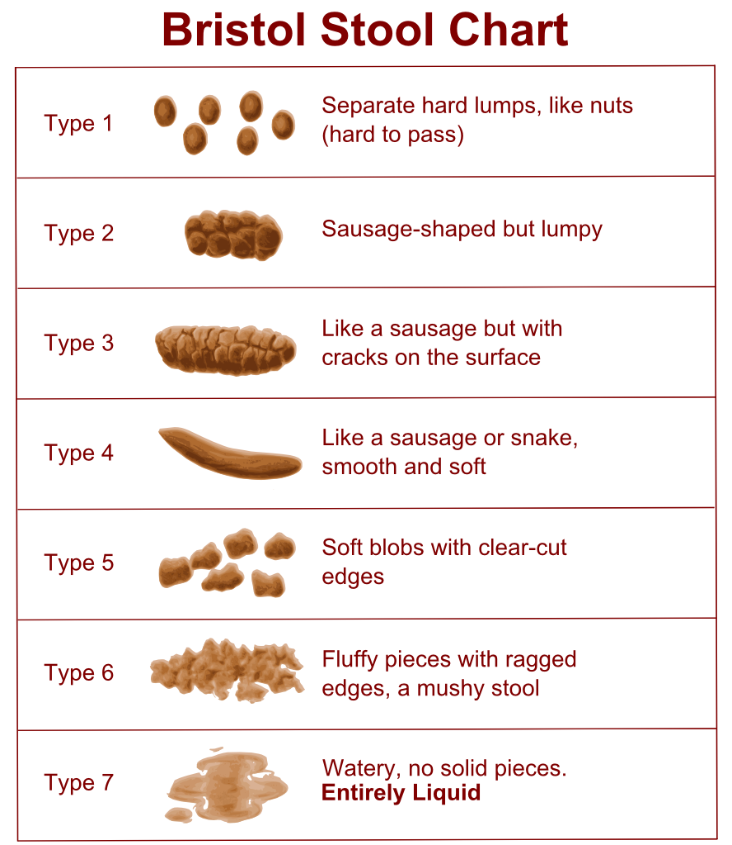
C. DIFF
Types 5-7 will be accepted
>24 hours ordered without collection will be cancelled
Repeat testing discouraged within 7 days

Slide 9
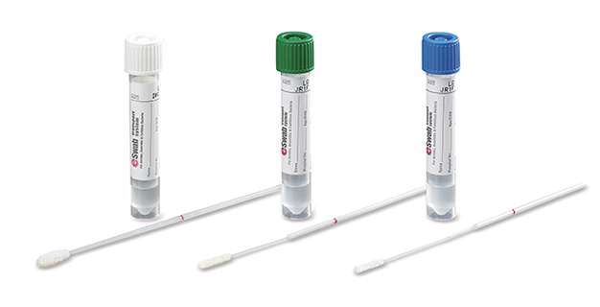
Previews
eSwab – to replace bacterial swabs
Will be used for Rapid Strep A

Slide 10
VIDEO – ROCHE LIAT
HTTPS://YOUTU.BE/KKYEP5CRYRA

