Slide 1
Sample Pathology Metrics
Division of Pathology

Slide 2
Total Pathology Cases Jan-December 2022

Slide 3
Pathology Reports Turn Around Time <2 days (Jan-Dec 2022) % of cases signed out within two days, excludes consults

Slide 4
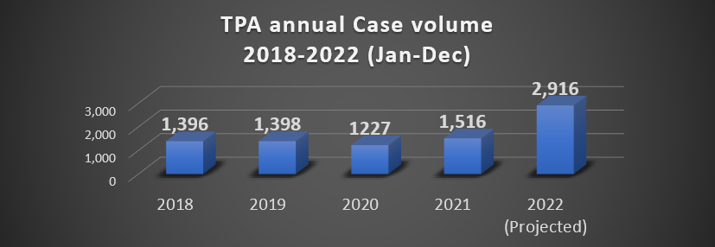
TPA Annual Volume (Jan-Dec 2022)

Slide 5
TPA Total Cases (Jan-Sept 2022)

Slide 6
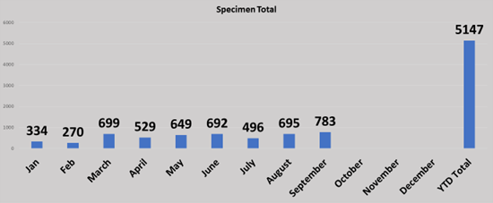
TPA total specimens (Jan-Sept2022)

Slide 7
Cytology, Bone Marrows, & Fine Needle Aspirations (Jan- Dec 2022)

Slide 8
Histology Workload(Jan-Dec 2022)

Slide 9
Average TAT (Jan-Dec 2022) Including Skin (Benchmark < 20 min)

Slide 10
# of Corrected Reports Jan-Dec 2022

Slide 11
% Corrected Reports (Jan-Nov 2022) Goal < 3%

