Slide 1
Microbiology Metrics and COVID/FLU/
Upper Respiratory
Sample Metrics

Slide 2
Ed Contaminated Blood Cultures 2018-2022 (Goal <3%)
QTR | LAB | NURSING | OVERALL
Q1 2018 | 0.6% | 1.9% | 1.0%
Q2 2018 | 1.0% | 2.6% | 1.4%
Q3 2018 | 1.3% | 2.4% | 1.5%
Q4 2018 | 0.6% | 2.9% | 1.3%
Q1 2019 | 1.1% | 3.3% | 1.7%
Q2 2019 | 1.2% | 3.0% | 1.0%
Q3 2019 | 0.7% | 3.0% | 1.4%
Q4 2019 | 0.5% | 1.0% | 0.7%
Q1 2020 | 0.7% | 2.3% | 1.4%
Q2 2020 | 1.4% | 3.1% | 2.3%
Q3 2020 | 0.8% | 3.6% | 2.0%
Q4 2020 | 0.8% | 1.9% | 1.2%
Q1 2021 | 0.8% | 2.3% | 1.4%
Q2 2021 | 0.7% | 1.9% | 1.2%
Q3 2021 | 1.0% | 3.2% | 1.8%
Q4 2021 | 1.2% | 2.5% | 1.9%
Q1 2022 | 1.8% | 3.9% | 2.9%
Q2 2022 | 0.8% | 2.1% | 1.4%
Q3 2022 | 0.9% | 3.4% | 2.1%

Slide 3
% Corrected Reports 2020-2022 (Goal ≤ 1%)
Q1 2020 | 0
Q2 2020 | 0.01%
Q3 2020 | 0.06%
Q4 2020 | 0.02%
Q1 2021 | 0.03%
Q2 2021 | 0.01%
Q3 2021 | 0.06%
Q4 2021 | 0.04%
Q1 2022 | 0.05%
Q2 2022 | 0.05%
Q3 2022 | 0.04%

Slide 4
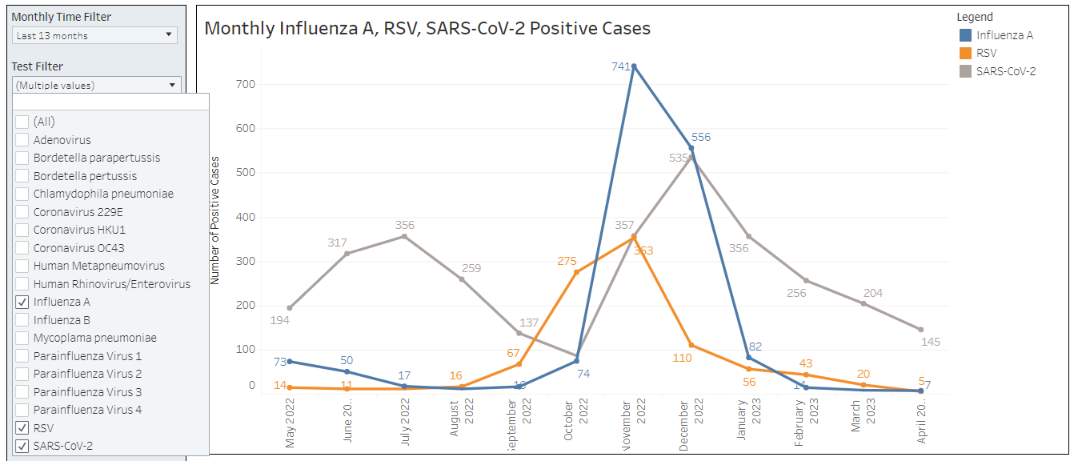
Sample Dashboard

Slide 5
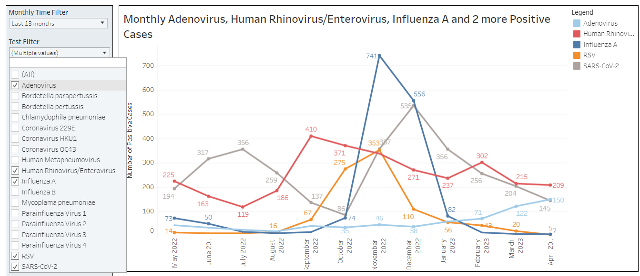

Slide 6
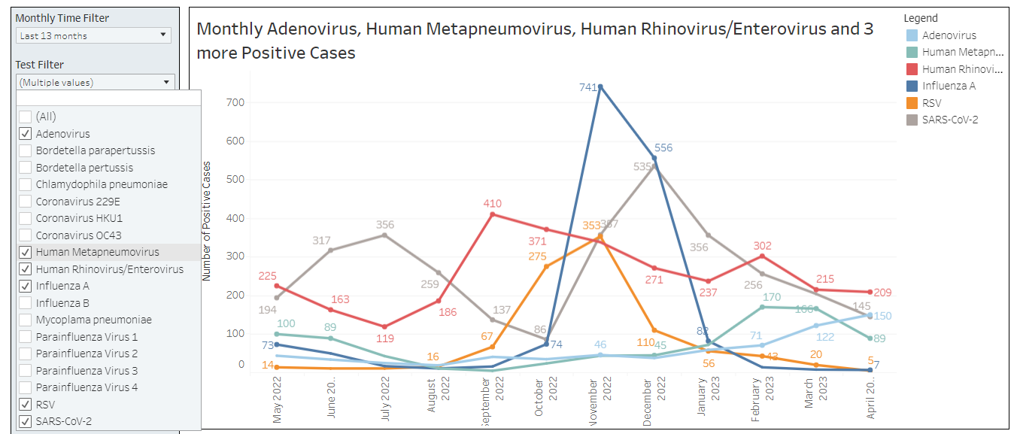

Slide 8
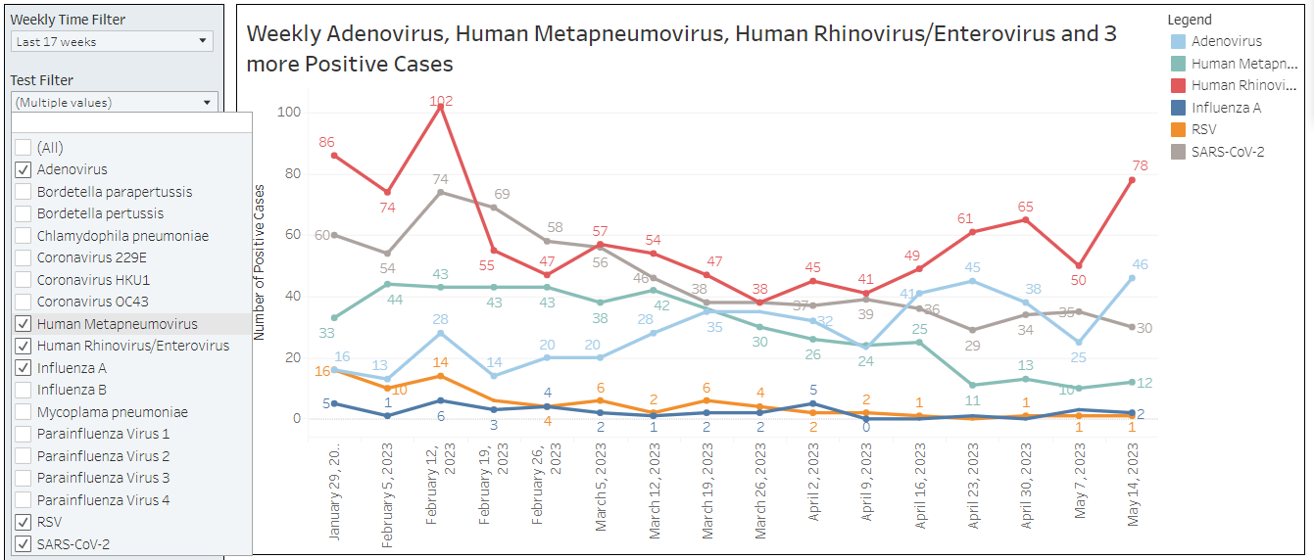

Slide 9
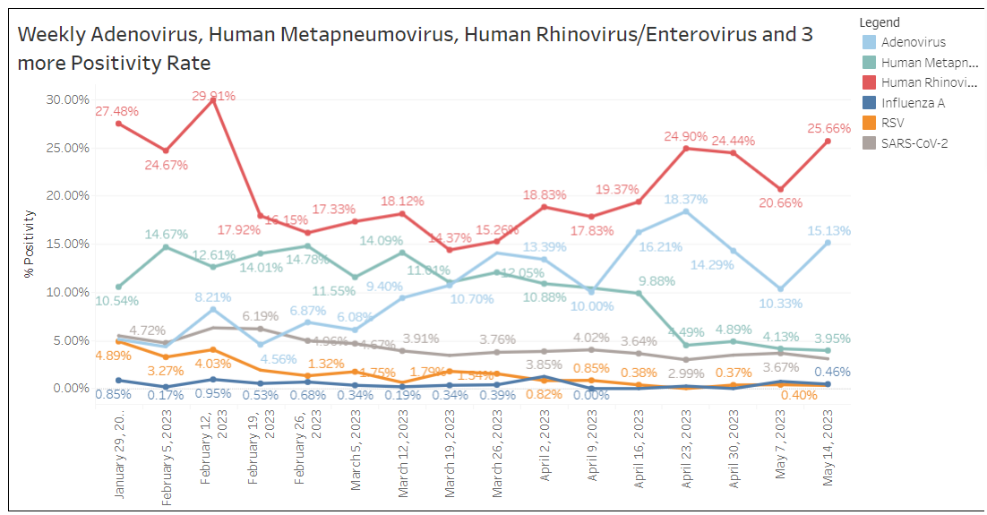

Slide 10
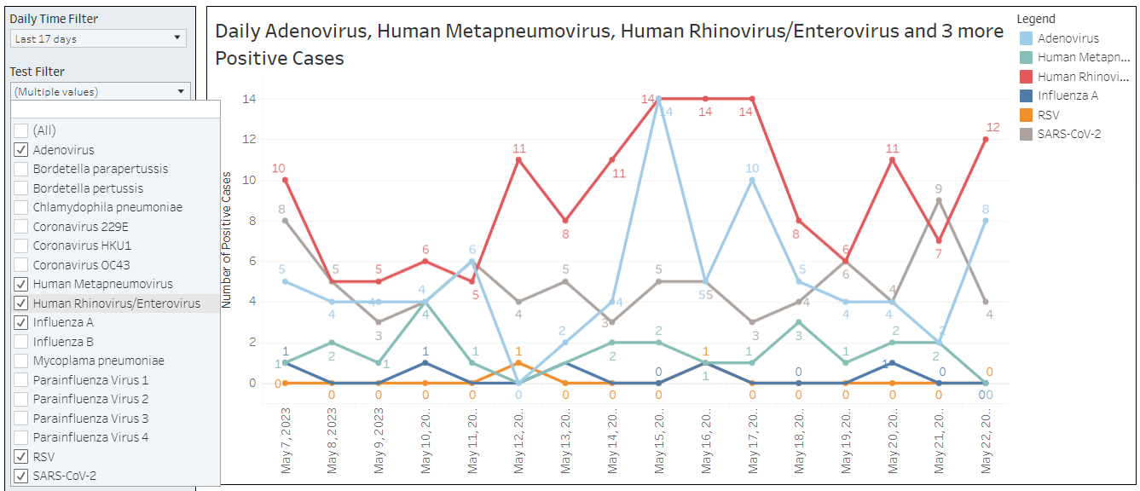

Slide 11
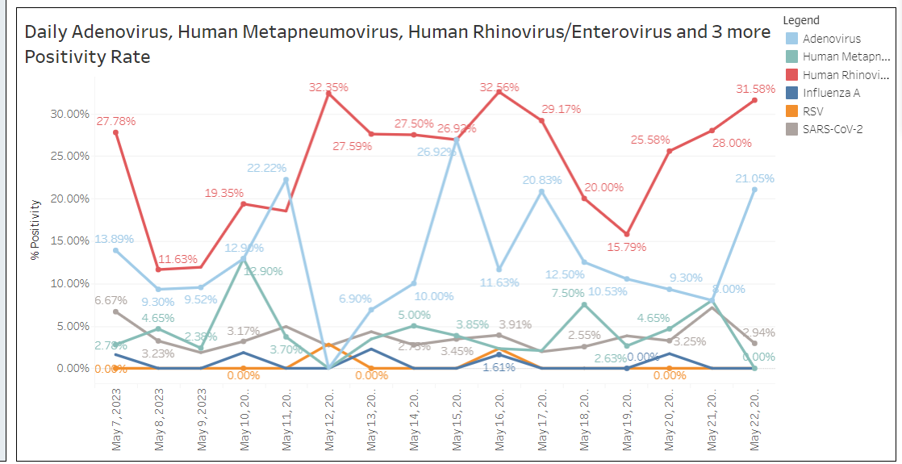

Slide 12
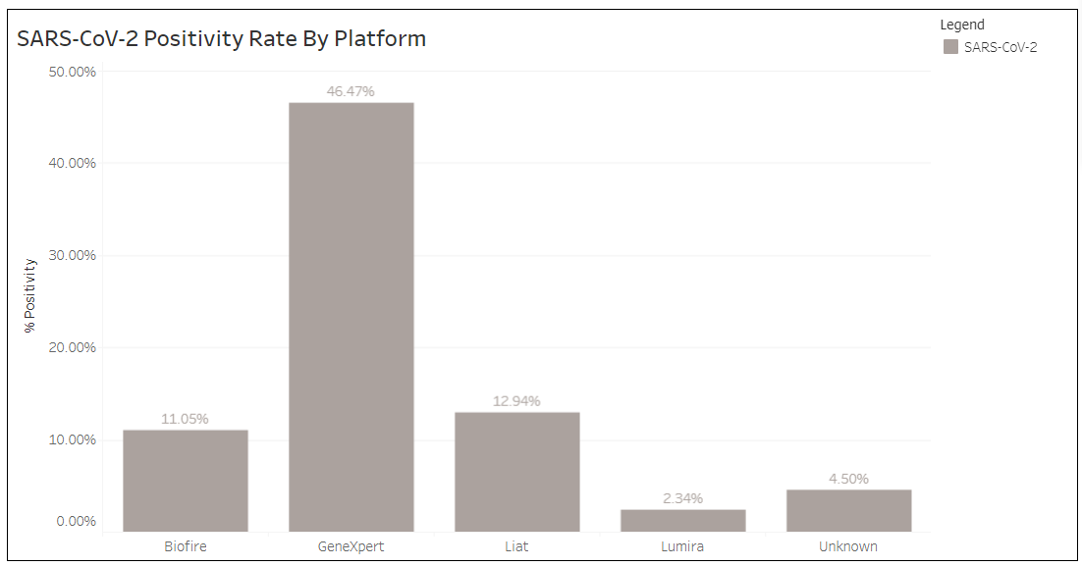

Slide 13
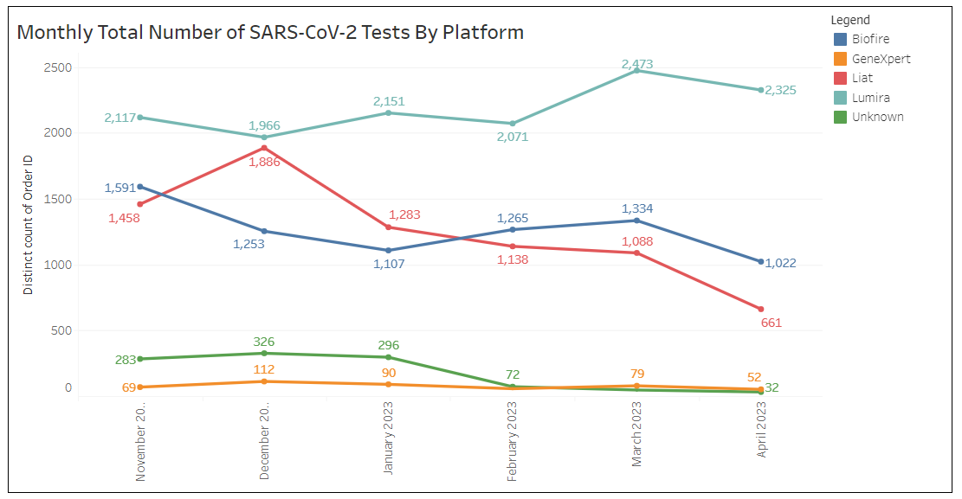

Slide 14
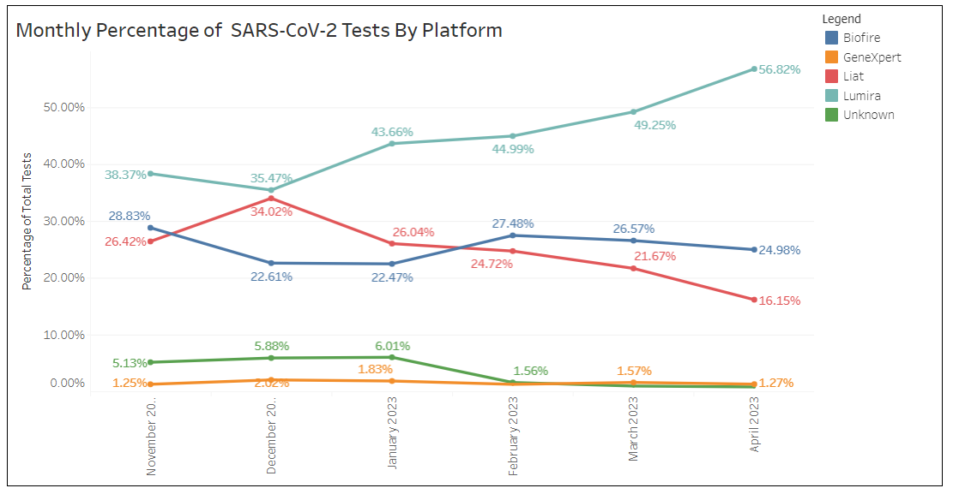

Slide 15
