Slide 1
Pre-analytic Dashboards
Sample Dashboards

Slide 2
Dashboard Metrics
% Hemolyzed
% contaminated
% Clotted
% QNS
Potassium Level
Arm band compliance
Filter by phlebotomist

Slide 3
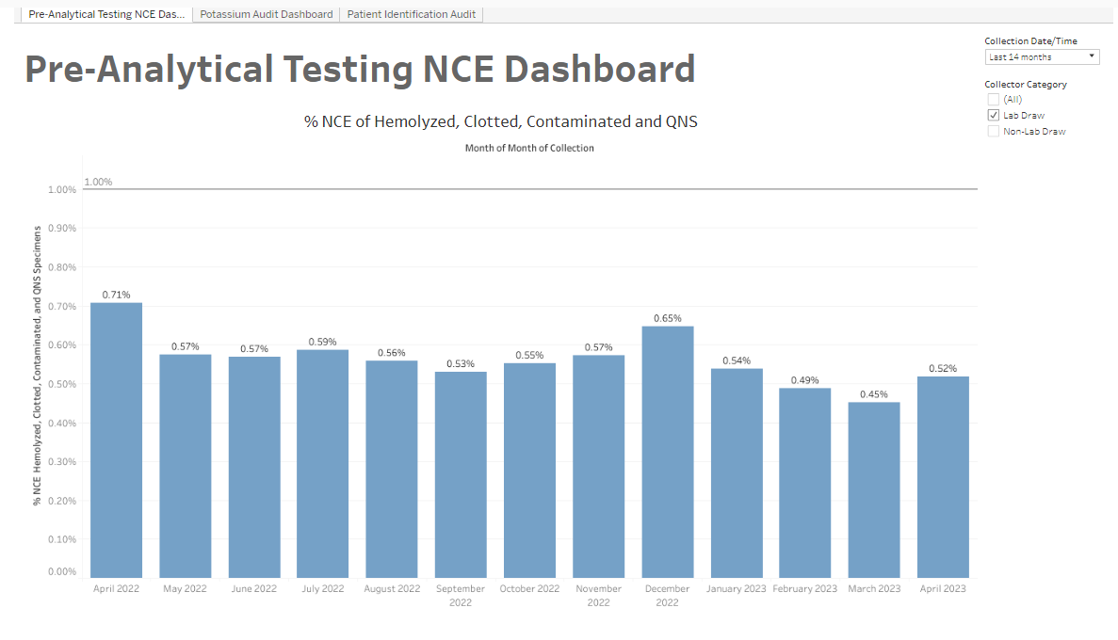
Dashboard Overview

Slide 4
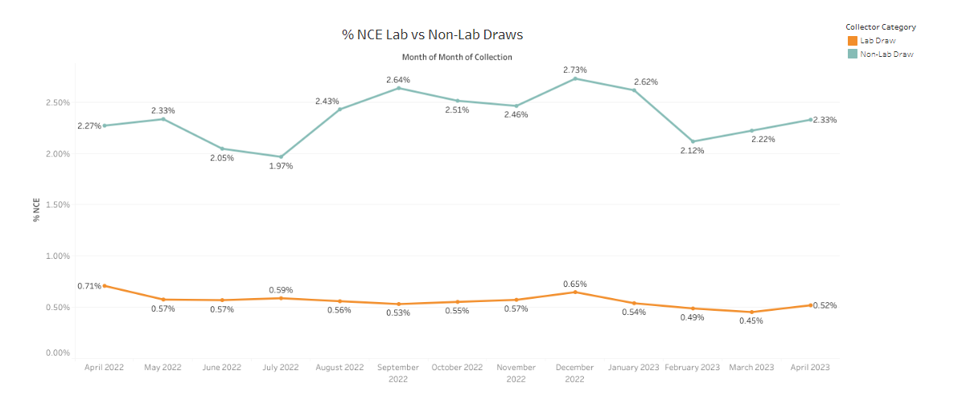
NCE Lab Vs. Non-Lab (Nursing)

Slide 5
% NCE (Hemolyzed and Clotted)

Slide 6
% Contaminated and QNS

Slide 7
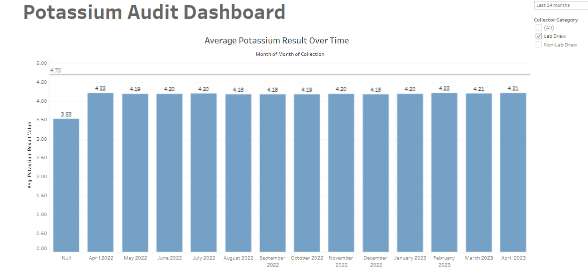
Potassium Audit <4.7 (can filter by Phlebotomist for education and retraining)

Slide 8
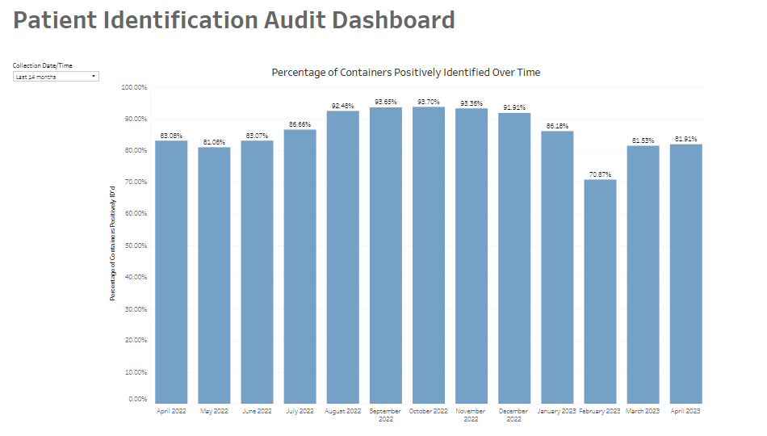
Arm band scanning/Patient Identification (Can filter by Phlebotomist for education/retraining)

