Slide 1
Blood Utilization Patient Blood Management
Sample Metrics

Slide 2
Patient Blood Management

Slide 3
Blood Utilization Dashboard
Should be able to filter by
Product type
Date range
Hgb value, PLT count value, INR…
Location
Physician
Specialty

Slide 4
Overview Home Page

Slide 5
Overview Home Page of 1 unit Vs. 2 units

Slide 6
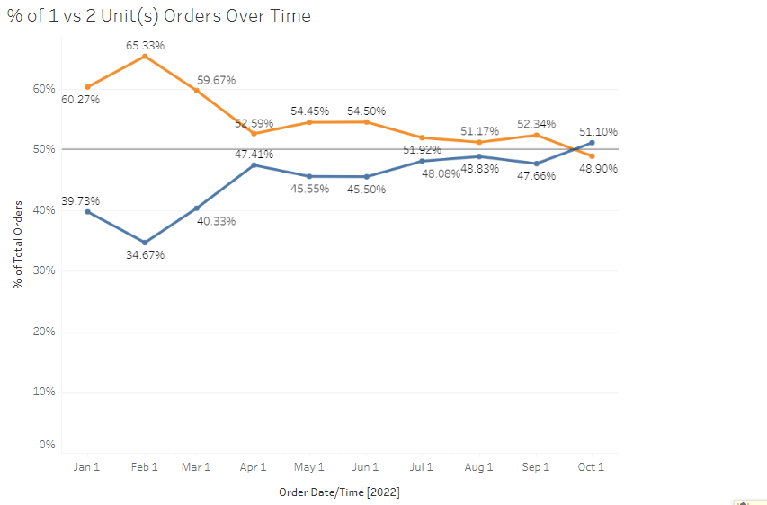
Percent of 1 VS 2 Unit(s) orders over time

Slide 7
1 VS 2 Unit (S) by Location

Slide 8
1 VS 2 Unit(S) Orders by Specialty

Slide 9
1 VS 2 Unit(S) by Ordering MD

Slide 10
RBC Utilization-All Location Hgb 7.0

Slide 11
RBC Utilization by Location Hgb 7.0

Slide 12
Hgb 7.0 Excluding Infusion center and Operating Rooms

Slide 13
Hgb 8.0 Excluding Infusion Center and ORs

Slide 14
Hgb. 8.0 by Specialty excluding Infusion Center and ORs

Slide 15
Hgb. 8.0 by Specialty excluding Infusion Center and the ORs

