Slide 1
Test Utilization Dashboard Vitamin-D Utilization
Example Dashboard

Slide 2
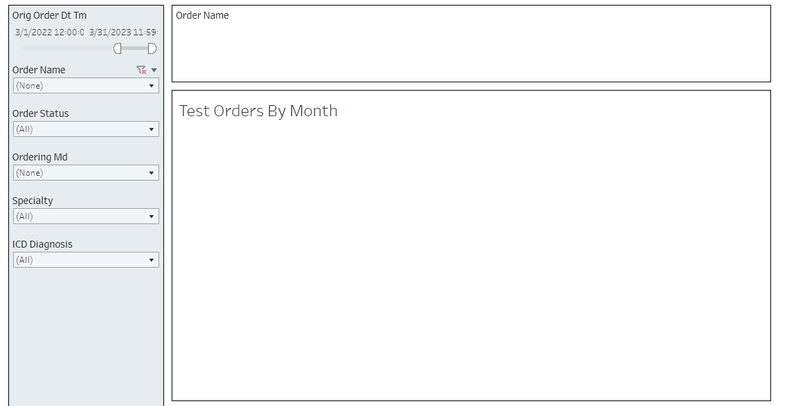
Test Utilization Dashboard-Overview

Slide 3
Dashboard Quality Metrics
Monthly trend by test volume
By ordering MD
By specialty
Month over month percent change in test orders

Slide 4
Filter by Test Name-Vitamin D

Slide 5
Vitamin D Utilization March 1, 2022 - March 31, 2023

Slide 6
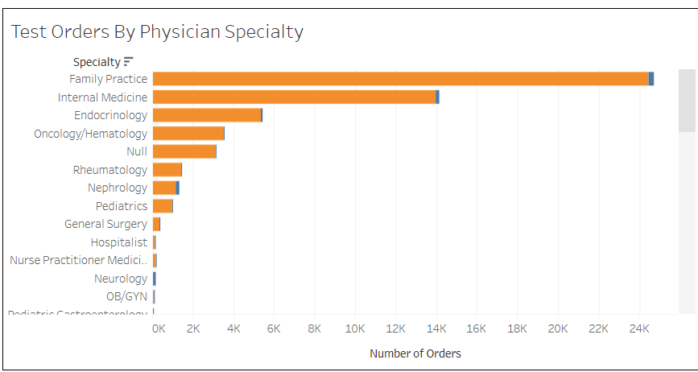
Vitamin D Utilization by Specialty

Slide 7
Example Cost per test and Potential Savings
Test | Performed | Cot per test (including reagents and Labor) | Avg. Monthly Volume | Monthly Cost | Annual cost | Potential Annual Savings 10% reduction | Potential Annual Savings 20% reduction | Potential Annual Savings 30% reduction | Potential Annual Savings 50% reduction
Vitamin D 25-Hydroxy | In-house | $5 | 4,250 | $21,250 | $255,000 | $25,500 | $51,000 | $76,500 | $127,500
Vitamin D 1,25 Hydroxy | Reference Lab | $21.48 | 85 | $1,825 | $21,900 | $2,190 | $4,380 | $6,570 | $10,950

