Slide 1
Turn-around-time Metrics
Sample Metrics

Slide 2
Turn-around-time
Received to completed
Order to receipt in the lab
Order to verify/completion

Slide 3
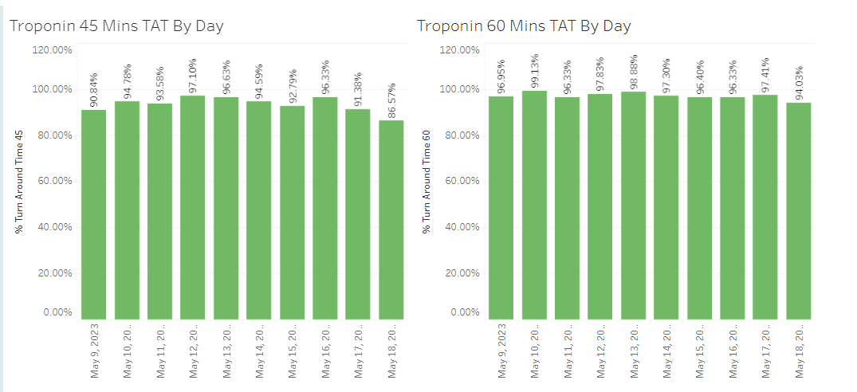
Troponin from Receipt to Completion
(within 45 minutes and 60 minutes)

Slide 4
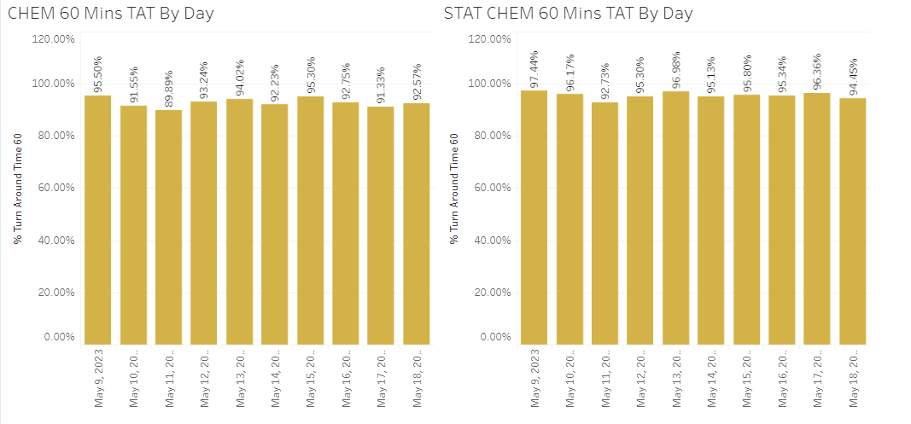
Chem TAT (Routine Vs. Stat/ED)

Slide 5
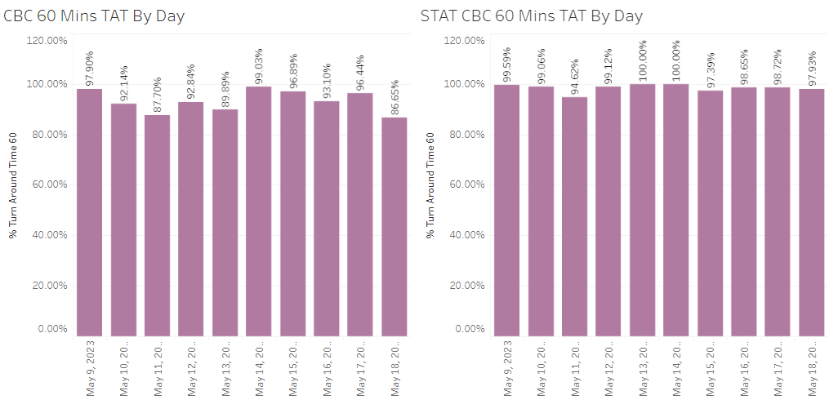
CBC TAT (Routine Vs. STAT/ED)

Slide 6
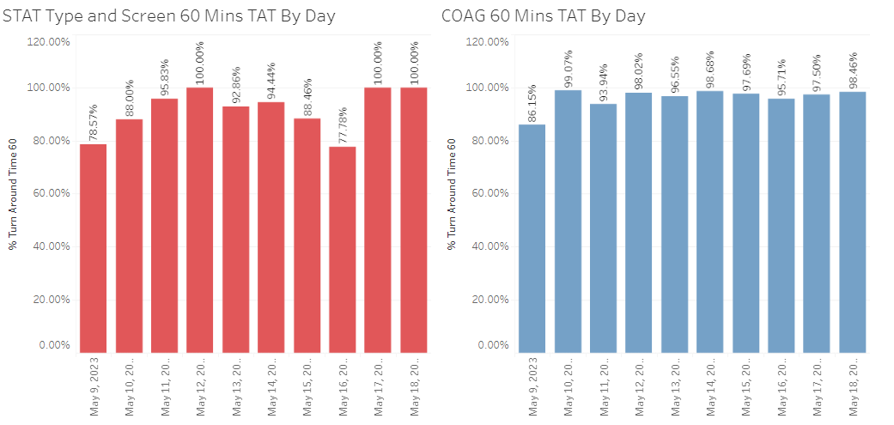
TYSC and COAG TAT

Slide 7
Monthly TAT
For trending purposes

Slide 8
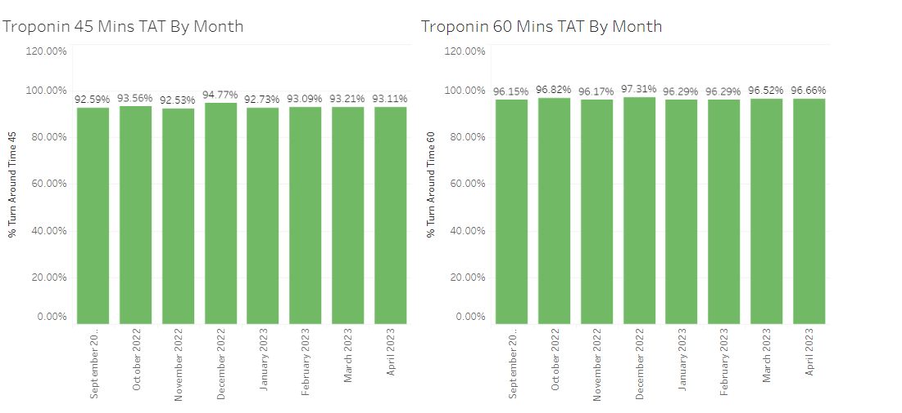
Monthly Troponin TAT

Slide 9
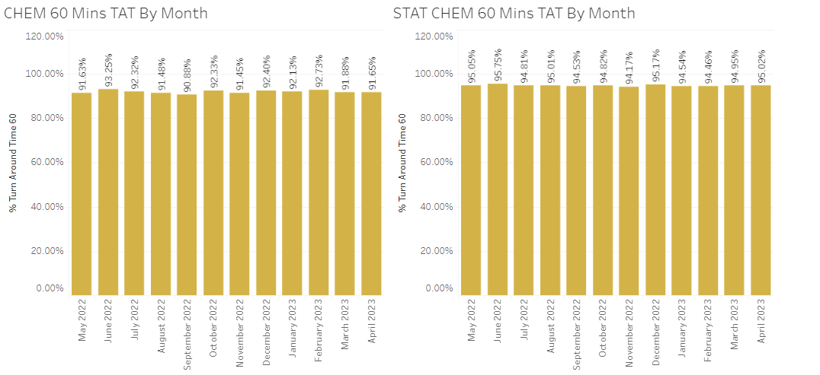
Monthly Chem TAT

Slide 10
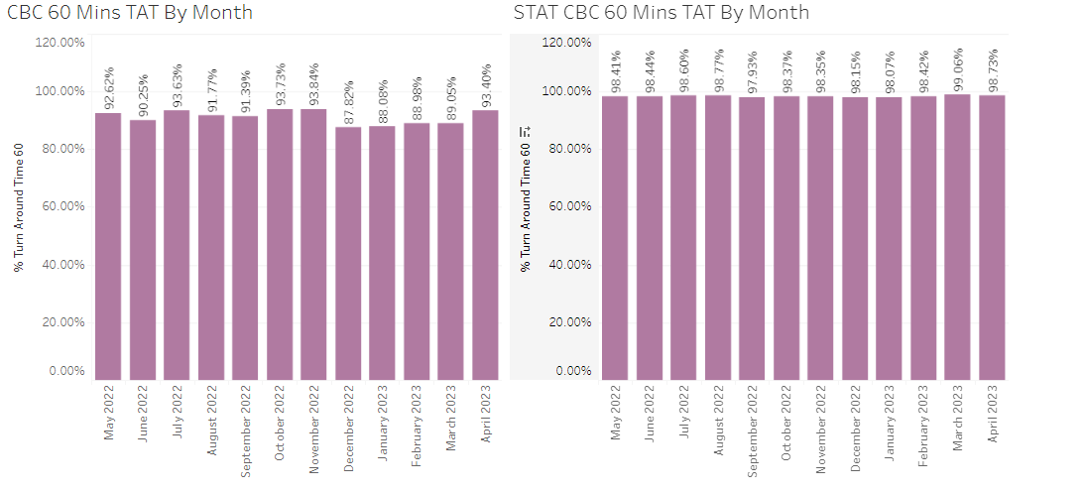
Monthly CBC TAT

Slide 11
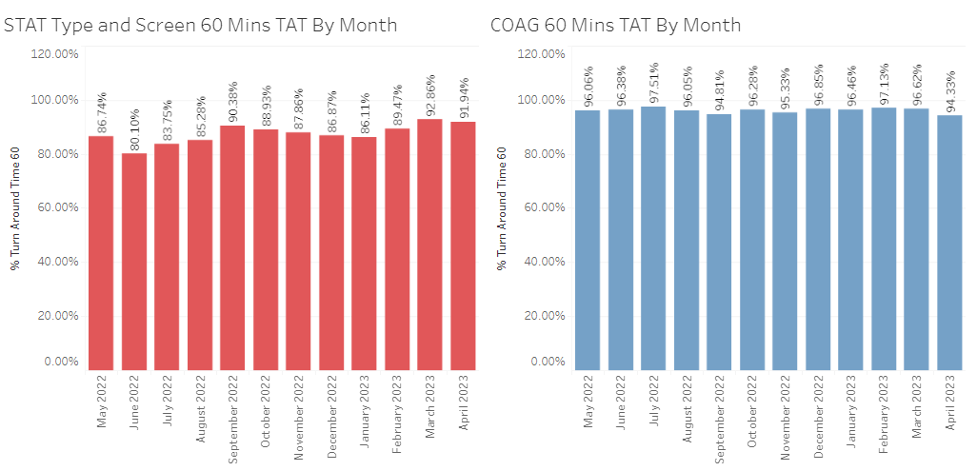
Monthly TYSC and COAG

