Slide 1
AM Laboratory Metrics
Sample Metrics

Slide 2
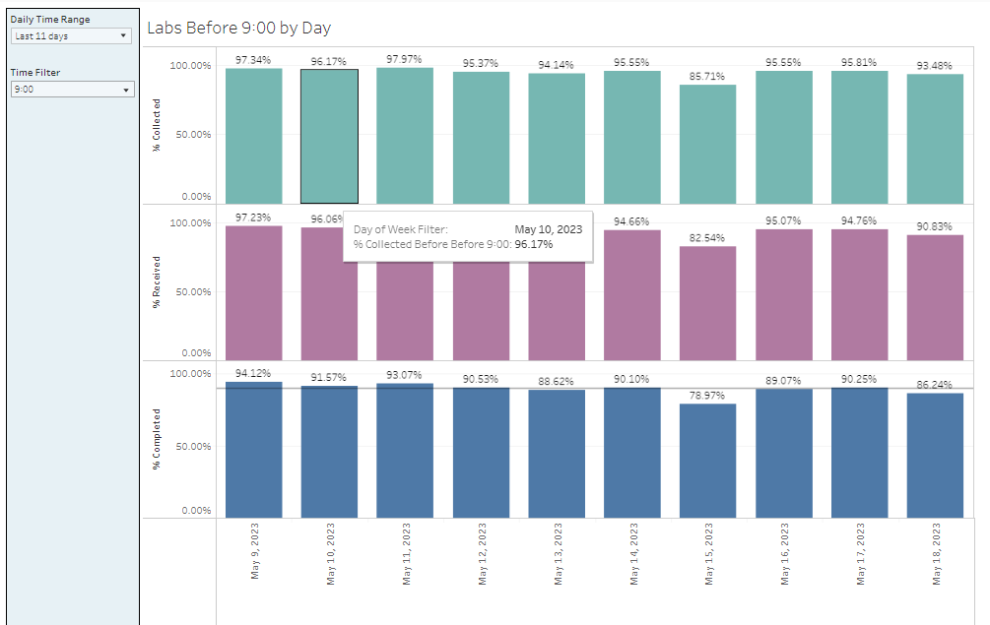
Daily AM Lab by 9 AM (% collected, % Received, % Completed)

Slide 3
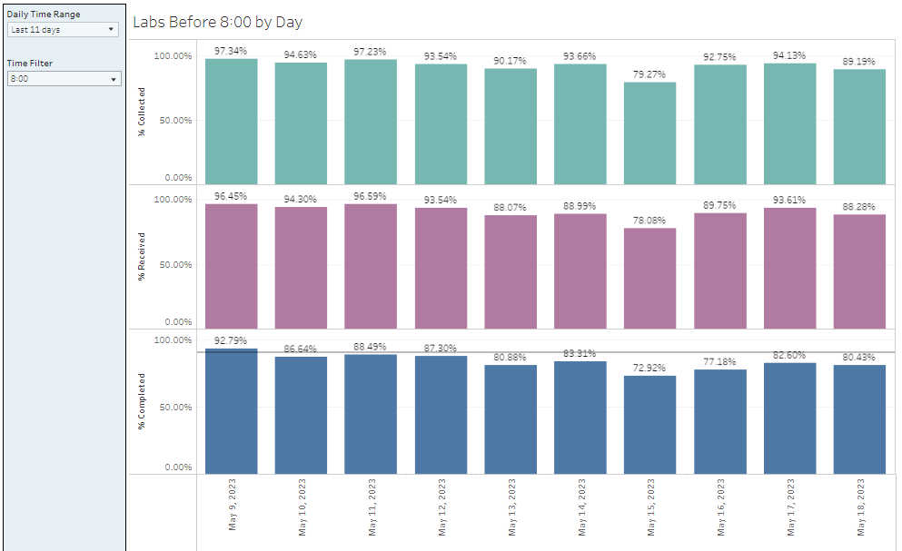
Daily AM Lab by 8 AM

Slide 4
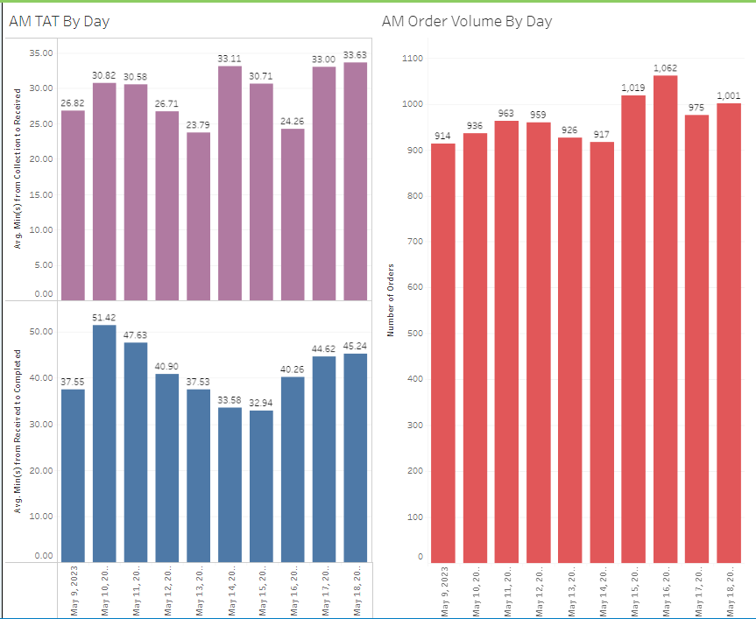
Daily AM TAT and Order Volume by 8 AM

Slide 5
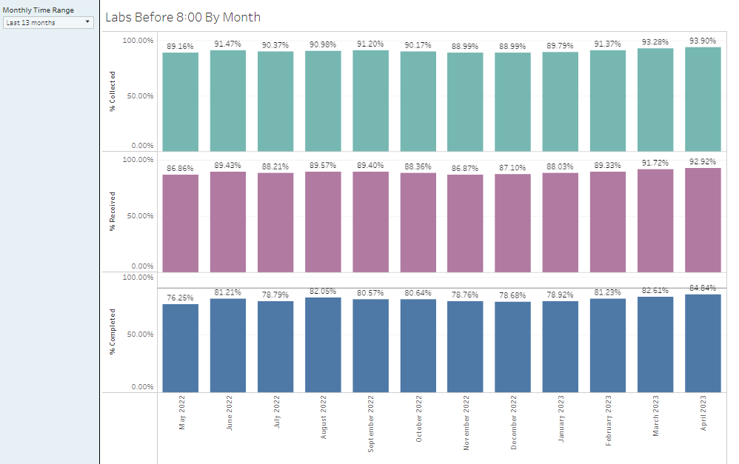
Monthly AM labs by 8 AM

Slide 6
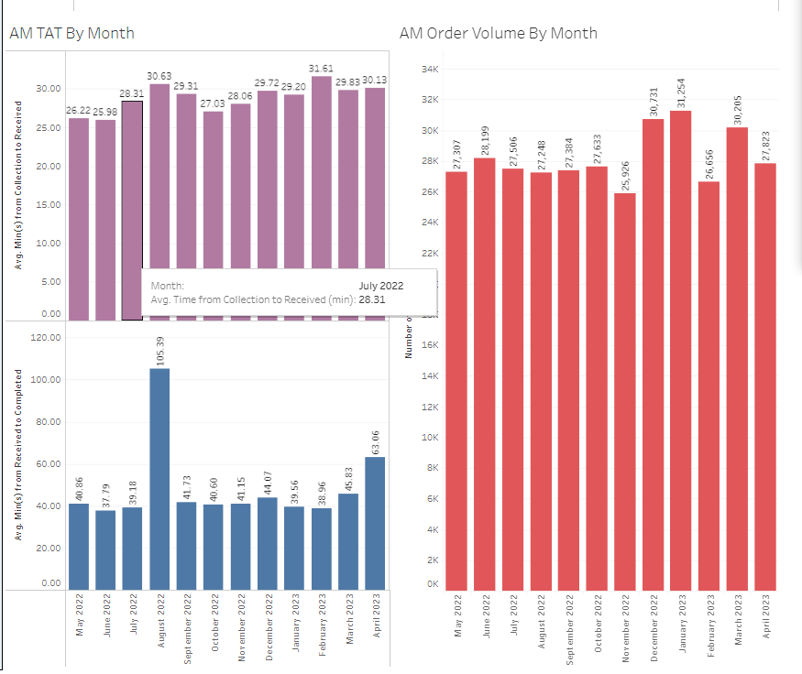
Monthly AM Lab TAT by 8 AM

