Slide 1
ASCP Negotiation & Advocacy Toolbox
A roadmap to advocating for the needs of your laboratory

Slide 2
Funding statement
This resource was made possible by cooperative agreement NU47OE000107 from the Centers for Disease Control and Prevention (CDC). Its contents are solely the responsibility of the American Society for Clinical Pathology (ASCP) and do not necessarily represent the official views of the CDC.

Slide 3
Pillar 1: Promoting Laboratory Visibility
Outlay a plan for communications to promote visibility of the laboratory and gain stakeholder buy-in and interest in the laboratory

Slide 4
Promoting Laboratory Visibility
Internal
External

Slide 5
Who is responsible?
The entire laboratory team is responsible for making the profession and the lab more visible.

Slide 6
Why should you participate in laboratory visibility?
RESOURCE AVAILABLE on website
EXAMPLES:
Emergency Department - provide TAT reports
OB Department - provide rejection rates for Newborn Screening
Quality Department - provide quality metrics and quality improvement plans and results, provide accreditation inspection results
Laboratory professionals are natural problem solvers
The more you participate in meetings, the more you and your department are seen as a valuable resource for the organization
Always look for ways to support improvement for other departments and offer up your services

Slide 7
Build Relationships with Your VP
Regular meetings with VP to educate on the laboratory, active projects, build bridges and common knowledge/language about the lab
Educate senior leadership about the strict regulatory requirement and the responsibility the lab has
Share marketing materials, newsletters
Forward articles or updates about the laboratory
Invite VP and other department leaders to: all red ribbon ceremonies, rounding at lab department meetings, speak at student graduations, inspection summation
Walk leaders from other departments and senior leadership through the lab
Present strong ROI to capital requests, new expenses

Slide 8
Speak the Same Language
When presenting or discussing projects or issues with Senior team members (C-suite), be sure to align with their plan and goals and use their language.
Tips:
Align your goals and strategic plan to the organizational goals, mission, vision, and core values
Understand your financials, cash flow, etc. and the terms they use (P&L/Profits and losses, responsibility report, etc.)
Know how and when to complete an ROI (Return on investment, cost analysis, etc.)
Understand and track Revenue / Expenses - be sure to account for variances
Understand the Capital / Operating Budget process and follow it - including the limits and approvals required for Capital and discretionary budgets

Slide 9
Internal Laboratory Visibility
RESOURCE AVAILABLE on website
Which interdisciplinary meetings should I present to? (examples)
What do I present?
Emergency Department meeting
Transfusion Committee
Infection Prevention Committee
Pharmacy/Antibiotic Stewardship Committee
FLU/COVID Surge Planning Committee
Blood Utilization Committee
Directors’ meeting
Applicable metrics (TAT, AM draws, COVID/FLU)
Test utilization
Blood utilization
Pre-analytical KPIs
Ordering practices
Changes in test menu: new tests/obsolete tests
New technologies
Change in reference ranges
Accreditation results

Slide 10
Engage with IT to Generate Presentable Data
Share examples of Dashboards
Work to understand IT department’s capabilities and restrictions
Pool resources and build on Dashboard platforms used in other clinical departments
Talk to Electronic Health Record vendor (Epic, Cerner, etc.)
RESOURCE AVAILABLE to download

Slide 11
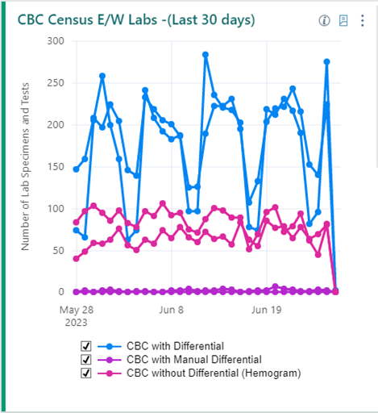
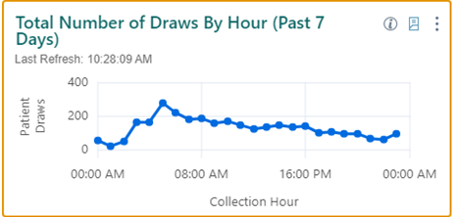
Dashboard Widget Examples
RESOURCE AVAILABLE on website

Slide 12
Engage with Marketing to Build Online Resources
Internal website (within laboratory)
Internal website (within organization)
External website (share public-facing info: certification, newsletters, etc.)
Provide an electronic request form (to the laboratory) on website
Develop digital communications plan with Marketing Department
Lab Week, promotions, sources for national visibility campaigns, YouTube channel, Newsletters, etc.

Slide 13
Internal Laboratory Visibility
RESOURCE AVAILABLE on website
Create videos
Blood donations
Specimen collection and labeling
Process in the lab (following a unit from collection to transfusion)
Automation
Leadership and staff spotlights
Rounding with other directors, managers and executives
Lab week (invite other department leaders and senior executives)
Ribbon-cutting ceremonies for go-live (invite senior leadership)

Slide 14
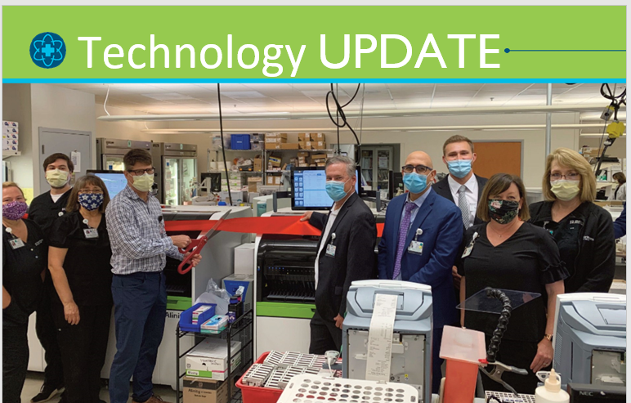
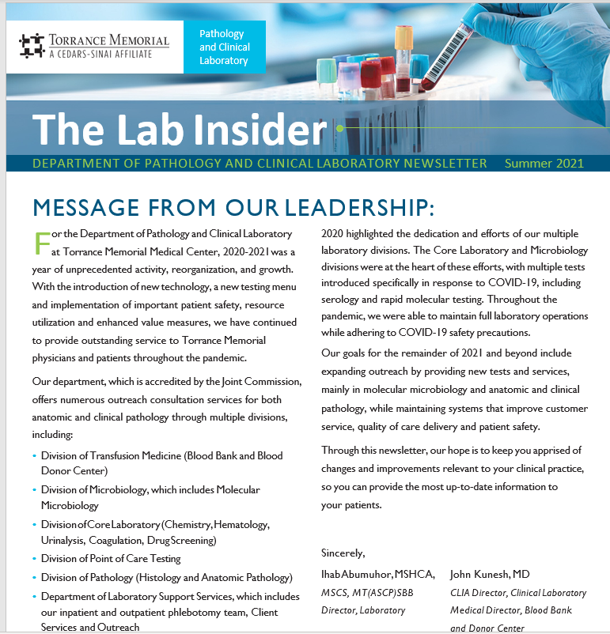
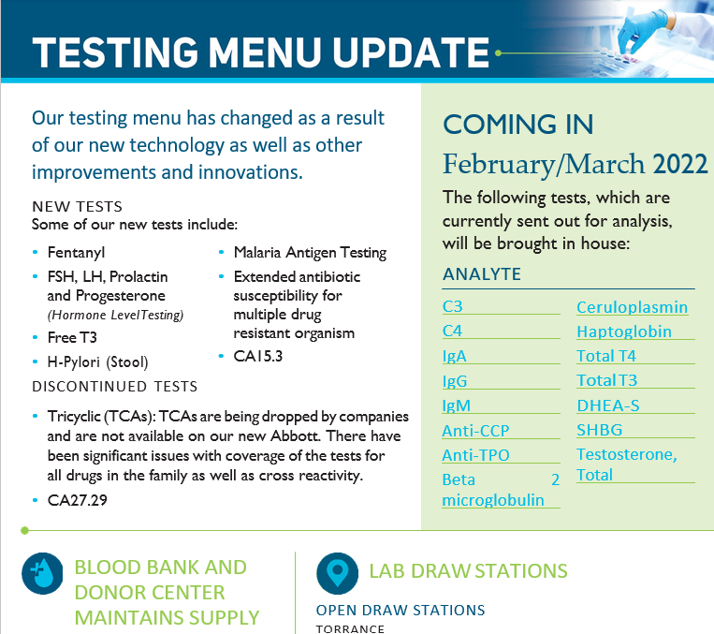
Laboratory Newsletters Examples
RESOURCE AVAILABLE to download

Slide 15
Engagement Opportunities with Hospital Staff
Lab visibility via hospital’s social committee
Hospital-wide lunch-and-learns for lab updates
Lab town halls for all lab staff
Rounding with other managers and directors outside of your lab
Communications with medical staff
Communication with the nursing education
Screensavers for certain updates (hospital-wide)

Slide 16
Hospital Newsletter Example

Slide 17
External Laboratory Visibility
Support Health Fairs (encourage integration of the laboratory as a part of the overall health system)
Promote blood donations
Point-of-Care testing
Develop lab newsletters (outside of immediate laboratory) and hospital community publications
Share achievements of external recognition (Leading Laboratories designation or other certifications)

Slide 18
External Laboratory Visibility Continued
Promote laboratory careers
High school career days, career fairs, present at high schools and colleges, YMCA, etc.
Share materials on laboratory professions
Provide lab tours to high schools and college students
Partner with other outside organizations (e.g. American Red Cross, churches, American Heart Association, etc.)

Slide 19
External Laboratory Visibility Continued
With the help of marketing, improve laboratory visibility using the following platforms:
Social media (Instagram, LinkedIn, YouTube Videos, Facebook)
Hospital website
News channel or local newspaper
Billboard spotlight (new services)
Case studies and publications
Work with vendors and marketing department to showcase the lab
Presenting at conferences, publications, poster presentations

Slide 20
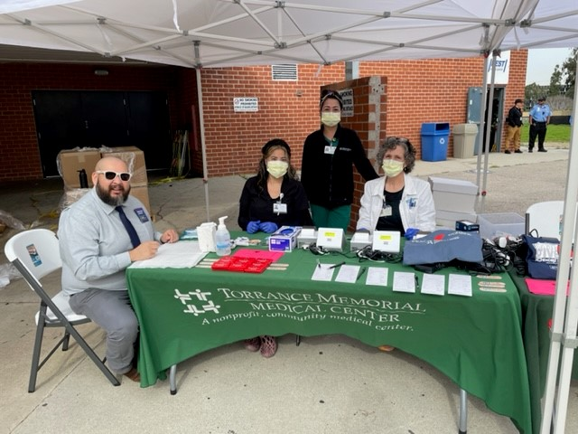
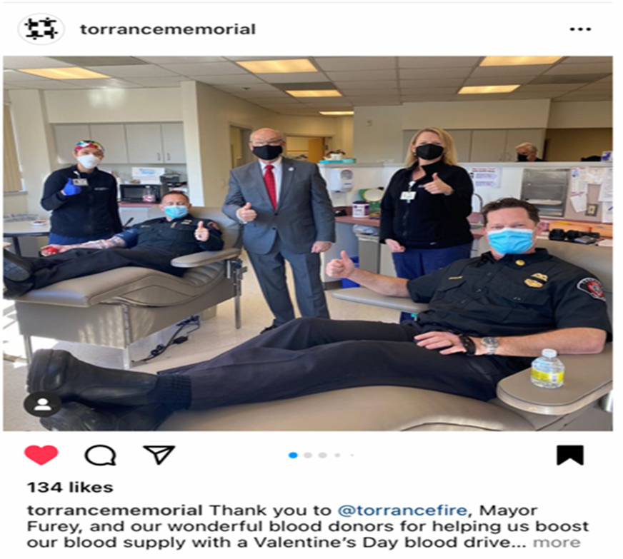
Community Publication and Involvement Example

Slide 21
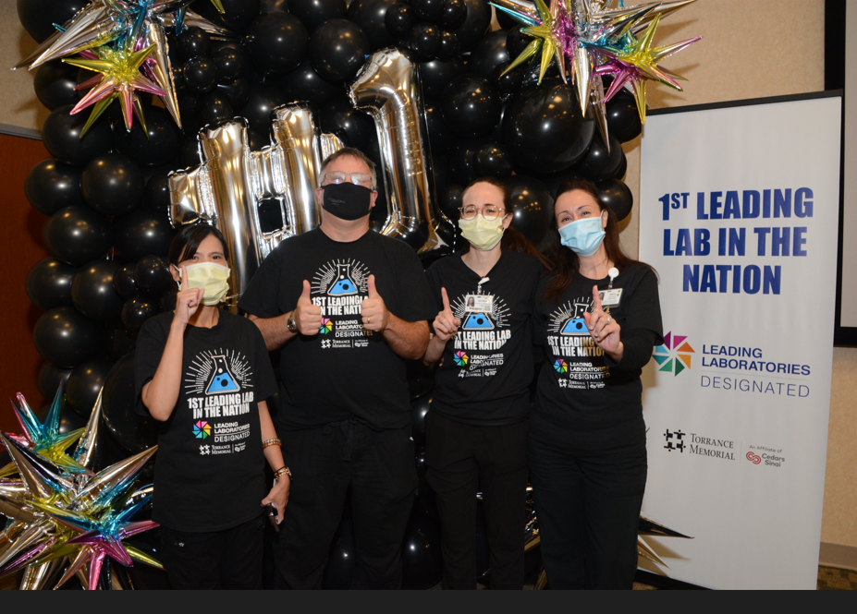
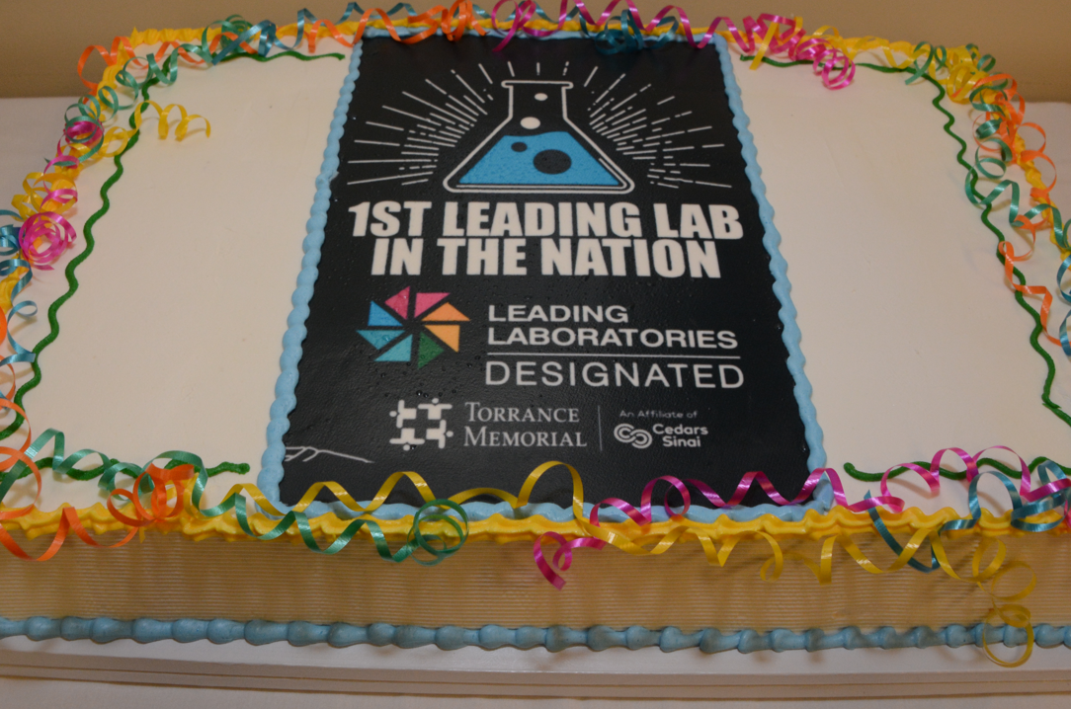
Leading Laboratories Quality Recognition

