Slide 1
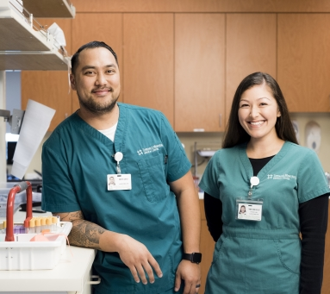
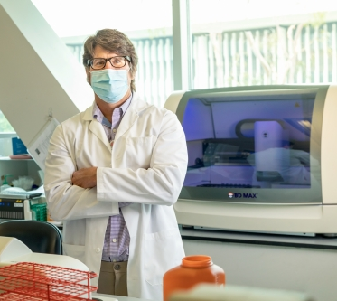
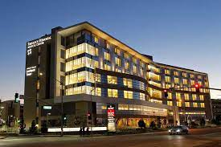
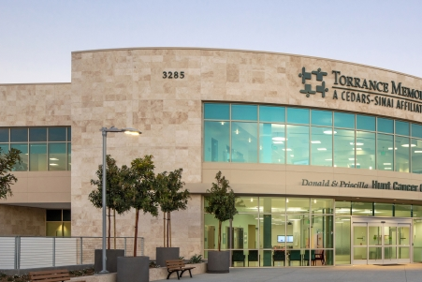

Pathology and Laboratory Medicine Strategic Plan
2021-2025

Slide 2
In this presentation:
Why Have a Strategic Plan?
Process to create the new plan
2021-2025 Department Strategic Plan
Review of accomplishments from our previous year and elements to leverage for the future.

Slide 3
Why have a strategic plan??
A roadmap
Provides direction and goals.
Defines priorities: What we do and what we won’t do.
Guides day-to-day decisions, including where we invest resources (time, people, $$).
Framework for evaluating progress and changing approaches.

Slide 4

What are the Parts of a Strategic Plan?
A mission statement defines the organization’s purpose.
It explains why we exist as an organization. It includes:
  A description of our purpose and goals
  Communicating our goals
  And how we will achieve them
A vision statement is a short statement about where the organization is headed.
It answers the question, “what will Cedars-Sinai look like in five or more years?”
A strategic plan is a roadmap to success
Notes:
The parts of a strategic plan are like ingredients for a recipe. Each part plays a role in shaping the plan and corresponds with the other parts to form a well thought-out plan of action.
A mission statement defines what an organization is, why it exists, its reason for being. At a minimum, a mission statement should define who your primary customers are, identify the products and services you produce, and describe the geographical location in which you operate.
A vision statement states what the organization’s goals are for the midterm or long-term future. A vision statement could range from one line to several paragraphs, so long as it identifies what the organization would like to achieve or accomplish.
A mission statement and vision statement are the foundation of a plan, like the main ingredients of a recipe.

Slide 5

What is the plan?
Phase I
Phase II
Phase III
Phase I
  Plan Interviews
  Stakeholder Survey (Nursing Leadership, outreach clients)
  Environmental Assessment and workflow
Phase II
  Refine or define Mission and Vision
  Define Goals with Measurable Outcomes
  Develop Specific Strategies and Tactics
Phase III
  Finalize the Strategic Plan
  Develop Implementation
  Plan with Target Dates and Assignments
  Identify Resource Requirements (if applicable)

Slide 6
The
Path and Lab New Strategic Plan: Six Pillars for the Future
People and Culture: Be the best place to work in pathology and laboratory medicine and cultivate diverse life-long learners.
Quality: Strengthen the quality program throughout the department and enhance patient safety.
Financials: Ensure that our overall financial performance continues to keep pace with the operating and capital requirements needed to advance our Divisional and Departmental mission and values.
Innovation: Accelerate Innovation and implement the best cutting- edge technologies throughout the laboratory.
Education: Educate the next generation of Laboratory leaders, supervisors, managers, and Clinical Lab Scientists.
Growth: Increase clinical volume, operational exapnsion and geographic outreach.

Slide 7
Vision
The vision of the department of Pathology and Clinical Laboratory at [Your Organization] is to continue to be the leading Clinical Laboratory, while enhancing our position as a recognized leader among the areas most respected, admired, and trusted Clinical Laboratories.

Slide 8
Mission
The mission of the Pathology and Clinical Laboratory at [Your Organization] is:
  Provide innovative, high quality timely and most effective clinical laboratory services
  Provide the best training and education to our Clinical Lab Scientists, pathologists and laboratory leaders.
  Expand outreach support and clinical test menu.
  Enhance our departmental culture of diversity, respect and professional growth.

Slide 9
Values
Pathologists are specialist physicians and laboratorians who collaborate and work together to provide high quality and timely patient care through the evaluation and consultation on patient specimens.
Maintain a safe, high quality collaborative work environment with opportunities for advancement and professional growth.
Promote continuous process improvement, efficient and high-quality diagnostic testing.
Maintain high level of integrity, respect and compassion throughout the department.
Accountability
Leading Change and Innovation
Diversity

Slide 10
How This Plan Was Created?
Met with leadership of the department of Pathology and Clinical Laboratory, including Supervisors, Managers, physicians and senior management
Observed the operation of the laboratory
Reviewed previous accomplishments
Met with outside the department stakeholders

Slide 11
Goal 1:
People and Culture: Be the best place to work in pathology and laboratory medicine and cultivate diverse life-long learners.
Strategies:
Recruit the best and talented Clinical Laboratory Scientists and Laboratory leaders.
Develop a succession plan for each Division to replenish the Department and preserve retiree knowledge.
Develop a recognition program and spot bonus for high performers (Value and celebrate individual and team accomplishments).
Ensure a transparent approach to annual performance reviews and salary increases
Review job descriptions and establish career ladders and career development programs for clinical laboratory personnel and administrative staff.
Establish and Develop a robust training and mentoring program for new and current laboratory staff.

Slide 12
Goal 1: People and Culture
Ensure the right people are in the right roles working on the right activities.
Promote cross departmental/divisional collaboration
Improve transparency, communication and trust across the entire department
Promote flexibility and develop fully engaged workforce across all divisions.
Promote nimbleness, efficiency, productivity, quality and safety across all divisions.
Promote respect, integrity and accountability across all divisions.

Slide 13

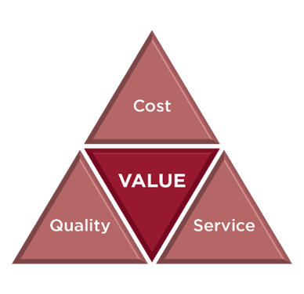
Goal 2: Quality
Develop an overall robust Quality Program
Define Quality indicators for each Division to be tracked monthly
Document all process improvements using PDSA format.
Develop a Quality Corner and Process Improvement Corner for the Lab.
Hire a Quality Assurance CLS for the Lab
Define frequency of Quality Assurance meetings with documented minutes.
Develop a Lab Safety committee
Reduce the number of errors/mislabeled specimens
Develop and operation meeting “SET”: Synergy Executive Team

Slide 14








Goal 3:Value added Care/ Financials
Identify, pursue early adoption of lean/value-added process improvements throughout the lab
Implement a high value stream committee to identify potential process improvement and cost savings.
Review all contracts and agreements and find any potential cost savings.
Transition to new vendors, if applicable
Collaborate on process improvement projects outside throughout the Medical Center.
Reduce Blood Utilization and identify a supplemental blood supplier
Increase blood collection in-house
Use outreach services to create new revenue from new clinical clients

Slide 15

Goal 4: Innovation (Early adoption of Technologies and tools)
Need to upgrade the most up to date technology with high throughput
Identify and Apply technology to bring in more specialized testing in-house
Implement Interfaces for equipment, where available
Review informatics needs (New Software, computer upgrades, data capture, …)
Implement digital pathology
Implement molecular Pathology/testing
Robotics for specimen delivery and blood products
Implement Haemobank 80 for remote allocation of blood
Implement Immunohistochemistry

Slide 16
Goal 6: Track Lab Performance and Recognition
Ensure that all staff knows how we are doing through visual analysis.
Utilize analytics and data to influence process improvements
Implement informatics to influence lab utilization, efficiencies and productivity lab wide
Implement Quarterly and Annual lab report to be distributed to all departments in your Medical Center
Apply to the Lab of the year award (MLO)

