Slide 1
ASCP Negotiation & Advocacy Toolbox
A roadmap to advocating for the needs of your laboratory

Slide 2
Funding statement
This resource was made possible by cooperative agreement NU47OE000107 from the Centers for Disease Control and Prevention (CDC). Its contents are solely the responsibility of the American Society for Clinical Pathology (ASCP) and do not necessarily represent the official views of the CDC.

Slide 3
Introduction

Slide 4
Key Learning Objectives for Toolbox
Articulate strategies to demonstrate the comprehensive value of your laboratory
Define your laboratory’s goals and visions in alignment with the organizational goals
Map the pathway to advocate for your laboratory and staff’s needs
Apply relevant tools and templates from the ASCP Negotiation and Advocacy Toolbox to implement advocacy efforts on behalf of your laboratory and staff

Slide 5
Working Backwards
To advocate for your laboratory and staffing needs, demonstration of the laboratory’s value to the overall healthcare system and patient care is critical.
Developing a structured laboratory strategic plan can help outline and operationalize the core pillars needed to demonstrate value of the laboratory.

Slide 6
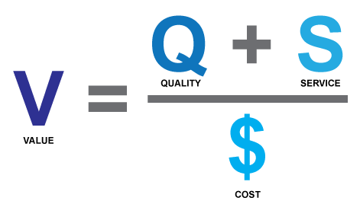
What is Value?
How do you determine the value of your clinical lab?
Define your lab goals and values
Define the value of your lab to:
  the health-system
  operations
  the patient
  the community
  interdisciplinary departments or population health
  maintaining quality
Where do you start?

Slide 7
Define Your Laboratory
Goal and Value

Slide 8
Define Your Laboratory Main Goal and Value
Your Goal
Your Value
[Your goal should relate back to your healthcare system’s goals to demonstrate how the laboratory contributes to achieving the overall goal of the hospital.]
[Your value should relate back to your healthcare system’s mission to demonstrate how the laboratory contributes to achieving the overall mission of the hospital.]

Slide 9
Define Your Laboratory Goal and Value Examples
Our Goal (example)
Our Value (example)
Provide innovative, precise, accurate, high-quality, timely and most-effective clinical laboratory services.
Add services and/or partner with teams to drive additional hospital and patient value through outreach expansion and clinical test menu.

Slide 10
Discussion Questions
What is the value your laboratory adds to the health system?
What resources can be used to quantitate value of the laboratory?
How can you quantitate qualitative value added?
Do you know what your bottom line is?
How is the laboratory represented in major service line meetings at your organization?
Are there system initiatives that have a laboratory component? (e.g. ER throughput, reducing length-of-stay, test utilization, patient blood management, etc.)
How does your laboratory participate in organization goals/KPIs, measures development, and improvements?

Slide 11
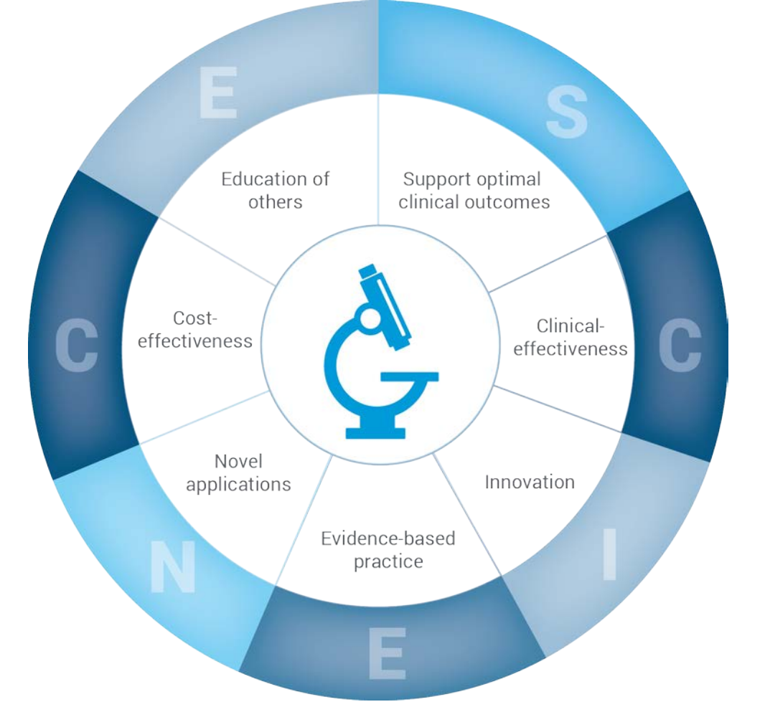
The Value of the Laboratory
https://arup.utah.edu/media/labValue/ValueLaboratory_InvestOutsource.pdf

Slide 12
Value of Your Laboratory
Value to system
Value to operations
Value to patients
Supports hospital accreditation
Wellness program
Health fairs
Employee drug screening
Consults
Develop/inform healthcare policies
Supports health equity
Lab testing and reducing Length-of-Stay (LOS)
Containing cost while providing quality testing
Strengthening test utilization
Supporting clinical efficiency and productivity
Improving quality-of-life outcomes
Identifying emerging health issues (Population Health)
Defining trends in chronic conditions
Critical for prenatal care

Slide 13
Value of Your Laboratory In Numbers
Value to system
Value to operations
Value to patients
$[MM] Revenue
    10% of all Hospital Revenues
    One of Top 3 Revenue Generating Departments
$ Expenses
    6.7% of all Hospital Expenses
    9:1 Gross Revenue: Expenses
20-30% Margin
[XXXk] Patient Draws/annually
[XXXk] Outreach Visits/annually
24/7 Operation [YYYY]
[XX] MM tests annually
[XX] MM orders
[XX] MM samples
[XXXk] Patients
    [XX] MM Chemistry
    [XX] MM Heme/Coag/UA
    [XXXk] POCT
80% of EMR is compromised of lab results
Laboratory testing has a widespread role in clinical decision making.
Laboratory testing plays a role in determining clinical outcome.
[XXk] units transfused/annually
[XXk] outreach visits/annually
[XXk] ER Visits/annually
Notes:
As a user of this document, please add your info in the bracketed fields to reflect accurate numbers.

Slide 14
How the Laboratory Contributes to the Hospital’s Success and Growth
Help control costs and expand testing capabilities
Develop new and market-specific tests
Streamline and expand test catalogs
Bring more routine tests in-house
Meet patient needs for complex and specialty testing
Establish KPIs to demonstrate success
Expand into adjacent local markets to shape population health
Share expertise to facilitate more accurate diagnosis
Increase pipeline of future laboratory professionals
Bring more visibility of the laboratory to the C-Suite and hospital leadership
Support opportunities for partnership with hospital’s marketing department and positive PR opportunities

Slide 15
Where do I start?
Creating a strategic plan

Slide 16
What is Strategic Planning?
Identifying priorities
Using
creativity
Setting long term objectives to improve performance
Generating options
Evaluating and deciding on strategies
Defining a monitoring process for implementation

Slide 17
What is the Purpose of a Strategic Plan?
Ensures alignment with the organization, increases credibility and visibility
Serves as a roadmap that provides direction and goals
Defines priorities and scope: what we will do and what we will not do
Guides day-to-day decisions, including where we invest resources (e.g. time, people, $$, etc.)
Identifies resources needed and those already available
Provides framework for evaluating progress and changing approaches

Slide 18

SMART Goals
RESOURCE AVAILABLE
on website
SMART goals refer to those which are:
Specific
Measurable
Achievable
Relevant
Time-bound
Set specific SMART goals for each pillar with expected completion dates.
Tie SMART goals to individual contribution projects and performance evaluations.

Slide 19
Six Simple Steps of Strategic Planning
Review organizational goals
Brainstorm:
  Strengths
  Weaknesses
  Opportunities
  Threats
Narrow your list - top 5 for each category
Define SMART goal(s) based upon this information
List tactics under each goal
Develop and monitor a Tracker - include owner assignments and timeframes for completion
RESOURCE AVAILABLE
on website

Slide 20
Align department goals, values, and pillars with the organizational goals and values

Slide 21
How Do I Develop Goals?
Analyze the information
  Discuss what you need to be successful
  Discuss what you have to accomplish? (directives / goals of organization)
Decide strategies
  What are top goals, desires?
Develop goals (2-3 SMART goals)
Define tracking / KPI measures
Execute the plan
RESOURCE AVAILABLE
on website

Slide 22
Define your Lab’s Pillars for the Future and Align with Organizational Pillars, Values, and Goals EXAMPLES
Promoting Laboratory Visibility
Outlay a plan for communications to promote visibility of the laboratory and gain stakeholder buy-in and interest in the laboratory

Slide 23
Define your Lab’s Pillars for the Future and Align with Organizational Pillars, Values, and Goals EXAMPLES1
People and Culture
Be the best place to work in pathology and laboratory medicine by cultivating diverse life-long learners and engaging and guiding the next generation of laboratory leaders, supervisors, managers, and MLS to build a culture of patient-focused lab advocates

Slide 24
Define your Lab’s Pillars for the Future and Align with Organizational Pillars, Values, and Goals EXAMPLES2
Quality
Strengthen the quality program and operational processes to reach accreditation or certification standards throughout the department, enhance patient safety, and support recognition of laboratory quality

Slide 25
Define your Lab’s Pillars for the Future and Align with Organizational Pillars, Values, and Goals EXAMPLES3
Financials
Ensure that overall financial performance continues to keep pace with the operating and capital requirements needed to advance divisional and departmental mission and values

Slide 26
Define your Lab’s Pillars for the Future and Align with Organizational Pillars, Values, and Goals EXAMPLES4
Service and Growth
Accelerate innovation and implement the best cutting-edge technologies throughout the laboratory to increase clinical volume, operational expansion, and geographic outreach

Slide 27

Finalizing Goals
Some businesses develop a report style Strategic Plan. For the laboratory, that is not as beneficial, as it takes time to develop, and it is rarely read by team members and other leaders.
It is typically more useable, easier to read, and easier to interpret if developed in a table format or even a PowerPoint presentation to share with your team and senior executives.
Review all goals as a group and ask:
Are they still appropriate?
Do they support our vision?
What else? Are we missing anything?
Are they clearly defined?
How will we monitor success?
Once these are resolved, develop your tracker/KPI monitor

Slide 28
Tracking Progress and Evaluating Success
Components needed to develop monitors:
Timeline
Responsibility/owner - one lead person
(even if whole team is supporting)
Levels of achievement - goals are easier to monitor when levels of success are established (e.g. Minimum, Threshold, Optimum, etc.)
RESOURCE AVAILABLE
on website

Slide 29
Monitoring and Adjusting Focus
Review all goals as a group, at least quarterly, and ask:
Are they still appropriate?
Do they support our vision?
What else? Are we missing anything?
Any adjustments needed?
Are we able to monitor success?
If not, how can we adjust our monitors?

Slide 30
Resources: Value of the Laboratory
www.clinicallab.com/the-hidden-value-in-the-clinical-lab-117
www.arup.utah.edu/media/labValue/ValueLaboratory_InvestOutsource.pdf
Is the value of hospital lab outreach underrated? (https://www.captodayonline.com/value-hospital-lab-outreach-underrated/)
How Outreach Programs Help Labs Achieve Financial Stability. (https://www.clinicallab.com/how-outreach-programs-help-labs-achieve-financial-stability-217)
Become the Outreach Laboratory of Choice. (www.medlabmag.com/article/1801)
Hospital Lab Outreach Still Effective Revenue Strategy (www.darkintelligencegroup.com/the-dark-report/laboratory-management/hospital-lab-outreach-still-effective-revenue-strategy/)
ASCP What’s My Next - Career Ambassadors: www.whatsmynext.org
Sikaris KA. Enhancing the Clinical Value of Medical Laboratory Testing. Clin Biochem Rev. 2017 Nov;38(3):107-114. PMID: 29332975; PMCID: PMC5759162. pubmed.ncbi.nlm.nih.gov/29332975/

Slide 31
Resources: Strategic Plan
health.ucdavis.edu/pathology/about_us/strategic_plan/index.html
www.bumc.bu.edu/busm-pathology/other/department-of-pathology-and-laboratory-medicine-strategic-plan-2009/
www.schulich.uwo.ca/pathol//about_us/overview/strategic_plan.html
www.pathologyoutlines.com/topic/managementlabplanning.html
Achieving Success in Clinical Laboratory Through Strategic Planning

