Slide 1
Partnerships in Service of Effective Data Sharing
Kelly Wroblewski, Kirsten Larson
Building Bridges Across the Laboratory Community June 26, 2024

Slide 2
Funding Statement
This resource was made possible by cooperative agreement NU47OE000107 from Centers for Disease Control and Prevention (CDC). Its contents are solely the responsibility of the American Society for Clinical Pathology (ASCP) and do not necessarily represent the official views of CDC.

Slide 3
Format of Today’s Session
Introduction of Subject Matter Experts & Case Study
  Case Study 1: Oh The Places Your Flu Specimens Go
  Case Study 2: Listeria Infections Linked to Soft Cheeses
  Q & A Session
Session Wrap-Up
  CMLE Credit Claiming
  Resources

Slide 4
Oh The Places Your Flu Specimens Go
Kelly Wroblewski, MPH, MLS(ASCP)
Association of Public Health Laboratories (APHL)
Notes:
Peer to Peer sharing 2/21/23-2/23/23

Slide 5
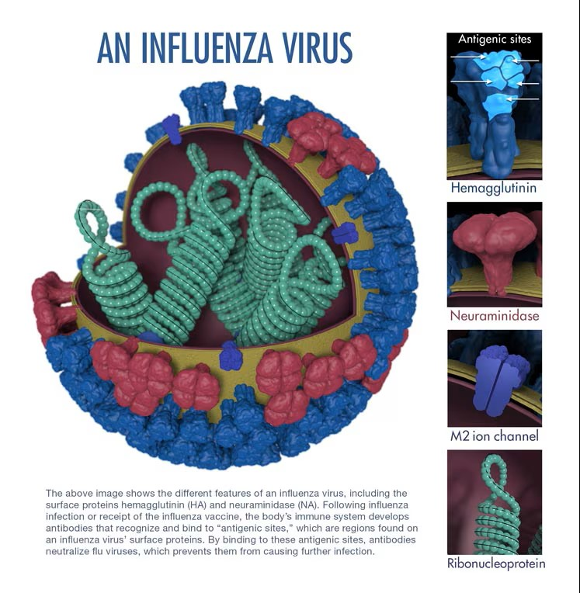
An influenza virus

Slide 6
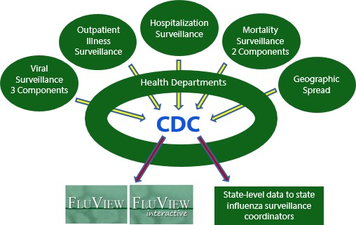
Overview of US Influenza Surveillance
Weekly Updates at http://www.cdc.gov/flu/weekly

Slide 7
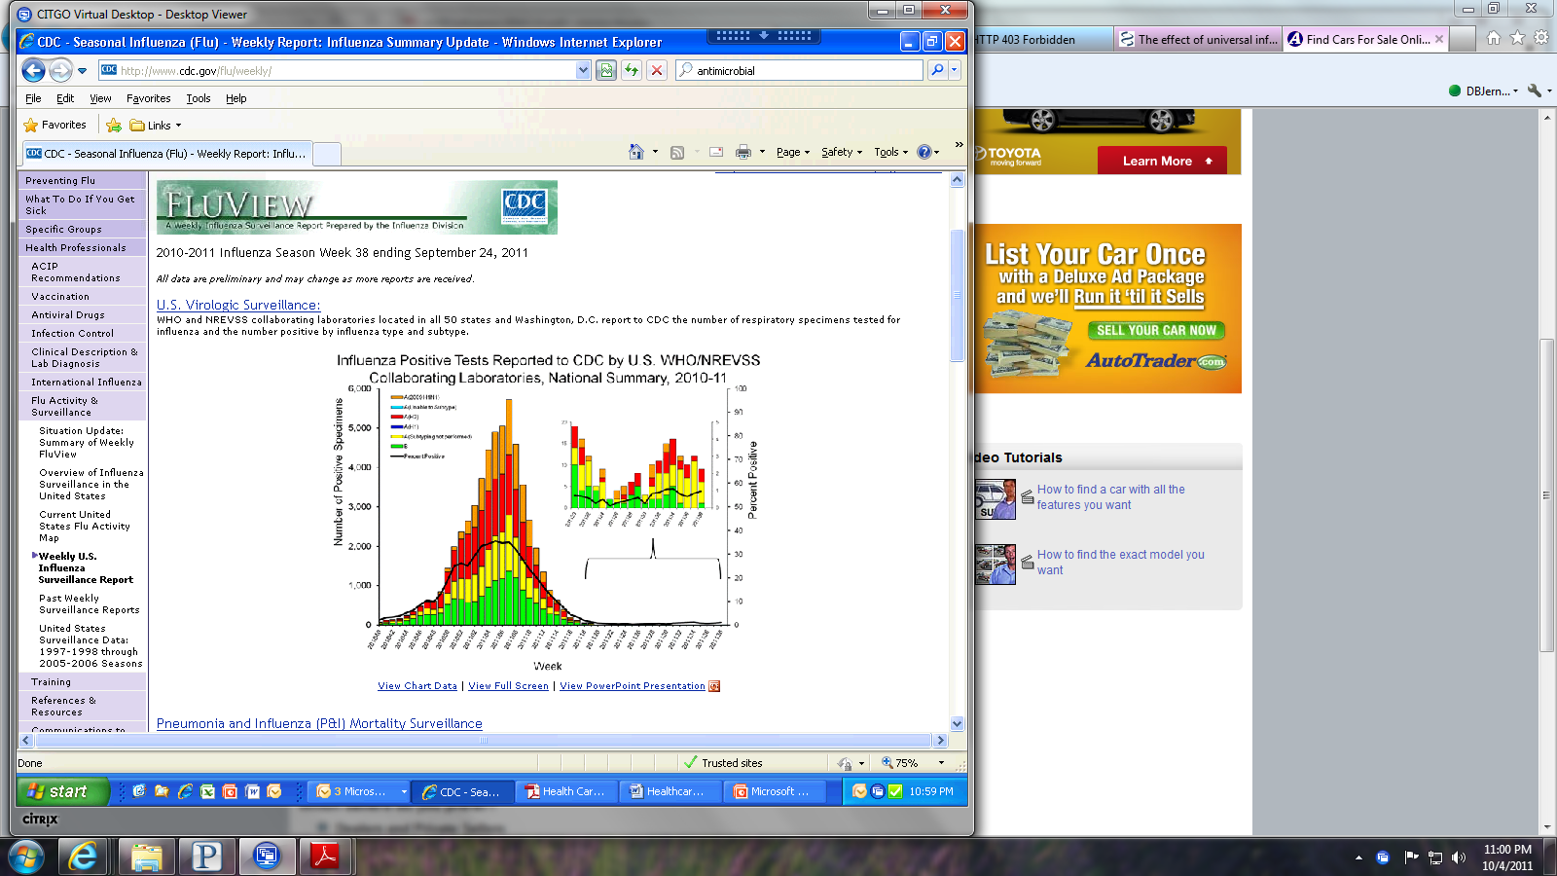
U.S. Influenza Surveillance Components
Viral Surveillance
  US Public Health Laboratory Surveillance and Characterization
  National Respiratory and Enteric Virus Surveillance System (NREVSS)
  Novel Influenza A Reporting

Slide 8

Novel Influenza A Virus Reporting
Novel Influenza A is Nationally Notifiable
Clinical laboratories that perform influenza virus subtyping should report any Influenza A positive that is tests “unsubtypable” by H1N1 or H3N2 assays
  Residual specimen should be sent to a public health laboratory for additional testing

Slide 9
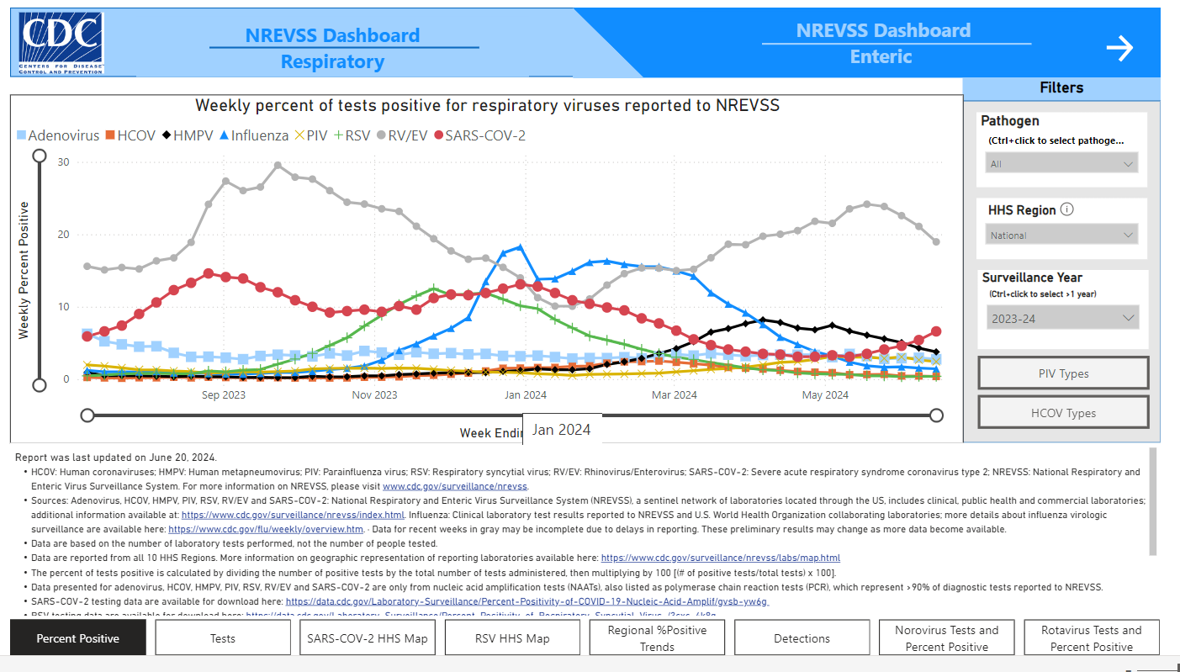
Nationally Respiratory and Enteric Virus Surveillance System

Slide 10
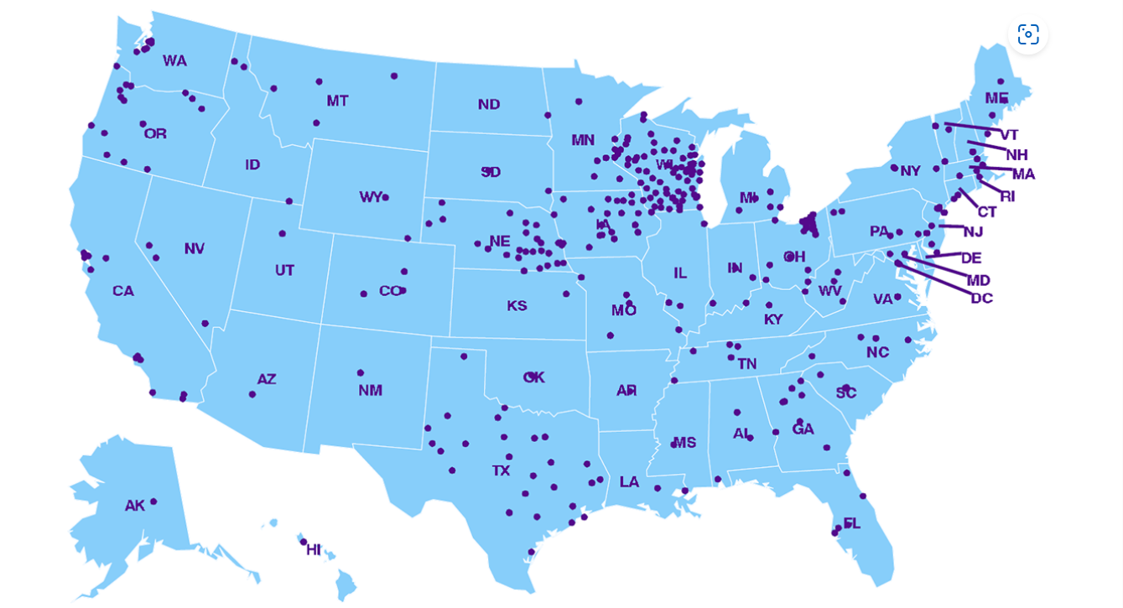
Map of Participating NREVSS Laboratories

Slide 11
FluView Interactive

Slide 12
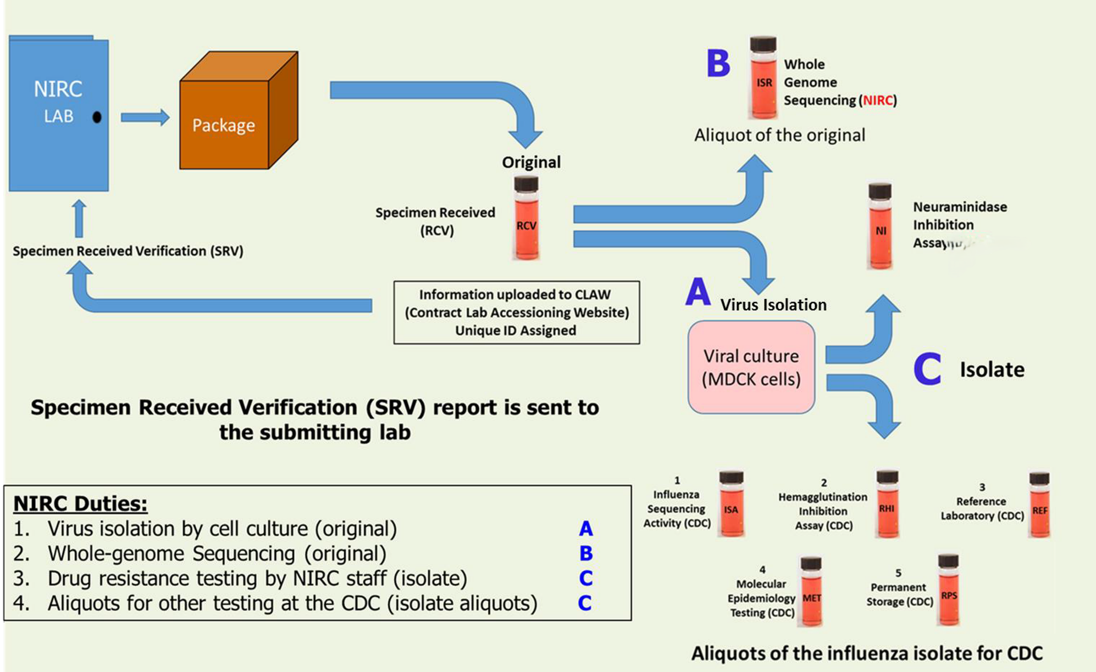
National Influenza Reference Centers (NIRCs)
Wisconsin – New York – California

Slide 13
Objectives of Public Health Laboratory Influenza Virologic Surveillance

Slide 14


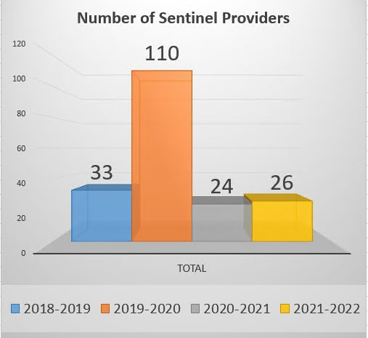
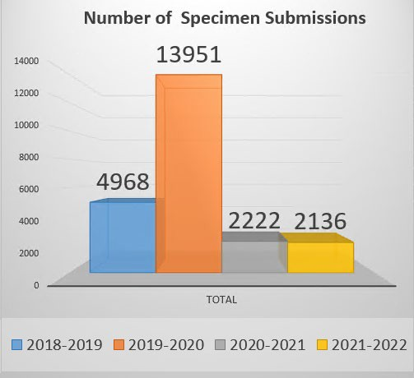
We Can’t Do it Without You!
www.aphl.org

Slide 15
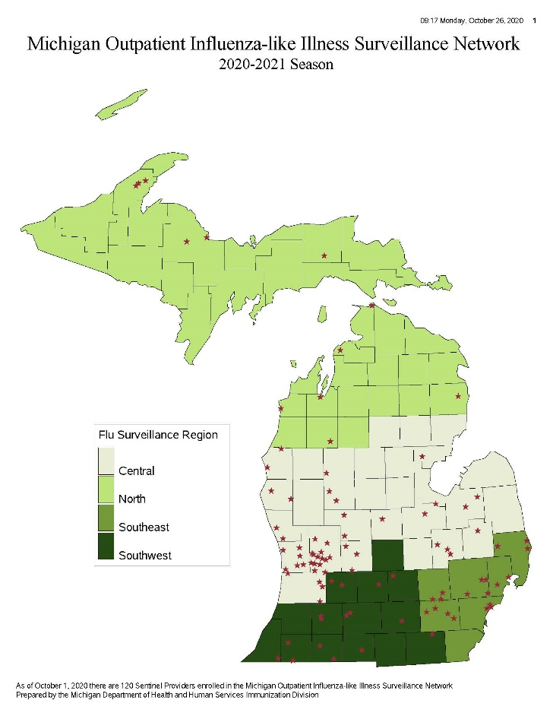
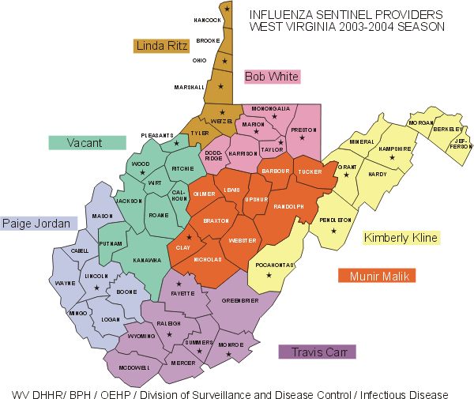
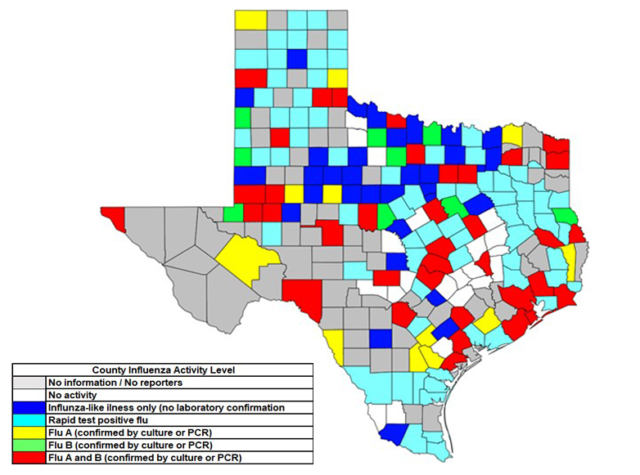
But It Looks A Little Different Everywhere

Slide 16
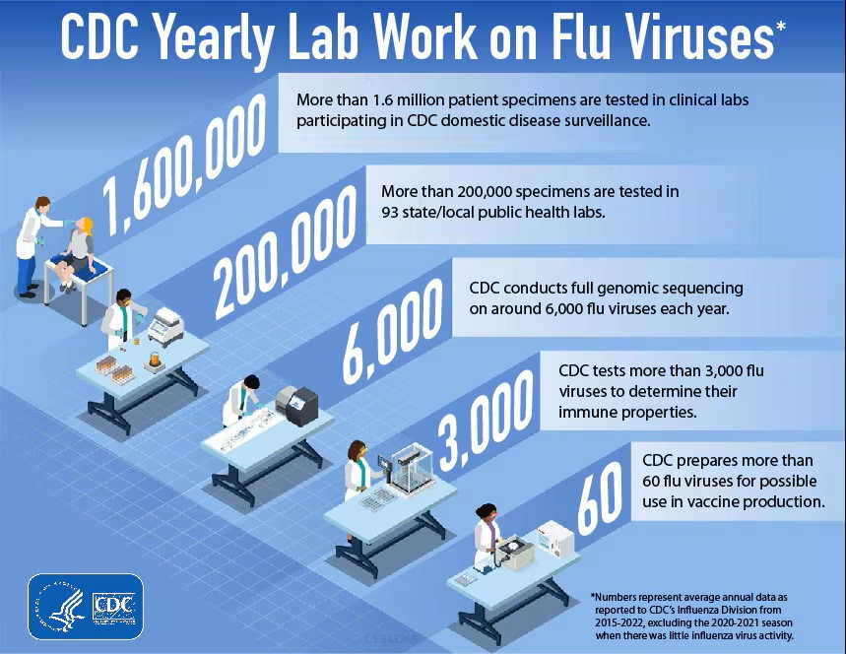
CDC Yearly Lab Work on Flu Viruses

Slide 17

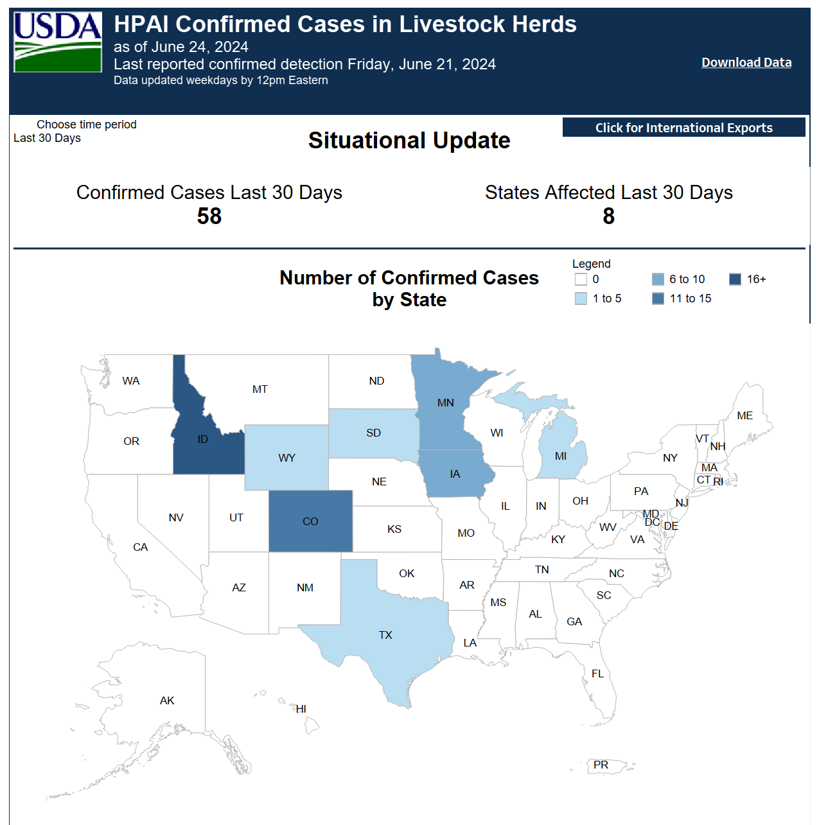
H5N1 in Dairy Cattle Partnership in Action

Slide 18
2024 Enhanced Summer Surveillance Guidance
Symptom monitoring among workers and others with recent exposures to HPAI A/H5 infected animals on farms or other locations.
Conduct outreach and education to people exhibiting animals (specifically swine, cattle and avian species) at or attending agricultural fairs.
Encourage ongoing influenza testing (preferably RT-PCR) of individuals with compatible illness throughout the summer, particular for persons with recent history of relevant exposures.
Enhance surveillance for novel influenza detection among severely ill patients by subtyping influenza A positives specimens from patients hospitalized or in the ICU.
Enhance surveillance for novel influenza A detections in the community by maintaining the flow of influenza positive specimens to and subtyping of influenza A positives by PHLs and investigation of unexplained clusters of respiratory illness.
Monitor influenza surveillance data for unexpected patterns.
Local data anomaly detection and investigation.

Slide 19
Lessons Learned and Best Practices
Strong clinical and public health laboratory partnerships are critical to maintaining a robust national influenza surveillance system.
Although each state’s system looks a little bit different, providing site specific data reports, certificates and continuing education opportunities are good incentives to encourage participation.
If there is something that would make it easier for clinical laboratories to participate, they should share that with their state or local public health laboratory.

Slide 20

Thank you and Questions

Slide 21
Listeria Infections Linked to Soft Cheeses
Kirsten Larson, MPH
Association of Public Health Laboratories (APHL)

Slide 22
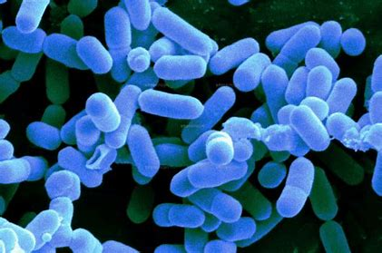

AN OUTBREAK IS DETECTED
CDC detects cluster of Listeria in December 2017
  Common pulsed-field gel electrophoresis (PFGE) pattern
  8 cases from 5 states (June 2014- November 2017)
  7 of 8 cases report Hispanic ethnicity
  6 cases report consuming queso fresco and cotija style cheeses
Georgia conducts an inspection of a retail establishment
  Food and environmental sampling are negative
No specific brand or type of cheese can be implicated
Outbreak closed in March 2018

Slide 23
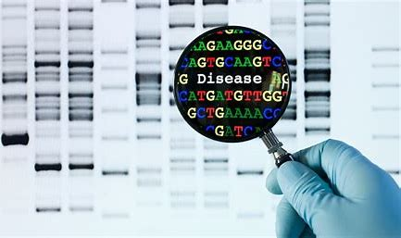
IMPROVING FOOD SAFETY SYSTEMS VIA PULSENET
As outlined in CIFOR Guidelines for Foodborne Disease Outbreak Response (www.cifor.us), two general methods used to detect outbreaks
  Pathogen-specific surveillance
  Complaint systems
PulseNet- main pathogen-specific surveillance system used by CDC to detect foodborne disease outbreaks (FBOs)
  National network of local, state and federal public health laboratories
  Uses bacterial DNA fingerprints to connect foodborne illness cases
Clinical laboratory partners contribute by providing foodborne illness isolates or specimens to public health

Slide 24
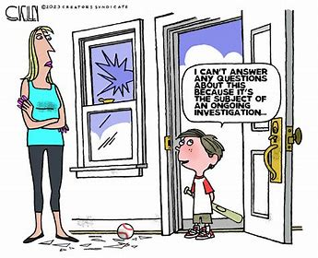
AN OUTBREAK RE-APPEARS
In August 2021, CDC reopens the Listeria cluster
  Three new matching cases within a 120-day timeframe
  Total of 21 cases from 10 states, all closely related by whole genome sequencing (WGS) (June 2014- November 2021)
  Nineteen cases (90%) report Hispanic ethnicity
  Fourteen of 19 interviewed report various brands of soft cheeses
  Most common cheese reported is queso fresco (12/14)
CA, CO, NV, TN and TX test numerous cheese samples from multiple retail establishments, all negative
FDA completes inspection and sampling at several firms
  All product, environmental and water samples negative
CDC and FDA close investigation in January 2022

Slide 25

EMERGING TECHNOLOGIES IN CLINICAL AND PUBLIC HEALTH LABORATORIES
PulseNet has transitioned from PFGE to WGS
  WGS provides several advantages over PFGE
Clinical laboratories are transitioning to culture-independent diagnostic tests (CIDTs)
  CIDTs offer several advantages to clinical community!
  CIDTs don’t provide an isolate
Public health continues to need isolates or specimens
  Working toward culture-independent methods
About PulseNet | PulseNet | CDC

Slide 26

AN OUTBREAK IS RE-OPENED AND SOLVED!
January 10, 2024, HI PHL reports positive cheese sample
  Matches Listeria cases from 2017-2021 cluster via WGS
  Sampled as part of FDA Laboratory Flexible Funding Model Program
  Aged cotija cheese produced by Firm A
  Firm A issues an initial recall on 1/11/2024, this will expand to include several additional products
CDC reopens the investigation on January 18
  Twenty-six illnesses from 11 states, No additional illnesses were identified after the investigation opens
  Twenty-two patients report Hispanic ethnicity.
  Sixteen of 22 cases interviewed report Queso Fresco type cheeses, 14 queso fresco, and 3 report cotija.
FDA initiates an on-site inspection at Firm A on February 5.
  Two environmental samples test positive for Listeria
  Match cheese and human cases via WGS.
CDC continues to monitor, closes investigation April 8

Slide 27
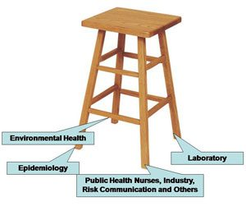
COLLABORATION AND DATA SHARING IS ESSENTIAL
Among disciplines- laboratory, environmental health, epidemiology, regulatory program(s), industry, PIOs
Across all levels of government- federal, state and local agencies
Within laboratory systems- clinic, reference, public health, human and animal food laboratories
Credit: Tennessee Integrated Food Safety
Center of Excellence

Slide 28
Lessons Learned
CIFOR Guidelines for Foodborne Disease Outbreak Response (www.cifor.us)
  Provides model practices for foodborne disease outbreak preparation, detection, investigation, control and follow-up.
Pathogen-specific surveillance through PulseNet
  Most robust method for detecting multistate foodborne disease outbreaks
  Relies on collaboration and data sharing among clinical and governmental laboratories
WGS offers several advantages over PFGE but still requires isolates
CIDTs offer several advantages over traditional methods but do not provide isolates
Collaboration across disciplines, all levels of government and within laboratory systems is essential for robust foodborne disease outbreak detection and response

Slide 29

Q&A

Slide 30
CMLE Credit Claiming for Today's Webinar
Claim 1 CMLE credit for this webinar from the ASCP Store
Instructions will be emailed to live attendees tomorrow 6/27 (via Zoom)
Credit claiming is only available within 1-month of the webinar date

Slide 31

THANK YOU FOR ATTENDING!
Celebrating YOUR successes
  99% of attendees reported learning something new
  Webinar attendance exceeded attendance from Series 1
  Attendee Demographics:
    Academic hospitals
    State public health labs
    Laboratory-associated non-profit organizations
    Non-academic hospitals
    Academic research laboratories
"I think the topics to date have been timely and relevant to our work in labs."
"Very Interesting topic, I always like listening to ways to be more inclusive and to learn about opportunities that I can share with peers. "
"This was great, smooth, and flowing, and the panelists were knowledgeable."

Slide 32

Missed or want to revisit a past
Building Bridges webinar?
Check out: https://www.supportcdconelab.org/
Navigate to the Virtual Learning tab for:
Building Bridges Series 1 & 2 recordings
Summarized best practice reports from each session

Slide 33

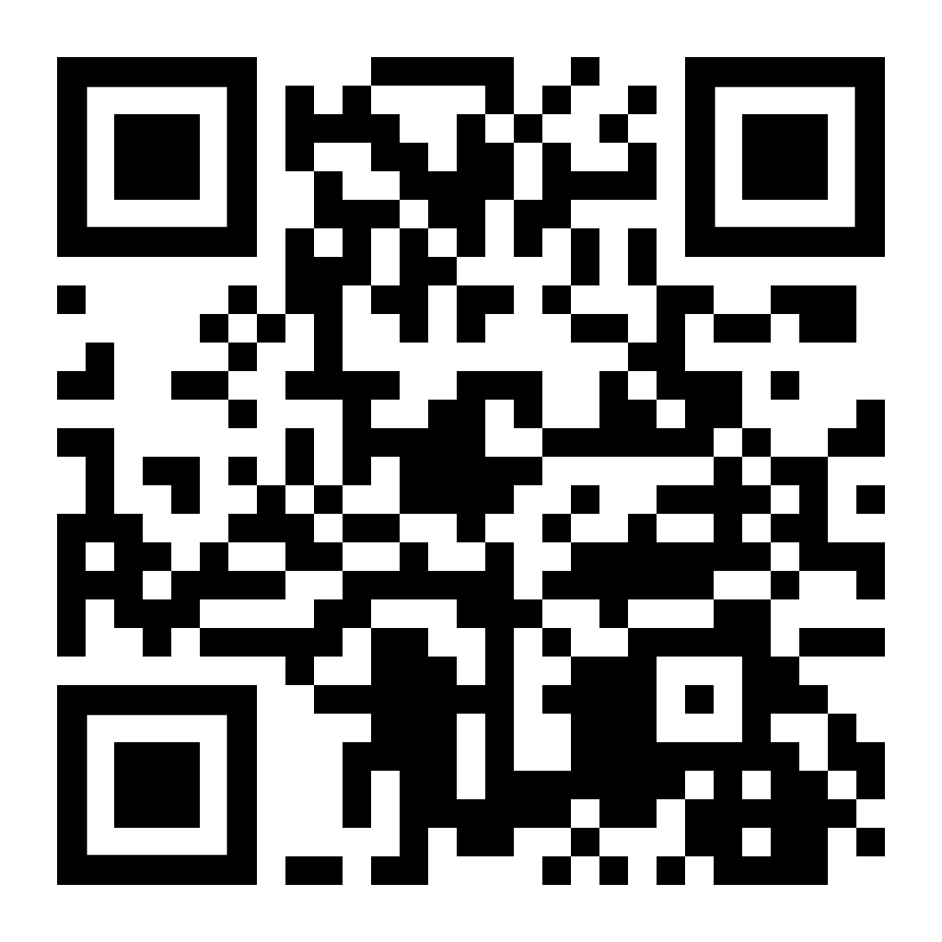
Looking ahead to Building Bridges Series 3
We are looking for Laboratory Professionals from various lab sectors to share their career trajectory
Feature unique collaborations/partnerships that shaped their careers
If you have a recommendation on someone to consider, please email us at grants@ascp.org
Stay tuned for the next series coming in 2025!
Info will be available at:
supportcdconelab.org

Slide 34
Thank you for attending!
More info at:
supportcdconelab.org
Or email us at:
grants@ascp.org
Partnerships in Service of Effective Data Sharing

