Slide 1
Twinning and Sharing Best Practices: Regional Partnerships Lorelei J. Kurimski, Tina Su, Ryan Bernard, John Laurance IV, Jason Wholehan, Dr. Christine Bean, Jill Power
Building Bridges Across the Laboratory Community – May 15, 2024

Slide 2
Funding Statement
This resource was made possible by cooperative agreement NU47OE000107 from Centers for Disease Control and Prevention (CDC). Its contents are solely the responsibility of the American Society for Clinical Pathology (ASCP) and do not necessarily represent the official views of CDC.

Slide 3
Format of Today’s Session
Introduction of Subject Matter Experts & Case Study
Case Study 1: Regional Consortia and Peer-to-Peer Learning with the State Hygienic Laboratory at the University of Iowa and The Missouri State Public Health Laboratory
Case Study 2: Twinning Best Practices
Case Study 3: Public Health Laboratories meet Clinical Laboratories
Q & A Session
Session Wrap-Up
Next month’s webinar
CMLE Credit Claiming
Resources

Slide 4
Regional Consortia and Peer-to-Peer Learning
Presenters: Lorelei Kurimski & Tina Su, APHL
Ryan Bernard, MO PHL
May 2024

Slide 5
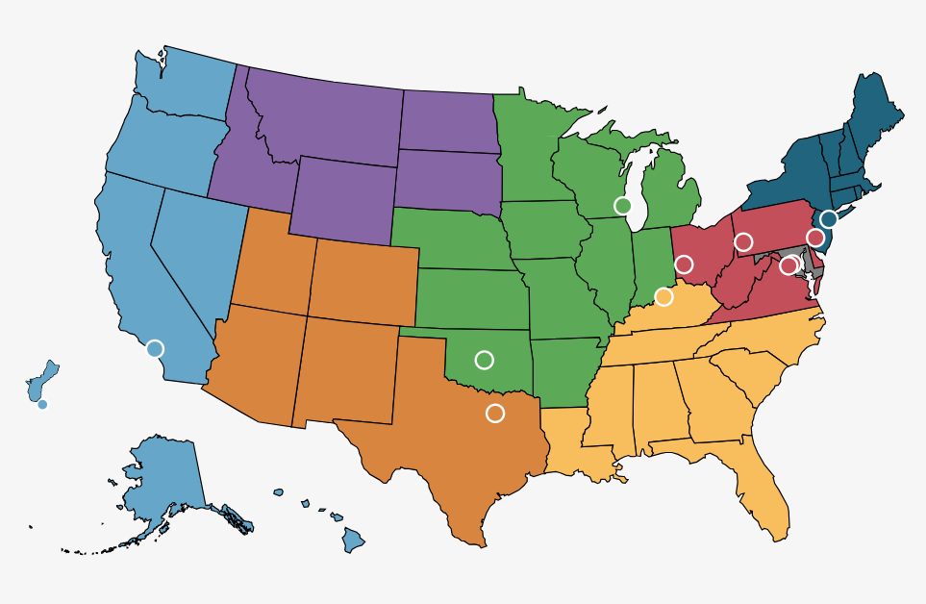
Understanding the Regional Consortia

Slide 6
Understanding the Regional Consortia1
Allow members to share testing services, expert guidance and resources with participating laboratories:
Sponsor workforce development and training events
Sharing testing services, resources and samples for validation
Lead quality improvement projects and collaborate on research studies
Engage in peer-to-peer learning

Slide 7
Peer-to-Peer Sharing with the State Hygienic Laboratory at the University of Iowa and The Missouri State Public Health Laboratory Ryan Bernard
Notes:
Peer to Peer sharing 2/21/23-2/23/23

Slide 8
Review Background and Initiation
Identify a Public Health Lab that is comparable in operation
Propose review terms with the partner and determine if the terms are agreeable
Develop a portfolio plan with partner and prepare to execute and rollout
Notes:
MSPHL wanted to review a peer that was similar in nature and operation to find some common ground. The proposed budget with the number of staff members dictated the scope of travel to the US Midwest. Utilizing APHL`s PHLSD and peer to peer networking through common LIMS system we landed on SHL. SHL Laboratory Support Services Director Sherri Marine acted as a lesion between myself and MSPHL Informatics Manager Shanna West.
SHL similarities MSPHL Statewide Courier Mailroom Kit Operations Utilizes OpenELIS Sherri, Shanna and I discussed what each of our expectations would be if the proposed plan took place and how to minimize business impact but still maximizing the overall exposer of the teams involvement. Discussions evolved on median specimen days landing on Wednesday and Thursday of the week with the proposed review and observation scope. Each team then went back to their respected management for approval. After we both received the green light.
We started working out dates for travel and the visit.

Slide 9
Peer-to-Peer Objectives
Share resources, services, and information between the Missouri State Public Health Laboratory (MSPHL) and the State Hygienic Laboratory at the University of Iowa (SHL)
Compare processes to potentially save money, reduce waste, and build a pathway for information sharing
Continue to grow and evolve as technology advances and public health demands change

Slide 10
Sharing Resources, Services, and Information
Focus areas:
Support Services: mailroom operation and staffing
Kit Components, Inventory
Support Services: Accessioning Operation and Staffing
Courier Drop Off
Informatics
Data Entry Team
Environmental
Clinical
Newborn Screening

Slide 11
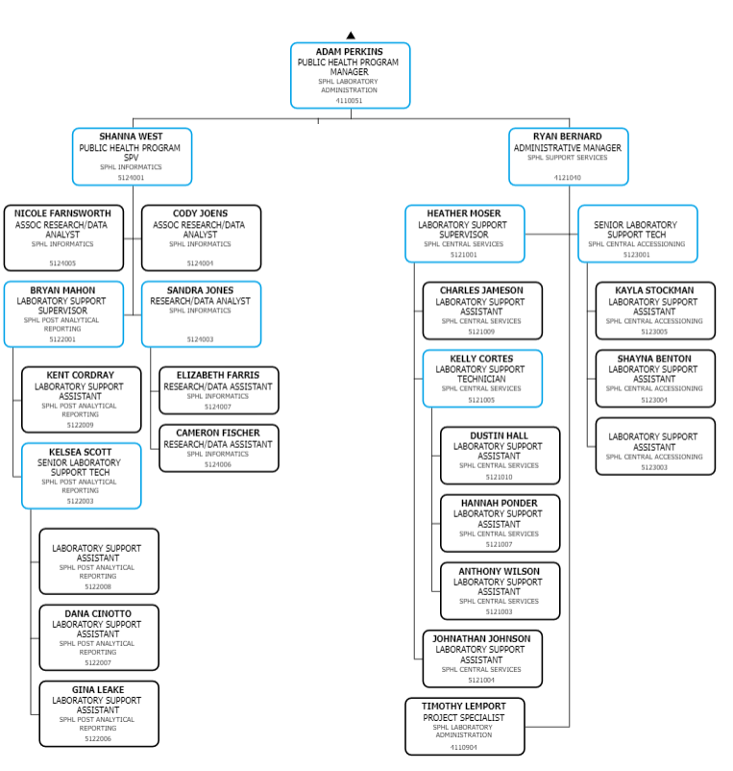
Focus Area Support Area Kit Packaging
Comparing org charts MSPHL is at 27 and SHL is at 29
Notes:
At the point of the Peer to Peer sharing MSPHL and SHL are similar in structure. Reporting structures include Data Entry, Accessioning, and Mailroom/Shipping operations. Difference noted are assigned duties, and scope of work in the laboratory. Where MSPHL was more involved with respiratory specimens SHL was more involved with necropsy. The FTE comparison was also similar with 29 at SHL and 27 MSPHL. FTE themselves differ position description and their status. SHL being connected through university enable a unique recruiting strategy, that can not be duplicated with the university and health lab union.

Slide 12
Support Area Central Services Kit Production
Support Services: mailroom operation and staffing
Virtually equal in Headcount/Kit Components
Differences observed in expectations SHL:
Necropsy
Kit Production specialized to staff
Cross functional
Notes:
SHL and MSPHL specimen counts were found to be similar in nature and in volume.
SHL and MSPHL and were found to be comparable in nature and structure. Although SHL is ahead of MSPHL in its cross function application.
MSPHL is comprised of 22 FTEs, SHL has 23 (not including Ankeny)
The similarity in processes were perfect for an external evaluation of processes. Whats going well, whats not?
MSPHL lacks the cross functionality that was observed at SHL, although there was some specialized staff for kit production it was discussed they have a plan to cross train the staff in those designated areas. MSPHL has been pursuing cross training.

Slide 13
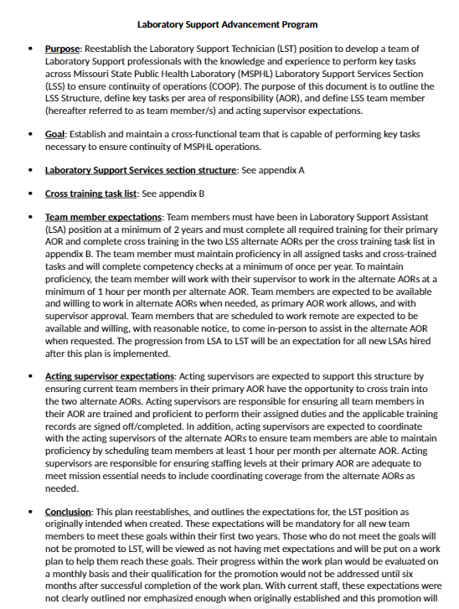
Lessons Learned Support Area Central Services
Support Services: MSPHL Improvements Post-Visit
Developed a support services step series
Increase cross-functional expectations
Notes:
SHL and MSPHL specimen counts were found to be similar in nature and in volume. SHL and MSPHL
SHL and MSPHL and were found to be comparable in structure. Although SHL is ahead of MSPHL in its cross-function application.
MSPHL took a look at our own internal operations and established a baseline of expectations across our support services functions and built the Laboratory support advancement program. This is a training program where an interested employee can completed a series of tasks and proficiencies cross train into the other support series function to earn a carrier latter step can cross train into the other support series functions.

Slide 14
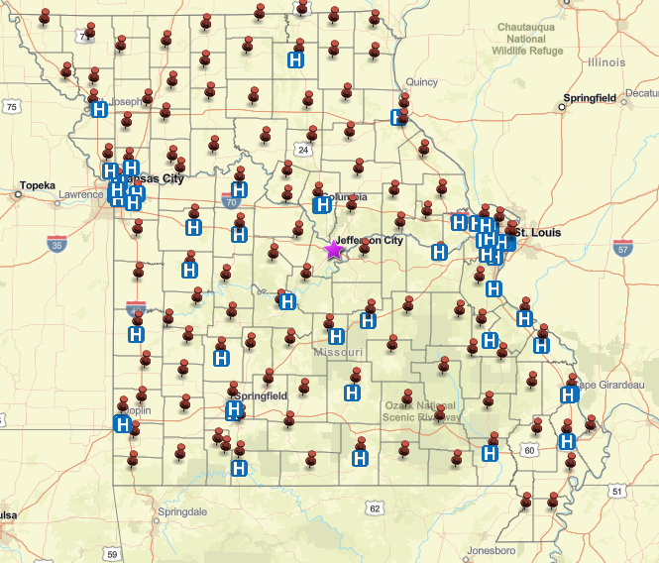
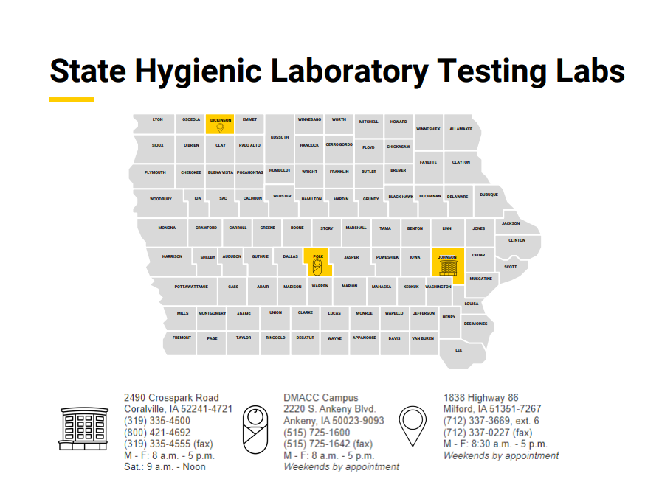
Support Area Central Accessioning
Support Services: Accessioning Operation and Staffing
Specimen quantities
Differing onsite quantities
Start time variance -0.5 hours
Similar work scope
Statewide Courier
On demand pickup
No set pickups
Accountability 100%
Notes:
SHL and MSPHL specimen counts were found to be similar in nature and in volume. Although the separation between Ankeny and Coralville create a different dynamic in testing volumes. Environmental specimens differed substantially, where-as clinical (covid) numbers were extremely different between MSPHL and SHL.
Start time were a topic of conversation at MSPHL routine is to test and work up specimens first thing every morning when the volume is its highest.
MSPHL starts Accessioning at 6am, but has the capabilities to start at 4am if needed- SHL starts there accessioning operates at 530. Both parties see benefits from their individual start times.
Another similarity noted through pre-peer to peer sharing was that each health lab has a statewide courier, and per capita have a similar population. It was noted that MSPHl courier contract was under revision and review at this time. It was noted through non-conformances specimen accountability at MSPHL was lacking, where as SHL could identify specimens to the exact specimen through a scanning system.

Slide 15
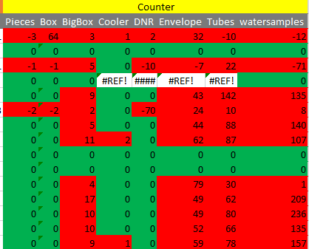
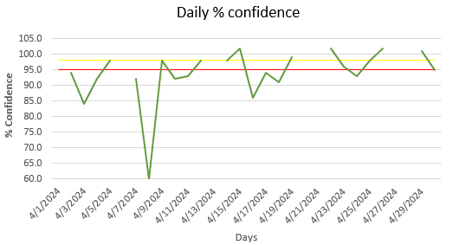
Lessons Learned Support Area Central Accessioning
Support Services: Accessioning Operation and Staffing Post Visit
Start times haven’t changed although it`s still a topic of conversation from capacity
Courier Improvements have been made to mock SHL reconciliation process
Notes:
SHL courier specimen accountability was extremely impressive considering the volume of specimens that cycles through on a daily basis.
SHL had and utilized the ability to reconcile packages to 100% on a daily basis.
MSPHL took this into consideration when reviewing and editing its Courier contract.
The internal evaluation showed a large variance between the portal, physical documentation, and what was attained at MSPHL .
Although MSPHL could not achieve the level of granularity it has been able to track individual package counts to decivery concerning events. The project has now reached 30 day maturity and shows an extremely positive turn around from where it was 45 days. Prior to the Courier Improvement project we were average +/-80 count standard deviation leaving MSPHL with <5% confidence between pickups and received items. With the improved project we are now averaging 94% confidence between what's picked up and received at MSPHL. I expect the trend to only improve with the advancements made at MSPHL and the courier itself.
There is still room for improvement in the process for the first 30 days into the new contract period with the contractor I`m extremely optimistic in the results improving.

Slide 16
Support Area Informatics/Data Entry Team
Support Services: Informatics/Data Entry Team
Environmental
Clinical
Newborn Screening
Notes:
SHL and MSPHL specimen counts were found to be similar in nature and in volume. SHL and MSPHL
Spent an extra day review processes remote session but ultimately found they were OpenELIS to the same capacity as SHL. There were slight variation in a FTE time allocation to the process but the software was being utilized in its totality. Conversation between SHL and MSPHL continue as we look to advance ourselves in the world of Public Health.

Slide 17
Lessons Learned for a successful Peer-to-Peer review
Clear communication
Mutual Respect and Understanding
Shared vision and goals
Notes:
Clear communication
Mutual Respect and Understanding
Shared vision and goals
In order for a lab twinning partnership to be effective, communication between the two partners must be clear, open and consistent. This includes setting goals and expectations for the partnership, as well as regularly updating each other on the progress and challenges.
Being a good, twinned partner means showing respect for you and your partners expertise, culture, and ways of working. It is important to approach the partnership with an open mind and willingness to learn from each other.
Successful twinning partnership is built on a shared vision and common goals. It is important for both partners to have a clean understanding of what they hope to achieve through the partnership and to work together toward those goals.
In a good partner, I look for someone who is collaborative, open-minded, and committed to the success of the partnership. They should be willing to listen, learn and adapt, and be proactive in sharing solutions to challenges that arise. Additionally, a good partner should be respectful, communicative and willing to work together towards shared goals.

Slide 18
Conclusions
5 employees from MSPHL were able to observe like processes and explore mirror processes
MSPHL was able to leverage the lessons learned through the Peer-to-Peer learning to better its agency and its partners
MSPHL and SHL have been able to utilize the peer-to-peer experience to leverage like parties for public health lab advancements
Notes:
Share resources, services and information with Missouri State Public Health Laboratory (MSPHL) and the State Hygienic Laboratory at the University of Iowa (SHL) one another
Compare processes to potentially save money, reduce waste, and build a pathway for information sharing
Continue to grow and evolve as technology advances and public health demands change.

Slide 19
Special Thanks
APHL and Bertina Su - for helping fund PHL mission to better public health by Peer to Peer sharing between MSPHL and SHL.
Iowa State Hygienic Laboratory Management and Sherri Marine + Team - for helping coordinate and facility MSPHL for 2 days. The experience was phenomenal, and the staff was extremely welcoming.
MSPHL - for allowing 5 employees to step away from their daily duties to take advantage of such a great opportunity.
Notes:
Share resources, services and information with Missouri State Public Health Laboratory (MSPHL) and the State Hygienic Laboratory at the University of Iowa (SHL) one another
Compare processes to potentially save money, reduce waste, and build a pathway for information sharing
Continue to grow and evolve as technology advances and public health demands change.

Slide 20
Building Bridges: Twinning Best Practices
Jason Wholehan
John Laurance

Slide 21
Training Partner Exchange
APHL coordinated knowledge exchange
Bioterrorism Training Coordinators
Michigan and Alaska PHLs participated
Traveled to spend time sharing and learning from each other
Short video to introduce the exchange
Notes:
To improve and enhance outreach and training provided by public health laboratories APHL, the Association of Public Health Laboratories piloted a training partners exchange.

Slide 22
Association of Public Health Laboratories piloted a training partners exchange
Notes:
In 2023 to improve and enhance outreach and training provided by public health laboratories APHL, the Association of Public Health Laboratories piloted a training partners exchange.
For this first round of this exchange project Michigan and Alaska were selected and paired together.
The goals of the program are to give public health lab trainers an opportunity to spend time with a partner at their host laboratory to experience different approaches to training. We were expected to share best practices and experiences with outreach.
To begin the exchange Jason from the Michigan lab traveled to Alaska to meet John. John faces many unique challenges in laboratory training while covering the largest state in the union. He has become a very experienced public health lab trainer who also leads the biothreat response lab in Alaska. During my visit we able to have in-depth discussions about training perspectives, approaches and processes. Next John took me to a regional hospital in Bethel, which is in western Alaska, to see his training approaches in action.
John has developed some great in-person training such as his biothreat bacterial identification and biosafety.
Yukon Kuskokwim delta regional hospital is fairly typical of sentinel microbiology laboratories in Alaska. YKD is geographically isolated and must be prepared to respond to public health emergencies. They serve a largely indigenous population and therefore signage at the hospital are bilingual. Posted in Yup’ik and English
We joined the scientists at Yukon Kuskokwim in their lab to deliver some hands-on training in biosafety and biothreat bacterial identification. John also held a packing and shipping of infectious substances class. The staff loved the practical training in biosafety cabinet usage and getting to see the biothreat bacteria in their own lab.
John made the return trip to Michigan. While Michigan isn’t nearly the size of Alaska, I face many similar challenges in providing outreach to my rural partners spread throughout northern Michigan and the upper peninsula. It was great to share ideas and learn best practices from John.

Slide 23
Importance of Knowledge Exchanges Why is it important for the Lab community to share experiences
Many roles in Laboratory
We all wear many hats
Safety, Preparedness, Education, etc.
Notes:
So why are knowledge exchanges and sharing experiences important for laboratories.
We all have many roles to play in the lab, it can feel like you are juggling many hats all at once. People in positions like John and I jump back and forth from safety to preparedness to education, and on and on.

Slide 24
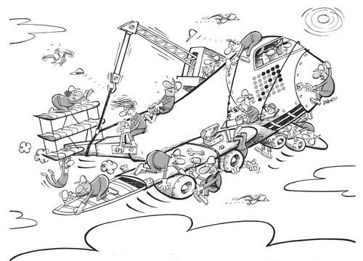
Importance of Knowledge Exchanges Why is it important for the Lab community to share experiences1
Many roles in Laboratory
We all wear many hats
Safety, Preparedness, Education, etc.
Thrust into new roles
We all bring strengths and weaknesses
Need to perform at a high level for partners/patients
Laboratorians building the lab while also flying a plane
Notes:
And often it is difficult to accumulate all the necessary knowledge before taking on any role in lab. They can’t teach you everything in your undergrad. There are always new topics to master, new things to learn, and on and on and on. And we always have to do our best for our partners and patients. Sometimes this can feel like you’re building the plane while flying, gather knowledge and expertise as you go.

Slide 25
Importance of Knowledge Exchanges Why is it important for the Lab community to share experiences2
Many roles in Laboratory
We all wear many hats
Safety, Preparedness, Education, etc.
Thrust into new roles
We all bring strengths and weaknesses
Need to perform at a high level for partners/patients
Building connections and networks of professional colleagues to learn and grow
Notes:
Staying connected to professional organization, ASCP, APHL, etc, and gaining new skills sets is vitally important. Having this experience with John and getting to slow down for a few days and observe another professional was a great way to gather that knowledge.

Slide 26
Lessons Learned
How to be a good twinning partner:
Have a schedule and make a plan
But leave plenty of space for open discussion
Be sure to include time with other SMEs to broaden the knowledge base
Notes:
So, some lessons learned about how to be a good twinning partner: John and I created action packed schedules for this exchange, but we also kept things open and flexible to see where our partner’s interests took the discussion. We set aside plenty of time for feedback so the exchange wasn’t just a knowledge dump of here’s what I do, isn’t that great! And since there is always so much going on in a public heath lab we made sure to introduce and spend time with other SMEs thought-out the lab for additional points of view.

Slide 27
PHL State Trainer Exchange Program
Division of Public Health​

Slide 28
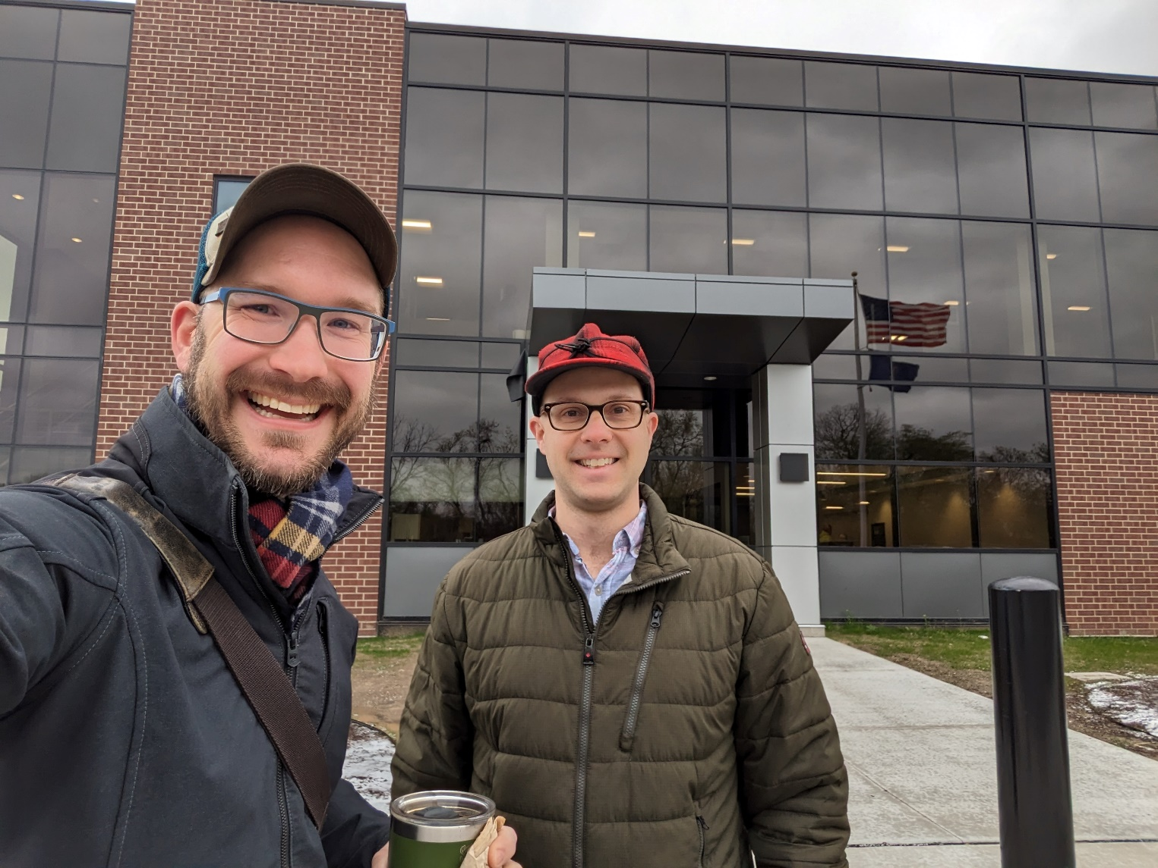
Benefit to Public Health Laboratories
Opportunities to learn from other PHLs with more than just webinars and conference calls.
The chance to see trainings put into practice and actually delivered to the clinical Laboratory.
Understand the barriers and challenges we face in how/where we train.
Knowing that whatever challenges you’re facing in your state, they are similar to other PHLs.
Division of Public Health

Slide 29
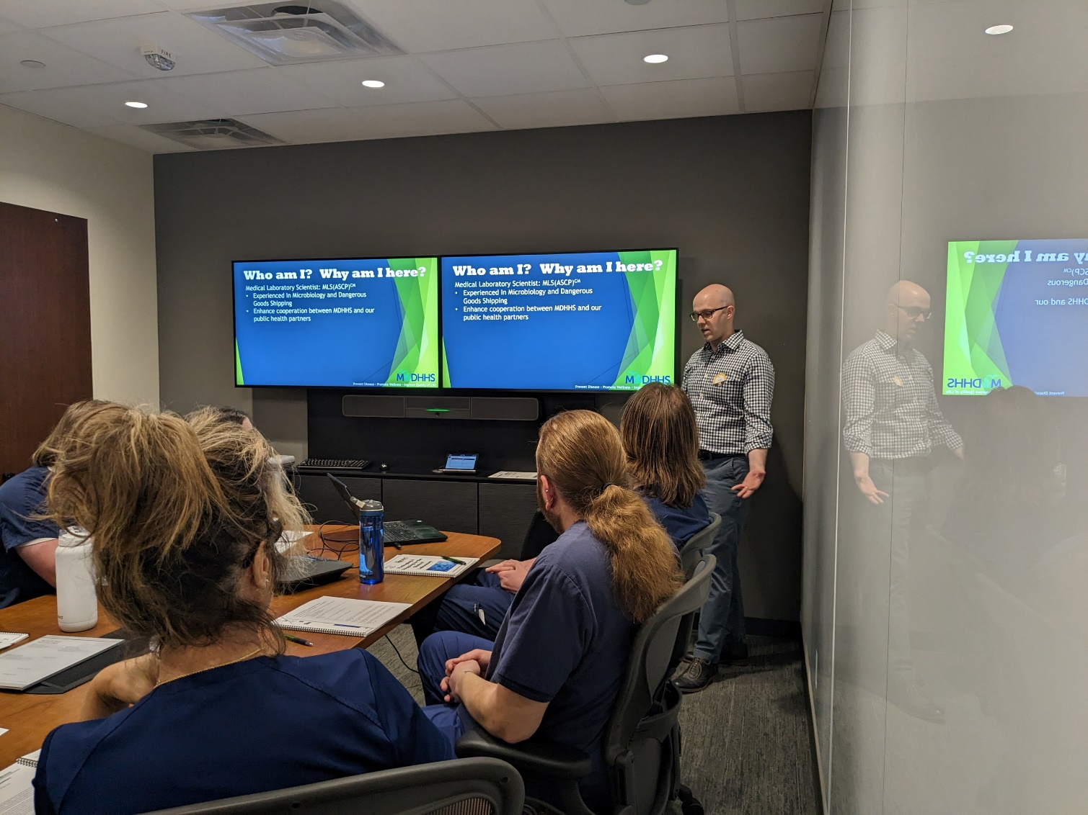
Benefit to Clinical Laboratories
State Public Health Labs are your training resource. These activities strengthen connections between states and provide excellent training opportunities.
Think beyond DOT/IATA packing and shipping, what are training you staff could use not just what they have to have.
If your PHL doesn’t have a training, chances are they know someone who does.
PHLs have the ability to deliver In-Person and facility specific training.
Division of Public Health

Slide 30
Elements of a Great Exchange Program
Be honest about what you want to learn from you partner lab, explore your weaknesses that you’d like to improve. Don’t feel embarrassed if something does need improvement.
Your lab might be really good at something you’d never thought about before, try to offer a lot of unique opportunities to show off your facility.
Take the time to show off your city/state, this might be your partners first time to that area. It also provides context for why your lab might operate the way it does.
Discuss ways to adapt what you learned to your facility. Not every solution another lab has success with can just be dropped into your own. Talk about this with your exchange partner, they might have good ideas on how to make it work.
Division of Public Health​

Slide 31
BIOSAFETY PARTNERSHIP: Building Bridges with Laboratory System Partners
Public Health Laboratories meet Clinical Laboratories
Jill Power, MS, M(ASCP), CMQ/OE(ASQ)
Christine Bean, PhD, MBA, MLS (ASCP)
May 15, 2024

Slide 32
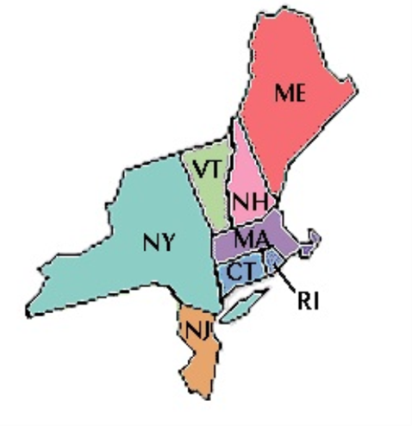
Regional Consortia:
NEEPHLD (NorthEast Environmental & Public Health Laboratory Directors) became a regional working group in the early 1980’s
Lab Directors meet in person 3-4 times per year
Examples of work include:
Sharing best practices
Sharing updates on facility, staffing and funding
Biosafety and Quality programs
Cross training and Competencies
Round robin PT
Drills & exercises

Slide 33
NEEPHLD Biosafety Officers
Nine jurisdictions – Maine, New Hampshire, Vermont, Massachusetts, Connecticut, Rhode Island, New York, New York City, New Jersey
Networking
Training
Outreach - Sentinel Lab Visits
Twinning opportunities

Slide 34
Role of BSO with Clinical Partners:
Biosafety subject matter expert
State/local laboratory liaison
Safety laboratory visit
Risk assessment review
Quality assessment for safety flow of work
Training opportunities
Product updates
Health alerts

Slide 35
Partners – 2018 Northeast Laboratory Safety Symposium
VENDORS –
Fisher
Baker
Local Companies
New Hampshire/Vermont Chapter
Bay State Chapter (Massachusetts)
NEEPHLD

Slide 36
Symposium Highlights
Introduction to Laboratory Safety
Laboratory Acquired Infections
Biosafety
Environmental Health and Safety
Safety Risk Assessments
Laboratory Security
Hands-on Safety Activities – Donning & Doffing, Chemical Spill cleanup, Biological Spill Cleanup, Respiratory Protection
Networking

Slide 37
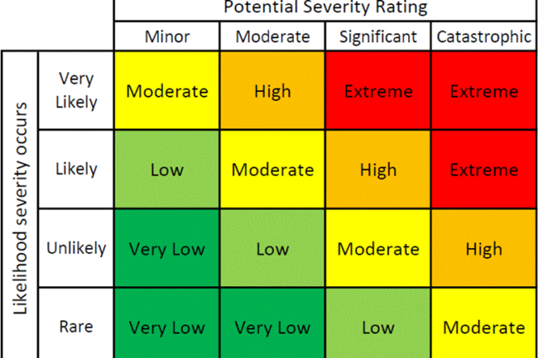
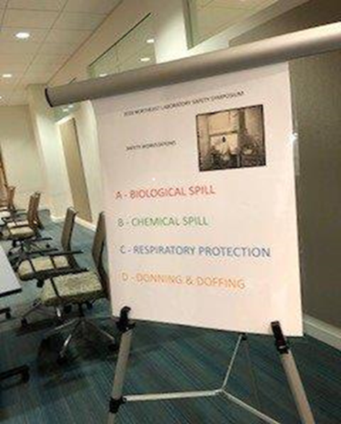
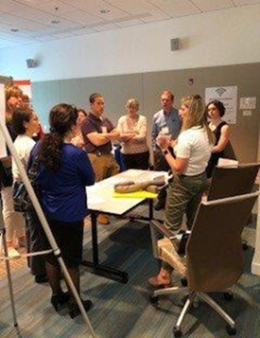
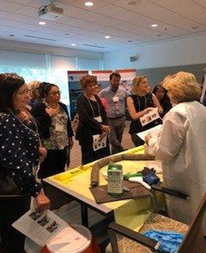
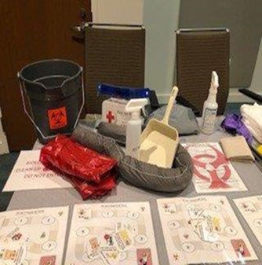
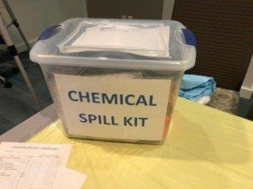
SAFETY ACTIVITIES

Slide 38
Lessons Learned
More programs like this are needed, specifically on safety
Participants identified safety improvements in their labs
How to develop a culture of Safety
BSO SMEs are an available resource to clinical partners
Understand how to perform a safety risk assessment
Regional laboratory partnerships can support each other by:
troubleshooting regionally-shared safety concerns (e.g. natural disasters)
participating in peer-to-peer lab visits
engaging in regionally-relevant regulatory discussions

Slide 39
Q&A

Slide 40
Next Month’s Webinar: June 26th, 11 am – 12 pm CST Partnerships in Service of Effective Data Sharing

Slide 41
Dr. Alvin Ring Empowerment Scholarship for Laboratory Professionals Apply Today!
Application Window: Feb 26 – May 31 2024
Financial aid for higher education or specialization in the medical laboratory sciences
Target candidates:
From underrepresented groups and/or underserved areas
Wide range of educational levels considered: high school seniors to in-service laboratorians
Scholarship range: $1000 - $5000
Help address the laboratory workforce shortage!
Info at: SupportCDCOneLab.org

Slide 42
CMLE Credit Claiming for Today's Webinar
Claim 1 CMLE credit for this webinar from the ASCP Store
Instructions will be emailed to live attendees tomorrow 5/16 (via Zoom)
Credit claiming is only available within 1-month of the webinar date

Slide 43
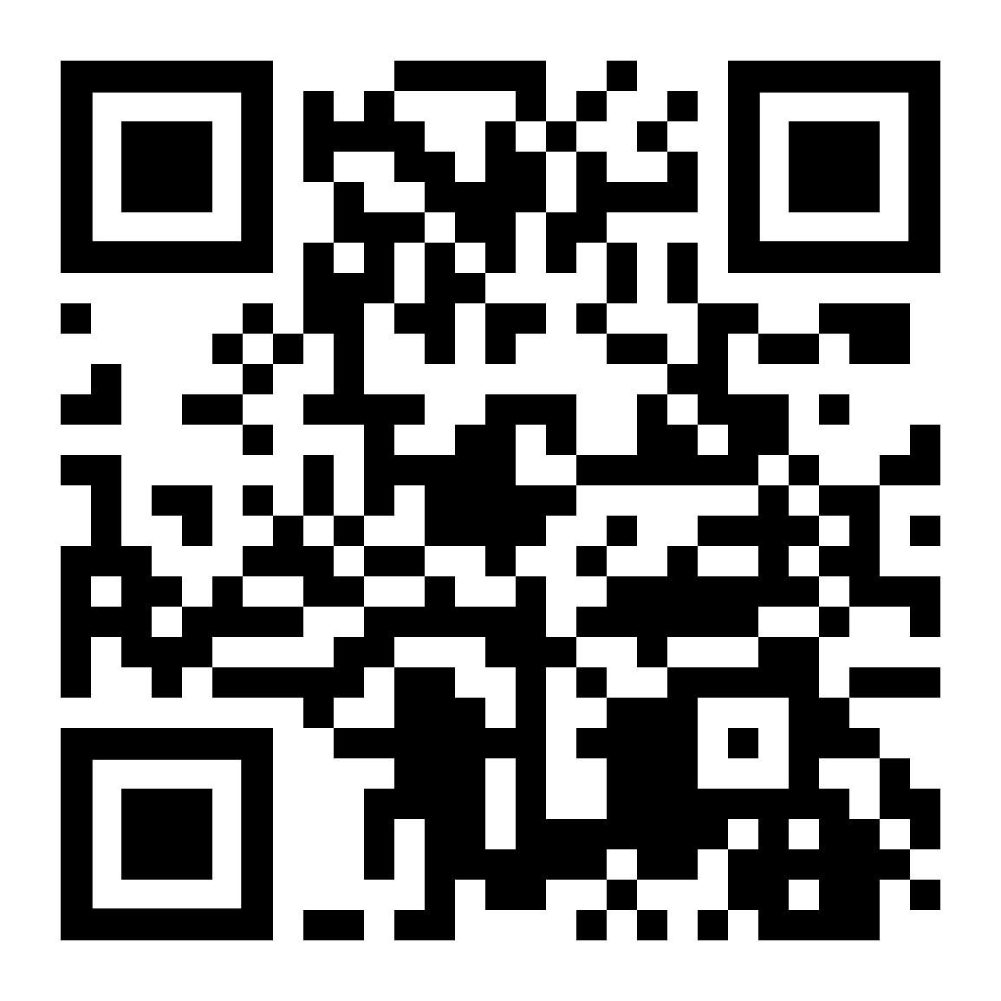
Thank you for attending!
More info at: supportcdconelab.org Or email us at:
grants@ascp.org
Twinning and Sharing Best Practices: Regional Partnerships

