Slide 1
Partnerships Supporting Laboratory Training and Fellowships
Dr. Angela Fritzinger, Dr. Karen Honeycutt, Dr. Kelly Winter
Building Bridges Across the Laboratory Community – April 24, 2024

Slide 2
Funding Statement
This resource was made possible by cooperative agreement NU47OE000107 from Centers for Disease Control and Prevention (CDC). Its contents are solely the responsibility of the American Society for Clinical Pathology (ASCP) and do not necessarily represent the official views of CDC.

Slide 3
Format of Today’s Session
Introduction of Subject Matter Experts & Case Study
  Case Study 1: Public Health Laboratory Sciences Concentration:
  Public Health Laboratory – Academic University Collaboration
  Case Study 2: Collaborations to Increase Educational Opportunities
  Case Study 3: OneLab Lessons Learned
  Q & A Session
Session Wrap-Up
  Next month’s webinar
  CMLE Credit Claiming
  Resources

Slide 4
Public Health Laboratory Sciences Concentration
Public Health Laboratory – Academic University Collaboration
Angela E. Fritzinger, Ph.D.
Division of Consolidated Laboratory Services Richmond, VA

Slide 5



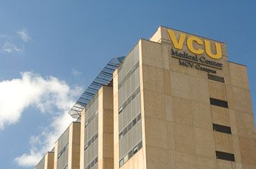
VISION & KEY PRIORITIES
Vision: Bridge Virginia Commonwealth University’s Master’s Degree Program in Clinical Laboratory Sciences with the Public Health Laboratory’s Scientific Workforce Need
Division of Consolidated Laboratory Services (DCLS)
Virginia Commonwealth University (VCU)
Create a talent pipeline of qualified laboratory scientists eligible for public health laboratory scientist positions at DCLS
Address critical gaps in DCLS workforce
Create opportunities for career advancement within DCLS
Offer opportunities to expand the Clinical Laboratory Science Program at VCU to include a concentration in public health laboratory science
Incorporate health services outside of routine, clinical laboratory services
Enhance practical laboratory experience beyond the traditional, clinical laboratory

Slide 6
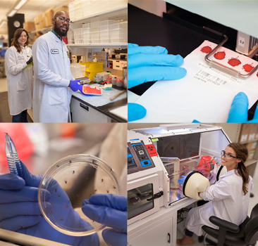
PUBLIC HEALTH LABORATORY SCIENCE (PHLS) CONCENTRATION CURRICULUM
3 Courses:
Fundamentals of Public Health, Epidemiology, and Laboratory Surveillance
Laboratory Techniques and Emergency Response and Preparedness
Quality and Ethics
1 Practicum (4 areas available):
Public Health Food Microbiology
Newborn Screening
Public Health Molecular Laboratory and Characterization
Public Health Molecular Laboratory and Whole Genome Sequencing

Slide 7
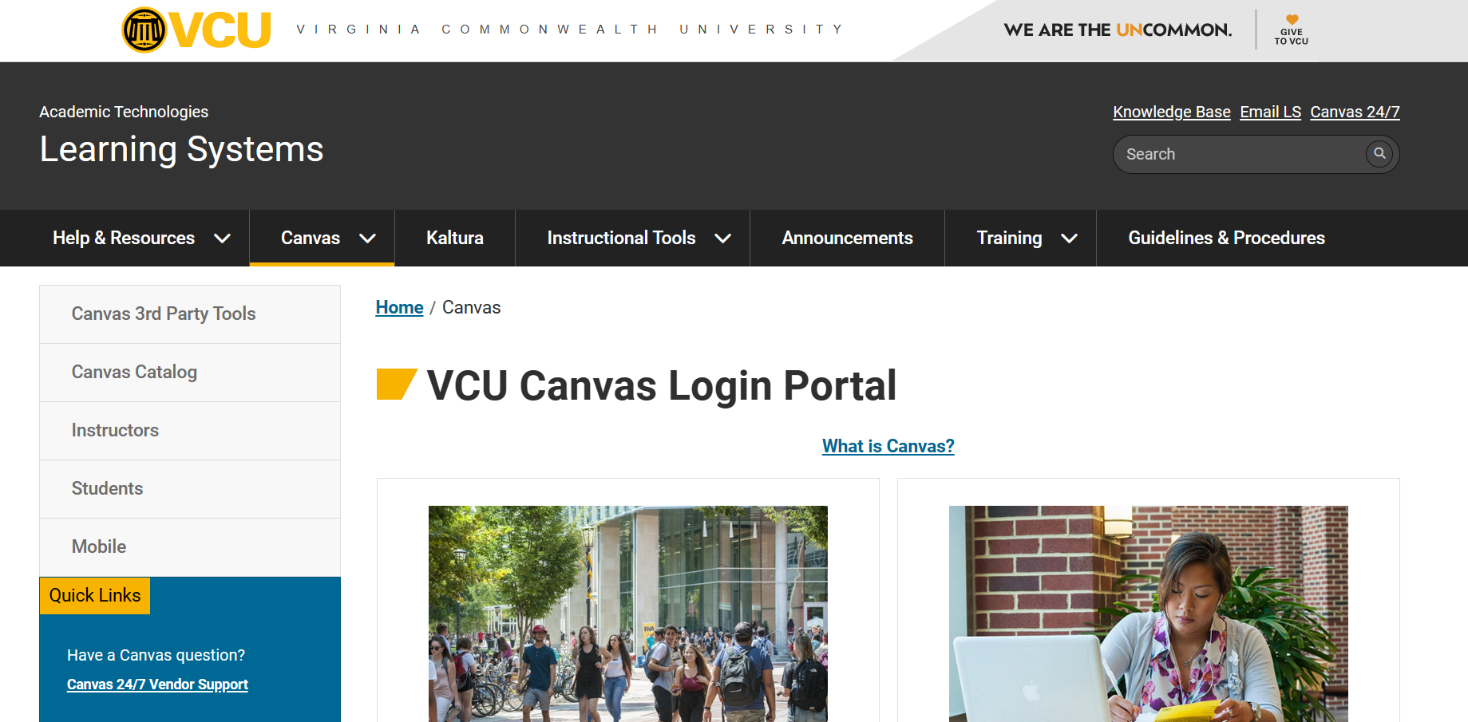




DEVELOPMENT
Curriculum: completely asynchronous (Canvas)
Identified pre-existing, publicly-available material for most domains:
  Association of Public Health Laboratories (APHL) Learning Portal
  Centers for Disease Control and Prevention TRAIN
  TRAIN Virginia
  University of Albany, State University of New York, Center for Public Health Continuing Education
Created content for other domains:
  DCLS developed and branded

Slide 8
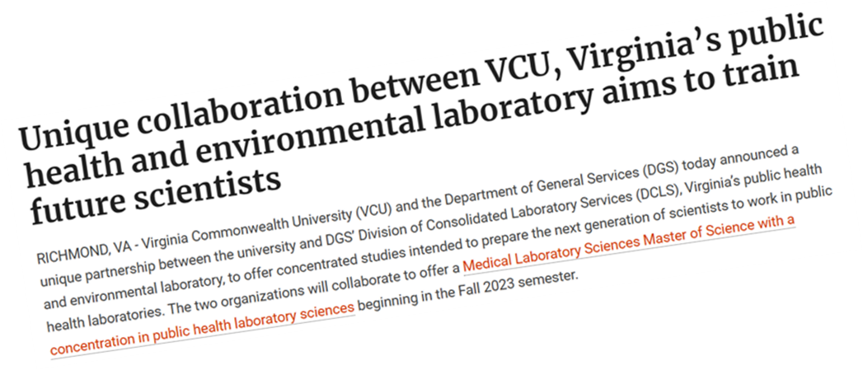
THE LAUNCH
Fall 2023: Fundamentals in Public Health, Epidemiology, and Laboratory Surveillance
Spring 2024: Laboratory Techniques and Emergency Response and Preparedness / Quality and Ethics
APHL provided scholarship funding to support the tuition costs associated with the PHLS Concentration at VCU
https://mls.chp.vcu.edu/about-us/featured-news/unique-collaboration-between-vcu-virginias-public-health-and-environmental-laboratory-aims-to-train-future-scientists-.html

Slide 9

Lessons Learned
Leverage existing partnerships with similar goals
  Network
  Share your ideas
  Learn about partners’ goals
Facilitate communication between partners and/or be willing to serve as a liaison
Anticipate obstacles and have a backup plan
Be flexible and willing to start small

Slide 10

For more information:
Angela E. Fritzinger, Ph.D.
angela.fritzinger@dgs.virginia.gov
757-235-1336
Denise M. Toney, Ph.D.
denise.toney@dgs.virginia.gov
804-648-4480 ext. 282

Slide 11

Collaborations to Increase Educational Opportunities
Dr. Karen Honeycutt, PhD, MEd, MASCP, MLS(ASCP)SM
Associate Professor and Program Director,
University of Nebraska Medical Center MLS Program

Slide 12
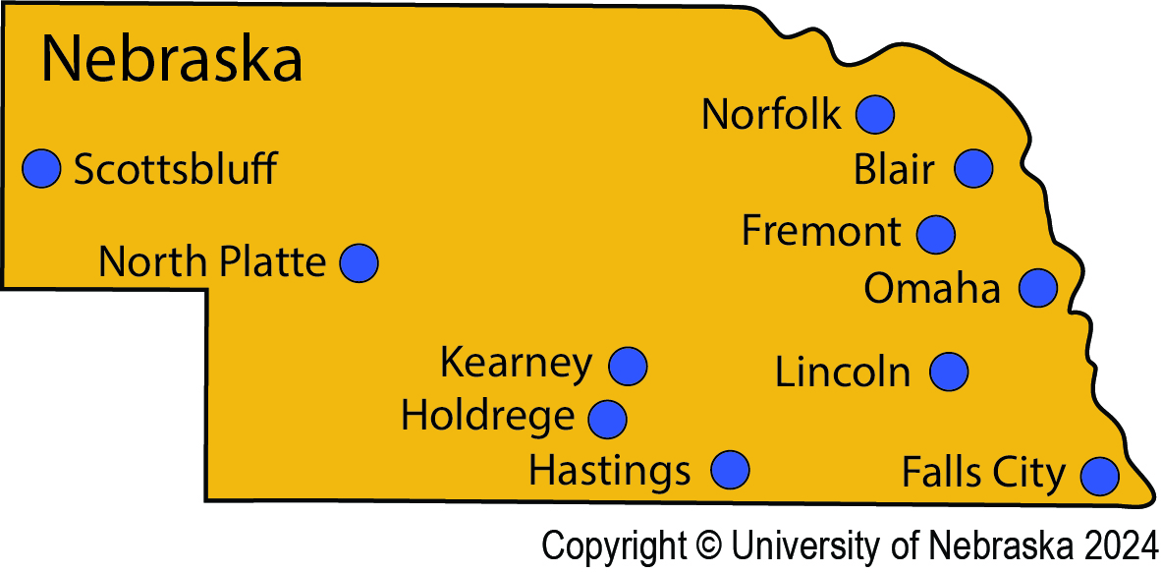
Decentralizing MLS Education to Rural Communities
HRSA funding late 1980’s
11.5 weeks during summer Omaha/Kearney campus
9 months in clinical site community to continue education
14 NE clinical sites / 9 in rural communities
Notes:
UNMC MLS Program is a 3+1 format.
Late 1980s awarded HRSA funding to decentralize MLS education from primarily urban areas to rural areas to meet Nebraska’s workforce needs.
Population is primarily on the eastern part of the state in Omaha/Lincoln metropolitan areas.
The model requires learners to come to either the Kearney or Omaha campus for 11.5 weeks during the summer to learn basic theory and technical skills. Then learners go to their clinical site community for 9 months.
1991 graduated the first class using the distance education model and it continues today.
Utilize 14 different clinical sites 2024-25 with 9 being clinical laboratory partners in rural communities.
The program does not fill all possible cohort slots. Program has a staff position that is 50% student recruitment.
As we presented on this model, we had inquiries from other universities. If the infrastructure and model was in place for Nebraska why not reach out to work with partners outside of the state.

Slide 13
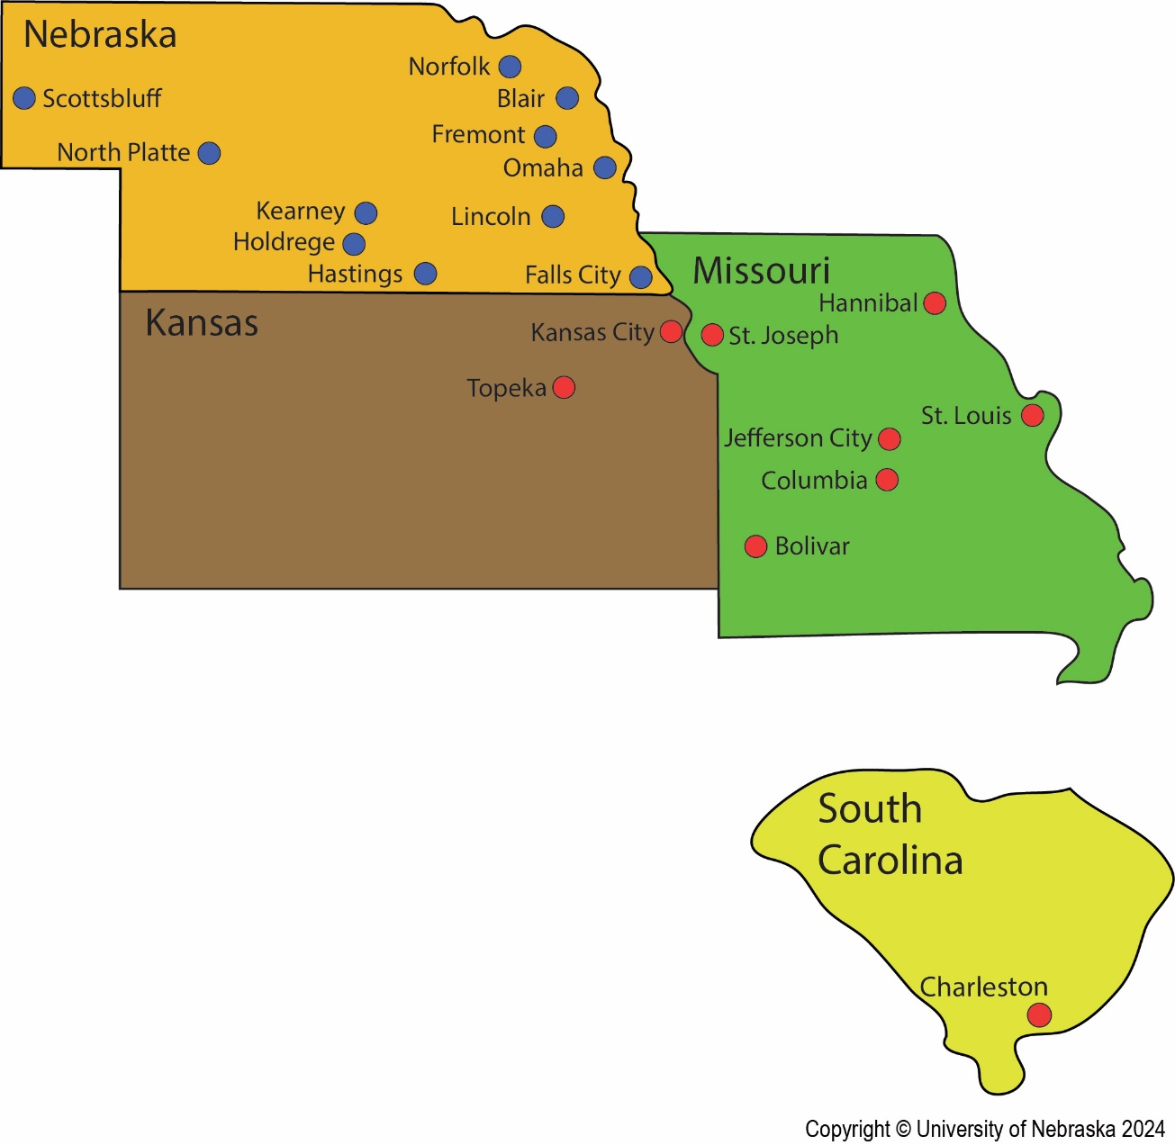
Decentralizing MLS Education to Meet Workforce Needs Outside of NE
Collaborating with other universities w/o MLS programs
Home university:
  Recruit students & clinical sites
  Students pay resident tuition
  Grants degree
UNMC provides professional education
  National certification exam
Notes:
As we presented on this model, we had inquiries from other universities. If the infrastructure and model was in place for Nebraska why not reach out to work with partners outside of the state.
In 2005 we partnered with the University of Missouri at Columbia. Home university is responsible for recruiting both students and clinical sites. Students pay tuition to home university (resident vs. nonresident tuition) and are considered visiting UNMC students. Home university accepts UNMC credits for professional education (approved via curriculum committees), home university grants the degree. The student is considered a UNMC NAACLS program completer and is eligible to sit for national certification exams. Currently we work with 4 universities and this map shows our regional and national reach.
Our partnerships have changed over the years. A barrier is requiring students to come to the Omaha/Kearney student laboratory (paying rent in two places). So partners can find new or more efficient solutions which is okay. The point is to provide MLS education in under resourced areas.
Another barrier: one-year program (good news/bad news); very rigorous, learners have little time for extracurricular opportunities, seems to suffer is student’s participation in professional organizations (not sure that is serving the profession in terms of advocacy), (MLS integrated into student-run clinics…medical student getting guidance from MLS student)

Slide 14

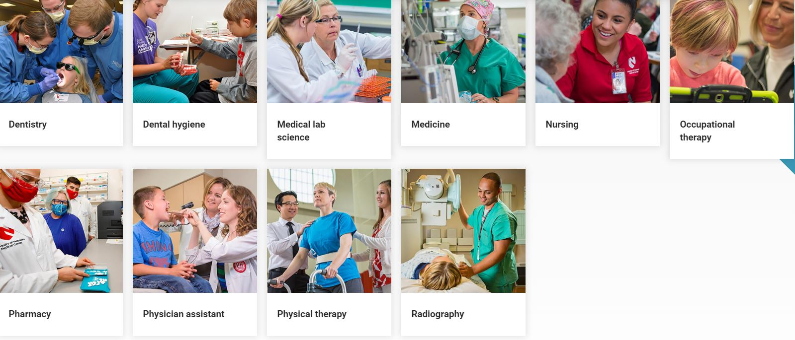
NE Rural Health Opportunities Program
Rural HS students apply
Undergraduate state college – scholarship
Guaranteed spot UNMC professional program
Graduates agree to work in rural community
Funded by NE legislative directive
https://www.unmc.edu/rural-health/workforce/index.html
Notes:
Health Opportunity Program is funded by state through legislative directive.
HS seniors from rural communities apply for limited slots in one of 10 health care professions. Accepted students complete their undergraduate course work on one of four state colleges and receive a full scholarship with a guaranteed spot in the professional program.. If they meet all of the program requirements, they will move into their UNMC professional program. MLS offers up to 12 guaranteed spots. This upcoming year, of 31 incoming UNMC students 5 are RHOP students. After graduating from the professional program graduates agree to work in a rural area.

Slide 15
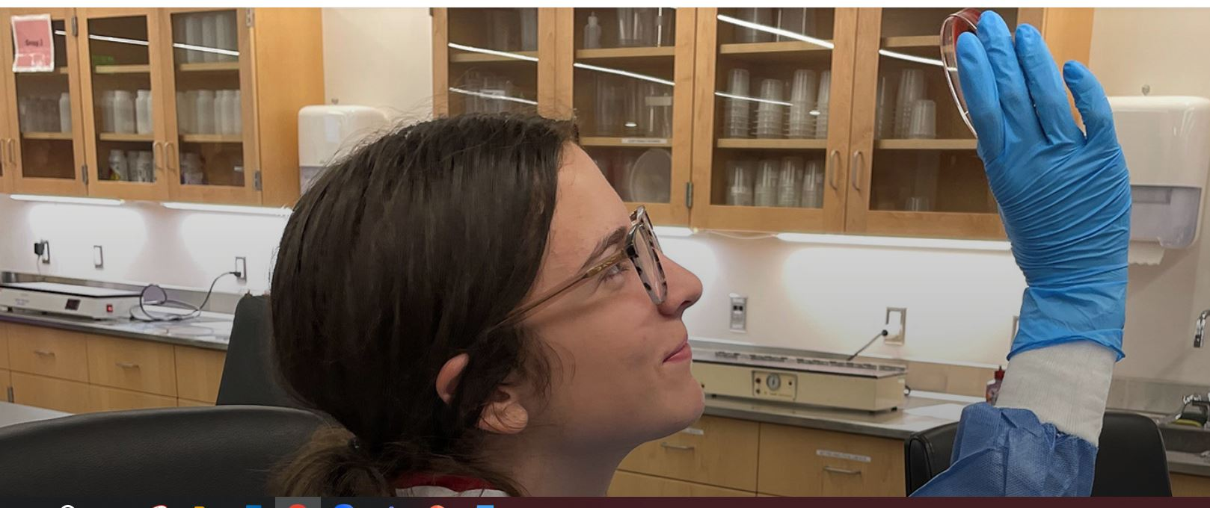
High School Collaborations – High School Alliance
Collaborate with 12 local, public school districts;
90 HS students accepted each year
UNMC faculty teach semester courses on campus
  MLS Infectious Disease
  Clinical pathology
  Anatomy (gross lab)
  40-50% hands-on time
Courses count as electives (HS teacher)
Expose learners to health professions and interprofessional foundation
Extend to Kearney campus
https://www.unmc.edu/alliance/
Notes:
Grant funded (Warren Buffett’s daughter foundations) collaboration and in-kind support from school districts

Slide 16

Lessons Learned3
Student recruitment opportunities don’t just happen; need to be proactive, planned and purposeful (patience)
Collaborations: respect relationships other programs have with clinical slots
Collaborations: focus is on increasing educational opportunities (not always favorable to program)
“Yes, and” mindset; be open to new ideas

Slide 17
OneLab Lessons Learned
Kelly Winter, PhD, MPH
Chief, Training and Workforce Development Branch,
Division of Laboratory Systems, Centers for Disease Control and Prevention

Slide 18
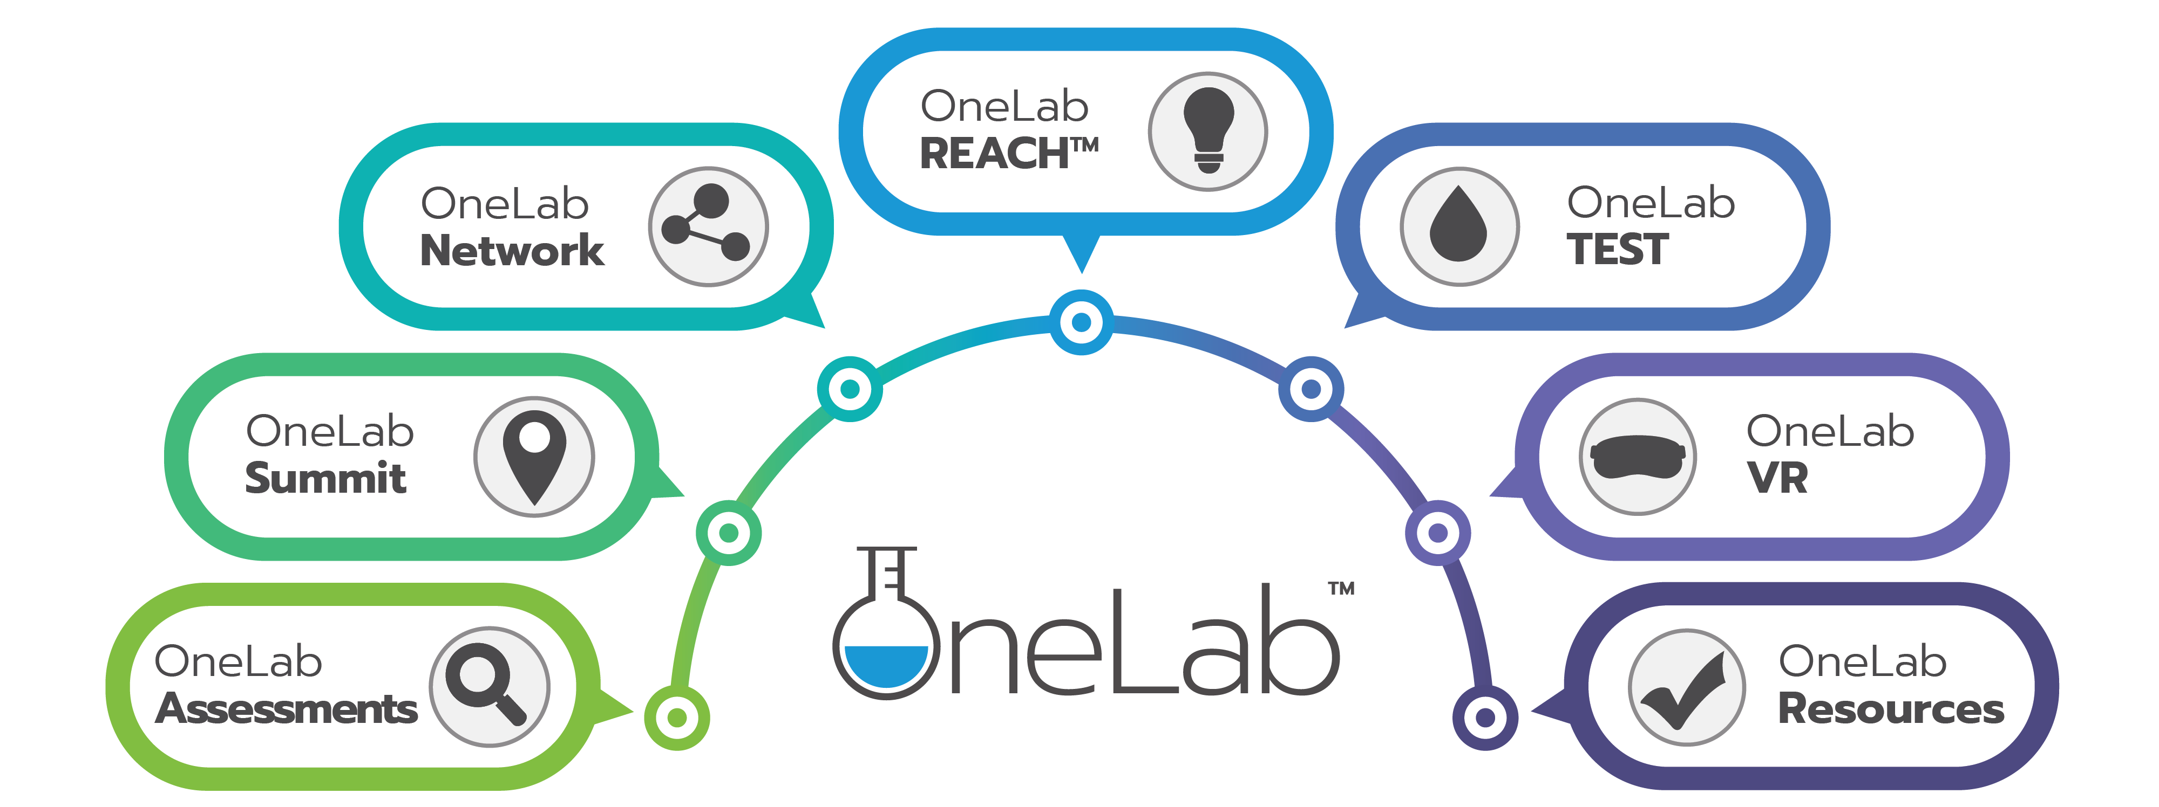
www.cdc.gov/onelab

Slide 19
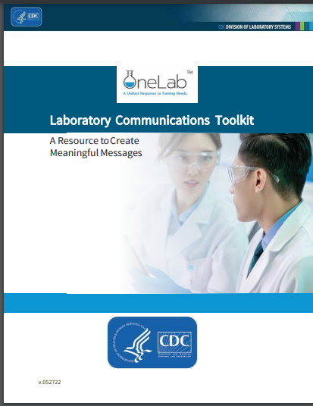
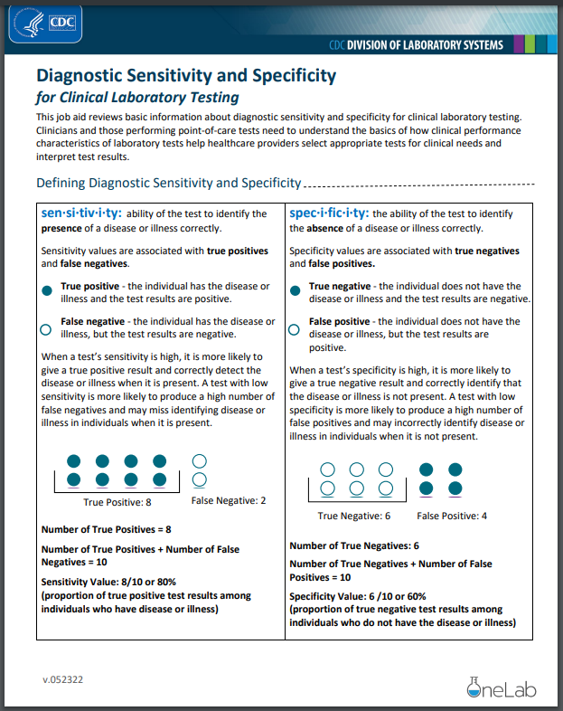
OneLab REACH
One-stop shop for free web-based
laboratory training resources:
  Live and recorded webinars
  Printable and video job aids
  Live Training of Trainers programs
  On-demand eLearning courses
  OneLab VR
  Coming soon: mini lessons and interactive job aids

Slide 20
What a Difference a Year Makes

Slide 21


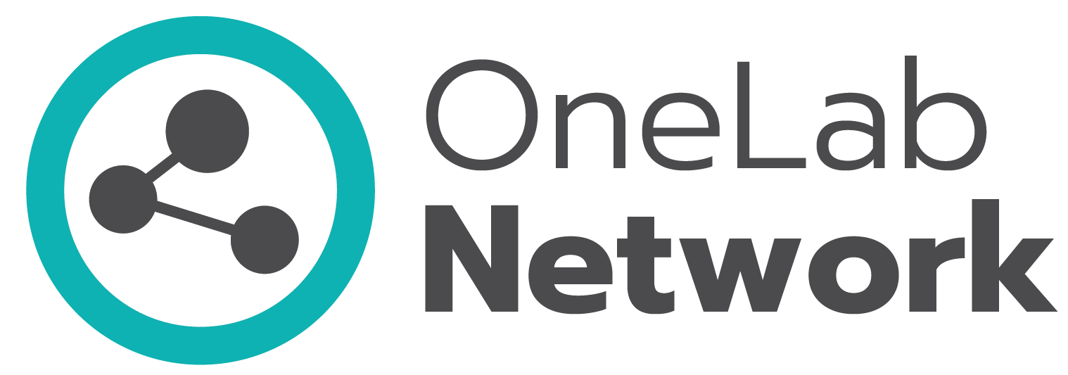

Membership has doubled in the past six months
OneLab now has 24,000+ unique members
22,600+ learners with 11,600 new learners since November
  OneLab training materials – eLearning and VR courses, job aids, webinars, videos, etc. – have attracted over 168,000 registrations in the first two quarters of FY24 – just 3,000 short of FY23 total in half the time
  Newest trainings: OneLab VR “Centrifuge Safety” practice scenario and “Fundamentals of Handling Compressed Gas Cylinders Safely” eLearning
10,900+ members with 4,900 new members since November
4,300+ members with 2,300 new members since November

Slide 22
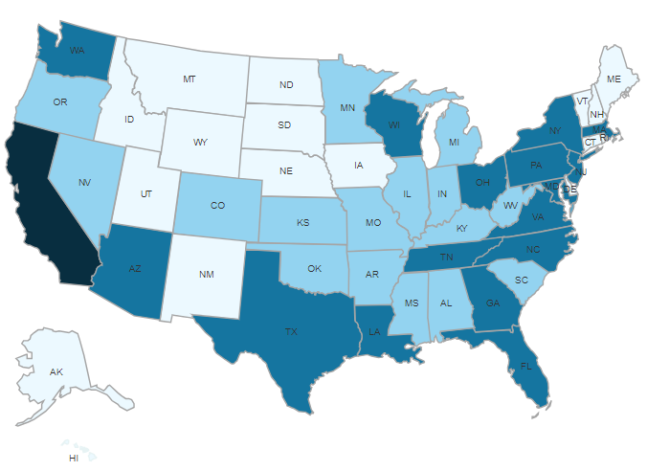




Membership by State
OneLab includes representatives from 15,000+ laboratories and professional organizations
CA
Legend
1-99 Members
100-249 Members
250-999 Members
1000+ Members

Slide 23
Lessons Learned2
Take a “minimum viable product” (MVP) approach
Gather real-time feedback from learners
Webinars and job aids set the foundation
for creating interactive online training
Partners’ contributions are essential – including in identifying additional partners

Slide 24
OneLab Resources
www.cdc.gov/onelab

Slide 25
Career Pathways in Public Health Laboratory Science
CDC and APHL have partnered to offer experiential learning placements in state, local, and territorial public health laboratories
Fellowship (1-2 years): prepares graduates of bachelor’s, master’s, and doctoral programs in laboratory-related fields to enter the workforce
Internship (12-16 weeks): introduces students enrolled in associate’s, bachelor’s, and MPH programs to potential laboratory career paths
www.aphl.org/careerpathways

Slide 26

Q&A

Slide 27
Next Month’s Webinar:
May 15th, 11 am – 12 pm CST
Twinning and Sharing Best Practices: Regional Partnerships

Slide 28
CMLE Credit Claiming for Today's Webinar
Claim 1 CMLE credit for this webinar from the ASCP Store
Instructions will be emailed to live attendees tomorrow 4/25 (via Zoom)
Credit claiming is only available within 1-month of the webinar date

Slide 29
Dr. Alvin Ring Empowerment Scholarship for
Laboratory Professionals
Apply Today!
Application Window: Feb 26 – May 31 2024
Financial aid for higher education or specialization in the medical laboratory sciences
Target candidates:
  From underrepresented groups and/or underserved areas
  Wide range of educational levels considered: high school seniors to in-service laboratorians
Scholarship range: $1000 - $5000
Help address the laboratory workforce shortage!
Info at: SupportCDCOneLab.org

Slide 30
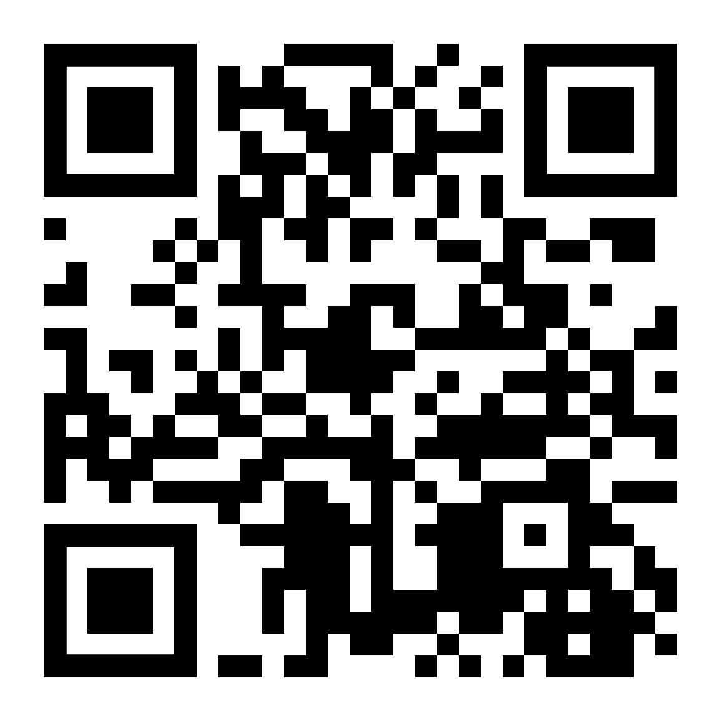
Thank you for attending!
More info at:
supportcdconelab.org
Partnerships Supporting Laboratory Training and Fellowships

