Slide 1
Supporting DE&I Initiatives in the Laboratory Workforce
Dana Powell Baker, H. Cliff Sullivan, Marilyn Bibbs Freeman
Building Bridges Across the Laboratory Community – March 27, 2024

Slide 2
Funding Statement
This resource was made possible by cooperative agreement NU47OE000107 from Centers for Disease Control and Prevention (CDC). Its contents are solely the responsibility of the American Society for Clinical Pathology (ASCP) and do not necessarily represent the official views of CDC.

Slide 3
Format of Today’s Session
Introduction of Subject Matter Experts & Case Study
  Case Study 1: Supporting DE&I Initiatives in the Laboratory Workforce: Career Pathways in Public Health Laboratory Science
  Case Study 2: Diversity, Equity, and Inclusion (DEI) Committee - ASCP
  Case Study 3: Diversity, Equity, Inclusion and Accessibility Committee - APHL
Q & A Session
Session Wrap-Up
  Next month’s webinar
  CMLE Credit Claiming
  Resources

Slide 4
Supporting DE&I Initiatives in the Laboratory Workforce: Career Pathways in Public Health Laboratory Science
Building Bridges Across the Laboratory Community
Wednesday, March 27, 2024
Notes:
DANA

Slide 5
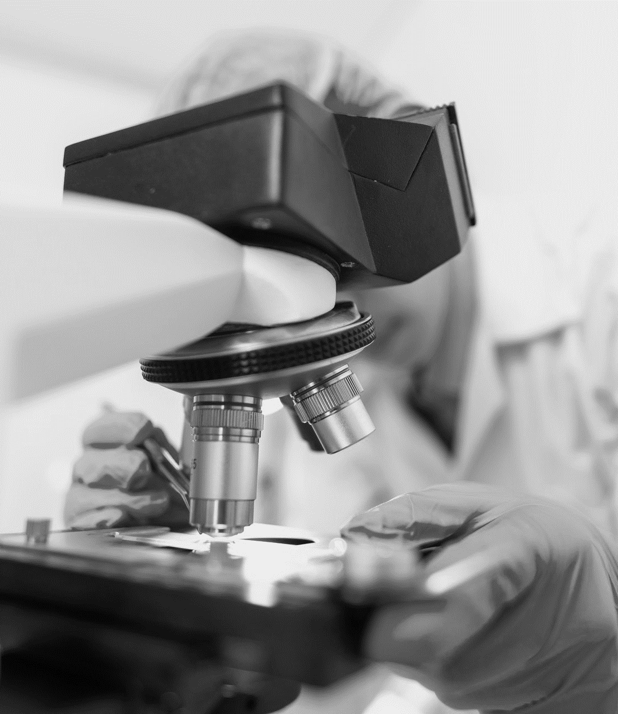
Who we are
The Association of Public Health Laboratories (APHL) works to strengthen laboratory systems serving the public’s health in the United States and globally.
APHL represents state and local governmental health laboratories in the United States
  This includes public health, agricultural, environmental and other related laboratories. Its members, known collectively as “public health laboratories​​,” monitor, detect and respond to health threats.
Notes:
DANA

Slide 6
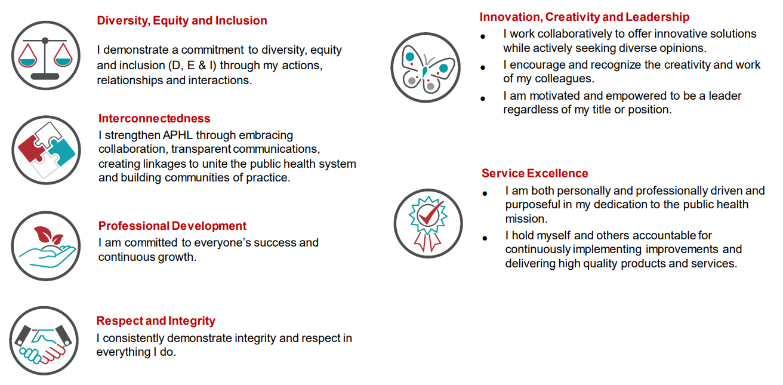
APHL Organizational Values
Notes:
DANA

Slide 7

What we do
APHL and the US Centers for Disease Control and Prevention (CDC) are seeking:
  Students who are interested in exploring career pathways in public health laboratory science
  Degreed applicants interested in starting or furthering an exciting career in public health laboratory science while working collaboratively with industry leaders and developing professional networks.
Notes:
DANA

Slide 8
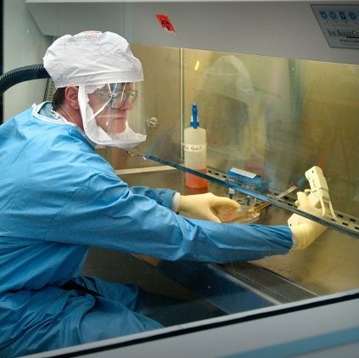
Career Pathways in Public Health Laboratory Science: an APHL-CDC Initiative
Academic Partnerships
A new program that forges collaborative relationships between public health laboratories and academic institutions for fellowship, internship, and leadership program opportunities.
Internships
A new initiative for current students pursuing relevant certificates, associate’s, bachelor’s, or master’s degrees to gain foundational experience in public health laboratories. Interns average up to 20 hours per week for 12 to 16 weeks.
Fellowship
Reimagined program for college graduates in nine program areas: bioinformatics, biosafety and biosecurity, emergency preparedness and response, environmental health, infectious disease, informatics, food safety, newborn screening, and quality management.
Leadership
The Emerging Leader and Laboratory Leaders of Today programs and alumni form future laboratory leaders. The Boot Camp program helps prepare for the Board Exam, which is required to direct high-complexity testing laboratories.
Notes:
Josh

Slide 9
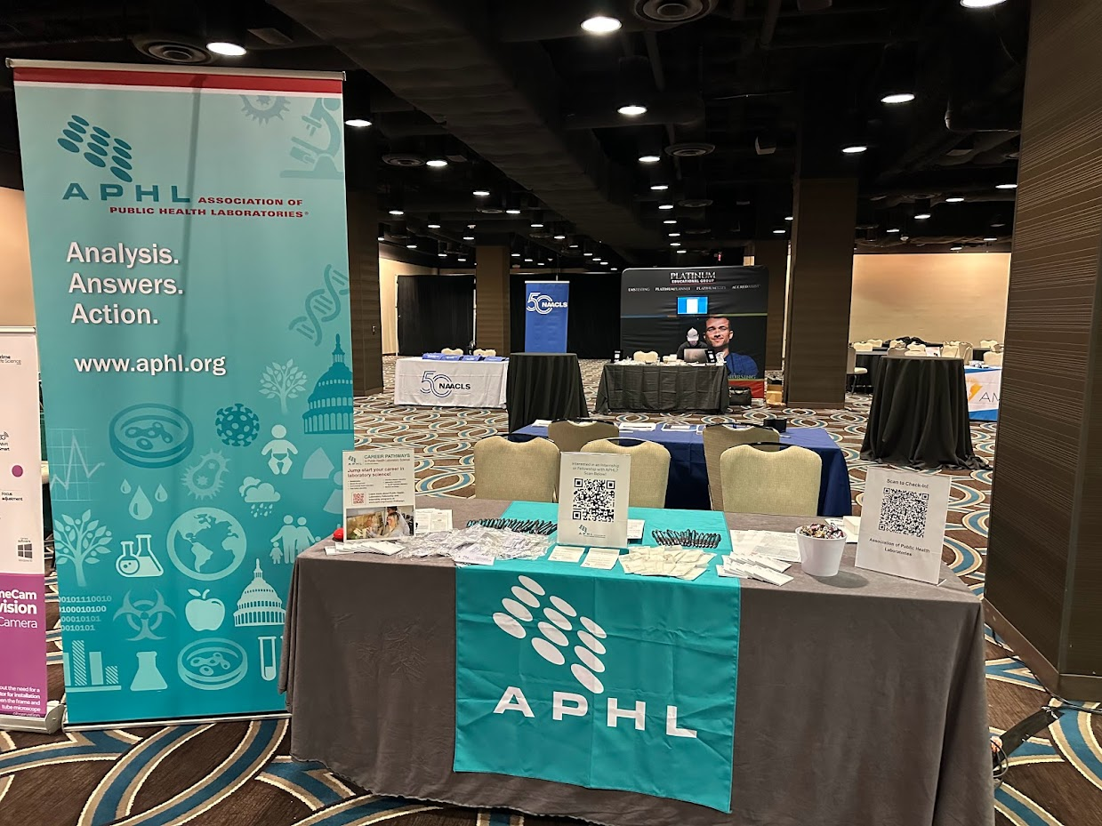
Academic Partnerships
Academic partnerships are essential in supporting the recruitment and retention efforts of the public health laboratory workforce.
In the APHL Academic Partnerships program, we aim to:
foster partnerships in the promotion of career pathways in public health laboratory science
support programmatic efforts and build connections between academic institutions and public health laboratories
promote educational and training opportunities for working professionals
strengthen partnerships with organizations that prioritize DEIA
Outreach Activities
Campus Visits
Career Fairs (Onsite and Virtual)
Exhibit Booths at Conferences
Job Board Posts
Newsletters/Publications
Social Media Engagement
Speaking Engagements
STEM(M) Advocacy
Notes:
DANA
Academic partnerships are essential in supporting the recruitment and retention efforts for the public health laboratory workforce.
The APHL Academic Partnerships program seeks to:
foster relationships with academic partners in the promotion of career pathways for public health laboratory science
support programmatic efforts for the fellowship, internship and leadership programs
establish and sustain collaborative relationships between local, state and/or territorial public health laboratories and academic institutions
strengthen academic partnerships with organizations who prioritize diversity, equity, inclusion and accessibility.

Slide 10
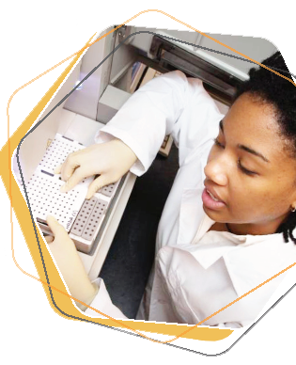
Public Health Laboratory Internship an APHL-CDC Initiative
Eligible candidates
Current student enrolled at an accredited institution and in pursuit of a relevant certificate, associate’s, bachelor’s, or master’s degree
Start and end dates: Flexible
Hours and program length: An average of 20 hours a week for 12 to 16 weeks
Applications are accepted and reviewed throughout the year
Interns will join a public health laboratory team to make an impact on protecting the health of our communities. Interns assist scientists working on meaningful projects while building skills such as general lab practices (e.g., pipetting, calibrations, etc.), data analysis, report management, problem solving, teamwork, and effective communication.
Requirements
Benefits
US citizen or permanent resident
Completed application form
Work history
Reference (either academic
or professional)
College transcripts
Network with public health laboratory professionals
First-hand experiences in public health laboratory initiatives
Competitive stipend
Build transferable skills

Slide 11

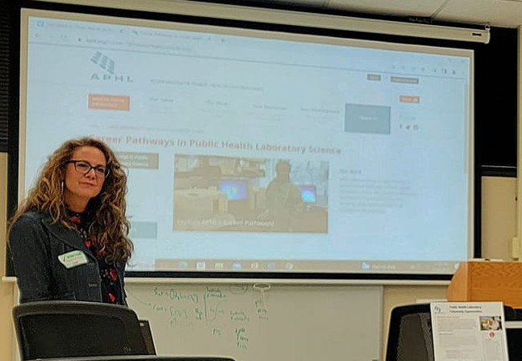

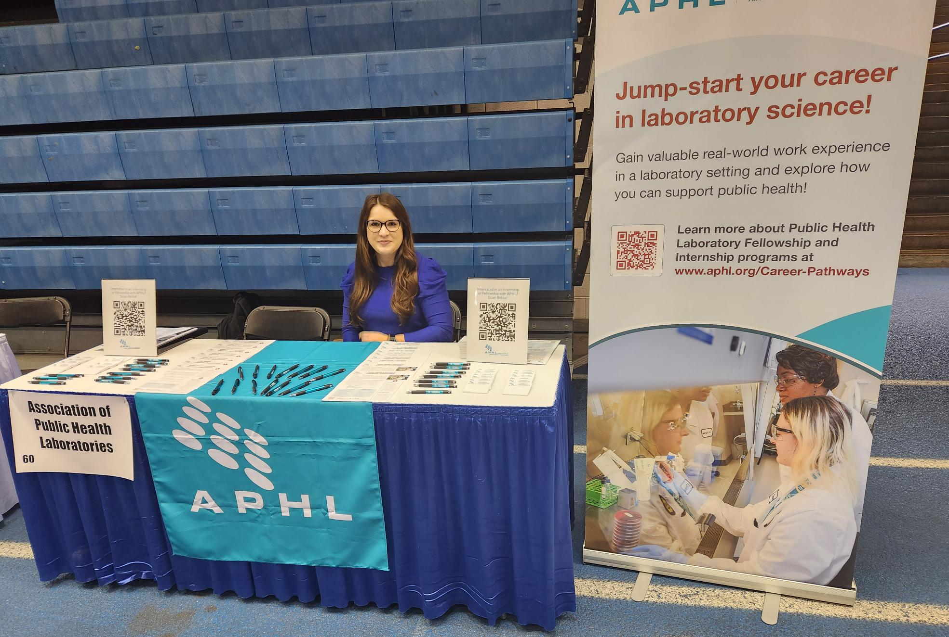
Timeline: Academic Outreach (Tennessee)
“Work Your Magic”:
March 14, 2023
TSU Career Fair:
March 24, 2023
Launch Date:
March 27, 2023
The first completed intern application was submitted on March 28th – from TSU!!!

Slide 12


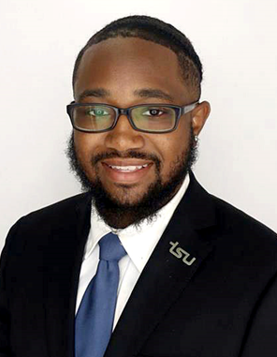

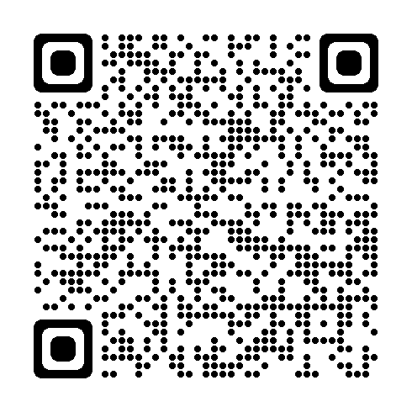
Public Health Laboratory Internship Program Success Story
Academic Institution: Tennessee State University
Public Health Laboratory: Tennessee State Public Health Laboratory
Location: Nashville, TN
Publication: TWD Internship Success Story - TN State (aphl.org)
Interns from the Tennessee Department of Health, Division of Laboratory Services, Mytasia Stone, right, and Kamren Williams, below.
Notes:
CHERIE (will introduce Kamren)

Slide 13

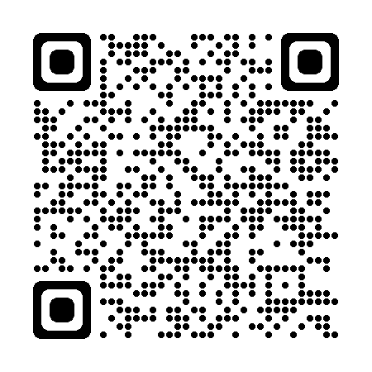

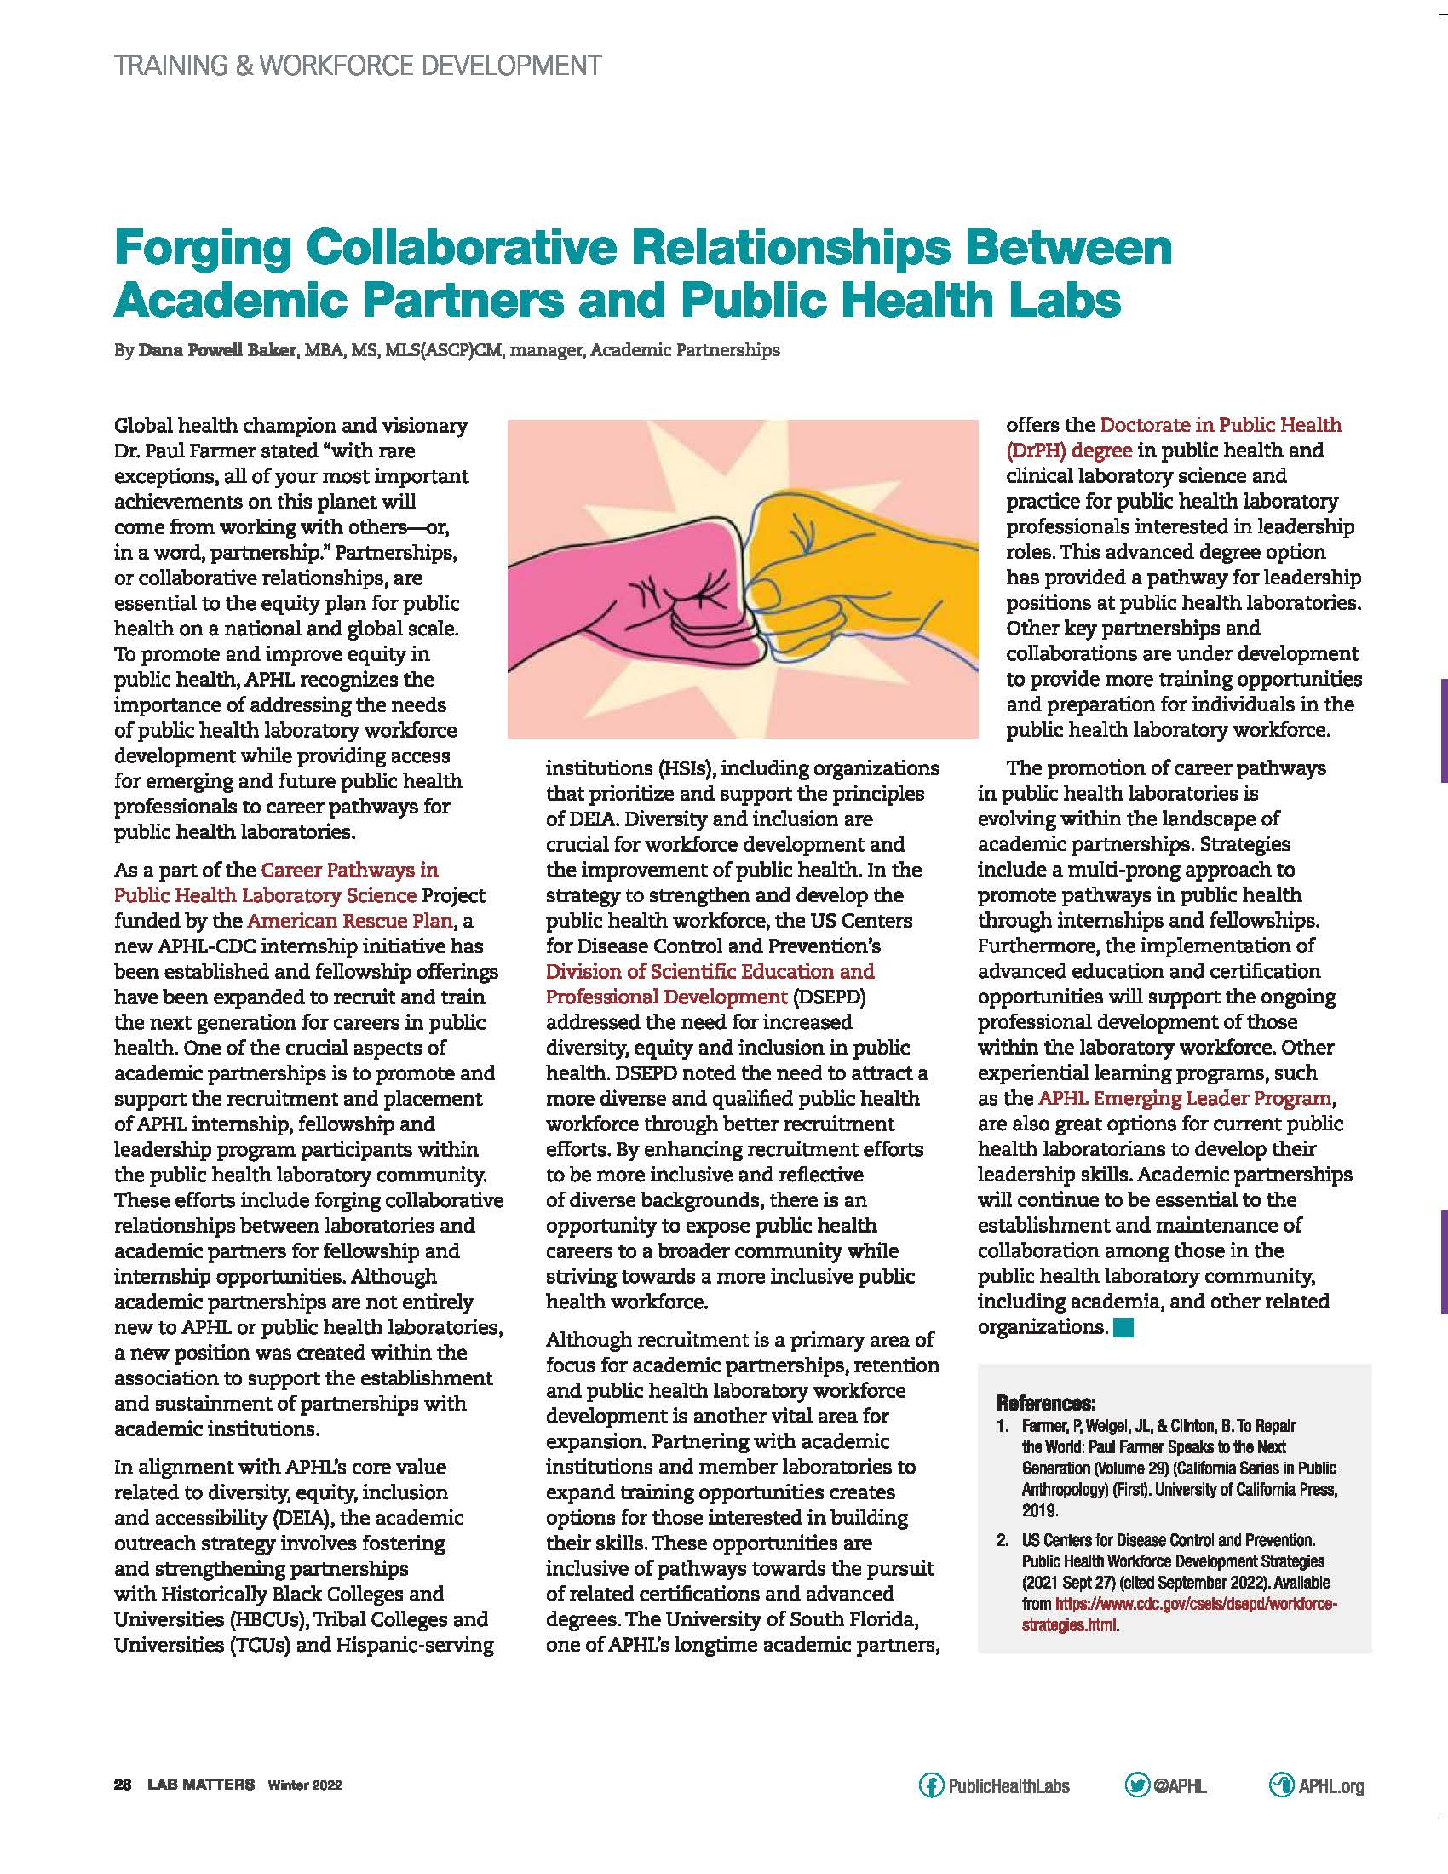
Outreach and Promotional Resources
Career Fair Announcements
AP Quarterly Newsletter
Lab Matters

Slide 14

Career Pathways in Public Health Laboratory Science an APHL-CDC Initiative
APHL’s “Career Pathways in Public Health Laboratory Science” program was named a recipient of the 2023 INSIGHT Into Diversity Inspiring Programs in STEM Award!
Our award-winning program supports this important work deemed worthy of this national recognition.
Recognized in the September 2023 issue of INSIGHT Into Diversity
Notes:
DANA

Slide 15
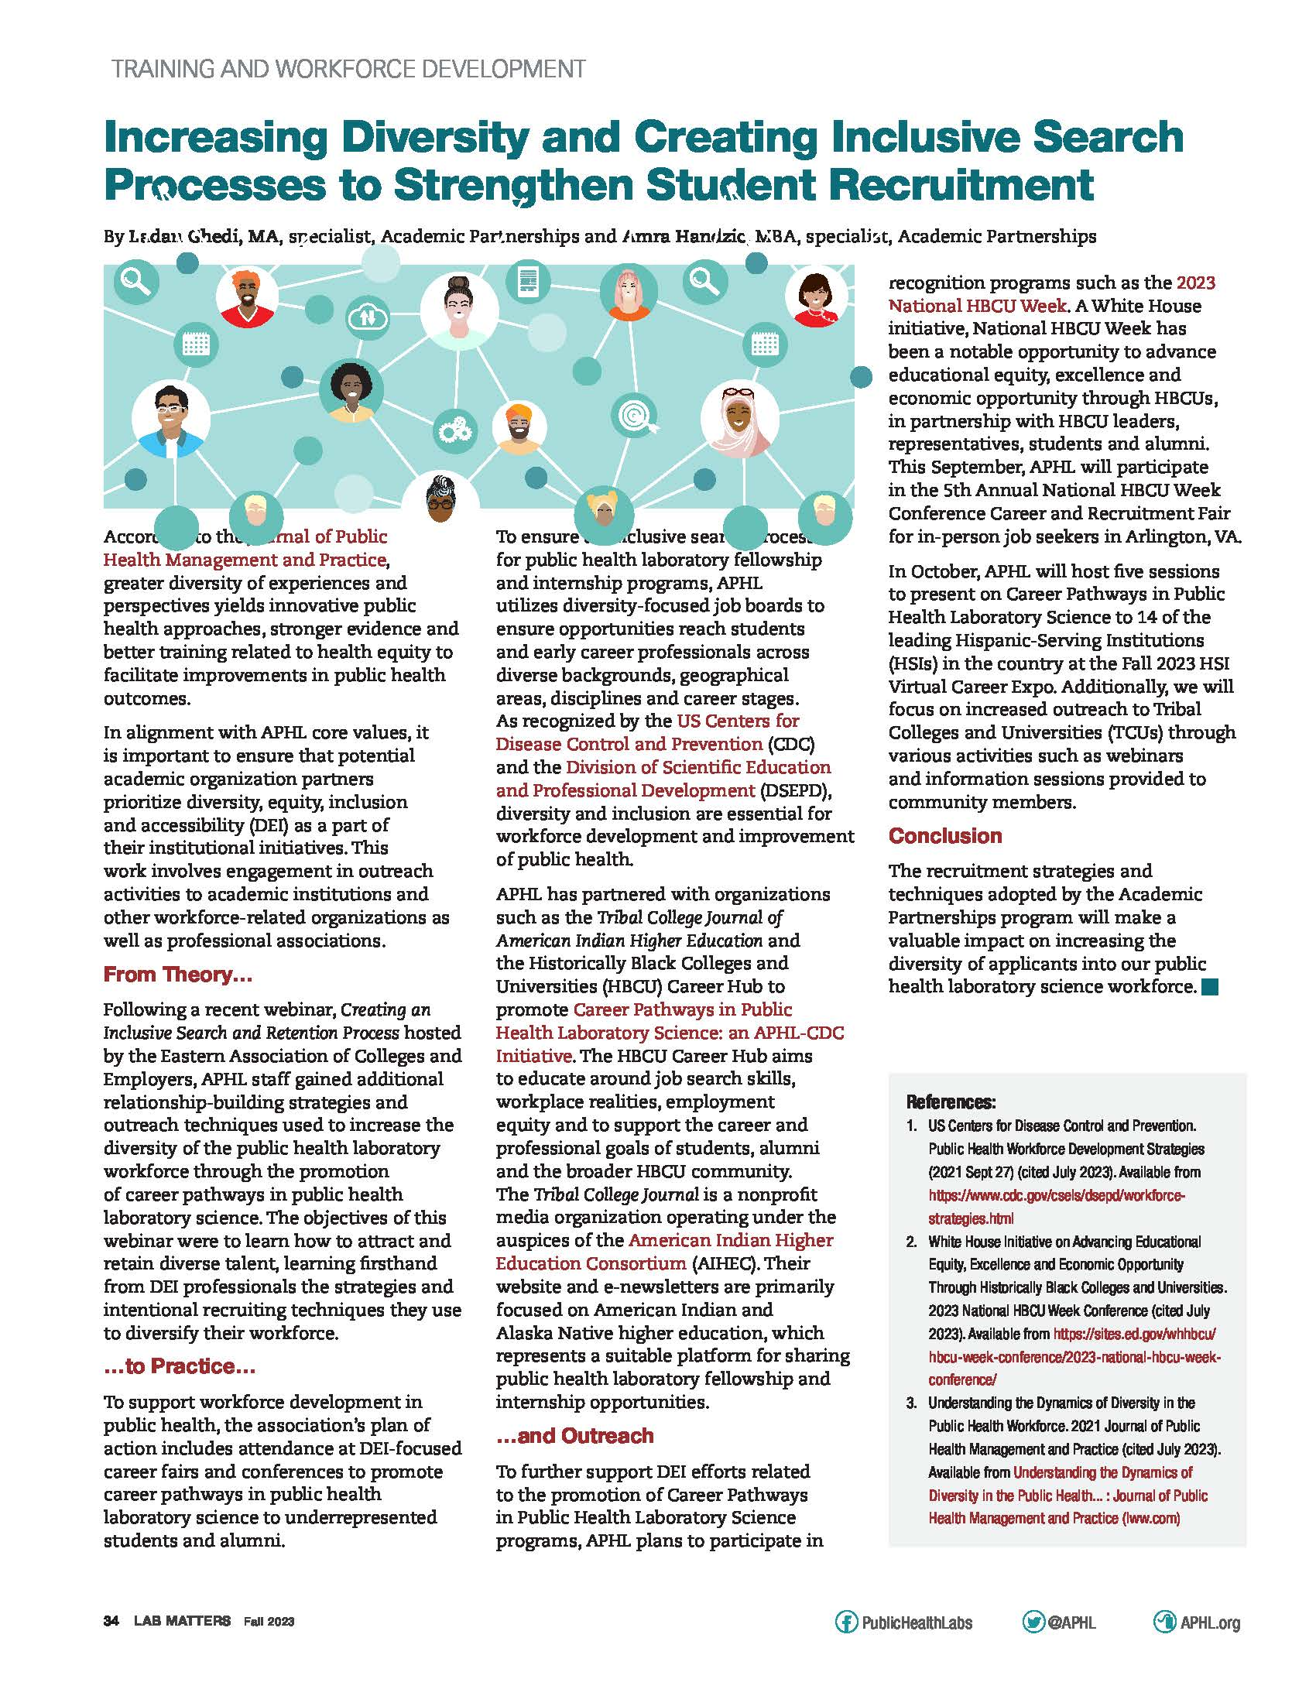
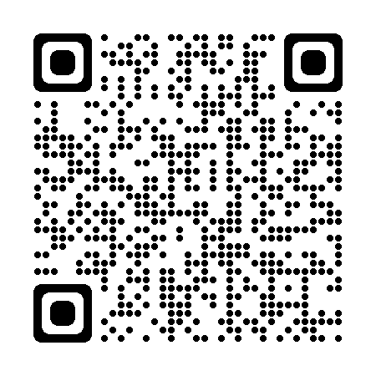
Lessons Learned
Share the vision
Establish an outreach strategy
DEI in action – be intentional
Employ best practices with effective communication and teamwork
Seize the opportunity!
Seek professional development opportunities

Slide 16

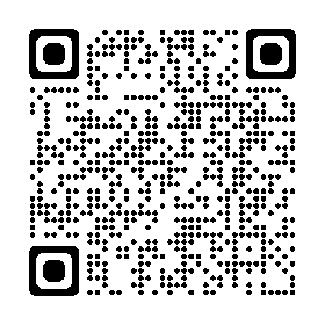
Contact Us!
To learn more about: | Email:
Academic Partnerships | academic.partnerships@aphl.org
Fellowships | fellowships@aphl.org
Internships | internships@aphl.org
Leadership | leadership@aphl.org
Scan the QR code for the Career Pathways in Public Health Laboratory Science website!
Notes:
LADAN

Slide 17

Thank You!
Dr. Dana Powell Baker – Manager, Academic Partnerships
Email: dana.baker@aphl.org
Notes:
LADAN

Slide 18

Diversity, Equity, & Inclusion (DEI)
ASCP Building Bridges Across the Laboratory Community Web Series
March 2024
www.ascp.org
Notes:
Slide1: I would like to thank the organizers for granting me this time to share what the ACSP DEI Council has been up to.

Slide 19

Mission
Diversity and inclusion are more than just words. Our mission is to create a diverse and inclusive pathology and laboratory medicine profession in which all individuals thrive through appreciation, respect, and engagement.
We do this by building leadership capability, awareness, and mentorship opportunities to promote an enriching and supportive professional environment that allows all to grow and succeed and empowers individual laboratories to reflect the communities they serve.
Notes:
Slide3: The mission for the ASCP DEI Committee is to foster a diverse and inclusive pathology and lab medicine field where everyone thrives. We promote leadership, awareness, and mentorship for an enriching and supportive environment, empowering labs to mirror their communities.

Slide 20
Division of Labor: DEI Working Groups - 2023
Education: Chaired by Von Samedi, MD PhD, FASCP
Workforce: Chaired by H. Cliff Sullivan, MD, F(ACHI), FASCP
Indigenous Health: Chaired by Stephanie Bolman-Altamirano, BA, CT(ASCP), BSN, NDCCDP
Notes:
Slide6: The DEI Committee is composed of three working groups, on one education, one on workforce, and one on indigenous health. Each working group is tasked with brainstorming and formulating initiatives to propose to the committee at large prior to moving proposals along the chain of command.

Slide 21
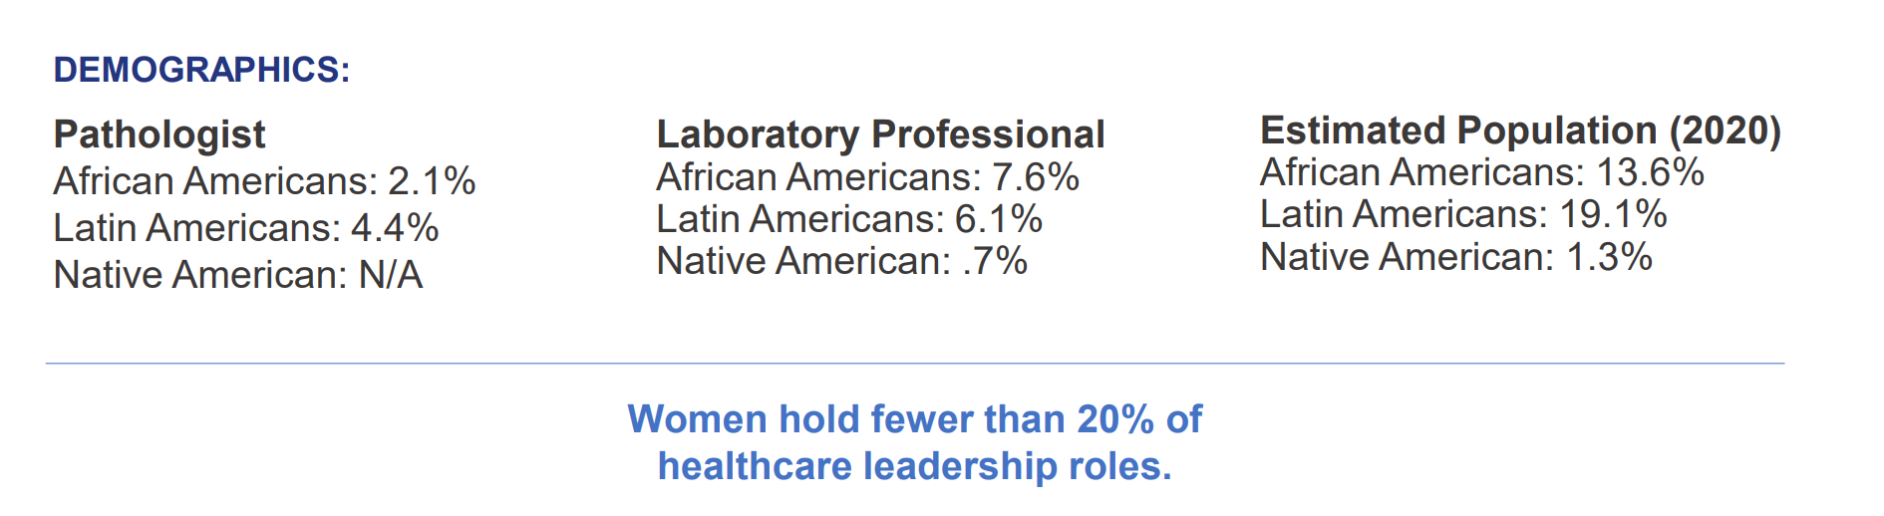
Demographics
Sources: US Census Bureau, 2017 Wage Survey, Medscape Lifestyle Report and Korn Ferry Consulting
Notes:
Slide9: One of our initial efforts was to assess our membership demographics to identify gaps and needs. We found that minority representation among both pathologist members and laboratory professionals was lower compared to the general population. Additionally, women held fewer than 20% of leadership roles. This led us to investigate why our membership did not reflect broader communities and why women were underrepresented in leadership positions.

Slide 22
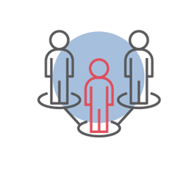

Target Audiences & Key Questions
Underrepresented Minorities
African Americans
Latin Americans
Native Americans
Empowerment of women and underrepresented minorities
With the high percentage of women in pathology/laboratory medicine, why do so few hold leadership roles?
Why is pathology/laboratory medicine not representative of the communities they serve?
Notes:
Slide8: First who are our target audiences? Well to main groups underrepresented minorities and our female constituents.

Slide 23
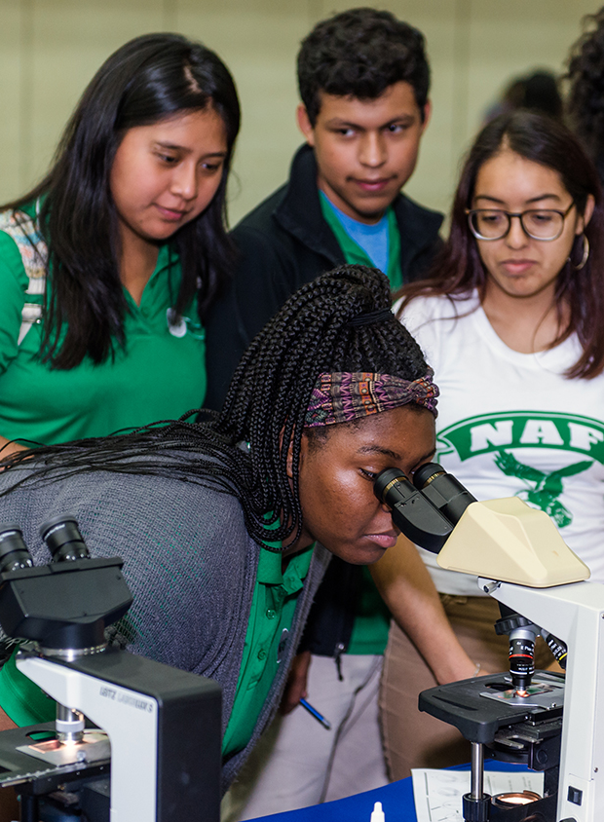
Strategy 1: Awareness
Leverage Career and Pathology Ambassador volunteer network to build awareness and recruit individuals into the profession.
  Giving presentations and attending STEM, Science and Career Fairs.
  Visiting medical students.
  Hosting students at NEXTPO.
Celebrate the diversity of our members via Heritage Months.
Offer scholarships and awards
  Reaching out to underrepresented minority students informing them of the Laboratory Student Scholarships
  Spring 2024: Launch DEI Award, recognizing one member who has made strides to promote DEI ideals in the areas of mentorship, education, training, workplaces, etc.
Notes:
Slide11: To raise awareness, we leverage our Career and Pathology Ambassador network, presenting at STEM fairs and visiting medical students. Events like NEXTPO, which targets students, offer exposure and insights into the field. We celebrate member diversity with Heritage Months and offer scholarships like the Laboratory Student Scholarships, reaching out to underrepresented minority students. And in Spring 2024, we launch the DEI Award, recognizing outstanding efforts in promoting diversity, equity, and inclusion across mentorship, education, training, and workplaces.

Slide 24

Strategy 2: Partnerships
Nth Dimensions
American Medical Women's Association (AMWA)
APC
Student National Medical Association (SNMA)
Association of Native American Medical Students (ANAMS)
Latino Medical Student Association (LMSA)
Black Medical Student Association (BMSA)
National Medical Association
Notes:
Slide12: We've partnered with various organizations to drive impactful initiatives: 1. We established a Memorandum of Understanding with the Society of Black Pathologists; 2. Collaborated with The Lab Drawer to develop interactive K-12 experiments in hematology and microbiology; 3. Made a 5-year commitment to the Clinton Global Initiative, focusing on developing the next generation of laboratory professionals.4. Partnered with the University of Washington Center for Health Workforce Studies to enhance recruitment and retention strategies for clinical laboratory workers. 5. Supported efforts with the National Kidney Foundation to reform eGFR calculations for Chronic Kidney Disease diagnosis. 6. Collaborated with ASH to eliminate exclusionary laboratory test reference ranges affecting malaria-endemic regions; 7. Joined forces with AABB and experts in blood banking/transfusion to develop a nationwide red blood cell alloantibody registry; 8. Participated in the ACGME Equity Matters Continuous Learning & Practice Improvement Initiative, focusing on healthcare workforce diversity, equitable learning environments, and addressing health disparities.

Slide 25
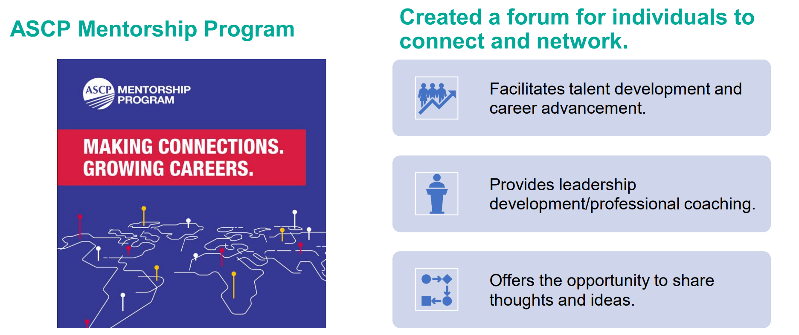
Strategy 3: Mentorship program
.
Notes:
Slide13: In order to foster mentorship, we created mentorship opportunities to provide support, learning, and development and built build a program for underrepresented minorities to provide guidance and support along academic journey.

Slide 26

Strategy 4: Education
Numerous in-person and virtual offerings: courses, town halls, and podcasts.
Annual Meeting sessions dedicated to healthcare equity.
Articles and editorials in two in-house journals and member magazine:
  Laboratory Medicine
  American Journal for Clinical Pathology
  Critical Values
Inclusion of faculty from diverse and underrepresented groups.
Notes:
Slide14: Addressing education, we developed a range of in-person and virtual events, including courses, town halls, and podcasts. Our Annual Meeting now features dedicated sessions on healthcare equity. Additionally, our in-house journals and member magazine feature articles and editorials addressing DEI. We also ensure diverse perspectives by including faculty from underrepresented groups in our programs and publications.

Slide 27

Strategy 5: Changing the DNA of ASCP
Formed a DEI CER-SAC to ensure this content is infused throughout the education portfolio.
Redesigned volunteer application process to ensure equity in committees and commissions.
Added DEI representation on the ASCP Board of Directors, Commission on Membership, Commission on Continuing Professional Development, Commission on Science, Technology & Policy, and Awards Committee.
Created a mechanism for ASCP Members to inquire about or suggest a position for the Commission on Science, Technology & Policy to consider.
Notes:
Slide15: In regards to changing the DNA, so to speak, of ASCP, we took proactive steps to embed DEI principles across our education initiatives by establishing a DEI CER-SAC (Curriculum, Educational Resource and Scientific Advisory Committee). Additionally, we revamped our volunteer application process to promote equity in committee selection. Furthermore, we enhanced DEI representation by including it in key bodies across the organization even up to the top with the Board of Directors. Finally, we enabled ASCP Members to suggest positions for consideration by the Commission on Science, Technology & Policy, fostering inclusivity and engagement.

Slide 28
Lessons Learned2
Organizational structure – Need support from above to help allocate resources and monitor progress.
  Leverage creditable research – High how greater diversity in the workforce results in greater profitability and value creation.
Divide and Conquer – Workgroup structure permits focused attention on different facets of DEI and strategies.
Adaptability – Redesign processes to ensure lasting change and sustainability.
Walk the talk – Integrate aspects of DEI at all levels and be mindful of representation throughout the organization.
  Evaluate changes – Demonstrate the importance and benefits of having a more inclusive workforce.
Notes:
Slide16: So what have we learned thus far: Well, we now recognize the importance of organizational support for effective resource allocation and progress monitoring; leveraging credible research highlights the profitability of diversity. We also found it helpful to use a "divide and conquer" approach, we focus on various DEI facets through workgroups. Also beneficial, was being adaptable to ensure lasting change by continuously refining processes. Importantly, we are "Walking the talk" to integrate DEI principles at all levels, emphasizing action over words; and evaluating changes in order to demonstrate the benefits of inclusivity, inspiring ongoing support for DEI initiatives.

Slide 29
Thank You!2
www.ascp.org
Notes:
Slide17: Thank you so much for your attention, looking forward to a lively Q&A session.

Slide 30
Diversity, Equity, Inclusion and Accessibility Committee
APHL
Dr. Marilyn Bibbs Freeman, Ph.D. M(ASCP)

Slide 31
Background
When: August 2020
Who: Internal vs external partners
  Internal: Our APHL community
  External: The communities we serve
Why: A response to the inequitable trifecta
  SARS-CoV-2 epidemic, increasing advocacy for racial justice, financial crisis
What: DEI Task Force (informal) then DEIA Committee (organized)
Notes:
Inequitable distribution of deleterious outcomes

Slide 32

High-Level Vision
Knowledge
Understanding
Practice
Notes:
Initially felt that we wanted to have an external impact on the people we served. As we got into doing the work, we realized maybe our own house needed some attention first.
At the highest level, our vision has always been to begin with sharing knowledge with the hope that this knowledge will be actualized in practice. But it is a continuum, and it is not immediate. It requires for people to have a growth mindset and be flexible in their thinking.
Knowledge: Equip ourselves and our team first so that we can be of service to others.
We teach ourselves, research, read, learn and debate topics each month
Understanding: Reinforce in different ways
We have multiple ways to share the knowledge
This is the step where growth mindset is the most important. Not only must we learn new things to support DEIA, but we must also unlearn behaviors and thought processes that are deleterious to DEIA.
We have a platform called Gathering Place where we post topics of interest in the form of statements, questions for feedback, podcasts, book recommendations
Formal training
Book club
Posters
Presentations
Workshops
Practice –As we become more strong, more brave and more courageous, we begin to see more comfort with the topics and conversations. We have seen others be intentional about DEIA in discussions and on teams.

Slide 33
Implementation
Plan
Do
Study
Act
Notes:
PLAN DO STUDY ACT for Process Improvement is supportive of incremental change
Plan
In addition to seeking input from partners, we stay up-to-date on current events. We intentionally create a safe space on the committee where all voices are heard by starting each meeting with a DEIA topic for reactions from each team member. Then we get into the business of deciding where we go next. How do we help our laboratory peers, leaders, and community? We are always collaborative. We have unspoken rules of engagement, with the main ones being to share freely, often, and respectfully. Finally, we narrow our choices of topics and then vote on the what we plan to do.
No ideas get discarded. We keep a brainstorming list that is always our go-to when creativity fails us.
Do
Focus on creating a safe space so that everyone feels comfortable to share. We created formal rules of engagement and we state them at the beginning of each live session.
We started by choosing low hanging fruit that people are comfortable discussing. Instead of jumping straight to racism, we listened to our partners and generational issues bubbled to the top. So, we started there.
It is important to provide the knowledge, the training, or the resources in a non-confrontational way. We have had great success with making our sessions interactive and conversational. We don’t want to talk at people. We want to speak with them. We ask open-ended questions to encourage discussion. We utilize effective communication strategies when someone speaks up by acknowledging their comment, repeating it, adding to it or presenting a different vantage point if necessary, or even asking follow-up questions. These strategies aren’t new. We became intentional and comfortable with practicing them.
Sometimes it can be easy to get wrapped up in using the data and making it perfect. You can lose focus this way. So, remember to always move forward. It needs to be powerful, not perfect. Search for the resources if you don’t have them. Address needs immediately when you can. We have learned that lack of timeliness can break a DEIA initiative.
Study: This is an area where we can likely improve. We get copious amounts of informal feedback provided verbally or by email. However, that misses those who don’t feel comfortable sharing their opinions directly. For the sessions at the annual APHL conference, there were anonymous surveys, and the feedback was overwhelmingly positive. We discuss it, adjust move on to the act section of this strategy.
Act: When we act, we make intentional decisions on what we will continue and what we will forgo or adjust for future sessions, which ultimately leads us back to the planning phase.
Reference: https://edhub.ama-assn.org/steps-forward/module/2702507
Plan
Input from partners
Current events
Voting process for committee
Do
Always forward
Powerful, not perfect
Study
Informal feedback
Act
Keep the activity or resource
Amend or discard the activity or resource

Slide 34
Collaborative Activities
Initial brainstorming
Members interested in the topic
DEIA survey
Capitalized on the power of the Quality Systems and Analytics Group @ APHL
Book club
Offered to all member laboratories with engagement ranging from a handful to well over 50
Gathering Place: All are Welcome
Collaborative community where all members can engage on topics related to DEIA

Slide 35
Collaborative Activities2
Committee and Initiative Collaborations
  Workforce Development
  Environmental Health
  Public Health Laboratory Training Center
  Emerging Leader Cohort
Notes:
Fact Sheets, Resources, and Poster

Slide 36
Feedback
Strengths:
“I am so glad that APHL created a space to have these conversations.”
“I appreciate the way you address tough topics with kindness.”
“That was a great book.”
“I want to create culture-based resource groups.”
Opportunities:
“APHL needs to focus less on DEI and more on the real work of public health.”
“People ignore me because of my accent.”
“I was passed over for a promotion and I think it has something to do with my race.”
“I want to have these conversations, but don’t know how.”

Slide 37

Aspirational Goals
2 instructor-lead trainings/yr
Affinity groups
Partner with all APHL committees
Evaluate PHL policy and practice
“Office Hours”
Accessible work area evaluations
Toolkits

Slide 38
Final Tips for Success
Be genuine
Be consistent
Be prepared
Always listen
Be flexible (growth mindset)
Move forward
Giving up is not an option

Slide 39

Q&A

Slide 40
Next Month’s Webinar:
April 24th, 11 am – 12 pm CST
Partnerships Supporting Laboratory Training and Fellowships

Slide 41
Dr. Alvin Ring Empowerment Scholarship for Laboratory Professionals
Apply Today!
Application Window: Feb 26 – May 31 2024
Financial aid for higher education or specialization in the medical laboratory sciences
Target candidates:
  From underrepresented groups and/or underserved areas
  Wide range of educational levels considered (high school to in-service laboratorians)
Scholarship range: $1000 - $5000
Registration info can be found on our website
Info at: SupportCDCOneLab.org

Slide 42

Register for “Thrive: People. Planning. Preparedness”
2024 OneLab Summit: April 16–18, 2024
  Laboratory educators, trainers and members of the laboratory community welcomed
  Learn about cutting-edge laboratory training development tools in CDC’s new learning management system OneLab REACH
  Collaborate and gain insights on new best practices from the clinical and PHL communities
  Explore the Virtual Exhibit Hall featuring laboratory workforce programs
Info at: bit.ly/OneLabREACH-ASCP

Slide 43
CMLE Credit Claiming for Today's Webinar
Claim 1 CMLE credit for this webinar from the ASCP Store
Instructions will be emailed to live attendees tomorrow 3/28 (via Zoom)
Credit claiming is only available within 1-month of the webinar date

Slide 44
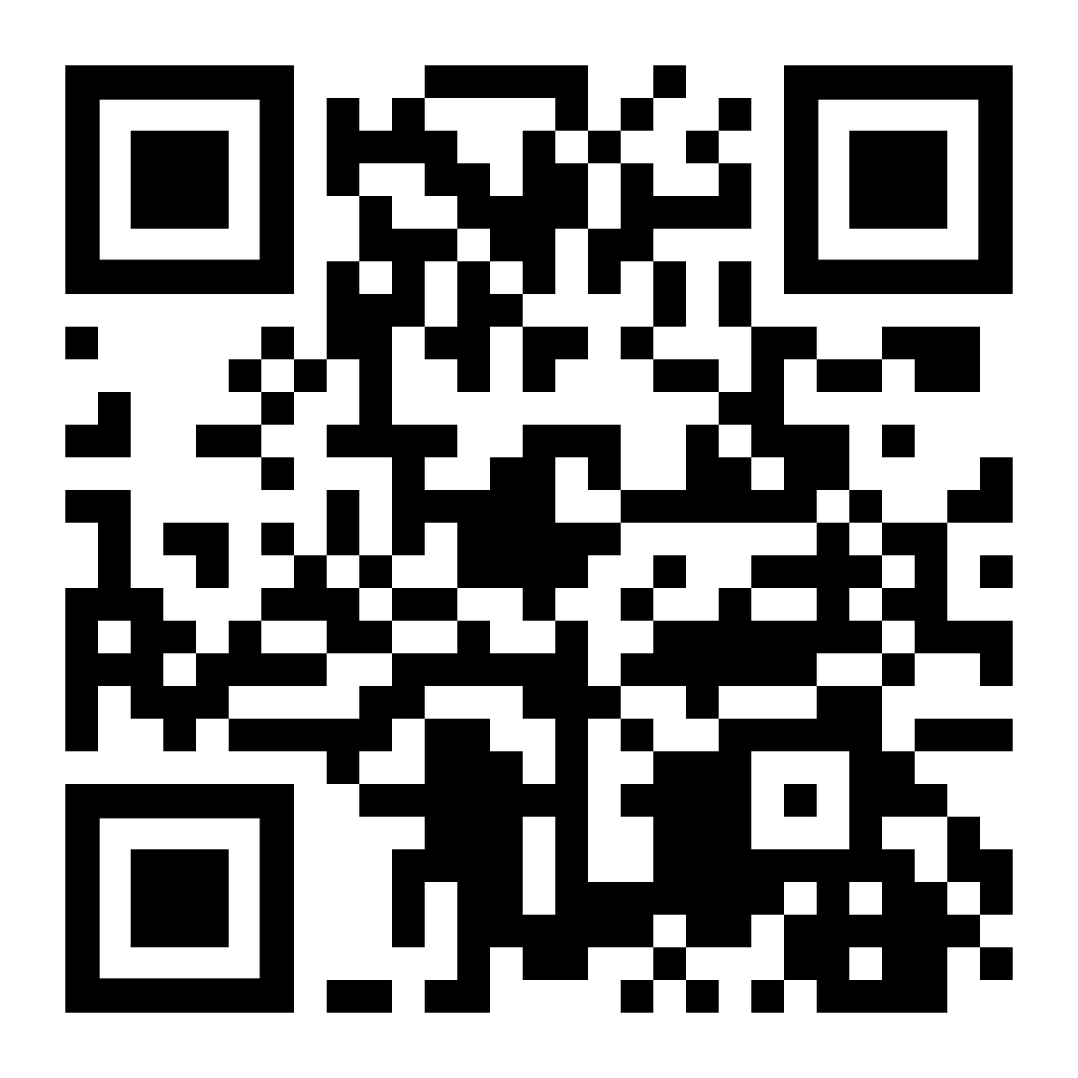
Thank you for attending!
More info at:
supportcdconelab.org
Supporting DE&I Initiatives in the Laboratory Workforce

