Slide 1



[Your Hospital Name]
Medical Laboratory
Science Program
[Needs to be a partnership – have a champion from nursing or other interprofessional team and one member from your finance or HR department]
[insert image of your hospital logo here]
Notes:
Replace images with pictures of your current team performing laboratory work (two smaller images) and larger image of your hospital or university.
Make sure to personalize images but keep professional.

Slide 2
Background
How does this impact the overall healthcare team and our patients?
“70% of medical decisions are based on diagnostic and laboratory testing.”
National Shortage in Laboratory Workforce
  Training programs unable to meet demand of growing field
  Aging Workforce and Retirements
Who can work in hospital laboratories?
  State Licensed and Board-Certified Professionals [Only Applicable Items]
  Additional Specialized Laboratory Training (e.g., hematology, blood bank, microbiology)
  Biological science degrees alone are not qualified for clinical laboratory positions
Limited Local Medical Laboratory Science (MLS) Training Programs
  University-Based Programs (Add your closest regional programs here - competitors)
  Hospital-Based Programs (Add your closet regional programs here – if very far emphasize that!)
Insert an image of your institution logo
Notes:
Fill in your details. You’ve got only 5 -10 minutes to make your point. Ho
Hit animation, “Why should you care?” - hit animation with the “Hook” Then lead into Baptist current growth and state of workforce.
Health care team relies heavily on what we do.

Slide 3
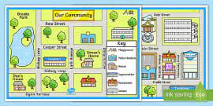
[Institution Name] – Current State (Why)
Expansion into [your regional expansion]
We’re Growing!
  [List new hospitals and ED lab locations]
  Additional expansion of our ambulatory campuses and primary care offices [increased volumes]
Retirements in Workforce
  Increase in non-productive and recruitment cost
  Operations maintained through overtime, critical staff bonuses, and borrowing existing staff
Training program needed
  Didactic classroom learning
  On-site medical laboratory techniques
Laboratory Personnel breakdown by Age (n = MLT/MLS total )
47.2%
Insert an image of your institution logo
Notes:
Regional expansion image – this can be obtained from your HR, marketing, or communications team.
Human Resources or internal programs can provide current employee counts. Percentage in each age group can be calculated by [count in each age range]/[total employee count]
We’re growing bullet point
Saying - 20 MLS staff team members and 2 laboratory supervisors needed.
Next point – say “Greater volume of laboratory testing and expansion of existing personnel”.
Increasing Retirements in Workforce – refer over to Laboratory Personnel Breakdown – 47.2% laboratory staff over the age of 46 (n = 210). Next point (Operations) – make sure to stress at the end to stress the national shortage of laboratory professionals plus the Mayo clinic 6% increase. “We need to train our own laboratory staff” – Ideal model being used across the nation.
Training Program Needed
Specialized training in preparing blood for transfusions, clinical chemistry, blood diseases (e.g., cancer, sickle cell), microbiology (e.g., identifying bacteria and appropriate antibiotics, molecular biology (specialized techniques, virus, and bacteria detection), and emerging sophisticated technology and concepts.

Slide 4
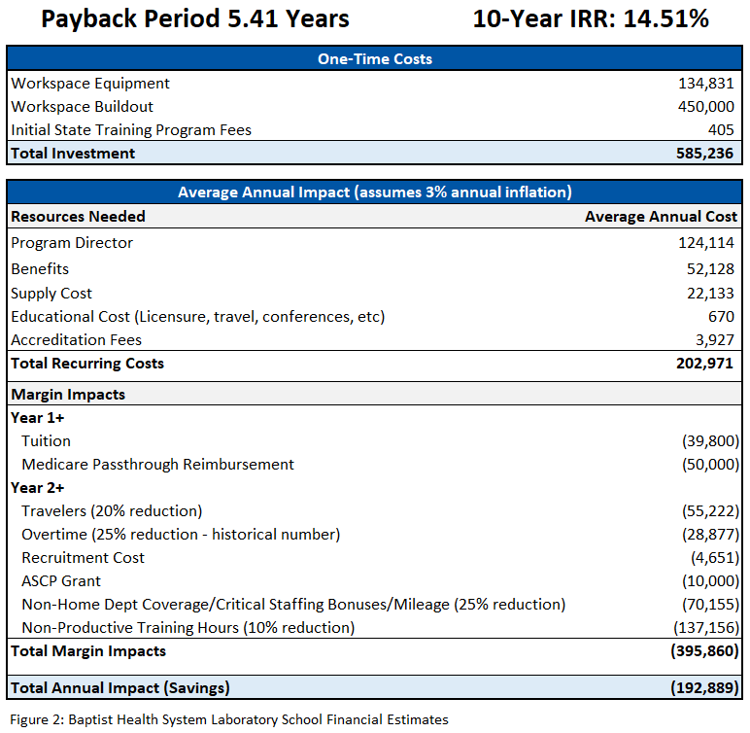
Financial Estimates
[Higher level view] – Only Key Financial Estimates here. Payback Period as close to 5 years. Project the Internal Rate of Return (IRR) for 10 years. Find a partner in finance interested in addressing workforce shortages. Pick key financials only. Don’t get them bogged down in granular details. Be ready to speak to details –when asked.
Find out what metrics matter to your audience (e.g. length of stay (LOS))
Insert an image of your institution logo
Notes:
Market Place – NPR reference
Mention the North Kansas program “70% of staff graduates from their MLS hospital-based program” This is an investment in our future – Not an instant return/putting a band-aide on a problem
***Long term benefit – “Proof of concept” - North Kansas City Hospital (NKCH) School of Medical Laboratory Science where 70% of NKCH’s laboratory personnel are graduates of their program¹¹.

Slide 5

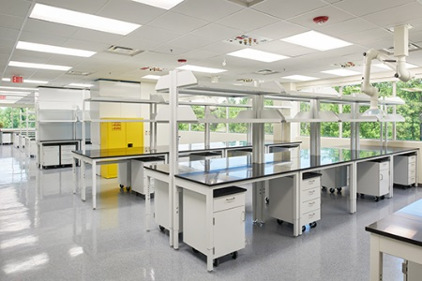
[Your Institution] Medical Laboratory Science Program
Program Start Up Needs
Program Director (FTE)
  Build and run program
Supply Cost
  Reagents
Capital Costs
  Program accreditation
  Buildout
    classroom, student laboratory, program director office
**Back-filled Laboratory Position will be need [if PD is in existing role]**
Insert an image of your institution logo
Notes:
Identify potential space, reagents needed, any community partners with financial backing. Ask for a back filling of faculty or laboratory position if program director is coming from an existing position.

