Slide 1
Using Turnaround Time (TAT) to Advocate for your Lab

Slide 2
Turnaround Time
Turnaround Time (TAT) impacts:
Length-of-Stay (LOS)
AM discharge by 11 AM
Faster diagnoses
Patient safety

Slide 3
Interpreting TAT Results and their Potenital Implications
Interpreting TAT Results and their Potential Implications
% of specimens collected by 8 AM is low (i.e. below 80%) indicates the need for additional phlebotomists to help with AM draws
Long TAT could be due to lack of control over Phlebotomy
Long specimen transport times could indicate an old pneumatic tube system, or lack of control over transport processes
Pre-analytic issues (high # of hemolyzed, QNS, clotted and Contaminated specimens)
% of specimens resulted by 8 AM or 9 AM is below threshold, could indicate the need for:
Additional MLS/Lab Technicians
Automation, newer equipment

Slide 4
Turnaround Time Sample Metrics
Useful Turnaround Time Metrics to use in the Lab for Troubleshooting
the Process Growing and aging population
Received to Completed
Order to Receipt in the Lab
Order to Verify/Completion

Slide 5
Troponin from Receipt to Completion (within 45 minutes and 60 minutes)

Slide 6
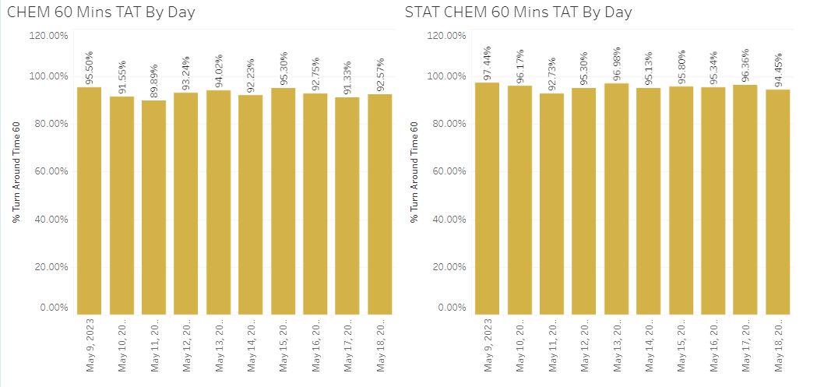
Chem TAT (Routine Vs. Stat/ED)

Slide 7
CBC TAT (Routine Vs. STAT/ED)

Slide 8
TYSC and COAG TAT

Slide 9
Monthly TAT
For trending purposes

Slide 10
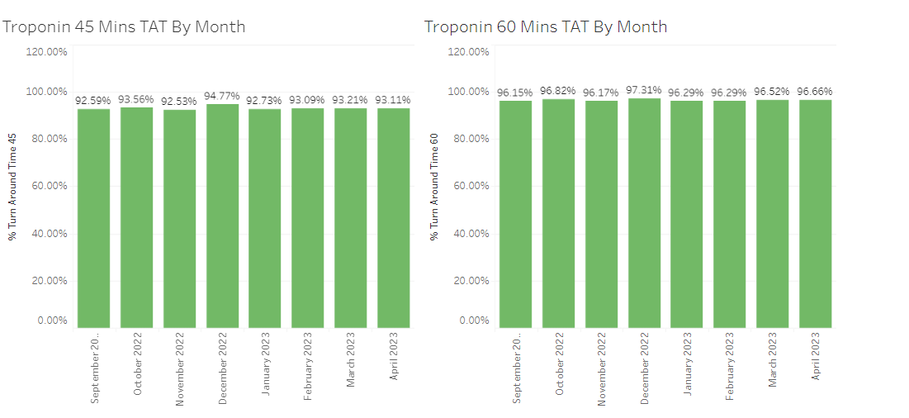
Monthly Troponin TAT

Slide 11
Monthly Chem TAT

Slide 12
Monthly CBC TAT

Slide 13
Monthly TYSC and COAG

