Slide 1
Lab Test Volume/Productivity to advocate for your Lab

Slide 2
Increasing Pressures on Diagnostic Testing
Healthcare executives understand the importance of the diagnostic lab to patient care; as many as 70 percent of clinical decisions are based on in vitro diagnostic lab results.
Unfortunately, three crucial healthcare trends present serious
challenges for diagnostic laboratories:
Growing test volume
Shortage of staff
Decreasing reimbursements

Slide 3
Increasing Pressures
Test volume continues to rise due to:
Growing and aging population
Continuous introduction of new lab tests
Enhancing proactive measures in managing disease-states more effectively.

Slide 4
Test Volume Metrics and Productivity
Test Volume Metrics can help review and optimize the following:
Productivity
Staffing
Implementation of Automation
Eliminate wasteful steps and motion
Align equipment to workflow so staff can move more efficiently
Optimize processes before automating to standardize and ensure consistency

Slide 5
Other Metrics
Monthly and Daily volume
Hourly test volume
Monthly Productivity
Hourly Productivity
Instrument Capacity

Slide 6
Metrics-Volume by encounter and Volume by ordering location

Slide 7
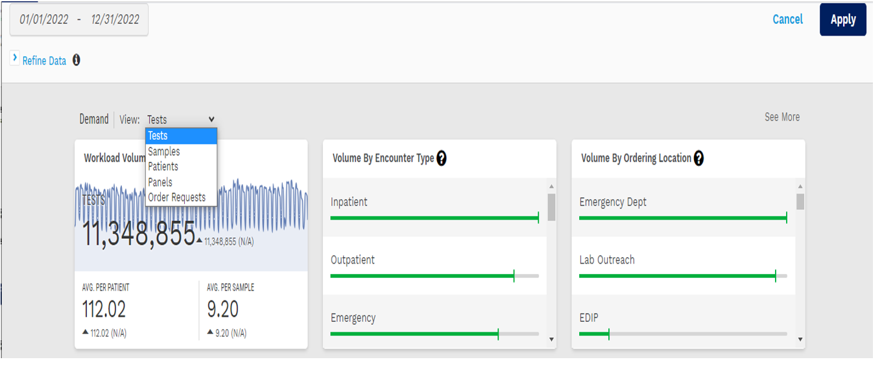
Volume by Tests, Samples, Patients, Panels

Slide 8
Order Volume: Filter by Test Volume, Department, Order Name, Ordering MD, Location

