Slide 1
Phlebotomy Metrics
AM Draws

Slide 2
Facts/ Background
Timeliness of inpatient tests is central to physician satisfaction with laboratory services.
About 30-40% of physicians listed either routine test turnaround time or inpatient STAT test turnaround time as the most important laboratory service category.
Results that are not back in time for physician rounding may lead to delays in patient management
The availability of results in time for physician morning rounds is an important laboratory quality indicator because:
Results in an increased length (LOS) of hospital stay.
Increased LOS results in an increased cost and loss in revenue

Slide 3
Background
Analyzing the percentage of Phlebotomy morning draws in a laboratory can provide valuable insights into workflow efficiency, resource allocation, and patient satisfaction.
When advocating for your lab based on the percent of morning draws, it's important to present the data in a clear and compelling manner, emphasizing the impact on patient care, efficiency gains, and the overall quality of lab services.
Providing concrete examples of how additional resources or changes in staffing can lead to positive outcomes will strengthen your case.

Slide 4
Evaluate Workflow and Build Key Quality Metrics
Analyze the data to identify specific peak hours during the morning. This information can guide staff scheduling and resource allocation to ensure that the lab is adequately staffed during periods of high demand.
Use the percentage of morning draws to advocate for appropriate staffing levels during peak hours. If the morning draws represent a significant portion of the daily workload, it may be necessary to allocate additional resources or adjust staffing schedules to meet the demand effectively.
Calculate the percentage of morning draws relative to the total number of draws performed by the laboratory. This metric helps assess the efficiency of morning operations and identifies peak periods of activity.

Slide 5
Recommendations
01
02
03
Calculate the percentage of morning draws relative to the total number of draws performed by the laboratory. This metric helps assess the efficiency of morning operations and identifies peak periods of activity.
Build an interactive metric to calculate:
% Of AM draws by certain time: 8 AM, 9 AM, 10 AM etc.
% of AM lab draws received in the Lab by 8 AM, 9 AM etc.
% of AM lab draws resulted by 8 AM, 9 AM, etc.
Set a benchmark: preferably 90% of lab results resulted by 8 AM or 9 AM so it is available for physician rounding.

Slide 6
AM Lab Metrics
Sample Metrics

Slide 7
Daily AM Lab by 9 AM (% collected, % Received, % Completed)

Slide 8
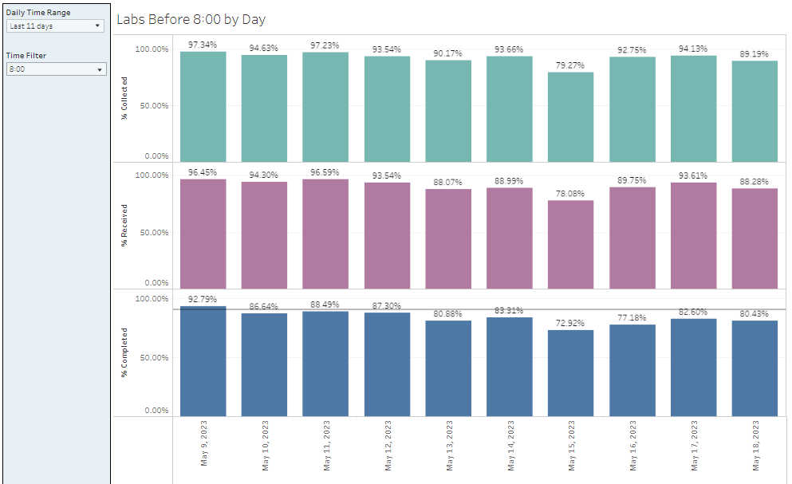
AM Labs by 8 AM

Slide 9
Daily AM TAT and Order Volume by 8 AM

Slide 10
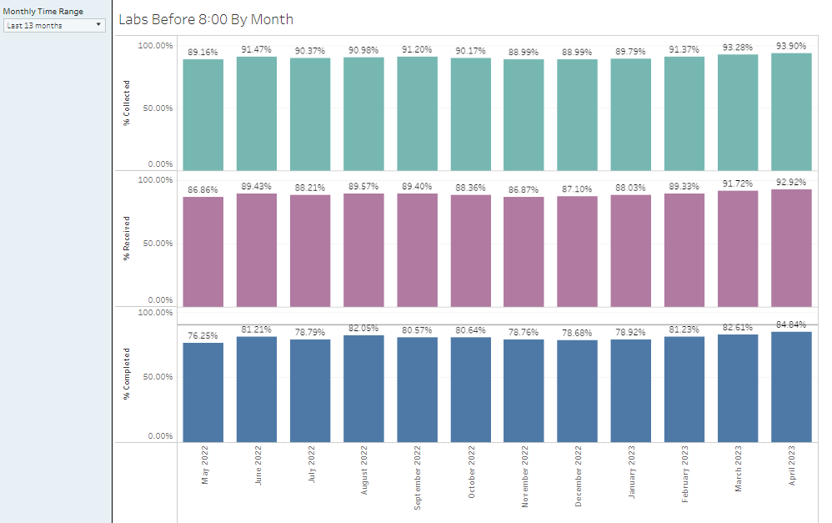
Monthly AM labs by 8 AM

Slide 11
Monthly AM Lab TAT by 8 AM

