Slide 1
Using Blood Utilization Metrics to Advocate for your Lab

Slide 2
Background
Utilization management in the Transfusion Service requires a multi-faceted approach due to the scope of practice of transfusion medicine.
Most clinical laboratories use 60–65% of their budget for labor and only 35–40% for consumables. In contrast, only 30% of the Transfusion Service budget is used for labor while 70% is allocated for consumables and blood products.
Blood product transfusion purchases are one of the largest line items among the hospital and laboratory charges.
Evaluating the sources of cost, managing inventory and establishing a blood management program based on evidence will lead to improved patient outcomes while reducing costs.

Slide 3
Background1
As cost pressures mount upon providers, blood conservation is a key area of focus where hospitals and health systems can improve the quality of care, reduce risk to patient safety, and eliminate excess spending concurrently.
Essentially, less is more when it comes to blood transfusion.

Slide 4
The Business Case for the Hospital C-Suite
As cost pressures mount upon providers, blood conservation is a key area of focus where hospitals and health systems can improve the quality of care, reduce risk to patient safety, and eliminate excess spending concurrently.
In order for patient blood management programs to thrive, buy-in from frontline providers is critical.
Develop a culture change and create new standards of care for blood use by:
Collaborating with physicians, nurses , and clinical leaders to form a multi-disciplinary transfusion committee.
Supporting education campaigns to underscore the minimal use of blood (i.e. “why give two when one will do”).
Focusing on Perioperative Management

Slide 5
Metrics
Blood usage can be tracked by including the following filters/Criteria:
Product Type:
Product Type:
Filter by:
Platelets
Red Cells
CRYO
Plasma
Hgb of 7.0 g/dl or 8.0 g/del etc.
PLT Count
Fibrinogen level
INR
Specialty
Location
Ordering MD

Slide 6
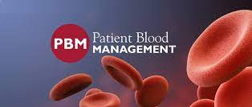
Blood Utilization Patient Blood Management Sample Metrics

Slide 7
Patient Blood Management

Slide 8
Blood Utilization Dashboard
Should be able to filter by
Product Type
Date range
Hgb Value, PLT count Value, INR…
Location
Physician
Specialty

Slide 9
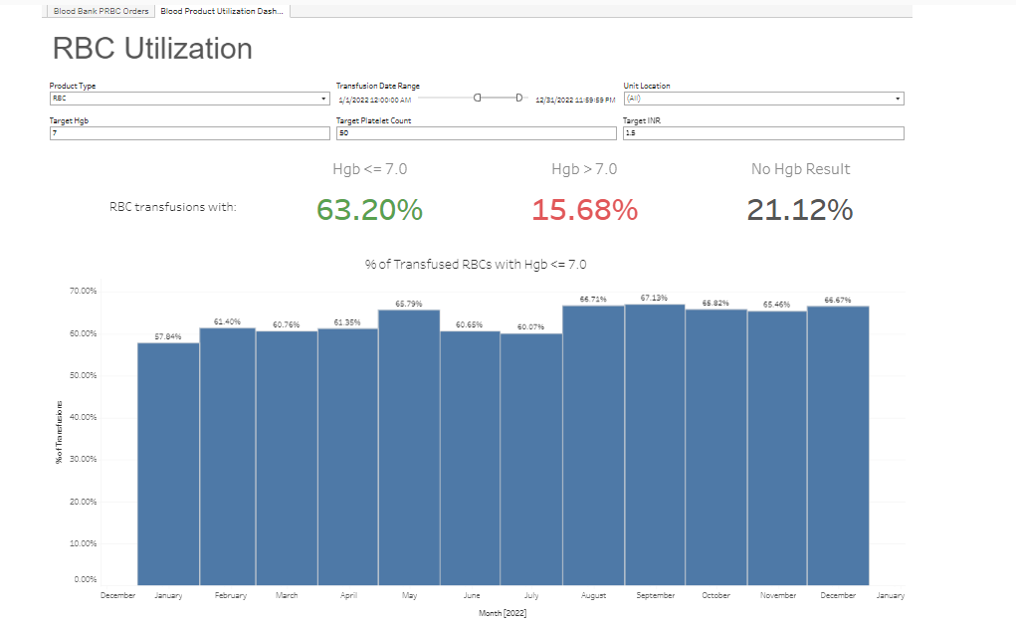
Overview Home Page

Slide 10
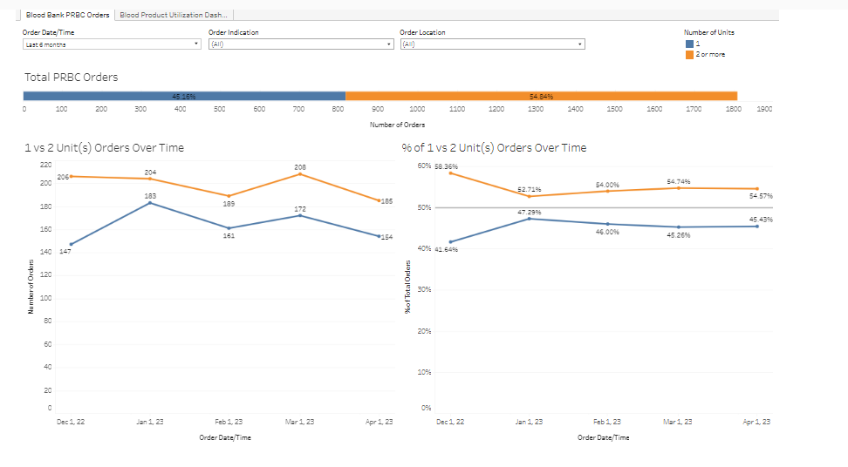
Overview Home Page of 1 unit Vs. 2 units

Slide 11
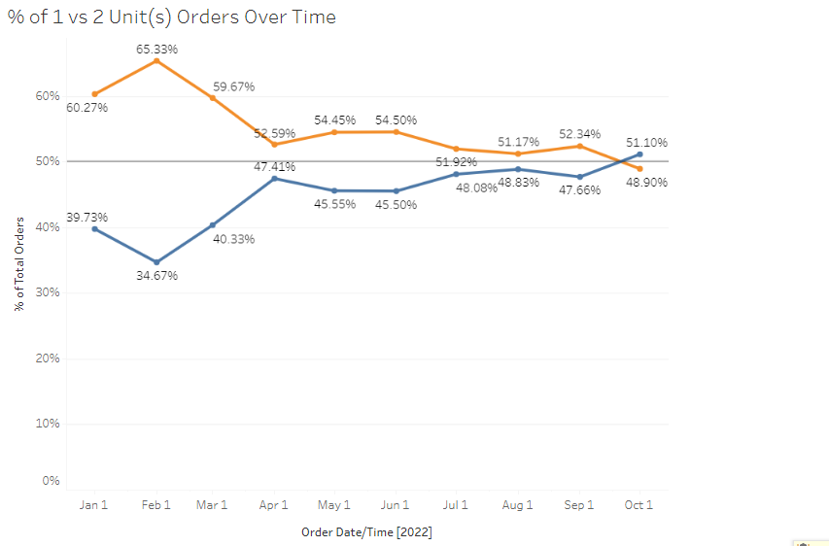
Percent of 1 VS 2 Unit(s) orders over time

Slide 12
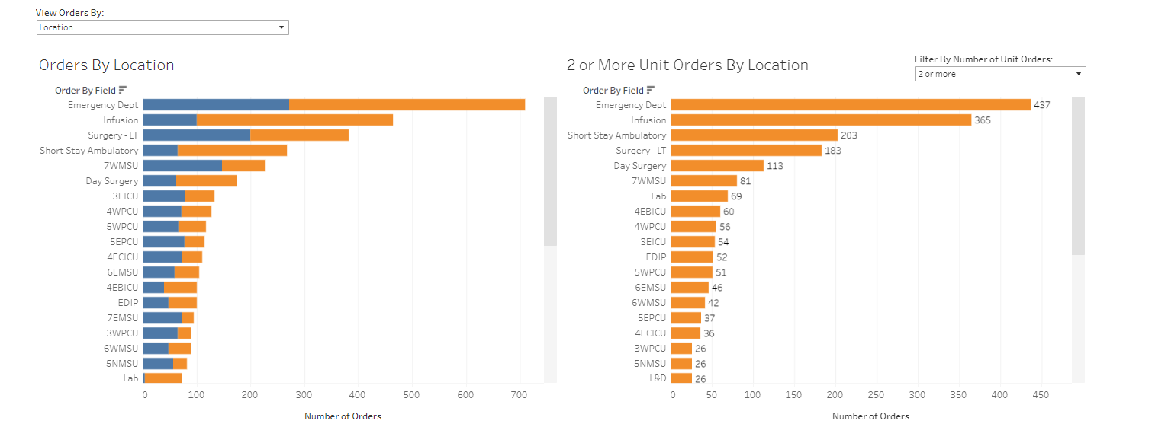
1 VS 2 Unit (S) by Location

Slide 13
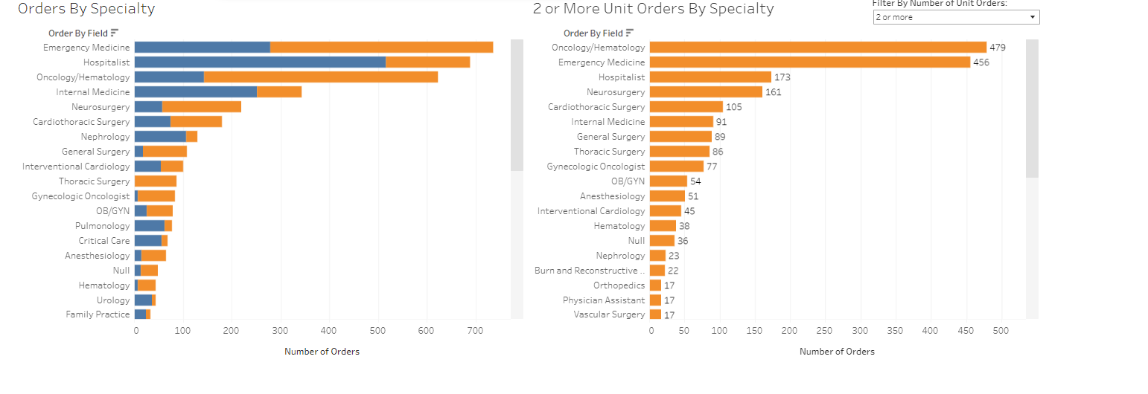
1 VS 2 Unit(S) Orders by Specialty

Slide 14
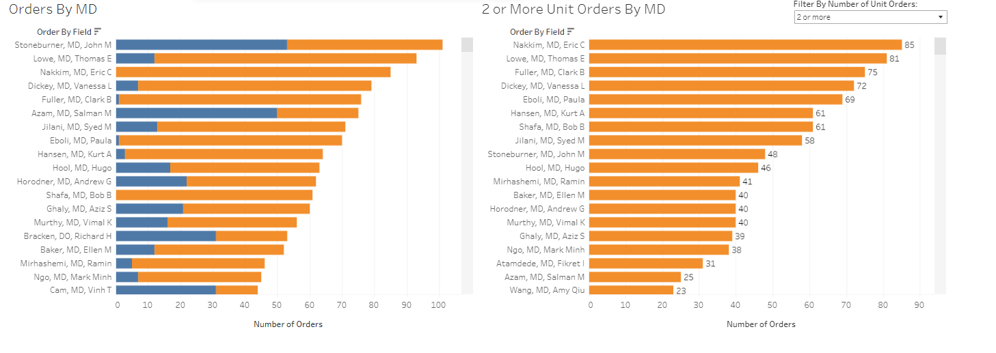
1 VS 2 Unit(S) by Ordering MD

Slide 15
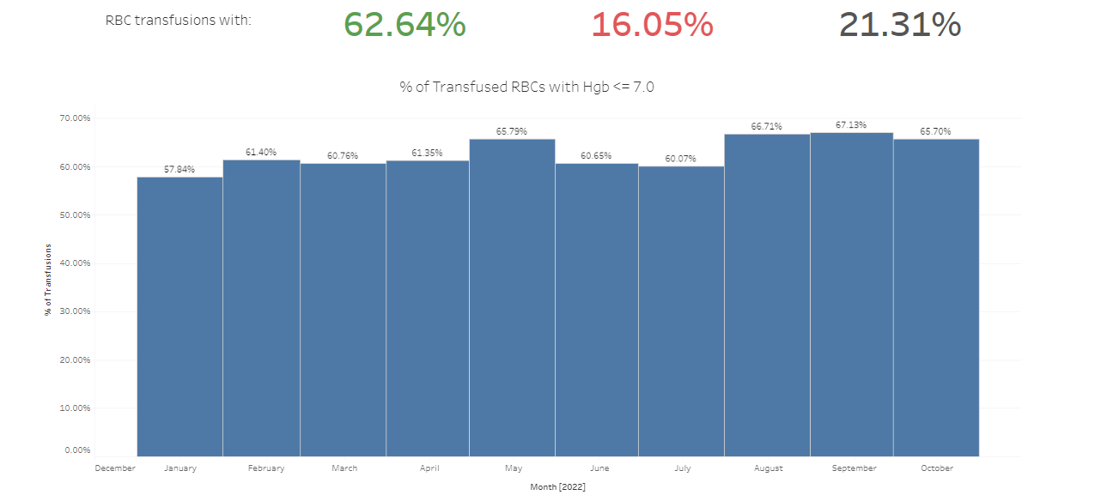
RBC Utilization-All Location Hgb 7.0

Slide 16
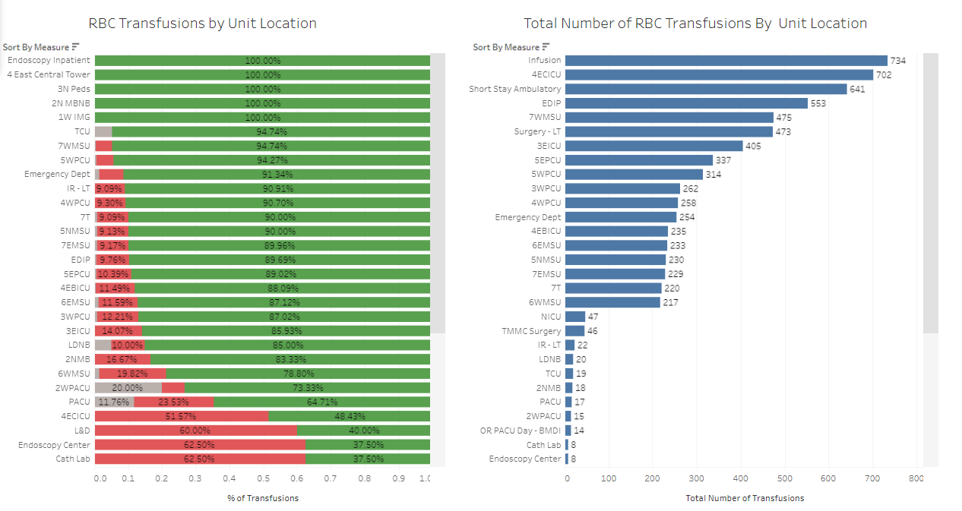
RBC Utilization by Location Hgb 7.0

Slide 17
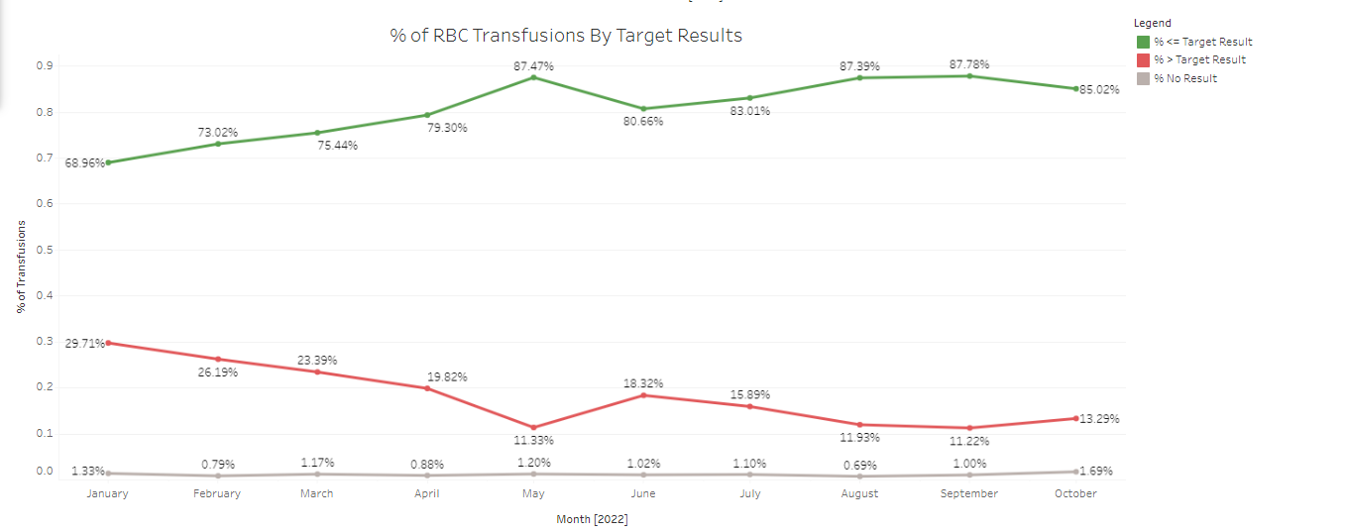
Hgb 7.0 Excluding Infusion center and Operating Rooms

Slide 18
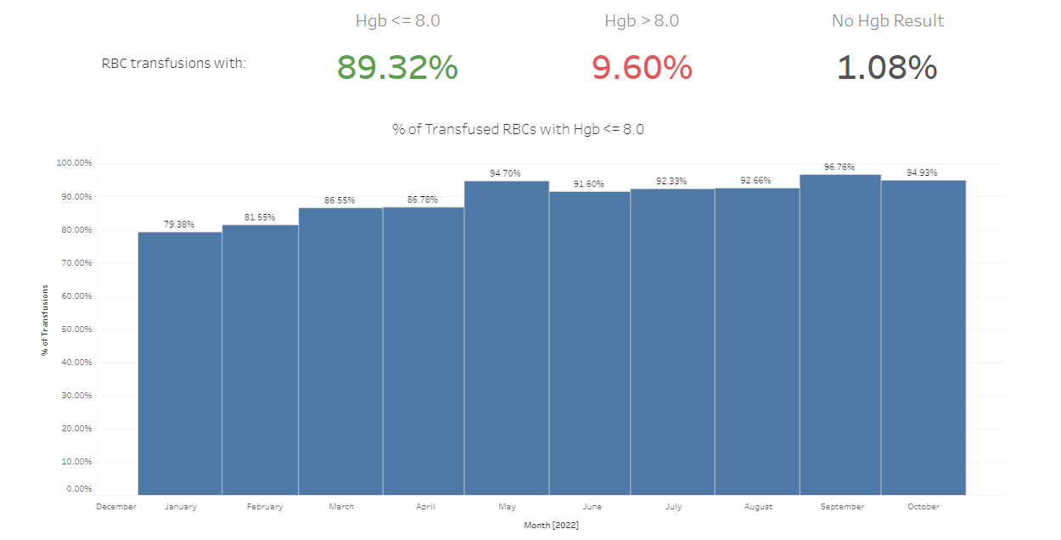
Hgb 8.0 Excluding Infusion Center and ORs

Slide 19
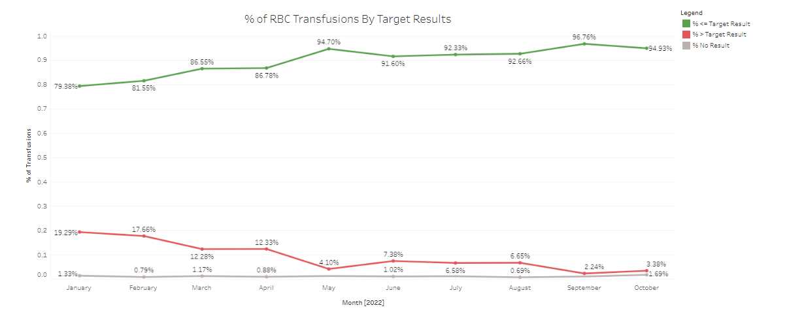
Hgb. 8.0 by Specialty excluding Infusion Center and ORs

Slide 20
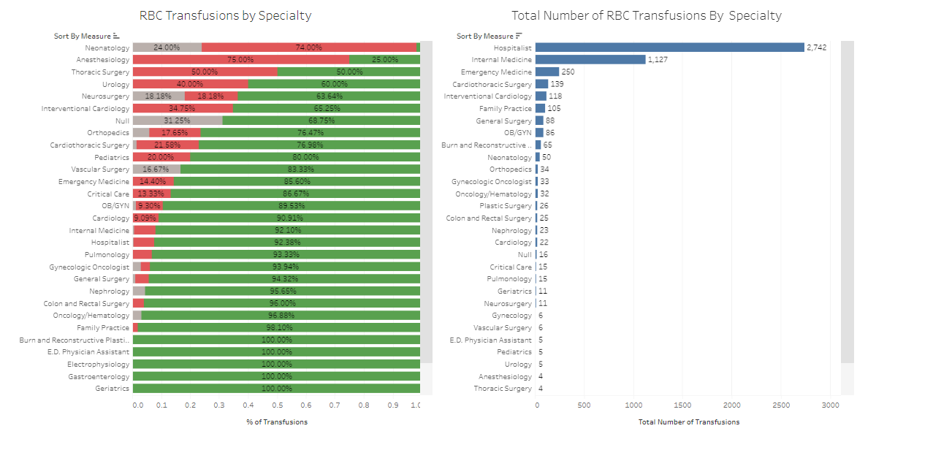
Hgb. 8.0 by Specialty excluding Infusion Center and ORs1

