Slide 1
International Lab Scientists Practicing in the US
Patricia Salazar Uychiat, Varvara Kozyreva, Martin Muganzi, Rex Famitangco, Matthew Schulze
Building Bridges Across the Laboratory Community – July 9, 2025

Slide 2

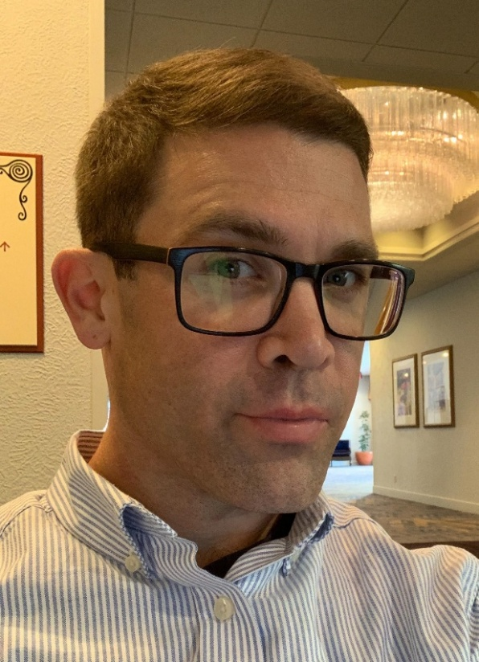
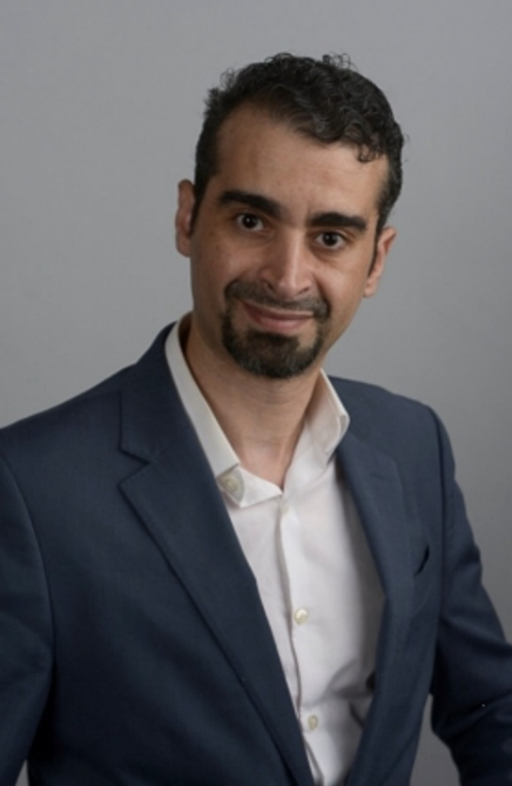
Joseph Baker
BA, MS
Director of Engagement & Experience​
ASCP Board of Certification
Mohamed Abdelmonem
PhD, MBA-HCM, CLS, H(ASCP)^{CM}CMBB^{CM}, MLS(ASCP^{i})^{CM}SBB^{iCM}
Clinical Laboratory Supervisor,
Stanford University School of Medicine

Slide 3
Funding Statement
This project is supported by Cooperative Agreement number CDC-RFA-OE22-2202 (CFDA No. 93.322), funded by the Centers for Disease Control and Prevention. Its contents are solely the responsibility of the American Society for Clinical Pathology and do not necessarily represent the official views of the Centers for Disease Control and Prevention or the Department of Health and Human Services. This project was 100% funded with federal funds to the American Society for Clinical Pathology (NU47OE000107).

Slide 4
Format of Today’s Session
Part 1: Navigating Career Transitions into the US Laboratory Workforce
    Patricia Salazar Uychiat
    Varvara Kozyreva
    Martin Muganzi
Part 2: Short Primer on Immigration Process
    Rex Famitangco
    Matthew Schulze
Q & A Session
Session Wrap-Up
Notes:
Pre-Webinar Slide Deck Runs: 10:55 – 11:01 am [~6 min]
Moderator(s) Introduce Session: 11:01 - 11:05 [~4 min]
Career Map Presentations (10-12 min/panelist): 11:05 am- 12:05 pm [~1 hr]
Q & A Session: 12:05 - 12:25 pm [~20 min]
Wrap-up: 12:25 – 12:30 pm [~5 min]

Slide 5
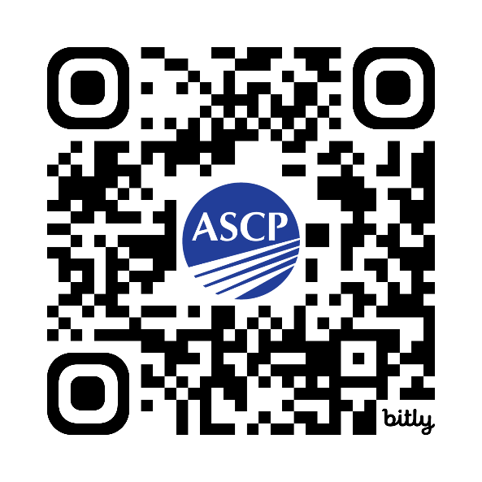
What to Expect at Today’s Session
This webinar will offer:
general guidance on international career transitions based on panelists’ experiences.
a brief overview of the US federal policies relevant to immigration and the lab workforce.
a supporting “In Case You Missed It” reference document – links, additional resources
  Available in 2 weeks on our Building Bridges site
  Shortcuts: QR code or https://bit.ly/ASCP-BB-Intl
Moderators and panelists may not address questions related to specific attendee circumstances

Slide 6

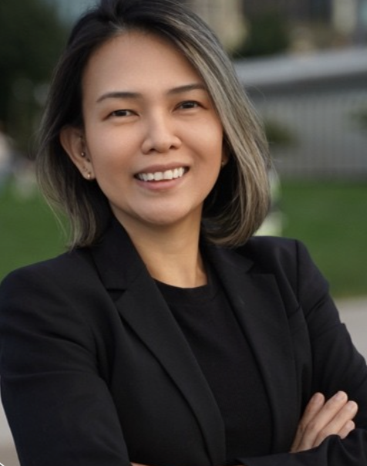
Patricia Salazar Uychiat
MLS(ASCP^{i})^{CM}
Associate Administrator of Laboratory Services,
USC Keck Medicine

Slide 7

Patricia Uychiat
In the 2025 ASCP Building Bridges Across the Laboratory Community series, we focus on highlighting the diverse array of laboratory career pathways and how exposure to formative experiences, often through collaborations, partnerships, and unique training opportunities, can shape these laboratory career trajectories.
MLS(ASCP^{i})^{CM},MHA*
EDUCATION
Executive MHA: Columbia University Mailman School of Public Health - October 2025*
BS Medical Laboratory Science: Southwestern University, Philippines - March 2010
Training in the Philippines
Exploring LIS through a hands-on role
Leading through the COVID-19 pandemic
Pursuing an Executive MHA at Columbia University
Formative Experiences in My Laboratory Career
2024
Associate Administrator, Laboratory Services
Keck Medicine of USC, Los Angeles, CA
“
How I “Build Bridges” within the Lab Community or Profession
Mentoring new laboratory professionals
Connecting on LinkedIn
Promote leadership and visibility for laboratorians worldwide
2018
Operations Manager → Director (CP and AP)
Mount Sinai West, New York, NY
Every skill you pick up is a stepping stone.
If there’s no clear path, make your own—and leave it a little wider for the next person.
2017
QC Supervisor, Chemistry
Mount Sinai Beth Israel, New York, NY
2016
Generalist Medical Laboratory Scientist
New York Presbyterian, The Allen Hospital, NY
Volunteering at hospitals and clinics
  ASCP mentoring program
  Seminars and Conventions
  PAMET
2015
LIS Analyst
Montefiore Medical Center, New York, NY
Opportunities of Interest*
2012
Blood Bank Medical Laboratory Scientist
Mount Sinai Medical Center, New York, NY
2011
Blood Bank Medical Laboratory Scientist
Montefiore Medical Center, Bronx, NY
The 3 Most Valuable Skills (Technical and/or Soft Skills) You Use on a Daily Basis
Problem Solving
Communication
Strategic Thinking
CURRENT RESPONSIBILITIES
Drives system-wide laboratory strategy
Oversee operations and regulatory compliance
Support team growth and leadership development

Slide 8

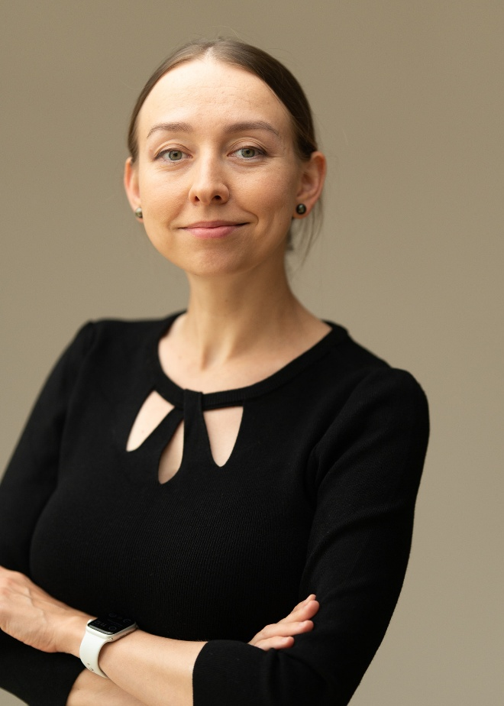
Varvara Kozyreva
PhD, PHM, HCLD(ABB)
Section Chief, Mycobacterial, Mycotic, and Parasitic Diseases Section –
Microbial Diseases Laboratory Branch,
California DPH

Slide 9
Varvara Kozyreva
In the 2025 ASCP Building Bridges Across the Laboratory Community series, we focus on highlighting the diverse array of laboratory career pathways and how exposure to formative experiences, often through collaborations, partnerships, and unique training opportunities, can shape these laboratory career trajectories.
PhD, PHM-CA(ABB), HCLD(ABB)
EDUCATION
BS, Biology Department (Biochemistry & Biophysics), Saratov State University, Russia
PhD, Microbiology, Smolensk State Medical Academy, Russia
Formative Experiences in My Laboratory Career
Validating whole-genome sequencing (WGS) as the first PHL in the US to offer a broad microbiological CLIA-compliant WGS assay (03/2016).
Giving keynote talk at ASM NGS 2018.
Rotating across local PHLs during CA PH Microbiologist (PHM) training.
Going on a ride with a social worker administering TB Directly Observed Therapy to the underserved population
California Department of Public Health (CDPH), Richmond, CA, US:
2021-now
Section Chief, Mycobacterial, Mycotic, and Parasitic Diseases Section; CDPH
“
2016-2021
Genotyping Unit Supervisor, Foodborne and Waterborne Diseases Section; CDPH
How I “Build Bridges” within the Lab Community or Profession
Participation in APHL committees.
Hosting fellows and student interns.
Giving annual lectures at the Curry International Tuberculosis Center for clinicians and TB program managers.
Collaborating with academic researchers.
2014-2016
Research Scientist III, Whole Genome Sequencing Core Laboratory; CPDH
Got a goal? Walk towards it.
Can’t walk? Crawl towards it.
Can’t crawl? Lie down and lie towards it.
Internet, possibly paraphrased Dr. Martin Luther King Jr.
West Virginia University (WVU), Morgantown, WV, US:
2012-2014
Postdoctoral Fellow, Biochemistry Department/Cancer Center; WVU
Institute of Antimicrobial Chemotherapy (IAC), Russia:
Opportunities of Interest*
APHL Public Heal​th Laboratory Fellowship Program
California Public Health Microbiologist certification training
APHL's Board Certification Exam Boot Camp
2006-2012
Staff Researcher, Molecular Mechanisms and Epidemiology of Antimicrobial Resistance Laboratory; IAC
CURRENT RESPONSIBILITIES
Supervision and administrative support for clinical laboratory testing.
Scientific guidance for troubleshooting of high-complexity testing, test development, and validation.
Regulatory compliance.
The 3 Most Valuable Skills (Technical and/or Soft Skills) You Use on a Daily Basis
Communication
Prioritization & time management
Resourcefulness
Notes:
APHL Public Heal​th Laboratory Fellowship Program; https://www.aphl.org/Career-Pathways/fellowships/Pages/default.aspx
Public Health Microbiologist (PHM) certification training; https://www.caphld.org/public-health-microbiologist-training
APHL's Board Certification Exam Boot Camp: https://www.aphl.org/Career-Pathways/Leadership/Pages/APHLs-Board-Certification-Exam-Boot-Camp.aspx

Slide 10
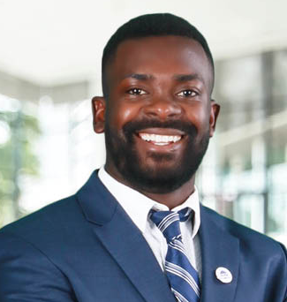
Martin Muganzi
MBA, MLS(ASCP^{i})^{CM}
Laboratory Information Systems Administrator
Kingman Regional Medical Center

Slide 11
Martin Muganzi
In the 2025 ASCP Building Bridges Across the Laboratory Community series, we focus on highlighting the diverse array of laboratory career pathways and how exposure to formative experiences, often through collaborations, partnerships, and unique training opportunities, can shape these laboratory career trajectories.
MBA, MLS(ASCP^{i})^{CM}
EDUCATION
Master of Business Administration, Uganda Martyrs University
Bachelor of Biomedical Laboratory Technology, Makerere University
Junior Lab Tech at Lancet Labs/Baylor Uganda
Assistant Lecturer at a university
Becoming ASCP Certified
40under40, LMU / Project Management
Formative Experiences in My Laboratory Career
Creating meaningful networks
Participating in local/national lab related events
Building networks for others to connect: Africa Laboratory Management Academy, ASCPi Facebook Group
2023
LIS Administrator
Laboratory, Kingman Regional Medical Center, Arizona
How I “Build Bridges” within the Lab Community or Profession
“
2022
Lead Medical Laboratory Scientist
Laboratory, Kingman Regional Medical Center, Arizona
2020
Medical Laboratory Scientist
Laboratory, Valley View Medical Center, Arizona
Life can be challenging, and so can everything in it –but when we each give our best, we lift everyone higher.
Laboratory Management University
Africa Laboratory Management Academy
Certification in Healthcare Information Systems
National Association for Healthcare Quality | Project Management Professional | Udemy Courses on HL7
2016
Assistant Lecturer
Dept. of Microbiology, Kampala International University
Opportunities of Interest*
CURRENT RESPONSIBILITIES
LIS Management and Maintenance
Project Management
Test Utilization
Workflow Optimization & Systems Integration
Data Management, User training and support
The 3 Most Valuable Skills (Technical and/or Soft Skills) You Use on a Daily Basis
Emotional Intelligence
Problem solving
Research and Writing
Notes:
*Please include links to active career or training opportunities relevant to your professional career trajectory. This information is accurate as of its publication.

Slide 12
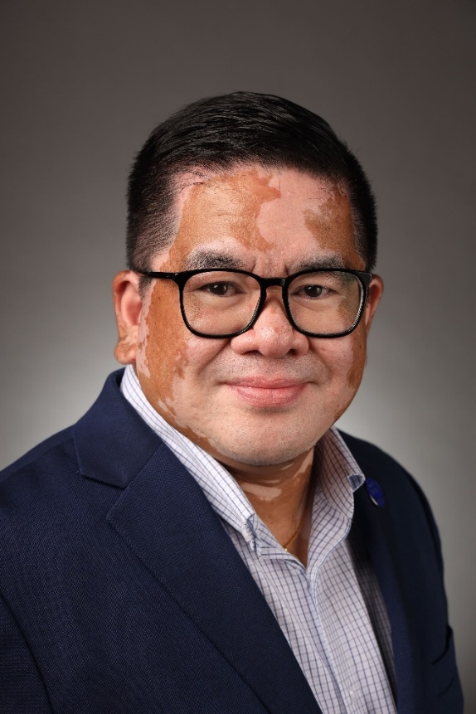
Rex Famitangco
MS, MASCP, MLS(ASCP)^{CM}QLC^{CM}
Laboratory Administrative Director
Morrill County Community Hospital

Slide 13


Rex F. Famitangco
In the 2025 ASCP Building Bridges Across the Laboratory Community series, we focus on highlighting the diverse array of laboratory career pathways and how exposure to formative experiences, often through collaborations, partnerships, and unique training opportunities, can shape these laboratory career trajectories.
MS, MASCP, MLS(ASCP)^{CM} QLC^{CM}, IFBA PC, RBP(ABSA)
EDUCATION
Master of Science, Clinical Laboratory Science,
Michigan State University
Bachelor of Science, Medical Technology,
Trinity University of Asia
Insert
photo
here
Formative Experiences in My Laboratory Career
MCCH day to day lab operations
ASCP Global Health & ASCP-BOC
CoVID-19 Pandemic
2003 -Current
Laboratory Administrative Director
Morrill County Community Hospital, USA
How I “Build Bridges” within the Lab Community or Profession
Participating in professional organization(s)
Fostering inclusivity
Participating in mentorship programs
“
2009 –
2020
MLT & PBT Program Director & Instructor
Western Nebraska Community College, USA
2003- 1999
Medical Laboratory Technologist II
Security Forces Hospital, Saudi Arabia
The only way to do great work is to LOVE what you do…
Laboratory Management
Quality Management System & Lean Healthcare
Biosafety & Biosecurity
1999-1997
Medical Technologist
UST Hospital, Philippines
Opportunities of Interest*
CURRENT RESPONSIBILITIES
Direct & Manage Daily Lab Operations
Technical & General Supervision
Train Laboratory & Clinic Nursing
Testing Personnel
The 3 Most Valuable Skills (Technical and/or Soft Skills) You Use on a Daily Basis
Communication
Teamwork
Emotional Intelligence
Notes:
*Please include links to active career or training opportunities relevant to your professional career trajectory. This information is accurate as of its publication.

Slide 14
Pathways for Foreign Medical Laboratory Professionals to work in the USA
Rex F. Famitangco, MSc, MASCP, MLS(ASCP)^{CM} QLC^{CM}, IFBA PC, RBP(ABSA)
Laboratory Administrative Director, Morrill County Community Hospital

Slide 15
Disclosure
The views expressed in this presentation are solely of those of the presenter and do not reflect the views of his employer(s), professional affiliates or colleagues.
I am NOT an immigration lawyer, but I have initiated and supported immigration processes for our foreign national team members based on available employer-sponsored pathways and guidance from our legal counsel.
I am a Past National President of PAMET-USA Inc. and Founding President of PAMET-USA Nebraska Chapter.

Slide 16
H-1B Visa Pathway Overview
Temporary, employer sponsored nonimmigrant visa
Valid for up to 6 years (initial 3 years + extension)
Position requires a bachelor’s degree in medical laboratory science or equivalent
Requires U.S. Labor Condition Application (LCA) and U.S. Citizenship and Immigration Services (USCIS) petition

Slide 17
H1-B Visa: Process & Timeline
1
U.S. Employer identifies need for MLS
2
Employer files Labor Condition Application (LCA) with U.S. DOL
(Time: Varies (1 week to >6months)
3
Employer files H-1B Petition (Form I-129) with USCIS
(Time: 2 to >6mos or <15 days with Premium Processing)
4
5
6
7
8
USCIS reviews petition and issues decision
(Time: 2 to >6mos or <15 days with Premium Processing)
If Approved: Receive H-1B Approval Notice (Form I-797)
(Time: 1 to 2 weeks)
Foreign MLS Applies for H-1B Visa Interview & Stamping at U.S. Embassy or Consulate
(Time: 2 to 4 weeks depending on embassy/consulate availability)
Visa Issued, Processing of Originating Country Requirement(s) and Entry to the U.S.
(Time: Visa issuance 1 week after interview; Country Requirement: Varies 2 to 4 weeks)
Begin employment as MLS under H-1B Status
Start Date: As listed on USCIS Approval Notice

Slide 18
EB-3 Visa Pathway
Employment-based immigrant visa (Green Card/Permanent Residency)
Permanent position offer required
Includes: Program Electronic Review Management (PERM) Labor Certification, USCIS I-140 petition and CGFNS VISA Screen
Wait times depend on country of birth and visa bulletin

Slide 19
EB-3 Visa: Process & Timeline
1
U.S. Employer offers permanent MLS position
2
Employer files PERM Labor Condition Application (LCA) with U.S. DOL
(Time: Varies (6 months to >9 months)
3
Upon PERM approval: Employer files I-140 Petition with USCIS
(Time: 6 to >8 months or <15 days with Premium Processing)
4
5
6
7
8
WAIT for Priority Date to become CURRENT (Visa Bulletin)
(Time: Varies by country, 0 to >2 years)
Apply for Immigrant Visa (Consular) or Adjustment of Status
(Time: 6 to >12 months)
Visa interview and medical examination
(Time: within 1 to >2 months depending on embassy/consulate availability)
Immigrant Visa Approval, processing of Originating Country Requirement(s) and Entry to the U.S. and Green Card issuance
(Time: Visa issuance 1-2 weeks after interview; Country Requirement: Varies 2 to 4 weeks)
Begin employment as permanent resident
(Time: Upon visa activation)

Slide 20
Credentialing and Certification Requirements
Credential evaluation (e.g. WES, ECE) for foreign degrees
Certification required (e.g. MLS(ASCPi)^{CM})
English Language Proficiency of non native English speakers
  TOEFL/IELTS for Visa Screen and some licensure requirements
State Licensure required in certain states (e.g. CA, FL, HI, LA, MT, NV, NY, ND, TN, WV, PR)

Slide 21
Workforce Climate
Increased demand for MLS due to workforce shortages
Tightened scrutiny of H1-B approvals in certain sectors
Visa retrogression impacts Green Card wait times

Slide 22
Key Takeaways for Foreign Lab Professionals
SET YOUR GOALS CLEARLY
Plan early, do your research and secure a sponsoring employer
Understand visa timelines and credentialing requirements
Stay updated on policy shifts and priority dates
Build a long-term pathway from temporary to permanent status
BE PATIENT

Slide 23
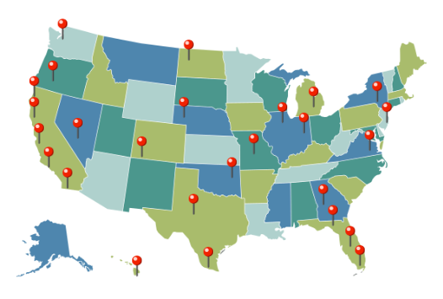

PAMET-USA Inc. at a Glance

Slide 24
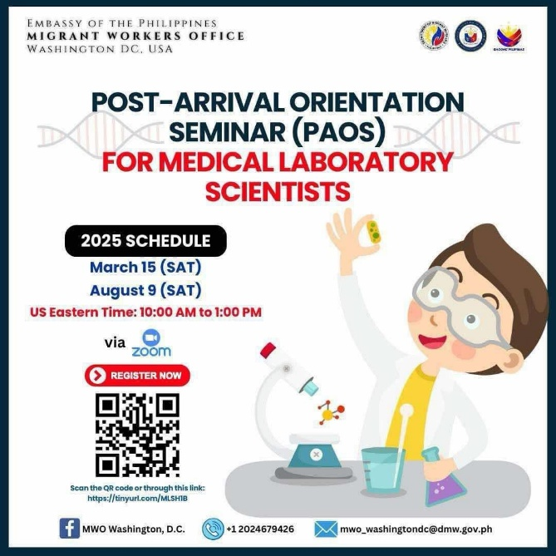
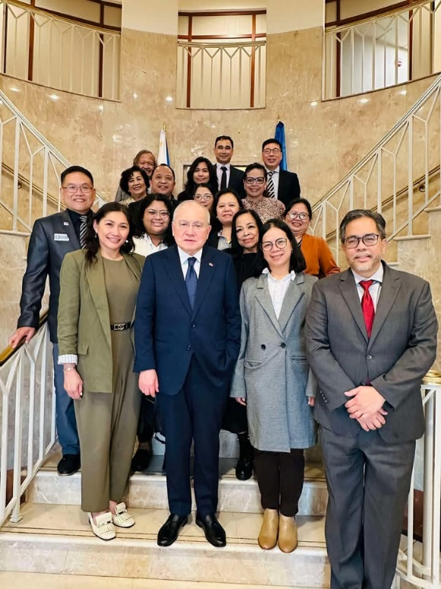
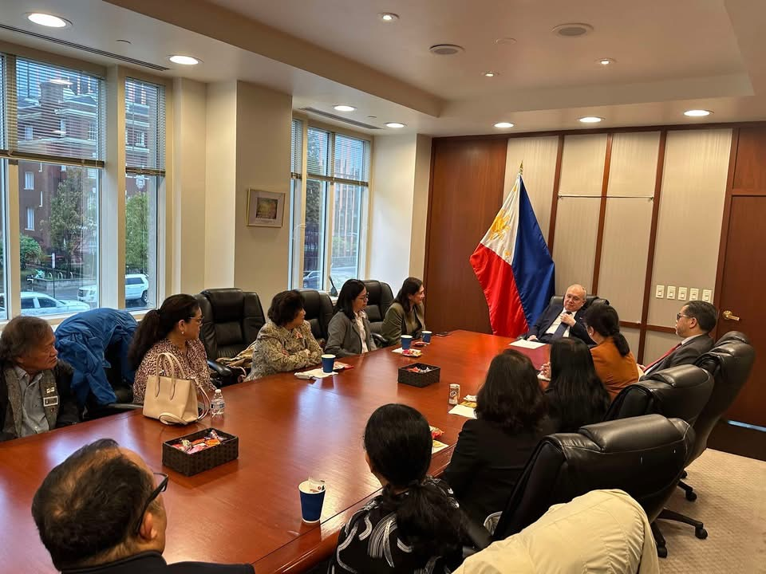
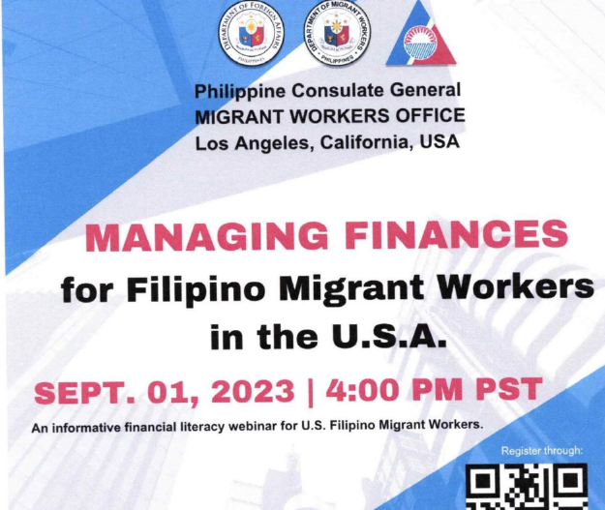
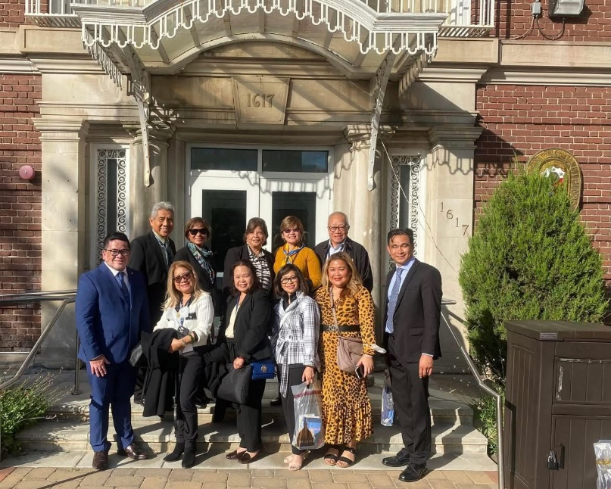
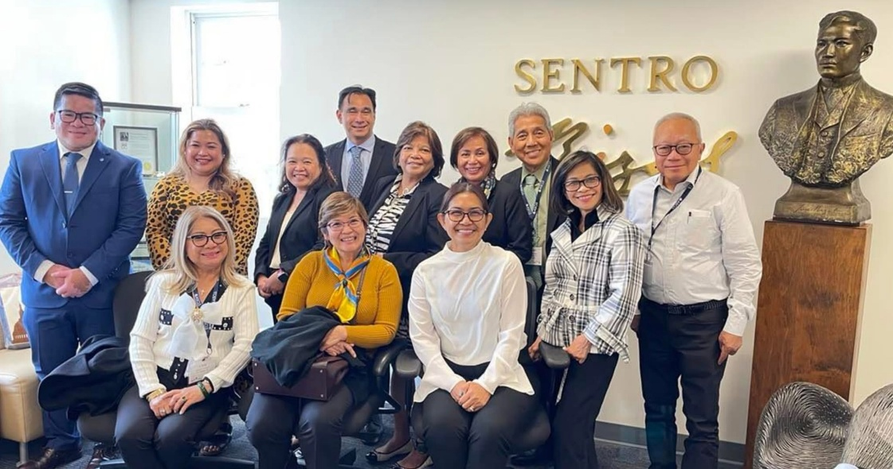
Supporting Migrant Workers

Slide 25
Uplifting New Filipino Medical Laboratory Professionals Through Community-Based Transitions
Relocation Assistance
  Airport pick-up coordination
  Temporary lodging guidance
  Help finding permanent housing/apartments
  Local orientation to the community
  Basic necessities
Settling in
  Social Security number (SSN) application assistance
  Help opening U.S. bank accounts
  Help setting up mobile phones and internet
  Guidance on U.S. postal system and PO Boxes

Slide 26
Uplifting New Filipino Medical Laboratory Professionals Through Community-Based Transitions1
Empowering Independence
  Driver’s license application guidance
  Public transportation navigation
  Introductions to grocery stored, churches and local businesses
  Local Filipino Community Connection
Employment Readiness
  Orientation in U.S. Lab systems
  Help navigating licensure, certification
  Mentorship from experienced Chapter Members

Slide 27
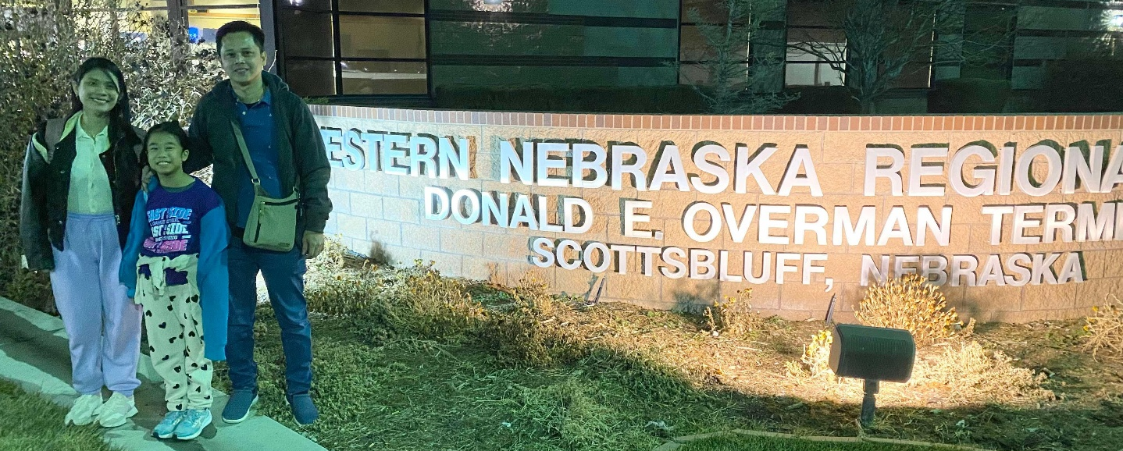
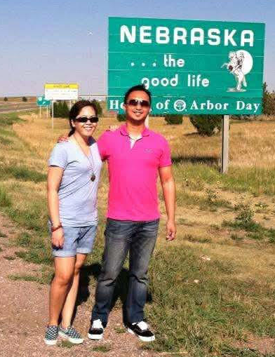
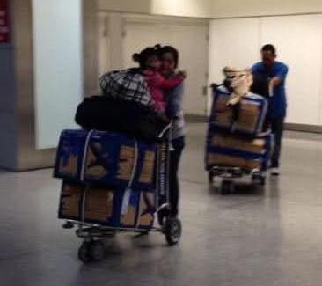
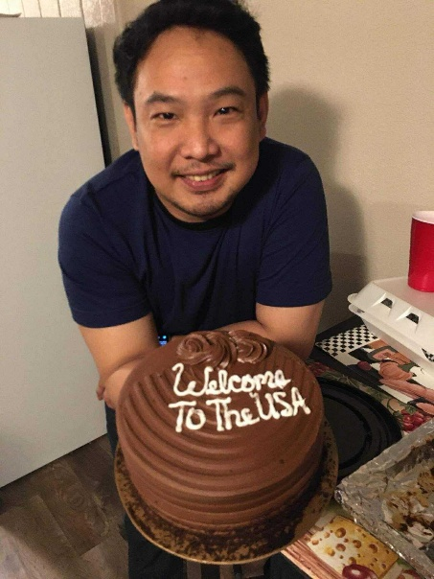
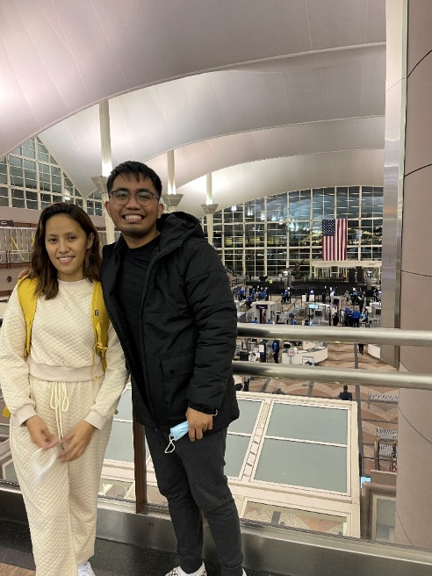
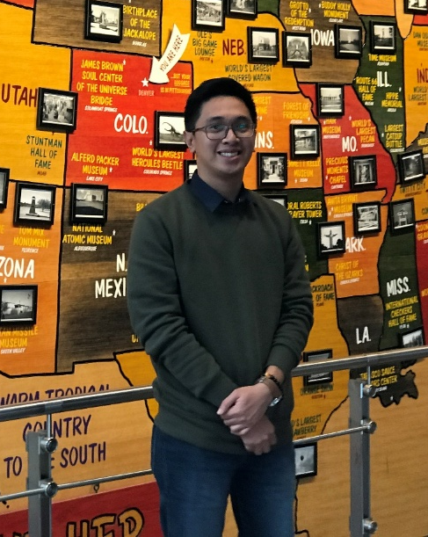
Your Why, Your Worth
Your journey is valid, your dreams are possible
You are not just filling a role, you are making a difference
What seems like a delay may be a preparation in disguise
Keep learning, keep serving, keep growing
You were never just a “temporary fix”, you are part of the solution.

Slide 28
Immigration Update
Matthew Schulze, American Society for Clinical Pathology
Senior Director, Center for Public Policy

Slide 29
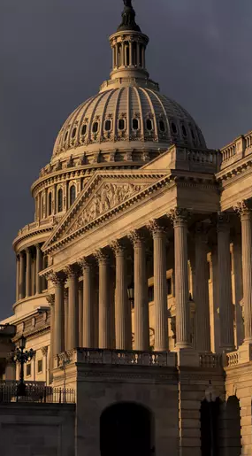
Discussion Overview
Current political climate regarding immigration law
Current legislation
H-1B overview
VisaScreen process
Questions

Slide 30
Political Outlook for Legal Immigration
Outlook: Unclear
Trump Administration focus is undocumented immigration
Support for legal immigration inconsistent
Common visas:
  Permanent Residency: EB-2 & EB-3
  Nonimmigrant Visas: F-1s, H-1B, J-1, and O-1
Internationals in valid immigration status have been impacted, particularly at colleges and universities
No reports of impact on IMGs
Some institutions advising international staff not to travel

Slide 31
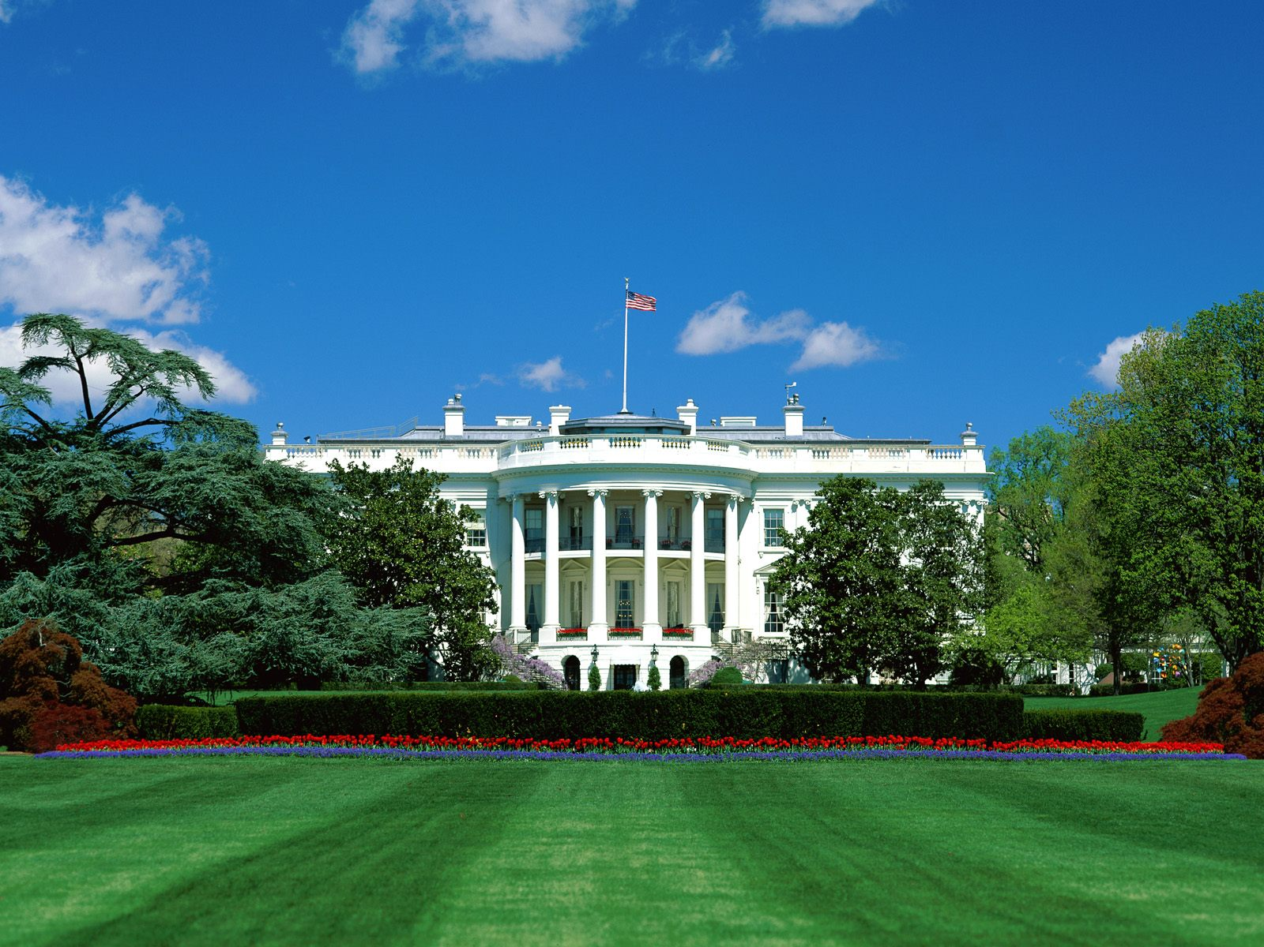
Legislation
The “Doctors in Our Borders Act” reintroduced by Rep. Mike Lawler (R-NY) and Yvette Clarke (D-NY)
Addresses physician shortages by expanding the Conrad 30 program
Exempts J-1 holders from the 2-year home residency requirement
Increases the number of state J-1 visa waivers from 30 to 100

Slide 32
Key Facts about the H-1B
Purpose: Employment-based
H-1B Cap: 65,000 visas per fiscal year
H-1B Cap Exemption: Two “exemptions” exist
  20,000 for advanced degree holders
  Employees of Institutions of Higher Education, Nonprofit Organizations Affiliated with Institutions of Higher Education, Government Research Organizations, and Nonprofit Research Organizations (No Numerical cap)

Slide 33
VisaScreen
Required for employment-based immigrant and non-immigrant visas (IIRAIRA 1996)
VisaScreen process assesses education, licensure status, and English language proficiency
Does not currently require certification exam except for individuals seeking work in licensure states

Slide 34
VisaScreen Requirements for MLSs
VisaScreen Requirements for Medical Laboratory Scientists:
First track
  Bachelor’s degree in Medical Laboratory Science/Medical Technology or a related life sciences field (e.g., biochemistry, biology, chemistry)
  Certification as International Medical Laboratory Scientist with ASCP
Second track
  Earn a bachelor’s degree in any field
  Have successfully completed at least a one-year medical technology structured program at a university level
  Must meet the clinical and laboratory hours of training

Slide 35
VisaScreen Requirements for MLTs
VisaScreen Requirements for Medical Laboratory Technicians:
First track
  Earn an associate degree is medical laboratory technology or related life sciences field (e.g., biochemistry, biology, chemistry).
  Have certification as International clinical laboratory technician (medical technician) with ASCP.
Second track
  Have successfully completed at least a one-year medical technician structured program at a university level.
  Meet the clinical and laboratory hours of training.

Slide 36

Q&A

Slide 37
CMLE Credit Claiming for Today's Webinar
Claim 1.5 CMLE credit for this webinar from the ASCP Store
Instructions will be emailed to live attendees tomorrow 7/10/25 (via Zoom)
Credit claiming is only available within 1-month of the webinar date

Slide 38
Thank you for attending!
More info to be shared at:
https://bit.ly/ASCP-BB-Intl
All free resources at:
supportCDCOneLab.org
International Laboratory Scientists in the US

