Slide 1
In-the-Field/Surveillance Mary Rodgers, Hans Desale, Travelle Mason, Keron Liverpool, W. Gunnar Conrow
Building Bridges Across the Laboratory Community – June 11, 2025

Slide 2
ASCP is proud to support CDC OneLabTM
Learn more about the CDC OneLab Initiative
Sign up for CDC’s free learning management system, OneLab REACH™
Access free ASCP lab training resources
Find out about Workforce Events & Scholarships
Catch-up on Building Bridges webinars

Slide 3
Funding Statement
This project is supported by Cooperative Agreement number CDC-RFA-OE22-2202 (CFDA No. 93.322), funded by the Centers for Disease Control and Prevention. Its contents are solely the responsibility of the American Society for Clinical Pathology and do not necessarily represent the official views of the Centers for Disease Control and Prevention or the Department of Health and Human Services. This project was 100% funded with federal funds to the American Society for Clinical Pathology (NU47OE000107).

Slide 4
Format of Today’s Session
Introduction of Panelists
Mary Rodgers
Hans Desale
Travelle Mason
Keron Liverpool
W. Gunnar Conrow
Q & A Session
Session Wrap-Up
Notes:
Pre-Webinar Slide Deck Runs: 10:55 – 11:01 am [~6 min]
Moderator(s) Introduce Session: 11:01 - 11:05 [~4 min]
Career Map Presentations (10-12 min/panelist): 11:05 am- 12:05 pm [~1 hr]
Q & A Session: 12:05 - 12:25 pm [~20 min]
Wrap-up: 12:25 – 12:30 pm [~5 min]

Slide 5
Name
In the 2025 ASCP Building Bridges Across the Laboratory Community series, we focus on highlighting the diverse array of laboratory career pathways and how exposure to formative experiences, often through collaborations, partnerships, and unique training opportunities, can shape these laboratory career trajectories.
Credentials
EDUCATION
Degree, Program University/College
Degree, Program University/College
Degree, Program University/College
Formative Experiences in My Laboratory Career
Opportunity 1
Opportunity 2
Opportunity 3
Year
Current position
Team or Department, Company
How I “Build Bridges” within the Lab Community or Profession
Response 1
Response 2
Response 3
“
Previous position
Team or Department, Company
Career advice quote
Year
Year
Previous position
Team or Department, Company
Training/Career Opportunity 1
Training /Career Opportunity 2
Training /Career Opportunity 3
Year
Previous position
Team or Department, Company
Opportunities of Interest*
CURRENT RESPONSIBILITIES
Responsibility 1
Responsibility 2
Responsibility 3
The 3 Most Valuable Skills (Technical and/or Soft Skills) You Use on a Daily Basis
Skill 1
Skill 2
Skill 3
Notes:
*Please include links to active career or training opportunities relevant to your professional career trajectory. This information is accurate as of its publication.

Slide 6
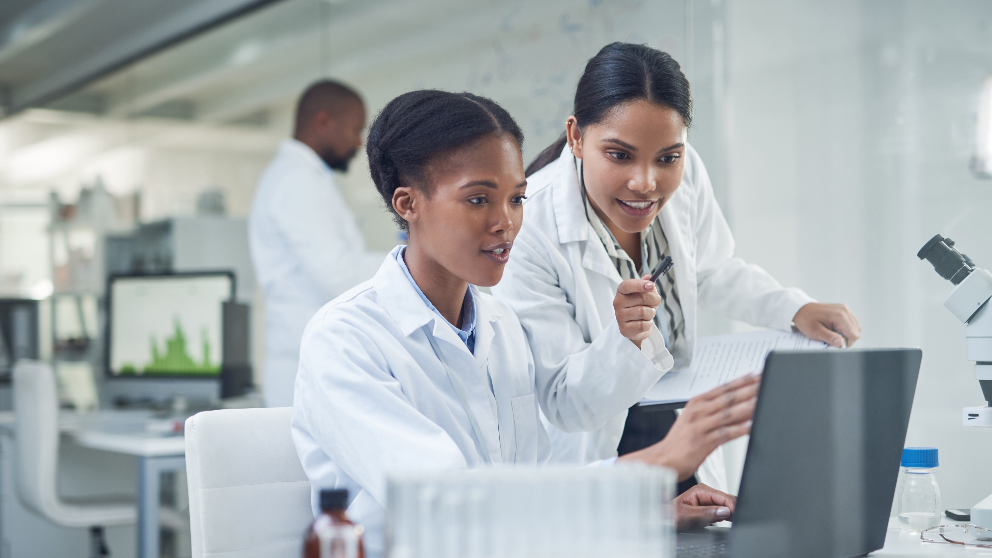
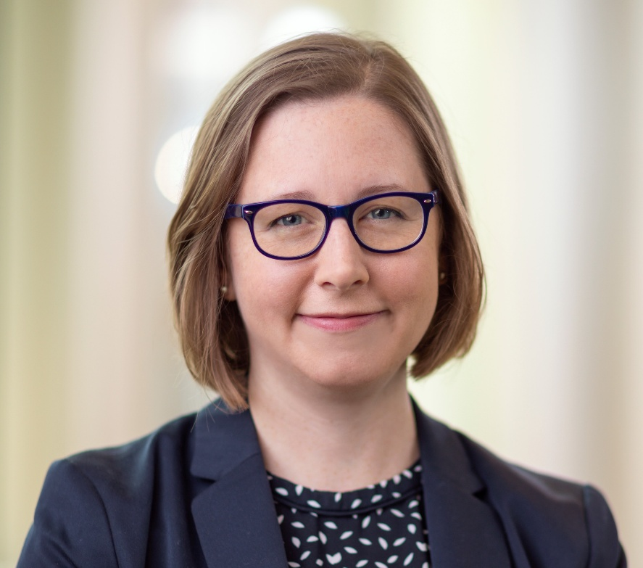
Mary Rodgers, PhD Associate Research Fellow Abbott Pandemic Defense Coalition

Slide 7
Mary Rodgers
In the 2025 ASCP Building Bridges Across the Laboratory Community series, we focus on highlighting the diverse array of laboratory career pathways and how exposure to formative experiences, often through collaborations, partnerships, and unique training opportunities, can shape these laboratory career trajectories.
PhD
EDUCATION
BS, Biochemistry, University of Wisconsin-Madison
PhD, Biological and Biomedical Sciences, Harvard University
Formative Experiences in My Laboratory Career
Early lab experiences in high school and undergraduate settings
First graduate student in a new lab
Finding a new strain of HIV
“
2023
Associate Research Fellow
R&D, Abbott
How I “Build Bridges” within the Lab Community or Profession
Interdisciplinary research during graduate school
Global collaborations
Epidemiology training program
2019
Principal Scientist
R&D, Abbott
Getting experiences in a variety of scientific settings will help you find the environment you can best thrive in
2014
Senior Scientist
R&D, Abbott
https://www.abbott.com/careers/students/internships
Opportunities of Interest*
2010
Postdoctoral Fellow
MMI, University of Southern California
CURRENT RESPONSIBILITIES
Manage the Abbott Pandemic Defense Coalition
Monitor viral variants for HIV, hepatitis viruses, SARS-CoV-2, influenza, dengue
Communicate research findings internally and externally
The 3 Most Valuable Skills (Technical and/or Soft Skills) You Use on a Daily Basis
Tailoring scientific communication to a variety of audiences
Organization
Curiosity – asking a lot of questions
Notes:
*Please include links to active career or training opportunities relevant to your professional career trajectory. This information is accurate as of its publication.

Slide 8
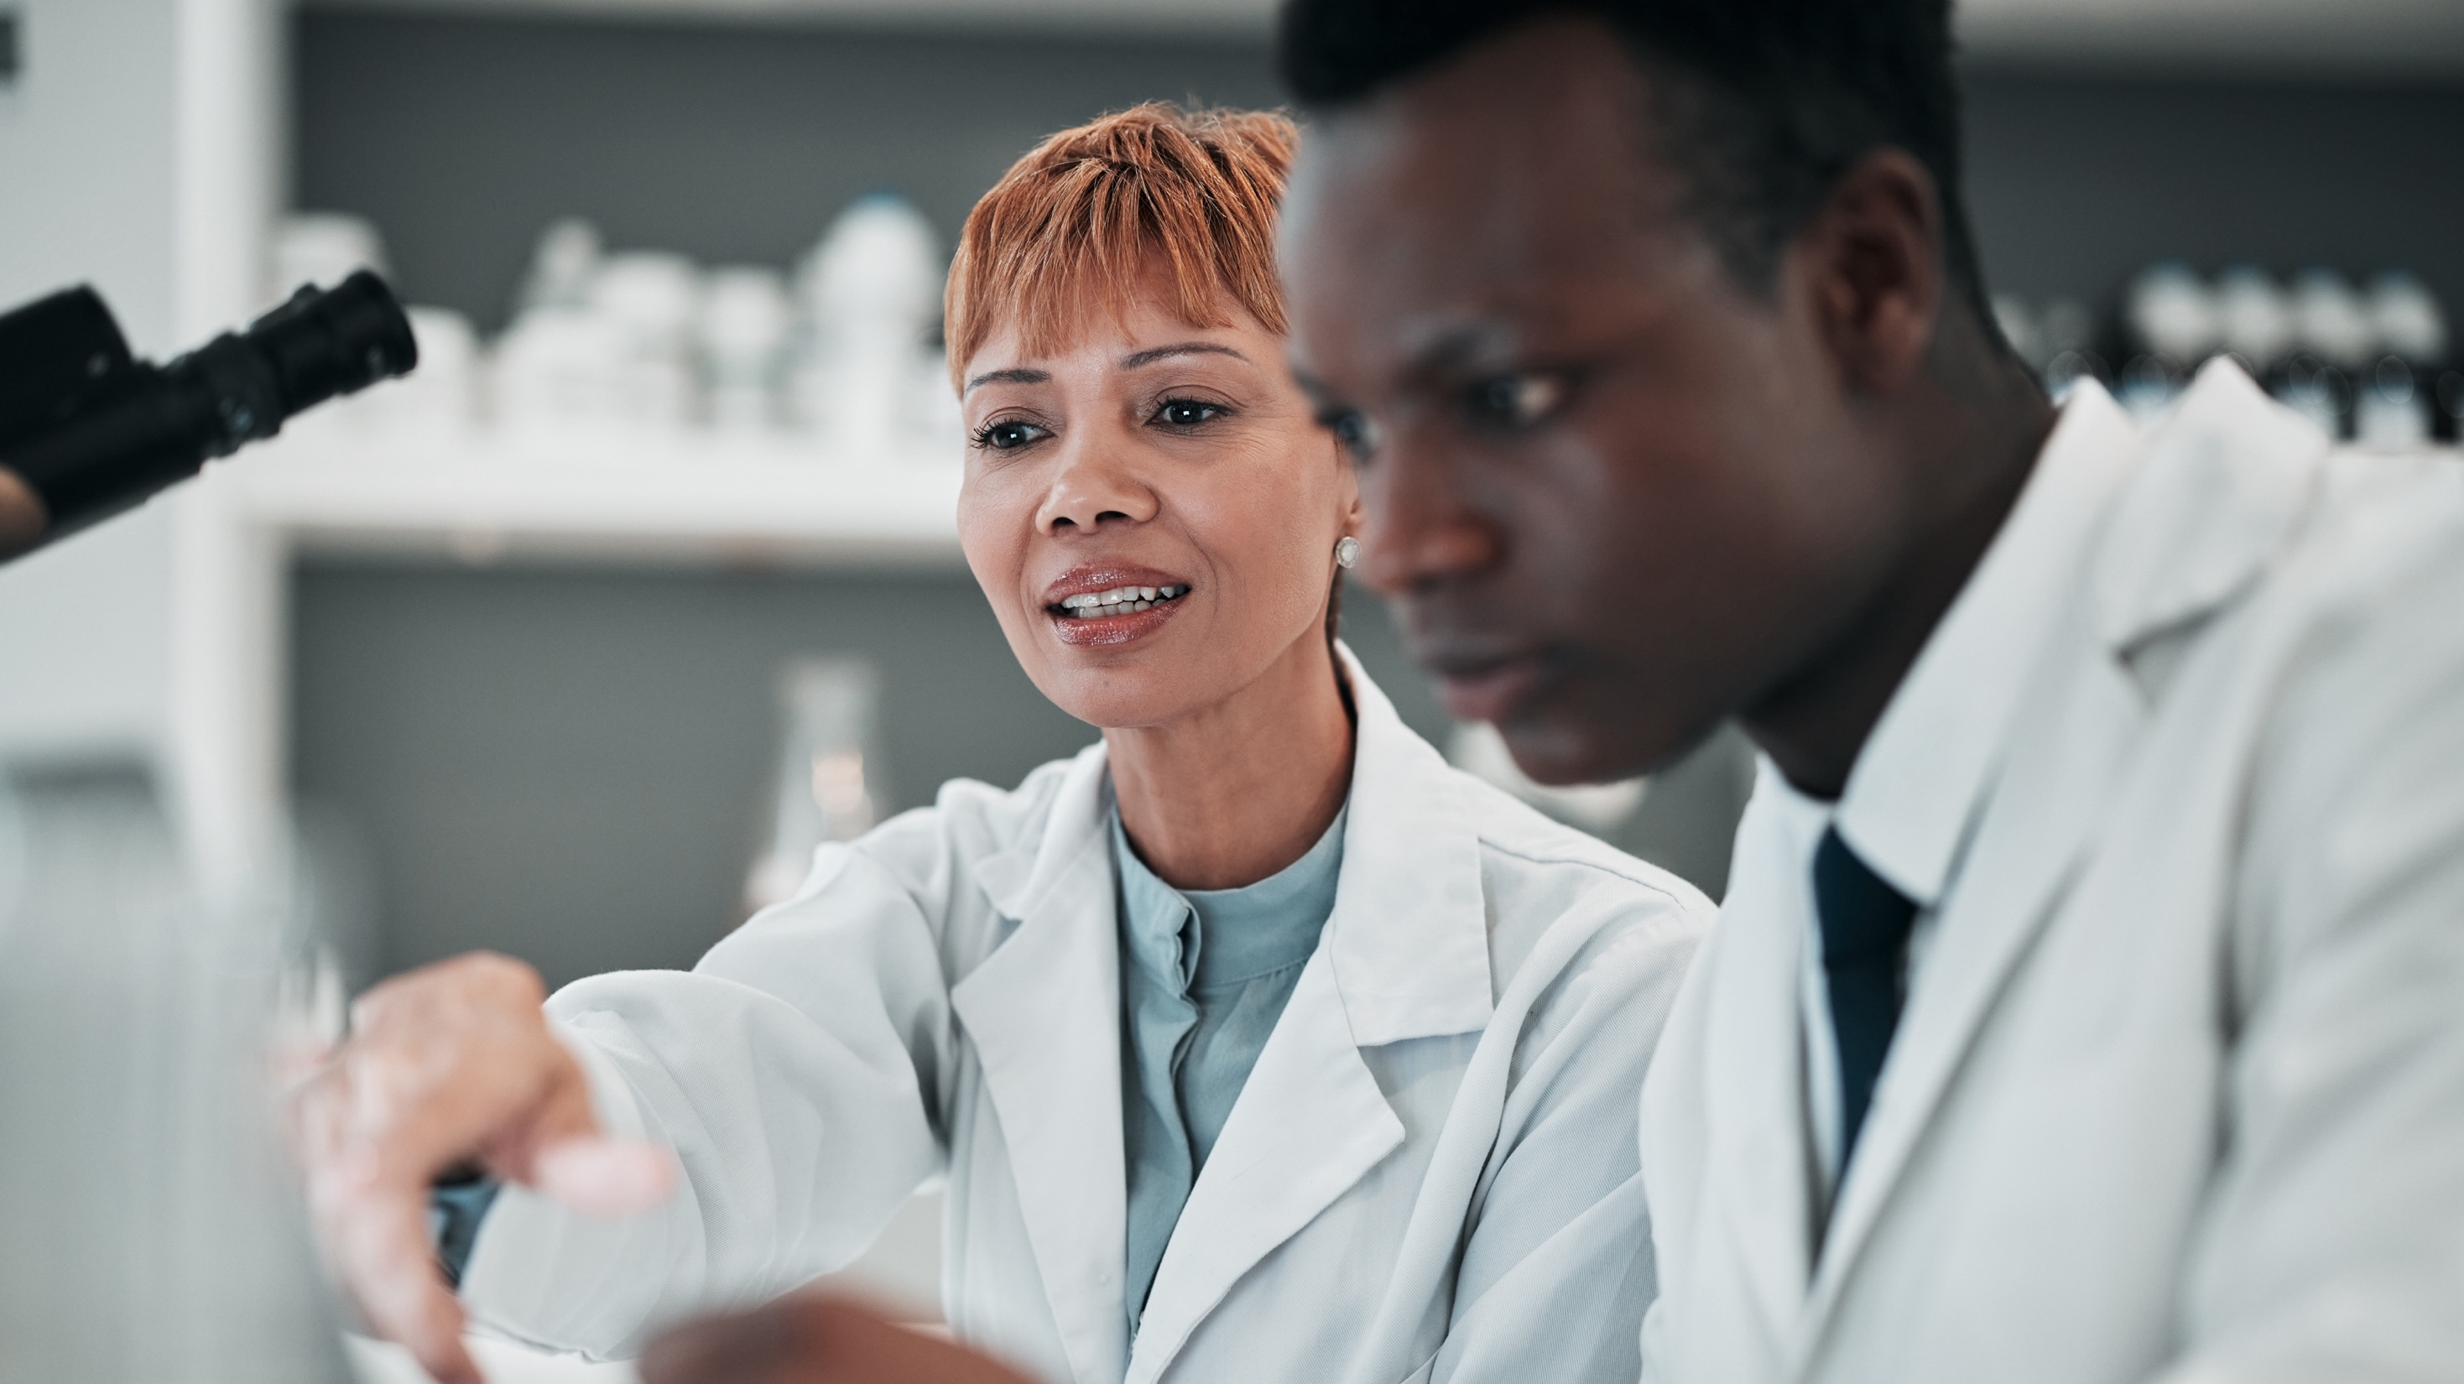
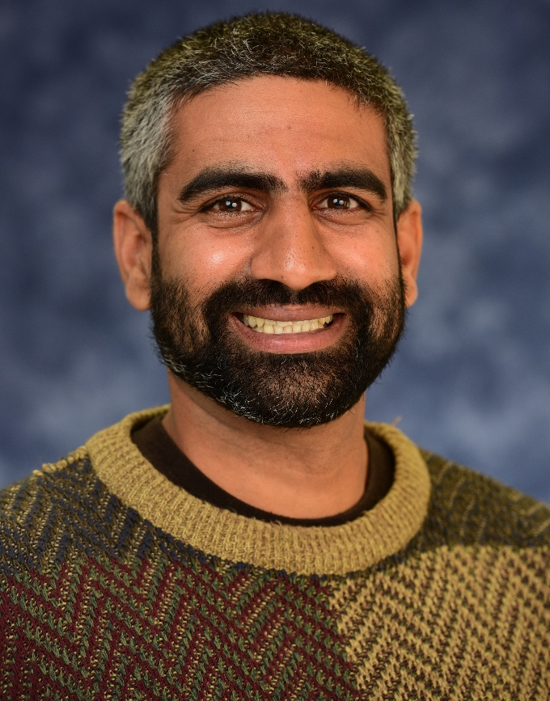
Hans Desale PhD, MPH CDC Laboratory Leadership Service Fellow, Dengue Branch Centers for Disease Control and Prevention (Puerto Rico)

Slide 9
Hans Desale
In the 2025 ASCP Building Bridges Across the Laboratory Community series, we focus on highlighting the diverse array of laboratory career pathways and how exposure to formative experiences, often through collaborations, partnerships, and unique training opportunities, can shape these laboratory career trajectories.
PhD, MPH&TM
EDUCATION
PhD, Tropical Medicine, Tulane University
MPH&TM, Tropical Medicine, Tulane University
BS, Biochemistry, UC San Diego
Exposure to diverse professional roles and challenges.
Capacity building through collaborative deployments.
Development of foundational laboratory skills.
Formative Experiences in My Laboratory Career
2023-present
Laboratory Leadership Service Fellow
Dengue Branch, CDC
Cultivate collaboration
Share experiences and stories to inspire connections.
Encourage open dialogue to foster mutual support
How I “Build Bridges” within the Lab Community or Profession
“
2016-2023
Graduate Researcher
Dept of Tropical Medicine, Tulane University
Associate Scientist II
Biology Team, Receptos
Be curious and open to new opportunities, every experience can teach you something
2008-2015
CDC Laboratory Leadership Service Fellowship
APHL/CDC Public Health Laboratory Fellowship
Opportunities of Interest*
CURRENT RESPONSIBILITIES
Strengthening Dengue surveillance systems
Enhancing laboratory capabilities and compliance
Evaluating diagnostic tools for public health impact
The 3 Most Valuable Skills (Technical and/or Soft Skills) You Use on a Daily Basis
Communication
Emotional Intelligence
Data Analysis
Notes:
*Please include links to active career or training opportunities relevant to your professional career trajectory. This information is accurate as of its publication.

Slide 10
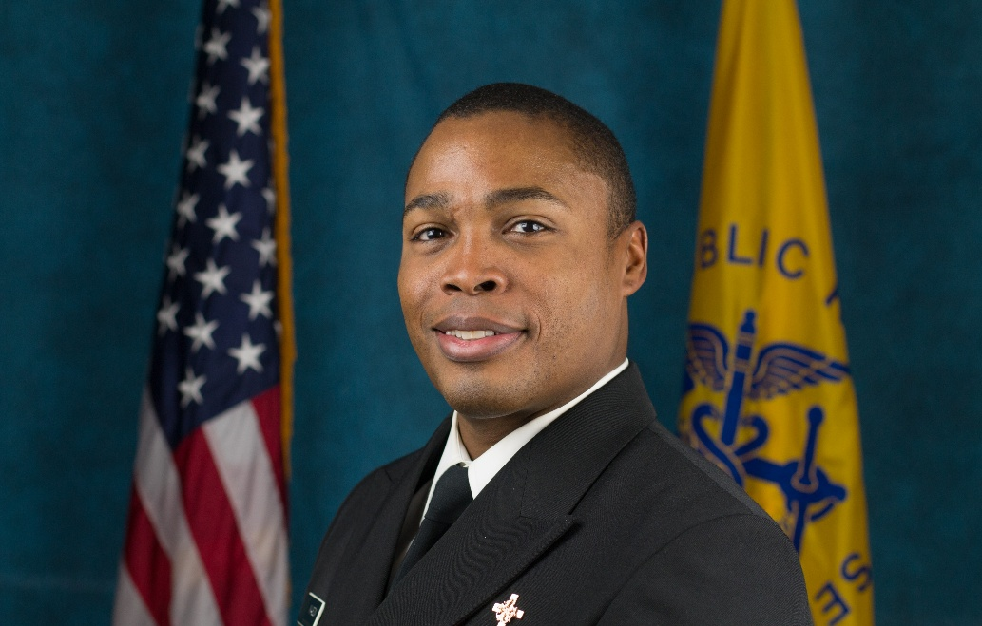
Travelle Mason BS, MLS(ASCP)^{CM}, MPH, CPH Commissioned Corps US Public Health Services Centers for Disease Control and Prevention

Slide 11
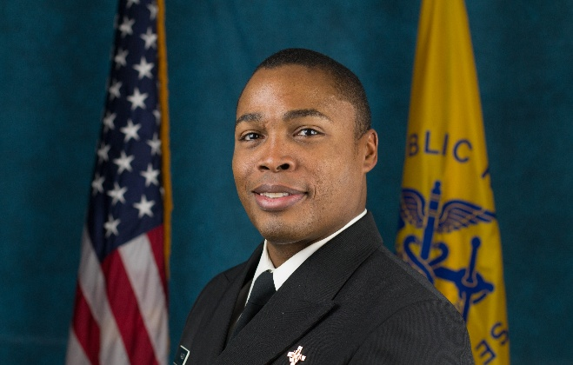
Travelle Mason
In the 2025 ASCP Building Bridges Across the Laboratory Community series, we focus on highlighting the diverse array of laboratory career pathways and how exposure to formative experiences, often through collaborations, partnerships, and unique training opportunities, can shape these laboratory career trajectories.
BS, MPH, MLS(ASCP)^{CM}, CPH
Formative Experiences in My Laboratory Career
St. Vincent’s Medical Center (Internship)
San Carlos Service Unit, AZ
FDA (Peru and Thailand)
EDUCATION
BS, Medical Technology, University of South Florida
MPH, Public Health Practice, University of South Florida
2022
Senior Public Health Advisor
Global Health Center, CDC
Chair, MLS Professional Advisory Group, U.S. Public Health Service, Commissioned Corps
Sharing Experiences and Opportunities
Joint Annual Meeting - SAFMLS, ASCLS and AGT
How I “Build Bridges” within the Lab Community or Profession
“
2019
Regulatory Health Project Manager
Center for Tobacco Products, FDA
2015
Consumer Safety Officer/Inspector
San Francisco District Office, FDA
2013
Lead Medical Laboratory Scientist
San Carlos Service Unit, Indian Health Service
Bellini College of Artificial Intelligence, USF
Foreign Service Regional Medical Laboratory Scientist
Global Health at CDC
USPHS, Commissioned Corps
You may not be able to do everything you learn, but make sure you learn everything you can do. – Jim Rohn
2011
Medical Laboratory Scientist II
Mayo Clinic, Jacksonville, FL
Opportunities of Interest*
CURRENT RESPONSIBILITIES
Manage projects with multiple stakeholders and areas of expertise that require a CDC wide perspective
Build and maintain relationships with USG partners relevant to global health and global health security policy development and implementation
Leverage CDC’s technical expertise to extend the agency’s impact
The 3 Most Valuable Skills (Technical and/or Soft Skills) You Use on a Daily Basis
Building Trust
Maintaining Relationships
Articulating Impact
Notes:
*Please include links to active career or training opportunities relevant to your professional career trajectory. This information is accurate as of its publication.

Slide 12
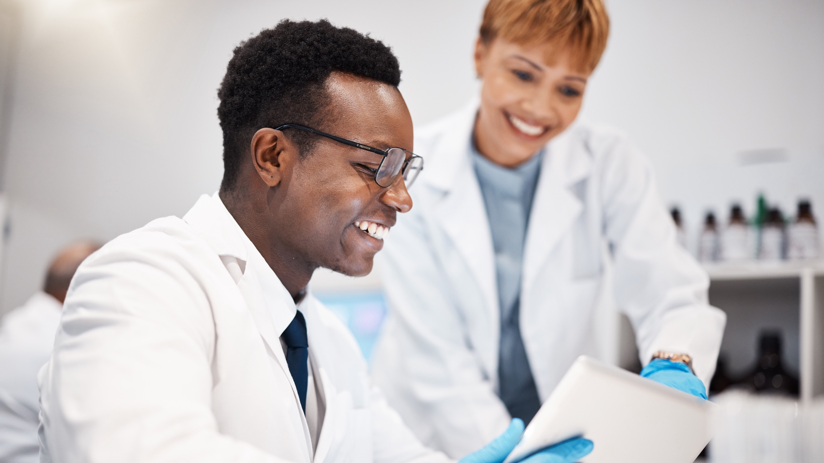
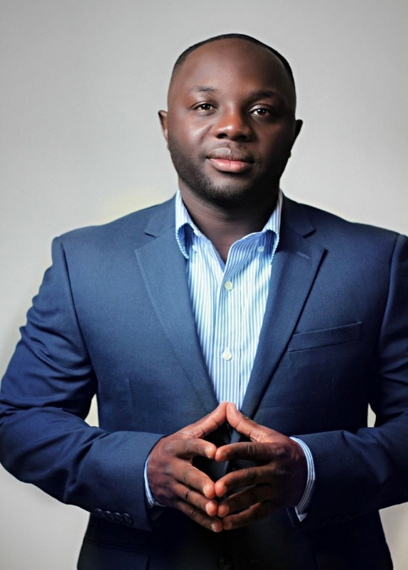
Keron Liverpool MBA, MLS(ASCP)^{CM} Medical Laboratory Scientist United States Navy

Slide 13
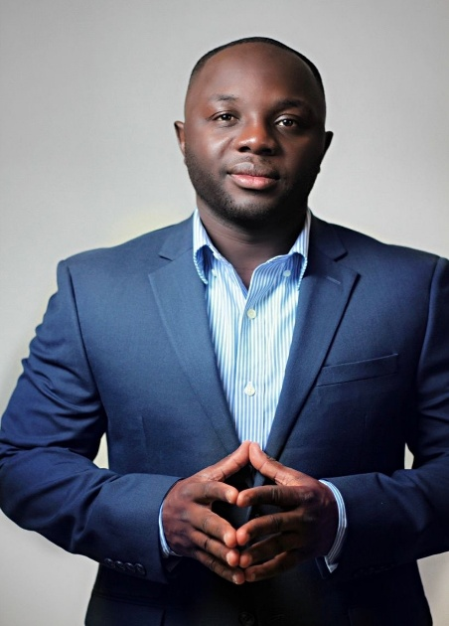
Keron Liverpool
In the 2025 ASCP Building Bridges Across the Laboratory Community series, we focus on highlighting the diverse array of laboratory career pathways and how exposure to formative experiences, often through collaborations, partnerships, and unique training opportunities, can shape these laboratory career trajectories.
MBA, MLS(ASCP)^{CM}
EDUCATION
MBA, Business Administration/University of Texas-Tyler
MA, Organizational Leadership/Incarnate Word
BS, Medical Laboratory Science/University of Cincinnati
Being a member ASCP Council of Laboratory Professionals
College of American Pathologists (CAP) proficiency testing administration
Instructor
Insert
photo
here
Formative Experiences in My Laboratory Career
2024
Laboratory Department Head
Overseas Lab
How I “Build Bridges” within the Lab Community or Profession
ASCP Ambassador
Networking and engaging with professionals
Advocate for recruitment and retention
“
2022
Laboratory Divisional Officer
Naval Hospital Portsmouth
2017
Laboratory Technologist/Instructor
Medical Education Training Campus
Take extreme ownership of everything in life.
Laboratory director
Operations Manager
ASCP Council of Laboratory Management and Administration
Opportunities of Interest*
2010
Laboratory Technician
US Navy
CURRENT RESPONSIBILITIES
Department Head
Oversee Laboratory operations
Supervise personnel
The 3 Most Valuable Skills (Technical and/or Soft Skills) You Use on a Daily Basis
Leadership
Resourceful
Coordination
Notes:
*Please include links to active career or training opportunities relevant to your professional career trajectory. This information is accurate as of its publication.

Slide 14
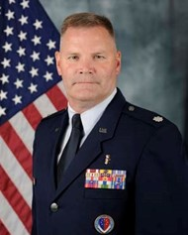
W. Gunnar Conrow Col, USAF, BSC, MLS(ASCP)^{CM} Chief of Laboratory Operations and Air Force Director, Center for Laboratory Medicine Services Defense Health Agency

Slide 15
W. Gunnar Conrow, Col, USAF
In the 2025 ASCP Building Bridges Across the Laboratory Community series, we focus on highlighting the diverse array of laboratory career pathways and how exposure to formative experiences, often through collaborations, partnerships, and unique training opportunities, can shape these laboratory career trajectories.
BSC, MLS(ASCP)^{CM}
EDUCATION
Wayland Baptist University: BS, Occupational Sciences, Focus Healthcare Admin
University of South Dakota: MS, Healthcare Administration
Air University: MS, Strategic Studies
Air University: MS, Operational Art and Strategy
Air Force MLT training
Lab/Section supervisor duties
Deputy Director, Center for Laboratory Medicine Services (CMLS)
Insert
photo
here
Formative Experiences in My Laboratory Career
2024
AF Director/Chief of Lab Operations
Center for Laboratory Medicine Services, Defense Health Agency, VA
Relationships (lab leaders, vendors, operational staff)
Strategic sessions
Educational events/volunteer opportunities
How I “Build Bridges” within the Lab Community or Profession
“
2022
Director
Center for Laboratory Medicine Services,
Defense Health Agency, VA
2018
Commander
17th Healthcare Operations Squadron,
Goodfellow AFB, TX
It is not about me; I am second
ACHE Fellow
Johns Hopkins Healthcare Leadership Courses
Global health courses/forums; https://cghe.usuhs.edu
Opportunities of Interest*
2014
Deputy Director
Center for Laboratory Medicine Services, Defense Health Agency, VA
CURRENT RESPONSIBILITIES
Enforce CLIA/CLIP requirements for Department of Defense (DoD) labs
Coordinate and build efficiencies in the Defense Health Agency (DHA) lab network
Talent management
The 3 Most Valuable Skills (Technical and/or Soft Skills) You Use on a Daily Basis
Active Listening
Communication – verbal, written, and emails
Strategic reflection, scanning, and planning
Notes:
*Please include links to active career or training opportunities relevant to your professional career trajectory. This information is accurate as of its publication.

Slide 16
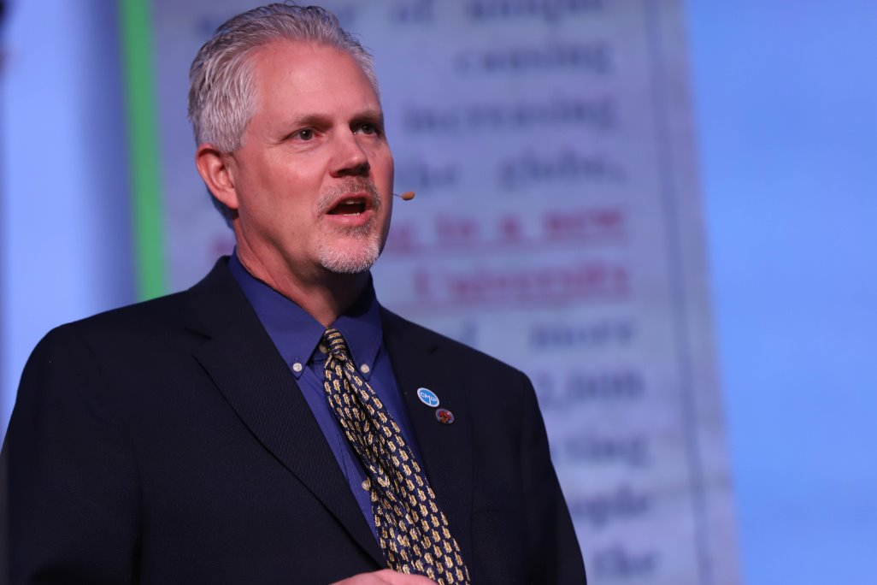
Rodney Rohde
PhD, MS, SM(ASCP)^{CM}SV^{CM},MB^{CM},FASCc University Distinguished Chair, MLS Program
Texas State University

Slide 17
Rodney E. Rohde
In the 2025 ASCP Building Bridges Across the Laboratory Community series, we focus on highlighting the diverse array of laboratory career pathways and how exposure to formative experiences, often through collaborations, partnerships, and unique training opportunities, can shape these laboratory career trajectories.
PhD, MS, SM (ASCP)^{CM}, SV^{CM}, MB^{CM}, FASCs, Global Fellow
MD Anderson Cancer Center Internship
CDC Visiting Scientist [2X]
Oral Rabies Vaccination Program, TX DSHS
Transfer to academia with MLS Program
Leadership roles and Subject Matter Expert
Global Fellowship / Science Communicator
EDUCATION
BS, Microbiology, SWTSU
MS, Virology (Biology), SWTSU
PhD, Adult Learning / Public Health, Texas State University
SM, SV, MB certifications with ASCP
Formative Experiences in My Laboratory Career
2002 – Present
Active in professional organizations
Multidisciplinary in research / teaching
Advisory Boards in industry and other
Subject Matter Expert & Science Communicator
Science Communicator
“
Regents’ Professor & Chair
MLS Program, Texas State University [TXST]
How I “Build Bridges” within the Lab Community or Profession
“You are never too important to thank others.”
“Perseverance, Persistence, Passion, and Prayer.”
“Keep on keeping on!”
1994 - Present
Associate Adjunct Professor, Biology, Austin Community College
2018 - Present
Associate Director
Translational Health Research Center, TXST
2011 - 18
Research Dean
College of Health Professions, TXST
CDC Fellowships
Mayo Clinic Laboratory Internships
Summer Undergraduate Research Fellowships [SURF] [ASM] [APHL]
Scholarships [ASCP ASCLS]
Opportunities of Interest*
1994 - 2002
Public Health Epidemiologist & Molecular Epidemiologist
Laboratory & Zoonosis Control, Texas DSHS
CURRENT RESPONSIBILITIES
International and national Subject Matter Expert
TXST MLS Program Chair leadership
Research and Teaching
Professional Consulting on MLS, Public Health, and research expertise [Rabies, AMR, microbiology, etc.]
Communication – Oral and Written
Listening AND Hearing
Resilience, Perseverance, and Adaptability
Organization and Prioritization
Keeping my perspective and calmness
under pressure
The Most Valuable Skills (Technical and/or Soft Skills) You Use on a Daily Basis
Notes:
*Please include links to active career or training opportunities relevant to your professional career trajectory. This information is accurate as of its publication.

Slide 18
Q&A

Slide 19
Next Month’s Webinar: July 9, 11 am – 12:30 pm CT International Lab Scientists Practicing in the US

Slide 20
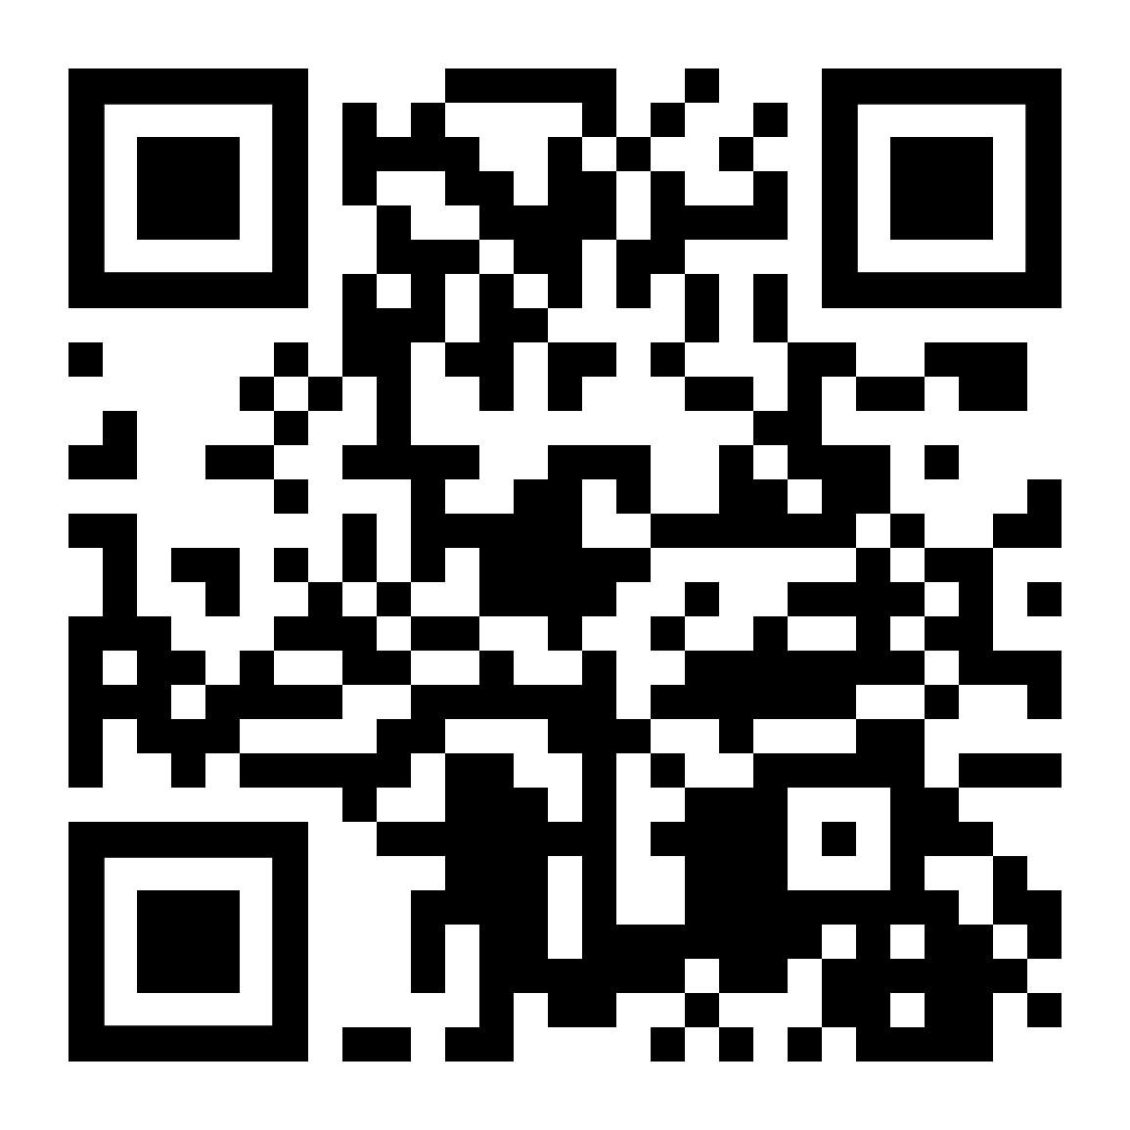
Thank you for attending!
More info at: supportcdconelab.org Or email us at:
grants@ascp.org
In the Field/Surveillance

