Slide 1
At-the-Bench: Public Health Laboratories Feature Anna Liddicoat, Susanne Crowe, Christopher Benton, Meshel Lange
Building Bridges Across the Laboratory Community – May 14, 2025

Slide 2
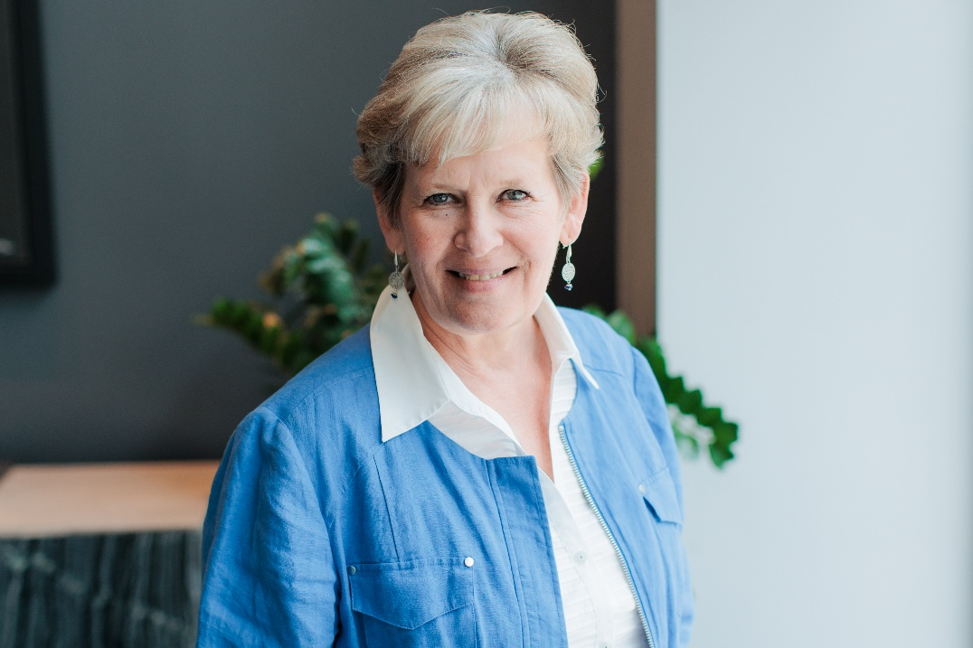
Christine Bean PhD, MBA, MLS(ASCP) Association of Public Health Laboratories Chief Learning Officer

Slide 3
ASCP is proud to support CDC OneLabTM
Learn more about the CDC OneLab Initiative
Sign up for CDC’s free learning management system, OneLab REACH™
Access free ASCP lab training resources
Find out about Workforce Events & Scholarships
Catch-up on Building Bridges webinars

Slide 4
Funding Statement
This project is supported by Cooperative Agreement number CDC-RFA-OE22-2202 (CFDA No. 93.322), funded by the Centers for Disease Control and Prevention. Its contents are solely the responsibility of the American Society for Clinical Pathology and do not necessarily represent the official views of the Centers for Disease Control and Prevention or the Department of Health and Human Services. This project was 100% funded with federal funds to the American Society for Clinical Pathology (NU47OE000107).

Slide 5
Format of Today’s Session
Introduction of Panelists
Anna Liddicoat
Susanne Crowe
Christopher Benton
Meshel A. Lange
Q & A Session
Session Wrap-Up
Notes:
Pre-Webinar Slide Deck Runs: 10:55 – 11:01 am [~6 min]
Moderator(s) Introduce Session: 11:01 - 11:05 [~4 min]
Career Map Presentations (10-12 min/panelist): 11:05 am- 12:05 pm [~1 hr]
Q & A Session: 12:05 - 12:25 pm [~20 min]
Wrap-up: 12:25 – 12:30 pm [~5 min]

Slide 6
Name
In the 2025 ASCP Building Bridges Across the Laboratory Community series, we focus on highlighting the diverse array of laboratory career pathways and how exposure to formative experiences, often through collaborations, partnerships, and unique training opportunities, can shape these laboratory career trajectories.
Credentials
EDUCATION
Degree, Program University/College
Degree, Program University/College
Degree, Program University/College
Formative Experiences in My Laboratory Career
Opportunity 1
Opportunity 2
Opportunity 3
Year
Current position
Team or Department, Company
How I “Build Bridges” within the Lab Community or Profession
Response 1
Response 2
Response 3
“
Previous position
Team or Department, Company
Career advice quote
Year
Year
Previous position
Team or Department, Company
Training/Career Opportunity 1
Training /Career Opportunity 2
Training /Career Opportunity 3
Year
Previous position
Team or Department, Company
Opportunities of Interest*
CURRENT RESPONSIBILITIES
Responsibility 1
Responsibility 2
Responsibility 3
The 3 Most Valuable Skills (Technical and/or Soft Skills) You Use on a Daily Basis
Skill 1
Skill 2
Skill 3
Notes:
*Please include links to active career or training opportunities relevant to your professional career trajectory. This information is accurate as of its publication.

Slide 7
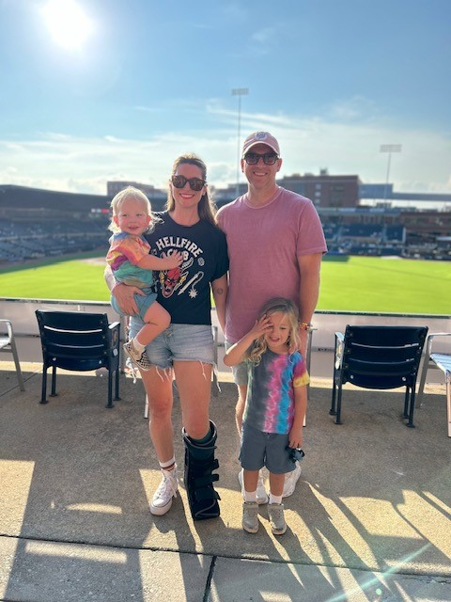
Anna Liddicoat MPH, RBP (ABSA) Biosecurity/Biosafety Officer, Department of Public Health NC State Laboratory of Public Health

Slide 8
Anna Liddicoat
In the 2025 ASCP Building Bridges Across the Laboratory Community series, we focus on highlighting the diverse array of laboratory career pathways and how exposure to formative experiences, often through collaborations, partnerships, and unique training opportunities, can shape these laboratory career trajectories.
BS, MPH, RBP(ABSA)
EDUCATION
BS, Biology, George Mason University
MPH, Env & Occ Health, Biosecurity & Disaster Preparedness, Saint Louis University
UN General Assembly Sweeps with NYC FBI Weapons of Mass Destruction Coordinator
Sentinel Lab Brucella Exposures
Awarded 2024 APHL Leadership award in Biosafety/Biosecurity
Formative Experiences in My Laboratory Career
2020-Present
Biosafety/Biosecurity Officer (BSO), Responsible Official (RO)
NC State Laboratory of Public Health (NCSLPH)
Participate on Association of Public Health Laboratories Biosafety Biosecurity Committee
Outreach to Sentinel Labs in NC
Saying yes to things like this!!
How I “Build Bridges” within the Lab Community or Profession
“
2016-2019
Chief of Health and Safety/BSO/Alternate RO
NYC Public Health Laboratory
Industrial Hygienist
NYC Department of Environmental Protection
It’s okay to say no to something if you don’t have the bandwidth, don’t say no to an opportunity though just because you’re scared”
2013-2016
ABSA Professional Development
APHL Biosafety and Biosecurity Resources
Eagleson Institute
2007-2011
Scientific Assistant
Verto Solutions/Flavors & Extracts Manufacturers Association
Opportunities of Interest*
CURRENT RESPONSIBILITIES
Managing NCSLPH’s Biosafety & Biosecurity Program
Serve as RO for internal Federal Select Agent Program
Safety team lead: Oversee Chem Hygiene Officer, and Occupational Health Coordinator
The 3 Most Valuable Skills (Technical and/or Soft Skills) You Use on a Daily Basis
Listening
Problem solving
Convincing lab technicians I am your friend and collaborator – not your policer!
Notes:
*Please include links to active career or training opportunities relevant to your professional career trajectory. This information is accurate as of its publication.

Slide 9
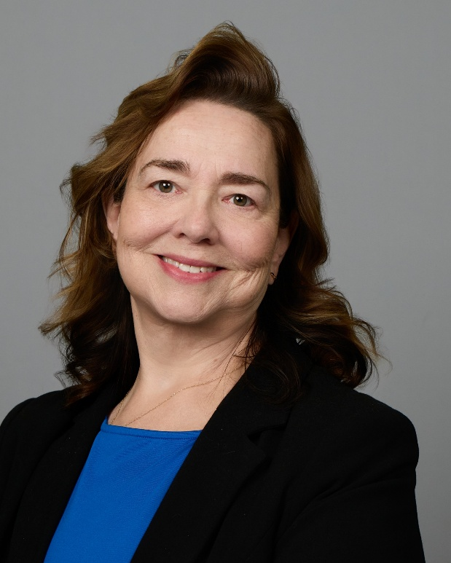
Susanne Crowe DrPH, MHA, HCLD(ABB) Assistant Bureau Chief & Jacksonville Laboratory Director Florida Department of Health

Slide 10
Susanne Crowe
In the 2025 ASCP Building Bridges Across the Laboratory Community series, we focus on highlighting the diverse array of laboratory career pathways and how exposure to formative experiences, often through collaborations, partnerships, and unique training opportunities, can shape these laboratory career trajectories.
DrPH, MHA, HCLD(ABB)
EDUCATION
DrPH, Public Health and Clinical Laboratory Science &
Practice, University of South Florida
MHA, Health Administration, University of North Florida
BS, Biology, Berry College
Formative Experiences in My Laboratory Career
Acting supervisor in 1992
Billing department special project
LIMS Administrator
2012
Laboratory Director
Florida Bureau of Public Health Laboratories
(FL DOH)
Association of Public Health Laboratories (APHL) committees and meetings
Mentor new supervisors and staff
Tours to student groups- volunteer opportunities!
How I “Build Bridges” within the Lab Community or Profession
“
1999
Administrator
Serology/Virology/Retrovirology, FL DOH
1994
Supervisor
Serology, FL DOH
Never pass up an opportunity to learn something new.
LIMS training, LOINC and SNOMED Trainings
DrPH program -USF
Networking and committee work
1991
Bench Scientist
Microbiology, Serology, FL DOH
Opportunities of Interest*
CURRENT RESPONSIBILITIES
Assistant Bureau Chief
Oversight of Jacksonville Laboratory
Laboratory Information System (LIMS) projects
The 3 Most Valuable Skills (Technical and/or Soft Skills) You Use on a Daily Basis
Listening
Empathy
Self awareness
Notes:
*Please include links to active career or training opportunities relevant to your professional career trajectory. This information is accurate as of its publication.

Slide 11
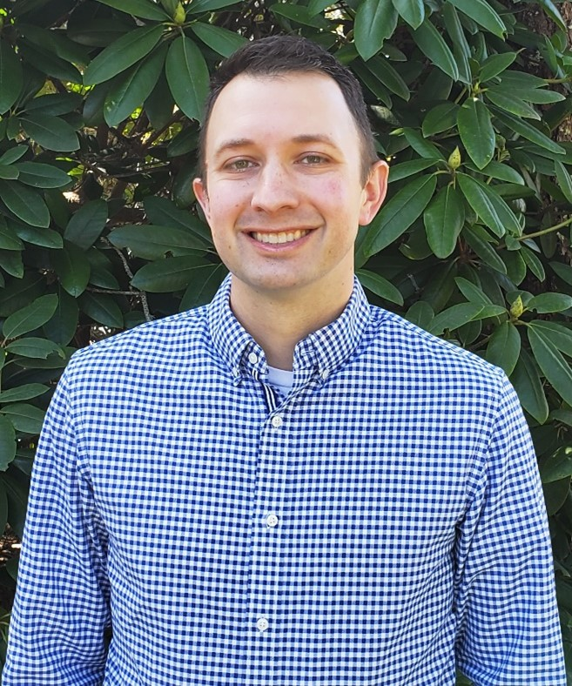
Christopher Benton PhD, MB(ASCP)^{CM}, PHLD(ABB) Virology Program Manager NH Department of Health & Human Services

Slide 12
Christopher Benton
In the 2025 ASCP Building Bridges Across the Laboratory Community series, we focus on highlighting the diverse array of laboratory career pathways and how exposure to formative experiences, often through collaborations, partnerships, and unique training opportunities, can shape these laboratory career trajectories.
PhD, MB (ASCP) ^{CM}, PHLD (ABB)
EDUCATION
PhD., Biochemistry, University of New Hampshire
MS, Microbiology, University of New Hampshire
BS, Biochemistry, University of New Hampshire
BA, Spanish, University of New Hampshire
Insert
photo
here
Formative Experiences in My Laboratory Career
COVID-19 Pandemic
APHL Emerging Leader Program
ABB PHLD Board Certification
2023
Virology Program Manager
State of New Hampshire Public Health Laboratories
Seek Opportunities to improve as a leader
Look for opportunities to improve morale
Participate in as much as possible
How I “Build Bridges” within the Lab Community or Profession
“
2022
Microbiology Program Manager
State of New Hampshire Public Health Laboratories
2015
Molecular Diagnostics Supervisor
Virology Program, State of New Hampshire Public Health Laboratories
If you’re the smartest person in the room, you’re probably in the wrong room.
APHL LLoT
APHL Foodborne Disease Committee
APHL ELP
2007
Laboratory Scientist
Molecular Diagnostics Unit, State of New Hampshire Public Health Laboratories
Opportunities of Interest*
CURRENT RESPONSIBILITIES
Virology Program Manager
Biothreat Program Principal investigator
CLIA Laboratory Director (July 2025)
The 3 Most Valuable Skills (Technical and/or Soft Skills) You Use on a Daily Basis
Communication with staff
Active Listening
Empathy
Notes:
*Please include links to active career or training opportunities relevant to your professional career trajectory. This information is accurate as of its publication.

Slide 13
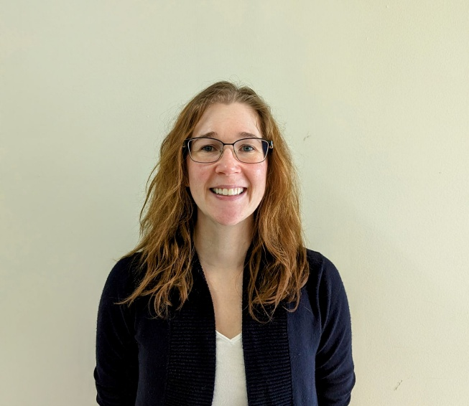
Meshel A. Lange, MS Chemical Emergency Response Coordinator, Chemical Emergency Response Laboratory, WI State Laboratory of Hygiene

Slide 14
Meshel Lange
In the 2025 ASCP Building Bridges Across the Laboratory Community series, we focus on highlighting the diverse array of laboratory career pathways and how exposure to formative experiences, often through collaborations, partnerships, and unique training opportunities, can shape these laboratory career trajectories.
MS
EDUCATION
BS, Chemistry & Broad Field Natural Science, Edgewood College
MS, Safety, University of Wisconsin - Whitewater
Coffee, no seriously
First responder outreach
Emerging threat responses
Participate in workgroups
Formative Experiences in My Laboratory Career
“
2023-Present
Laboratory Manager
Chemical Emergency Response, Wisconsin State Laboratory of Hygiene (WSLH)
Science is the art of failure. We fail until we figure it out.
Please don’t sniff the threat sample.
Be the best partner you can be and others will meet you there.
How I “Build Bridges” within the Lab Community or Profession
Be the student
Partner to solve problems
Participate in conferences
Provide mentorship & guidance
2019-2023
Chemist Supervisor
Chemical Emergency Response, WSLH
2013-2019
Senior Chemist
Chemical Emergency Response, WSLH
APHL Career Pathways
APHL Emergency Response
APHL Training Resources
WAHMR Conference
2010-2013
Senior Chemist - Project
Chemical Emergency Response, WSLH
Opportunities of Interest*
CURRENT RESPONSIBILITIES
LRN-C Level 1 Chemical Threats Coordinator
Clinical regulatory compliance
Outreach & training
Unknown substance response expert
The 3 Most Valuable Skills (Technical and/or Soft Skills) You Use on a Daily Basis
Technical competency
Collaboration
Management soft skills
Notes:
*Please include links to active career or training opportunities relevant to your professional career trajectory. This information is accurate as of its publication.

Slide 15
Q&A

Slide 16
Next Month’s Webinar: June 11, 11 am – 12:30 pm CT In-the-Field/Surveillance

Slide 17
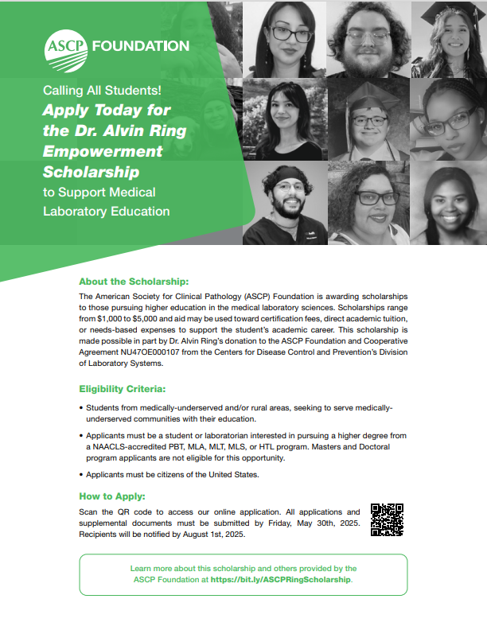
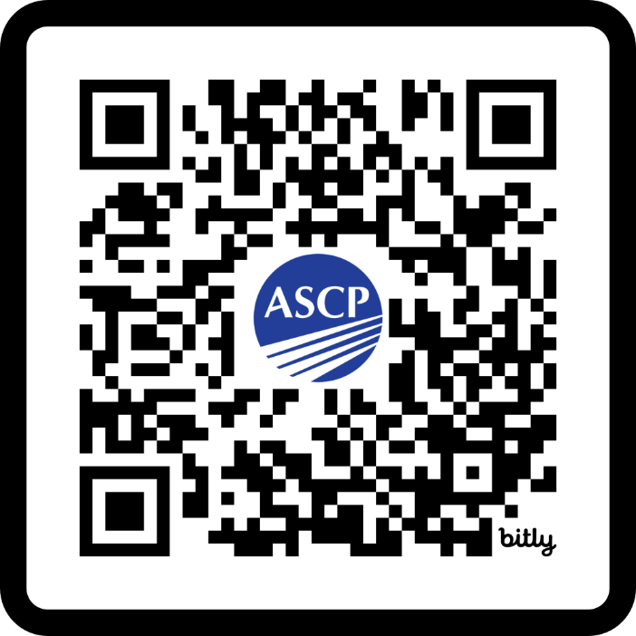
Ring Scholarship closes in two weeks!
This scholarship is for students
interested in pursuing
laboratory science education. Encourage a student to APPLY
today and share widely within your NETWORK!
https://bit.ly/ASCPRingScholarship

Slide 18
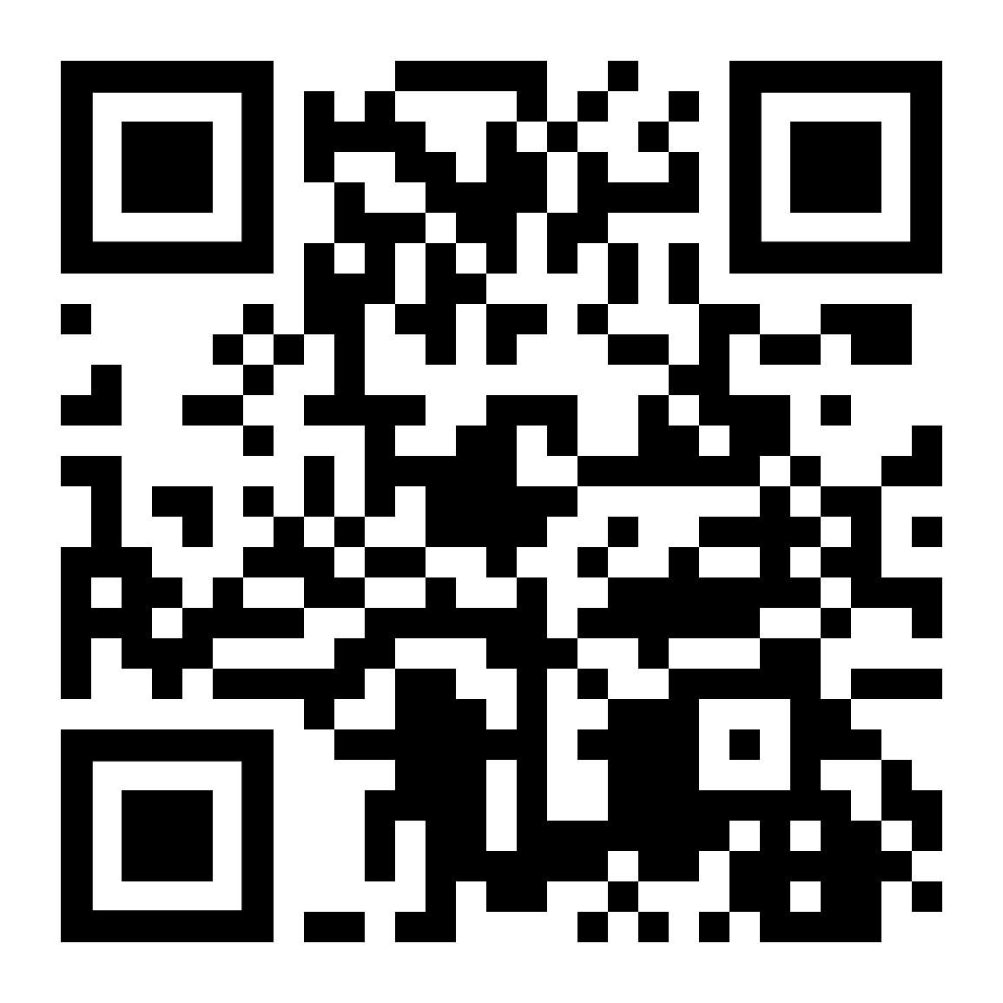
Thank you for attending!
More info at: supportcdconelab.org Or email us at:
grants@ascp.org
At-the-Bench: Public Health Laboratories Feature

