Slide 1
Laboratory Education and Visibility Lauren Schiefelbein, Maheswari Mukherjee, Vanessa Jones Johnson, James Payne IV, Patricia Tille
Building Bridges Across the Laboratory Community – April 16, 2025

Slide 2
ASCP is proud to support CDC OneLabTM
Learn more about the CDC OneLab Initiative
Sign up for CDC’s free learning management system, OneLab REACH™
Access free ASCP lab training resources
Find out about Workforce Events & Scholarships
Catch-up on Building Bridges webinars

Slide 3
Funding Statement
This project is supported by Cooperative Agreement number CDC-RFA-OE22-2202 (CFDA No. 93.322), funded by the Centers for Disease Control and Prevention. Its contents are solely the responsibility of the American Society for Clinical Pathology and do not necessarily represent the official views of the Centers for Disease Control and Prevention or the Department of Health and Human Services. This project was 100% funded with federal funds to the American Society for Clinical Pathology (NU47OE000107).

Slide 4
Format of Today’s Session
Introduction of Panelists
Lauren Schiefelbein
Maheswari Mukherjee
Vanessa Jones Johnson
James Payne IV
Patricia Tille
Q & A Session
Session Wrap-Up
Notes:
Pre-Webinar Slide Deck Runs: 10:55 – 11:01 am [~6 min]
Moderator(s) Introduce Session: 11:01 - 11:05 [~4 min]
Career Map Presentations (10-12 min/panelist): 11:05 am- 12:05 pm [~1 hr]
Q & A Session: 12:05 - 12:25 pm [~20 min]
Wrap-up: 12:25 – 12:30 pm [~5 min]

Slide 5
Name
In the 2025 ASCP Building Bridges Across the Laboratory Community series, we focus on highlighting the diverse array of laboratory career pathways and how exposure to formative experiences, often through collaborations, partnerships, and unique training opportunities, can shape these laboratory career trajectories.
Credentials
EDUCATION
Degree, Program University/College
Degree, Program University/College
Degree, Program University/College
Formative Experiences in My Laboratory Career
Opportunity 1
Opportunity 2
Opportunity 3
Year
Current position
Team or Department, Company
How I “Build Bridges” within the Lab Community or Profession
Response 1
Response 2
Response 3
“
Previous position
Team or Department, Company
Career advice quote
Year
Year
Previous position
Team or Department, Company
Training/Career Opportunity 1
Training /Career Opportunity 2
Training /Career Opportunity 3
Year
Previous position
Team or Department, Company
Opportunities of Interest*
CURRENT RESPONSIBILITIES
Responsibility 1
Responsibility 2
Responsibility 3
The 3 Most Valuable Skills (Technical and/or Soft Skills) You Use on a Daily Basis
Skill 1
Skill 2
Skill 3
Notes:
*Please include links to active career or training opportunities relevant to your professional career trajectory. This information is accurate as of its publication.

Slide 6
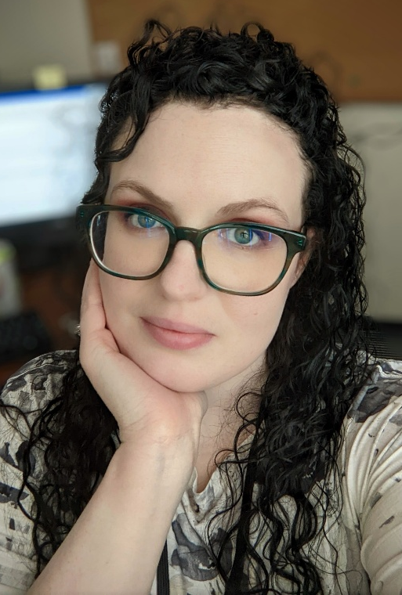
Lauren Schiefelbein
MLS(ASCP)^{CM}
Education Coordinator
University of Nebraska Medical Center

Slide 7
Lauren Schiefelbein
In the 2025 ASCP Building Bridges Across the Laboratory Community series, we focus on highlighting the diverse array of laboratory career pathways and how exposure to formative experiences, often through collaborations, partnerships, and unique training opportunities, can shape these laboratory career trajectories.
MLS (ASCP)
CM
EDUCATION
MS, Healthcare Professions Teaching and Technology, xxxxUNMC (In progress)
BS, Medical Laboratory Science, UNMC
BS, Biology, UNL / UNO
From Cat Labs to STAT Labs
Back to School: UNMC MLS Program
Onward to Clinical Academia
Formative Experiences in My Laboratory Career
2022
MLS Education Coordinator
MLS Program, UNMC
“Lo-Fi” Lab Engagement
Active Mentorship
"Planting Trees”
How I “Build Bridges” within the Lab Community or Profession
“
2017
Medical Laboratory Scientist
Core Laboratory, Nebraska Medicine
Forward is still forward, whichever way you are facing.
Keep moving.
Only look back to enjoy the view.
2014
Laboratory Support / Phlebotomist
Specimen Processing, Nebraska Medicine
UNMC Healthcare Professions Teaching & Technology Program
Teaching Without Walls by Michael Wesch
2013
Animal Care-Giver
Cat Staff, Nebraska Humane Society
Opportunities of Interest*
CURRENT RESPONSIBILITIES
Teaching hands-on laboratory skills to students
Managing our MLS Program’s “Student Laboratory”
MLS recruitment and engagement events
Coordinating with students
Coordinating with clinical sites
Reconceptualizing
Communication
Continuous Learning
The 3 Most Valuable Skills (Technical and/or Soft Skills) You Use on a Daily Basis
Notes:
*Please include links to active career or training opportunities relevant to your professional career trajectory. This information is accurate as of its publication.

Slide 8
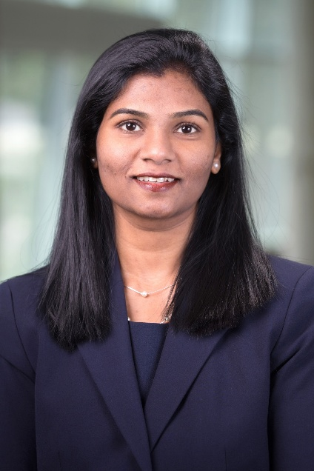
Maheswari Mukherjee
PhD, MSc, BPT, SCT(ASCP)^{CM}
Associate Professor and the Director of the Cytology Program
University of Nebraska Medical Center

Slide 9
Maheswari Mukherjee
In the 2025 ASCP Building Bridges Across the Laboratory Community series, we focus on highlighting the diverse array of laboratory career pathways and how exposure to formative experiences, often through collaborations, partnerships, and unique training opportunities, can shape these laboratory career trajectories.
PhD, MSc, BPT, SCT(ASCP)^{CM}
EDUCATION
Doctor of Philosophy, University of Nebraska Medical Center
Post Baccalaureate Certificate Cytotechnology,
University of Nebraska Medical Center
MSc, Mahatma Gandhi University, SME, India
BPT, Dr. M.G.R Medical University, KMCH, India
Formative Experiences in My Laboratory Career
Physiotherapy to Anatomy
Anatomy to Cytology
Educator/Director
2022- Current
Director
Diagnostic Cytology Program,
College of Allied Health Professions,
University of Nebraska Medical Center
How I “Build Bridges” within the Lab Community or Profession
Collaboration with 16 Clinical Placement Locations in the United States
Engagement with international digital cytology students
“
2020-Current
Associate Professor
Diagnostic Cytology Program,
College of Allied Health Professions,
University of Nebraska Medical Center
Innovative Distance Education in Diagnostic Cytology
Recruitment Activities, e.g. UNMC Backstage Pass
Do what you love, and success will follow. Passion is the fuel behind a successful career
Meg Whitman
Opportunities of Interest*
2004-2005
Assistant Professor
Kovai Medical Center Research and Educational Trust, Tamil Nadu, INDIA.
CURRENT RESPONSIBILITIES
Administration: Directing the Masters of Diagnostic Cytology Program
Teaching: Several Cytology courses
Research: Digital Pathology, Eye Tracking, E-learning
The 3 Most Valuable Skills (Technical and/or Soft Skills) You Use on a Daily Basis
Team player
Creativity
Flexibility
Notes:
*Please include links to active career or training opportunities relevant to your professional career trajectory. This information is accurate as of its publication.

Slide 10
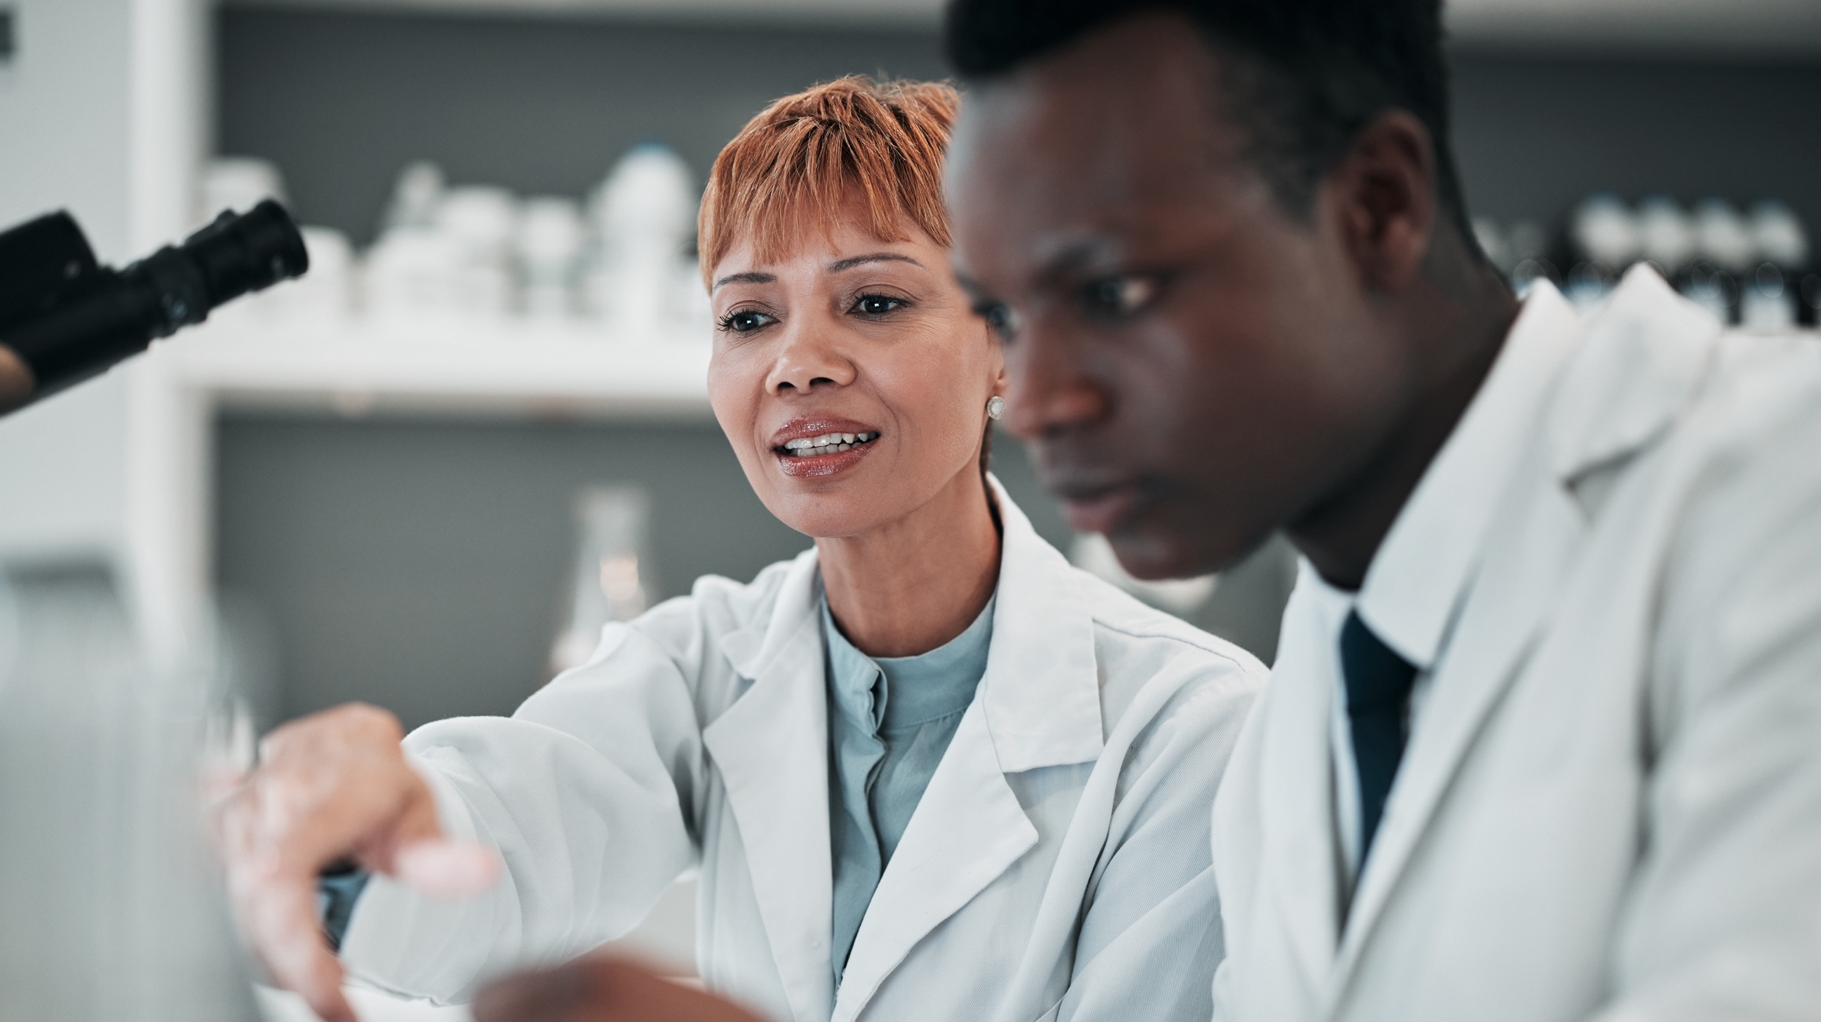
Vanessa Jones Johnson
MBA, MA, MLS(ASCP)
Associate Professor and Director
Program in Medical Laboratory Science
Louisiana Tech University

Slide 11
Vanessa Jones
Johnson
In the 2025 ASCP Building Bridges Across the Laboratory Community series, we focus on highlighting the diverse array of laboratory career pathways and how exposure to formative experiences, often through collaborations, partnerships, and unique training opportunities, can shape these laboratory career trajectories.
MBA, MA, MLS(ASCP)
EDUCATION
MA, Industrial/Organizational Psychology; Louisiana Tech University
MBA, Louisiana Tech University
BS, Medical Laboratory Science; Louisiana Tech University
Formative Experiences in My Laboratory Career
Numbers weren’t my future
Relearning the Coagulation cascade
Adjunct Professor
2012
Associate Professor & MLS Program Director
School of Biological Sciences
Louisiana Tech University
“
How I “Build Bridges” within the Lab Community or Profession
Recognize and overcome silos
Seek opportunities to learn from/teach others
Engagement beyond testing
2006
MT Program Director
Pathology & Laboratory Medicine Service
Overton Brooks VA Center
Find what you love, make a career out of it and you will never work a day in your life.
”No” is a complete sentence.
Failure is simply delayed success.
2003
Supervisory Medical Technologist
Hematology/Blood Bank/Coagulation
Overton Brooks VA Medical Center
Professional Networking
ASCLS Leadership Academy
NAACLS Volunteer
2001
Staff Medical Technologist
Hematology/Special Coagulation
Overton Brooks VA Medical Center
Opportunities of Interest*
CURRENT RESPONSIBILITIES
Program Director for University Based MLS Program
Teach MLS lecture and laboratory courses
University and MLS recruitment events/programs
The 3 Most Valuable Skills (Technical and/or Soft Skills) You Use on a Daily Basis
Communication
Multi-tasking & Prioritization
Situational Awareness
Notes:
Professional Networking Resources:
https://ascls.org/clec/
https://www.lscls.org/
https://www.asclsms.org/
*Please include links to active career or training opportunities relevant to your professional career trajectory. This information is accurate as of its publication.

Slide 12
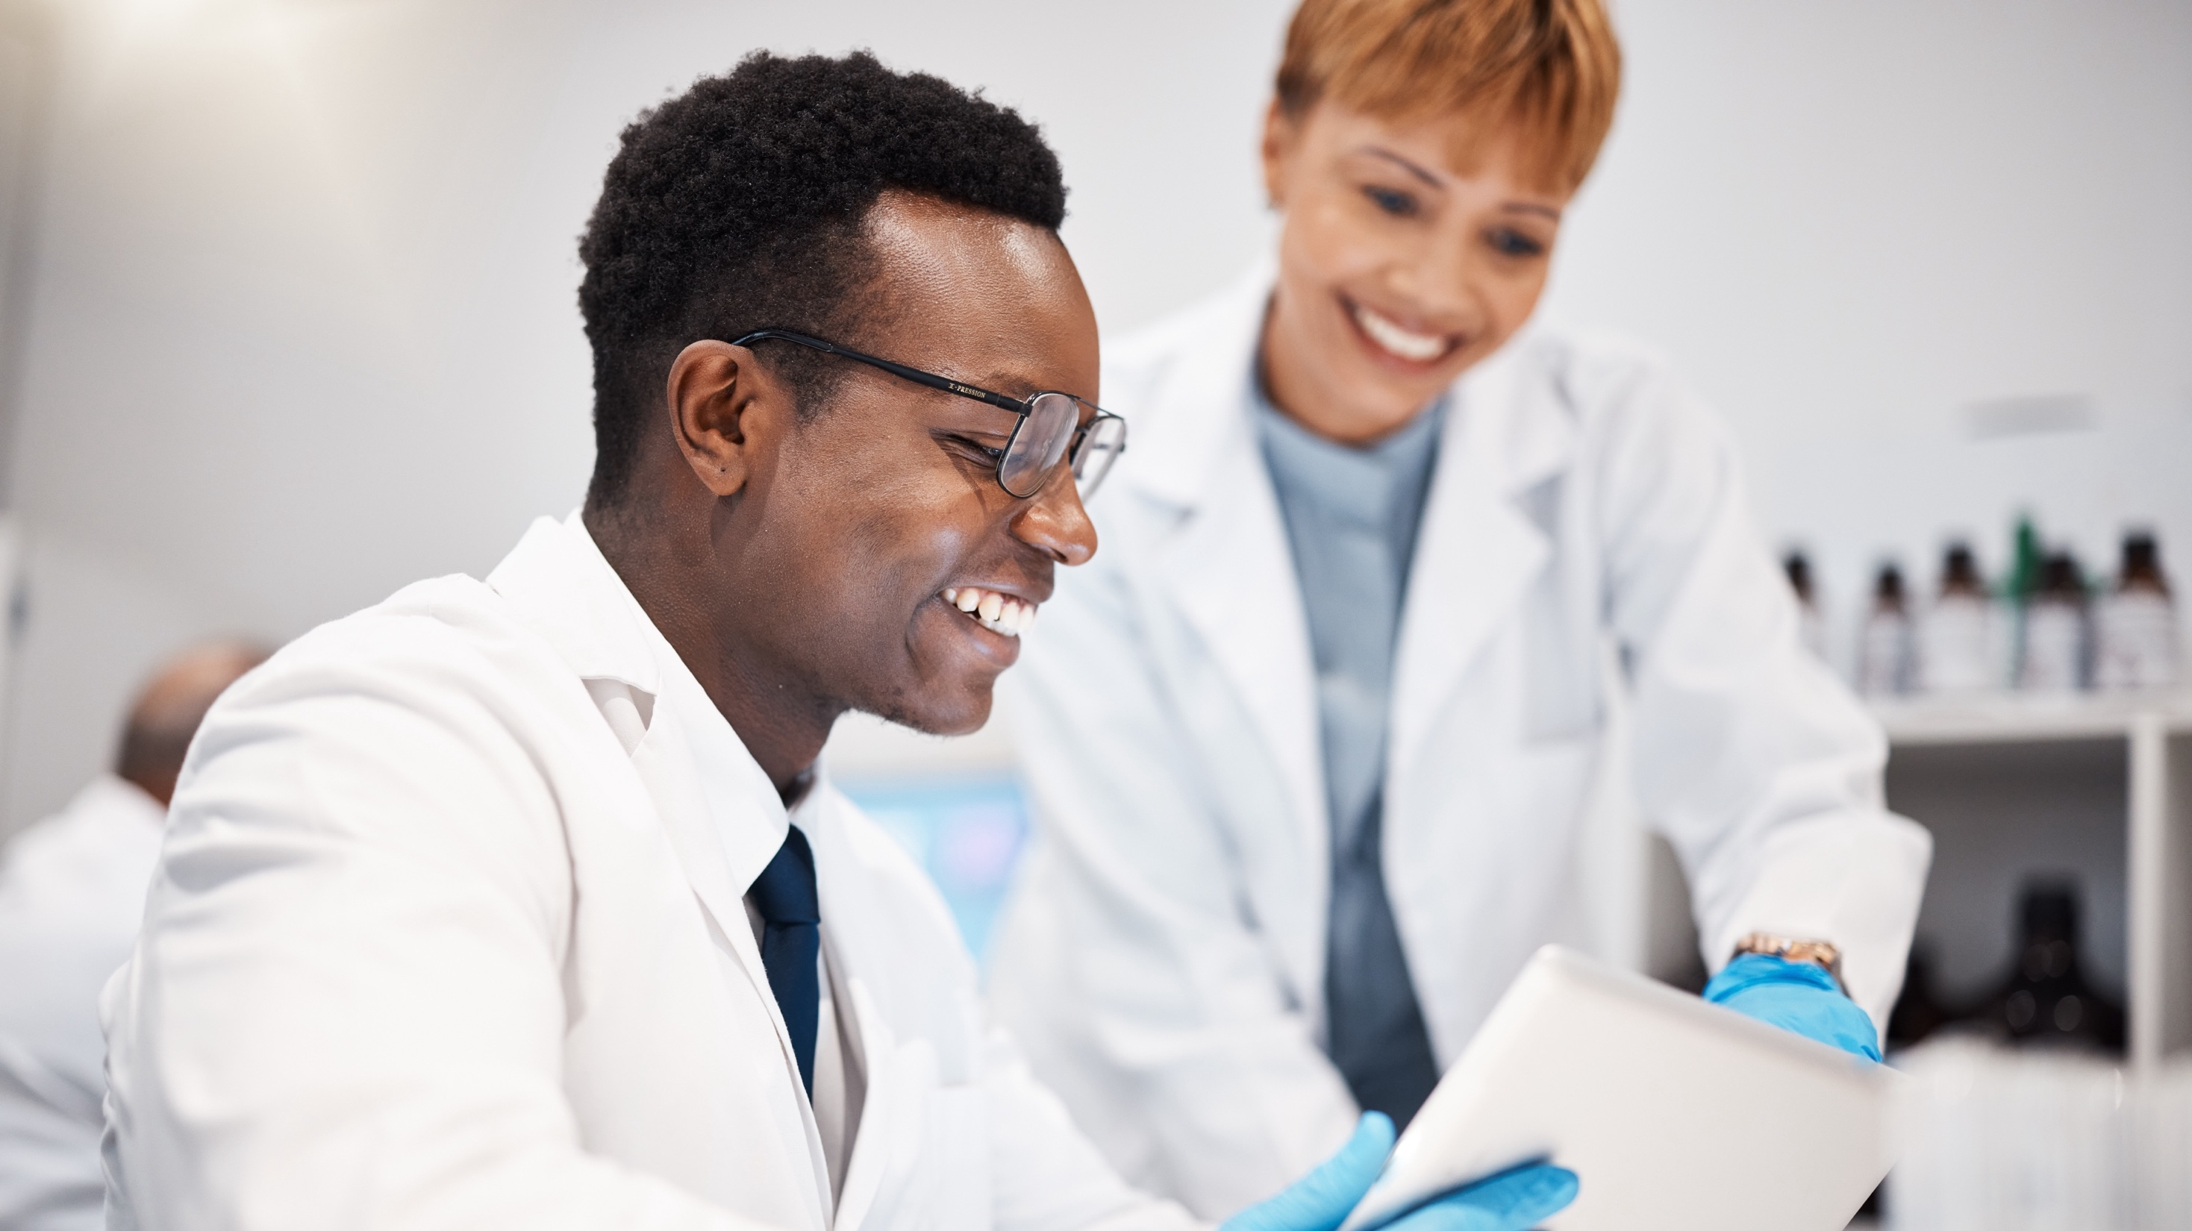
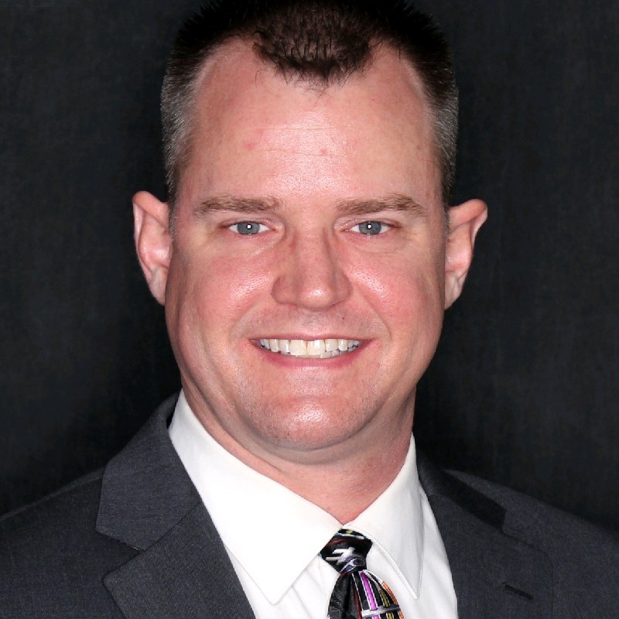
James Payne IV
MS, AHI (AMT), CPT (NHA)
MLA and Phlebotomy Instructor WEMOCO Career and Technical Education Center

Slide 13
James Payne IV
In the 2025 ASCP Building Bridges Across the Laboratory Community series, we focus on highlighting the diverse array of laboratory career pathways and how exposure to formative experiences, often through collaborations, partnerships, and unique training opportunities, can shape these laboratory career trajectories.
MS, AHI(AMT), CPT(NHA)
EDUCATION
MS Degree, Science Education at University of Rochester
BS Degree, Marine Biology at Stony Brook University
AS Degree, Liberal Arts at Monroe Community College
Taking on the role of training new students, tech, PhD candidates and post docs how to work in our lab
Having to create a world class laboratory program with no equipment, standards or guidance and starting two weeks before the start of school.
Formative Experiences in My Laboratory Career
2011 - Present
Medical Laboratory Assisting and Phlebotomy Instructor
Career & Technical Education, Monroe 2- Orleans BOCES
Professional Volunteering: I am active in my professional organizations
Community Advocate: I help counselors/admin and politicians to understand lab medicine.
Writing/Speaking: I write in journals, magazine and speak at conferences and on podcasts
“
How I “Build Bridges” within the Lab Community or Profession
2007-2009
Research Technician IV
Grayhack Laboratory, URMC
You learn almost nothing from success but if you are paying attention, you could learn everything from failure.
2005 - 2007
Research Technician III
Federoff Laboratory, URMC
2000 -2004
Beach Manager/Rink Manager
Recreation Department, City of Rochester
CDC Public Health Fellowship
ASCP Career Ambassadors
ASCP Committee Volunteer
Opportunities of Interest*
CURRENT RESPONSIBILITIES
Teaching high schools how to work in a medical laboratory and draw blood while preparing them for college medical laboratory programs
Guiding co-ops for students to work in a medical laboratory and draw blood on real patients
Networking to increase the opportunities for our students and provide them with guest speakers.
The 3 Most Valuable Skills (Technical and/or Soft Skills) You Use on a Daily Basis
Work ethic
Self motivation
Lifelong learner
Notes:
*Please include links to active career or training opportunities relevant to your professional career trajectory. This information is accurate as of its publication.

Slide 14
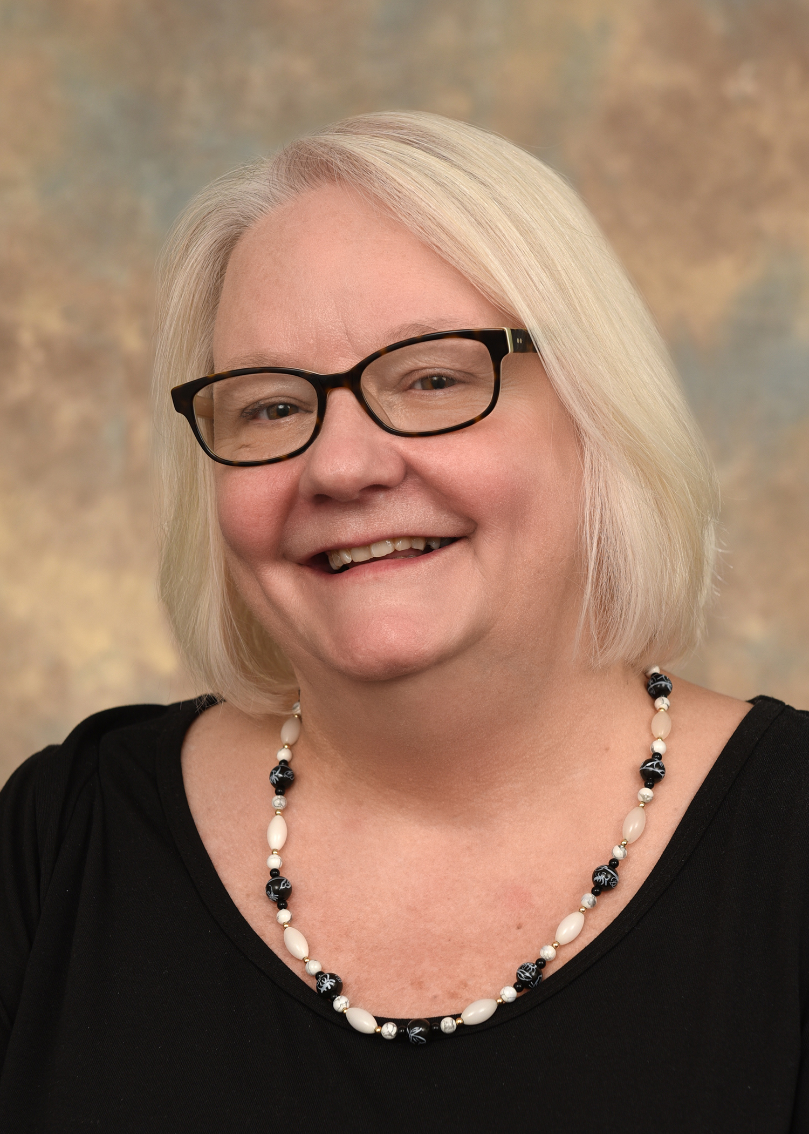
Patricia Tille
PhD, MLS(ASCP), AHI(AMT), FACSc
Professor and Graduate Program Director Medical Laboratory Science
University of Cincinnati College of Allied Health Sciences

Slide 15
Patricia Tille
In the 2025 ASCP Building Bridges Across the Laboratory Community series, we focus on highlighting the diverse array of laboratory career pathways and how exposure to formative experiences, often through collaborations, partnerships, and unique training opportunities, can shape these laboratory career trajectories.
PhD, MLS(ASCP), AHI(AMT), FACSc
EDUCATION
Ph.D. Biomedical Health Sci; Sanford School of Medicine
Medical Laboratory Science, Certificate, Sanford Health
BS. Biology, University of Sioux Falls
Insert
photo
here
Formative Experiences in My Laboratory Career
Designing a new molecular laboratory
Cardiovascular research
Law Enforcement Experience
2018
Professor, VC Dept, Program Director
Clinical Health Infor Sci, Univ. Cincinnati
How I “Build Bridges” within the Lab Community or Profession
Grade schools to high schools
International Fed. Biomedical Lab Science (IFBLS)
ASCLS President
“
2009
Assoc Prof, Program Director
Chem. Dept, SD State University
Everyone teaches,
Everyone learns,
And together we
are ALL leaders!
2004
Assoc. Prof, Program Director
Natural Science Dept, Univ of Sioux Falls
Opportunities of Interest*
Industry Partner-Boards
Consulting across health care
Networking in all areas
2000
Assoc. Prof. Program Director
Natural Science Dept, Mount Marty Univ
CURRENT RESPONSIBILITIES
Graduate Program Development, Assessment
Vice Chair Dept, Oversight, faculty evaluations, budget
Teaching within the Graduate Program/Advising
The 3 Most Valuable Skills (Technical and/or Soft Skills) You Use on a Daily Basis
Eternal Optimist
Authentic and Transparent
Communication (Writing/Speaking)
Notes:
*Please include links to active career or training opportunities relevant to your professional career trajectory. This information is accurate as of its publication.

Slide 16
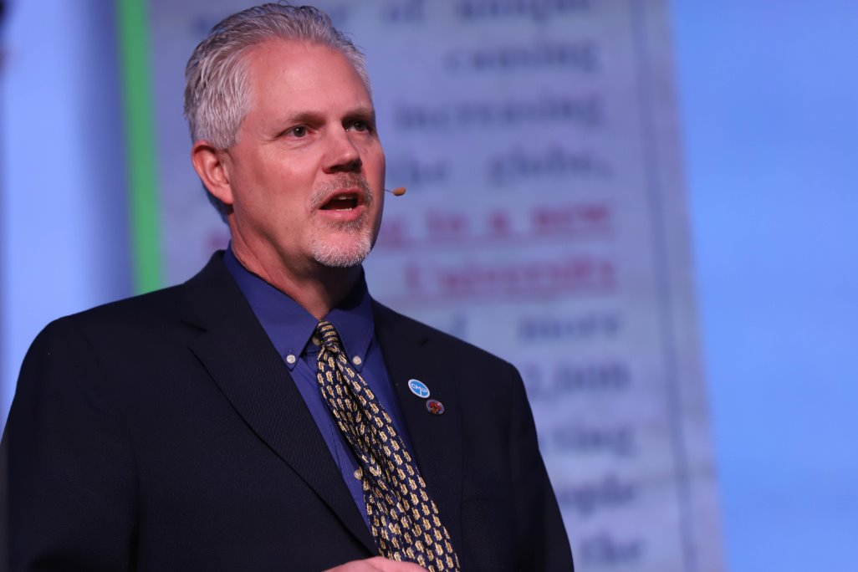
Rodney Rohde
PhD, MS, SM(ASCP)^{CM}SV^{CM},MB^{CM},FASCc University Distinguished Chair, MLS Program
Texas State University

Slide 17
Rodney E. Rohde
In the 2025 ASCP Building Bridges Across the Laboratory Community series, we focus on highlighting the diverse array of laboratory career pathways and how exposure to formative experiences, often through collaborations, partnerships, and unique training opportunities, can shape these laboratory career trajectories.
PhD, MS, SM (ASCP)^{CM}, SV^{CM}, MB^{CM}, FASCs, Global Fellow
MD Anderson Cancer Center Internship
CDC Visiting Scientist [2X]
Oral Rabies Vaccination Program, TX DSHS
Transfer to academia with MLS Program
Leadership roles and Subject Matter Expert
Global Fellowship / Science Communicator
EDUCATION
BS, Microbiology, SWTSU
MS, Virology (Biology), SWTSU
PhD, Adult Learning / Public Health, Texas State University
SM, SV, MB certifications with ASCP
Formative Experiences in My Laboratory Career
2002 – Present
Active in professional organizations
Multidisciplinary in research / teaching
Advisory Boards in industry and other
Subject Matter Expert & Science Communicator
Science Communicator
“
Regents’ Professor & Chair
MLS Program, Texas State University [TXST]
How I “Build Bridges” within the Lab Community or Profession
“You are never too important to thank others.”
“Perseverance, Persistence, Passion, and Prayer.”
“Keep on keeping on!”
1994 - Present
Associate Adjunct Professor, Biology, Austin Community College
2018 - Present
Associate Director
Translational Health Research Center, TXST
2011 - 18
Research Dean
College of Health Professions, TXST
CDC Fellowships
Mayo Clinic Laboratory Internships
Summer Undergraduate Research Fellowships [SURF] [ASM] [APHL]
Scholarships [ASCP ASCLS]
Opportunities of Interest*
1994 - 2002
Public Health Epidemiologist & Molecular Epidemiologist
Laboratory & Zoonosis Control, Texas DSHS
CURRENT RESPONSIBILITIES
International and national Subject Matter Expert
TXST MLS Program Chair leadership
Research and Teaching
Professional Consulting on MLS, Public Health, and research expertise [Rabies, AMR, microbiology, etc.]
Communication – Oral and Written
Listening AND Hearing
Resilience, Perseverance, and Adaptability
Organization and Prioritization
Keeping my perspective and calmness
under pressure
The Most Valuable Skills (Technical and/or Soft Skills) You Use on a Daily Basis
Notes:
*Please include links to active career or training opportunities relevant to your professional career trajectory. This information is accurate as of its publication.

Slide 18
Q&A

Slide 19
Next Month’s Webinar: May 14, 11 am – 12:30 pm CT At-the-Bench: Public Health Laboratories Feature

Slide 20
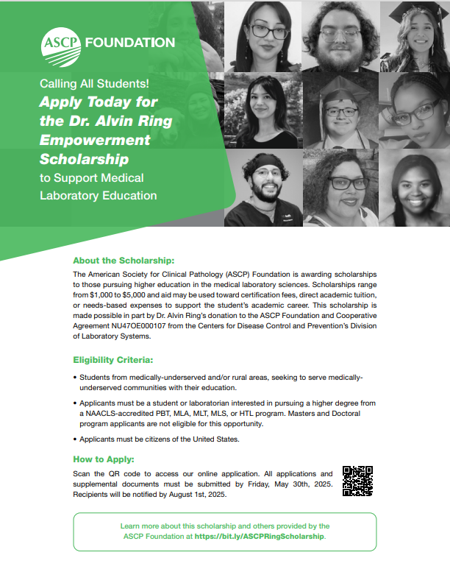
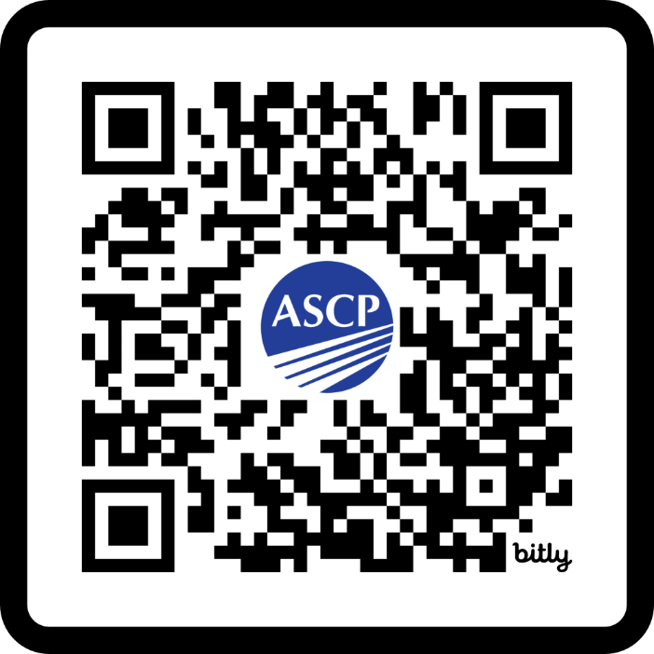
Ring Scholarship Now Open!
This scholarship is for students
interested in pursuing
laboratory science education. Encourage a student to APPLY
today and share widely within your NETWORK!
https://bit.ly/ASCPRingScholarship

Slide 21
Free ASCP Continuing Education in Service of CDC OneLab™
Blood Culture Collection Best Practices for Laboratory Professionals
Target Audience: phlebotomists, quality managers, and other clinical lab team members
Objective: increase knowledge, skills, and competence in applying best practices for adult blood culture collection in clinical laboratories
The activity offers 1.0 CME/CMLE credit.
Case-Based Best Practices in Effective Test Utilization for Clinical Laboratories
Target audience: clinical laboratory directors, clinical laboratory managers, residents, fellows, and other clinical lab team members
Objective: increase knowledge, skills, and competence in effective test utilization best practices for clinical laboratory settings.
The activity offers 1.0 CME/CMLE credit.
Find out more about these and other free laboratory resources from ASCP at: supportcdconelab.org

Slide 22
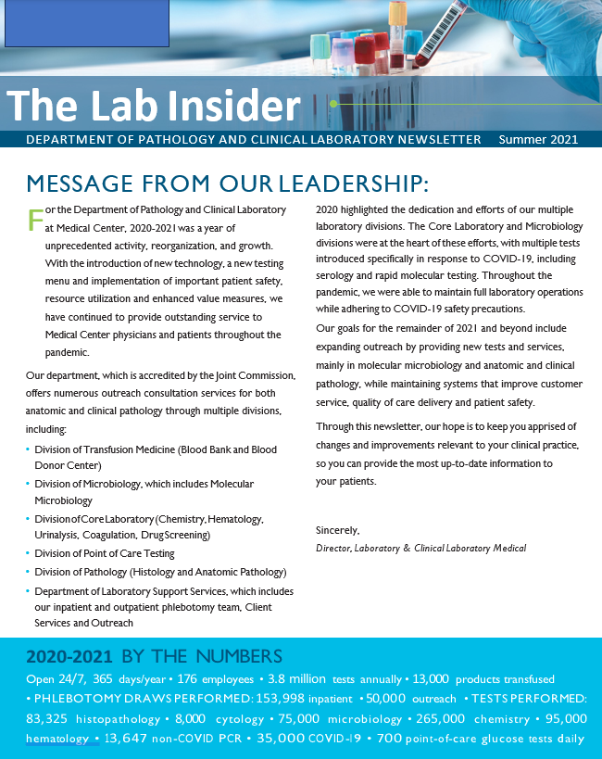
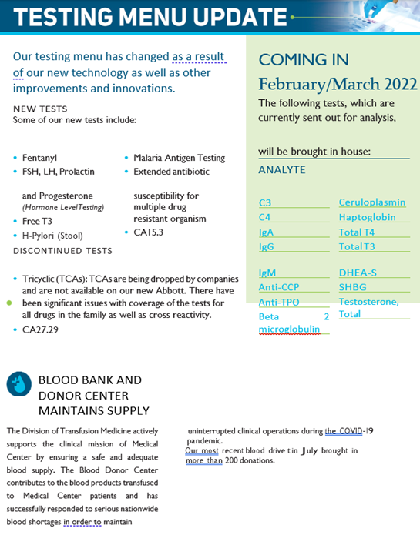
Looking for ways to increase your lab’s visibility?
Check out ASCP’s Negotiation and Advocacy Toolbox!
Find 100+ FREE and ready-to-use tools and templates to advocate for your lab, like this Sample Lab Newsletter (with 300+ downloads to date)!
Apply 5 central pillars to demonstrate your lab’s value to the overall healthcare system
Share with your lab team leadership!
Pillar 1 – Lab Visibility Tool: Sample Lab Newsletter
Available at: https://www.supportcdconelab.org/toolbox/

Slide 23
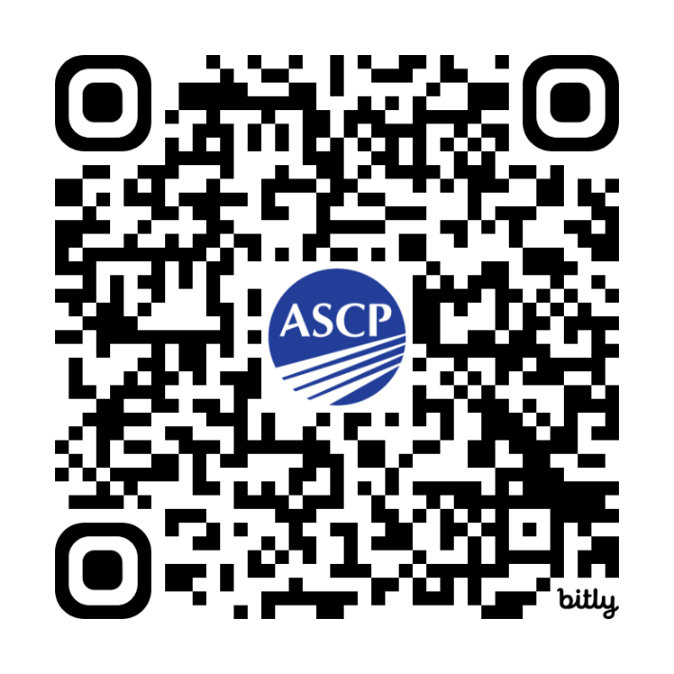
Free, Interactive Logic-Based Quiz for Lab Scientists!
Aligning with Your Lab Team Quiz
Target Audience: laboratory leadership, motivated lab team members
Purpose of the Quiz: Considers self-identified skills and personnel strengths and shares suggestions on supporting laboratory tasks that may be of interest to you
More info at: supportcdconelab.org
Take the quiz at: https://bit.ly/AligningWithYourLabTeamQuiz

Slide 24
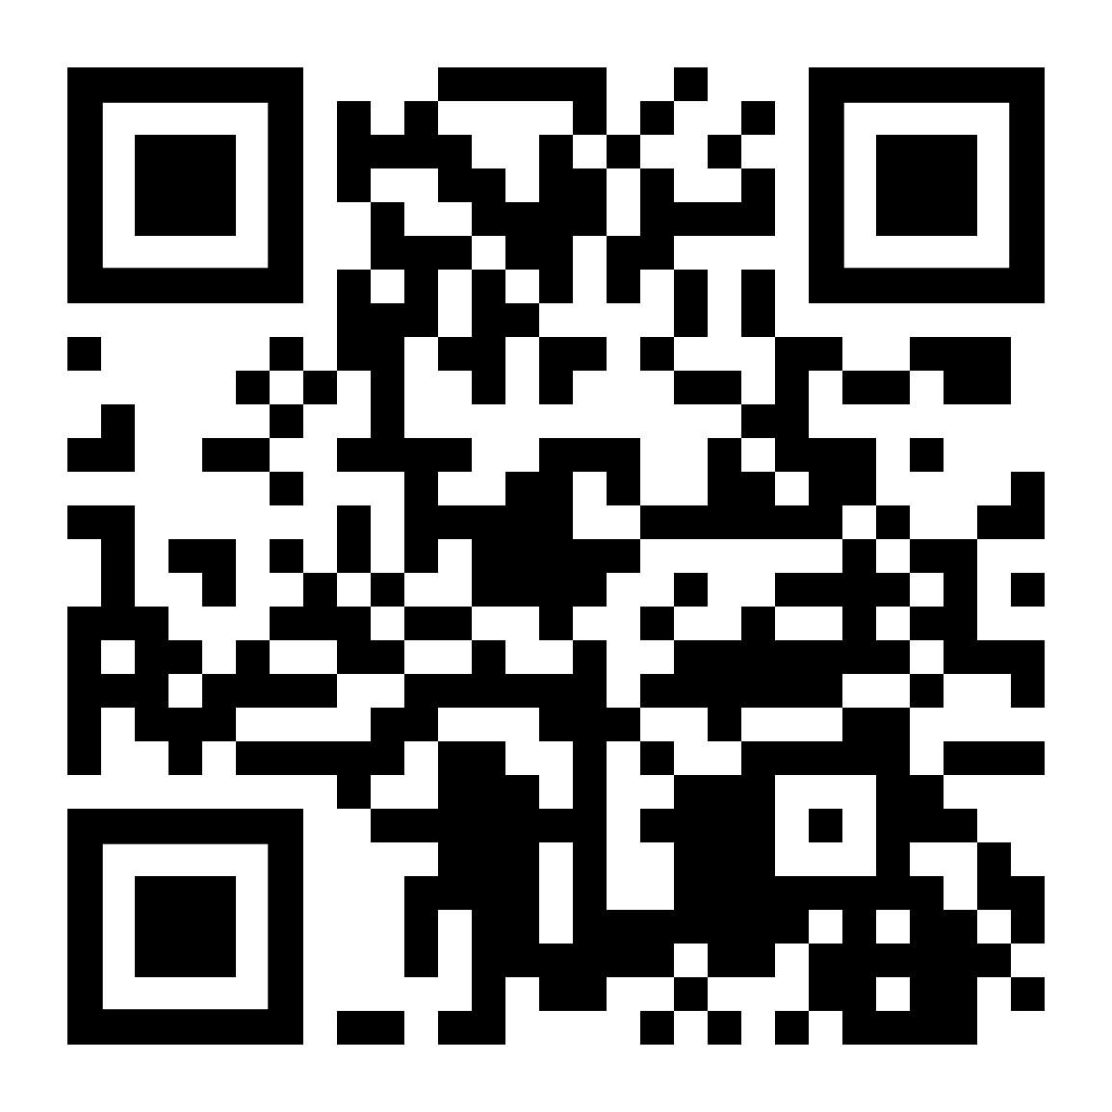
Thank you for attending!
More info at: supportcdconelab.org Or email us at:
grants@ascp.org
Laboratory Education and Visibility

