Slide 1
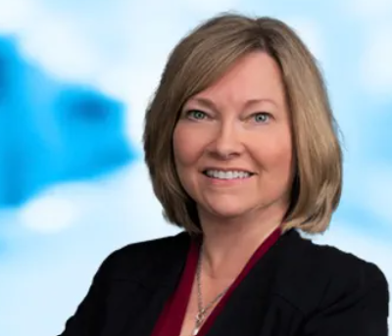
Executive Leadership Anne Walsh-Feeks, Mike Eller, Amy Spiczka, Stephanie Whitehead, Myra Kunas Moderator: Diana Kremitske, MHA, MS, MLS(ASCP) Vice President of Operations, Diagnostic Medicine Institute, Geisinger
Building Bridges Across the Laboratory Community – February 12, 2025

Slide 2
ASCP is proud to support CDC OneLabTM
Learn more about the CDC OneLab Initiative
Sign up for CDC’s free learning management system, OneLab REACH™
Access free ASCP lab training resources
Find out about Workforce Events & Scholarships
Catch-up on Building Bridges webinars

Slide 3
Funding Statement
This resource was made possible by cooperative agreement NU47OE000107 from Centers for Disease Control and Prevention (CDC). Its contents are solely the responsibility of the American Society for Clinical Pathology (ASCP) and do not necessarily represent the official views of CDC.

Slide 4
Format of Today’s Session
Introduction of Panelists
Anne Walsh-Feeks
Mike Eller
Amy Spiczka
Stephanie Whitehead
Myra Kunas
Q & A Session
Session Wrap-Up

Slide 5
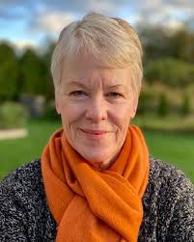
Anne Walsh-Feeks
MS, PA (ASCP), FACHE
Chief Operating Officer of Ambulatory Services Stony Brook Medicine

Slide 6
Anne Walsh-Feeks
In the 2025 ASCP Building Bridges Across the Laboratory Community series, we focus on highlighting the diverse array of laboratory career pathways and how exposure to formative experiences, often through collaborations, partnerships, and unique training opportunities, can shape these laboratory career trajectories.
MS, M(ASCP), PA(ASCP), FACHE
EDUCATION
BA, Biology & Anthropology, CUNY Queens College
PA Certification, SUNY Downstate Medical Center
MS, Health Policy & Management, NYU
AIDS Epidemic
Laboratory supervisory opportunities
Hospital-wide Reengineering Program
AAPA and ASCP board involvement
Insert
photo
here
Formative Experiences in My Laboratory Career
2018-present
Asst. Dean and COO Ambulatory Operations, Stony Brook Medicine
Participation in ASCP Committees
Participation on panels to share my experiences and motivate others.
Providing mentorship and guidance to young and mid-.careerists
How I “Build Bridges” within the Lab Community or Profession
“
2015-2018
Administrative Director Pathology & Laboratory Medicine
NYU LI (formerly Winthrop Univ. Hosp.)
2013-2015
Chief Administrative Officer
NY Presbyterian Queens
When a door opens seriously consider walking through it
Philanthropy- Chair of the ASCP Foundation
Mentorship- participation in the ASCP Mentorship Program
2010-2013
1991-2010
1982-1991
Sr. Director-Northwell Health
Multiple Roles-Winthrop Univ. Hosp.
Supervisor Pathology-NYU Medical Center
Opportunities of Interest*
CURRENT RESPONSIBILITIES
Lead ambulatory practice network
Lead practice optimization and access initiatives
Identify and initiate strategic opportunities
The 3 Most Valuable Skills (Technical and/or Soft Skills) You Use on a Daily Basis
Listening
Project Management
Insuring follow up
Emotional Intelligence
Notes:
*Please include links to active career or training opportunities relevant to your professional career trajectory. This information is accurate as of its publication.

Slide 7
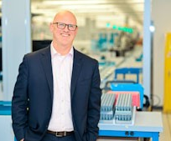
Mike Eller
BS, MBA
Vice President of Strategy and Business Development
Northwell Health Laboratories

Slide 8
Mike Eller
In the 2025 ASCP Building Bridges Across the Laboratory Community series, we focus on highlighting the diverse array of laboratory career pathways and how exposure to formative experiences, often through collaborations, partnerships, and unique training opportunities, can shape these laboratory career trajectories.
VP, Business Development and Strategy
Got a job in a specialty Lyme Disease lab in Southampton Hospital in 1996
Sales opportunity in 1998
Got my mentor in 2002
Managed 4 Northwell Labs
Signed CLNY JV with NYC H+H/Northwell
EDUCATION
BS, Clinical Lab Science, SUNY Stony Brook
MBA, Health Care Admin, Hofstra University
Formative Experiences in My Laboratory Career
11/23 – Present
Vice President, Business Development
Laboratory, Northwell Health
Always look for ways to partner
Always think how the lab can support various Health System goals
Think “outside the lab”
Be innovative and focus on the consumer/patient and clinicians
How I “Build Bridges” within the Lab Community or Profession
“If you don’t do something, nothing gets done”
1/17-11/23
AVP, Business Strategy
Laboratory, Northwell Health
5/15-11/23
AVP, Hospital Laboratory Operations
Laboratory, Northwell Health
Project Management Certification (PMI)
Northwell Leadership Training
Six Sigma/Lean Training
5/08-5/15
Sr. Administrative Director
4 Northwell Hospital Labs, Northwell Health
Opportunities of Interest*
CURRENT RESPONSIBILITIES
Sales and marketing strategy
Oversee IT operations and strategy for the lab
Project management operations
Patient experience strategy
The 3 Most Valuable Skills (Technical and/or Soft Skills) You Use on a Daily Basis
PowerPoint – tell your story
Active Listening – Shut up and listen
Artificial Intelligence/ChatGPT - new tools are coming out everyday
Notes:
*Please include links to active career or training opportunities relevant to your professional career trajectory. This information is accurate as of its publication.

Slide 9
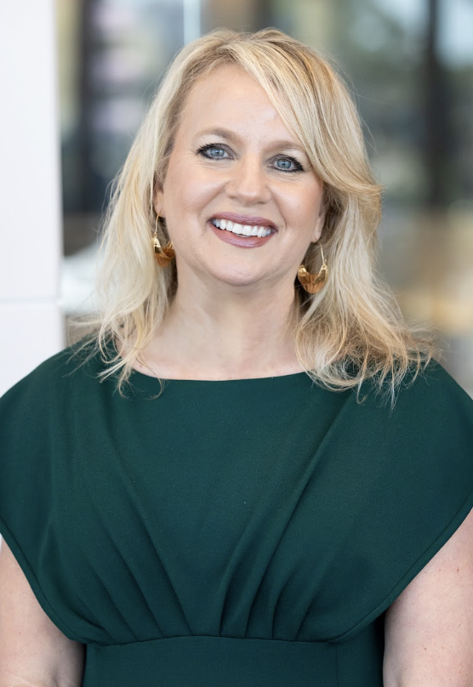
Amy Spiczka
DHSc, MS, HTL(ASCP)^{CM}SCT,MB^{CM},CPHQ
Executive Director American Society for Clinical Pathology Board of Certification

Slide 10
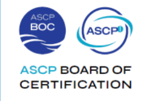
Amy Spiczka
In the 2025 ASCP Building Bridges Across the Laboratory Community series, we focus on highlighting the diverse array of laboratory career pathways and how exposure to formative experiences, often through collaborations, partnerships, and unique training opportunities, can shape these laboratory career trajectories.
DHSC, MS,,HTL(ASCP)^{CM} SCT,MB^{CM}, CPHQ
EDUCATION
Doctor of Health Sciences (DHSc)
Master of Science, Education (MS)
Cytologist Program (4+1) / Molecular Biology
Histotechnology, Medical Laboratory Technology
Formative Experiences in My Laboratory Career
Insert
photo
here
Science of “leadership”
Identify & own your transformation
Elevate others
“
Current
Executive Director | ASCP BOC
Chief Officer | Examinations & Credentialing
How I “Build Bridges” within the Lab Community or Profession
Trust through transparency
Cultivate talent, strengths
Affirm connections
2018 - 22
Senior Director | Quality & Patient Safety, ASCP
Honor and nurture humble beginnings as you live out your dreams
2010 - 19
Operations Manager | Anatomic Pathology, Mayo Clinic AZ
Opportunities of Interest
ASCP Board of Certification
Patient Safety CQI
Gallup CliftonStrengths
Emerging technologies, data
Histotechnology Program Director
Cytology Education Coordinator
Division Education Supervisor |
Anatomic Pathology, Mayo Clinic Rochester, MN
2008 - 10
CURRENT RESPONSIBILITIES
Elevate patients’ experiences, outcomes
Advance professional visibility and value through credentialing
Optimize operations excellence
3 Most Valuable Skills (Technical and/or Soft Skills) You Use on a Daily Basis
Visibility
Affirm empathy
Healthy relationships inspire improvements
Notes:
*Please include links to active career or training opportunities relevant to your professional career trajectory. This information is accurate as of its publication.

Slide 11
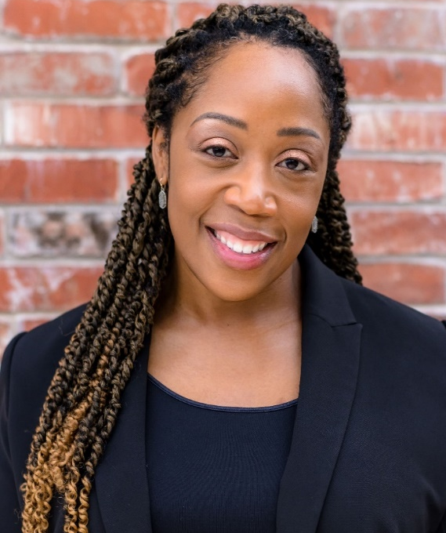
Stephanie Whitehead
MBA, MPH, MLS(ASCP)
Executive Director of Pathology and Laboratory Services University Health

Slide 12
“
Stephanie Whitehead
In the 2025 ASCP Building Bridges Across the Laboratory Community series, we focus on highlighting the diverse array of laboratory career pathways and how exposure to formative experiences, often through collaborations, partnerships, and unique training opportunities, can shape these laboratory career trajectories.
MBA, MPH, MLS (ASCP)
Transition to Leadership and Management
Handling High-Pressure Situations and Crisis Management
Volunteer and leadership activities/involvement in professional organizations
Formative Experiences in My Laboratory Career
EDUCATION
Master in Public Health (MPH)
Master in Business Administration (MBA)
Bachelor of Science in Medical Laboratory Science (BS MLS)
How I “Build Bridges” within the Lab Community or Profession
Fostering Interdisciplinary Collaboration
Supporting others in their Professional Development through Mentorship
Promoting Cross-Institutional Networking
Instagram and X: @swhitehead_mls
LinkedIn: @stephanieywhitehead
“
Present
Executive Director
Pathology Services, University Health
Following a crisis, leaders inevitably become the face of the tragedy. How a leader reacts in the early stages of a crisis –or NOT reacts- communicates volumes and sets the tone for the rest of the team.
–Jeff Gorter
Laboratory Director
Rural Laboratories in MS and South TX
ASCP Communities, Chapters and educational resource - Home - ASCP Community
Leadership Development and Mentorship Tools –eLABorate Topics Podcast
LinkedIn Social Media platform for networking and building Connections
2012-2008
Opportunities of Interest
2006-2008
Medical Laboratory Scientist
Generalist
CURRENT RESPONSIBILITIES
Leadership and Strategic Oversight for Inpatient and Ambulatory Operations
Operational and Financial Management
Regulatory and Quality Assurance responsibility
The 3 Most Valuable Skills (Technical and/or Soft Skills) You Use on a Daily Basis
Communication (Verbal and Written)
Problem-Solving and Critical Thinking
Trauma Informed Care and Leadership and Positive Intelligence (PQ) training Positive Intelligence | Building mental fitness for all
Notes:
*Please include links to active career or training opportunities relevant to your professional career trajectory. This information is accurate as of its publication.

Slide 13
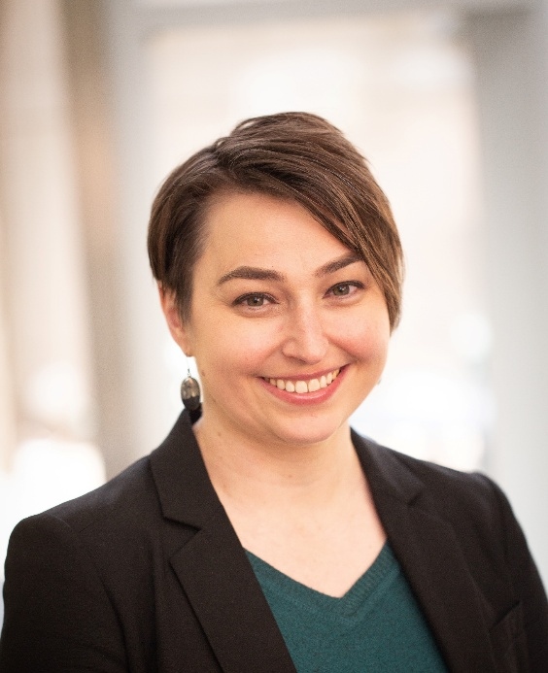
Myra Kunas
MS
Assistant Commissioner, Health Protection Bureau Minnesota Department of Health

Slide 14
Myra Kunas
In the 2025 ASCP Building Bridges Across the Laboratory Community series, we focus on highlighting the diverse array of laboratory career pathways and how exposure to formative experiences, often through collaborations, partnerships, and unique training opportunities, can shape these laboratory career trajectories.
MS
EDUCATION
MS, Earth and Ecosystem Science / Tulane University
BS, Biology (Ecology emphasis)/Polymer Chemistry minor / Winona Sate University
BA, Mathematics/Statistics Minor / Winona State University
Formative Experiences in My Laboratory Career
2014 PHL building Flood
2015 Environmental Lab Fraud
George Floyd riots
2021-2022 Great Resignation
2023-current
Assistant Commissioner
Health Protection Bureau, Minnesota Department of Health (MDH)
Breakdown complex work to find commonalities and relate back to programs.
Acknowledge when you make a mistake and apologize.
Cross training and respecting the IT processes and workflow.
How I “Build Bridges” within the Lab Community or Profession
“
2020-2023
Division Director
Public Health Laboratory, MDH
2015-2020
Assistant Division Director
Public Health Laboratory, MDH
Always maintain the attitude of a student. – Nick Offerman
MN Emerging Leaders Institute
APHL Emerging Leader Program
MN Senior Leaders Institute
2009-2015
Operations Unit Supervisor
Environmental Lab/PHL, MDH
Opportunities of Interest*
CURRENT RESPONSIBILITIES
Development of Strategies to Improve PH Systems
Advancing health equity throughout the Bureau
Recovery following the COVID Pandemic
The 3 Most Valuable Skills (Technical and/or Soft Skills) You Use on a Daily Basis
Conflict Resolution / Coaching / Mentoring
Active Listening / Communication / Advocacy
Project Management
Notes:
*Please include links to active career or training opportunities relevant to your professional career trajectory. This information is accurate as of its publication.

Slide 15
Q&A

Slide 16
Next Month’s Webinar: March 12, 11 am – 12:30 pm CT At-the-Bench: Clinical Laboratories Feature

Slide 17
CMLE Credit Claiming for Today's Webinar
Claim 1.5 CMLE credit for this webinar from the ASCP Store
Instructions will be emailed to live attendees tomorrow 2/13/25 (via Zoom)
Credit claiming is only available within 1-month of the webinar date

Slide 18
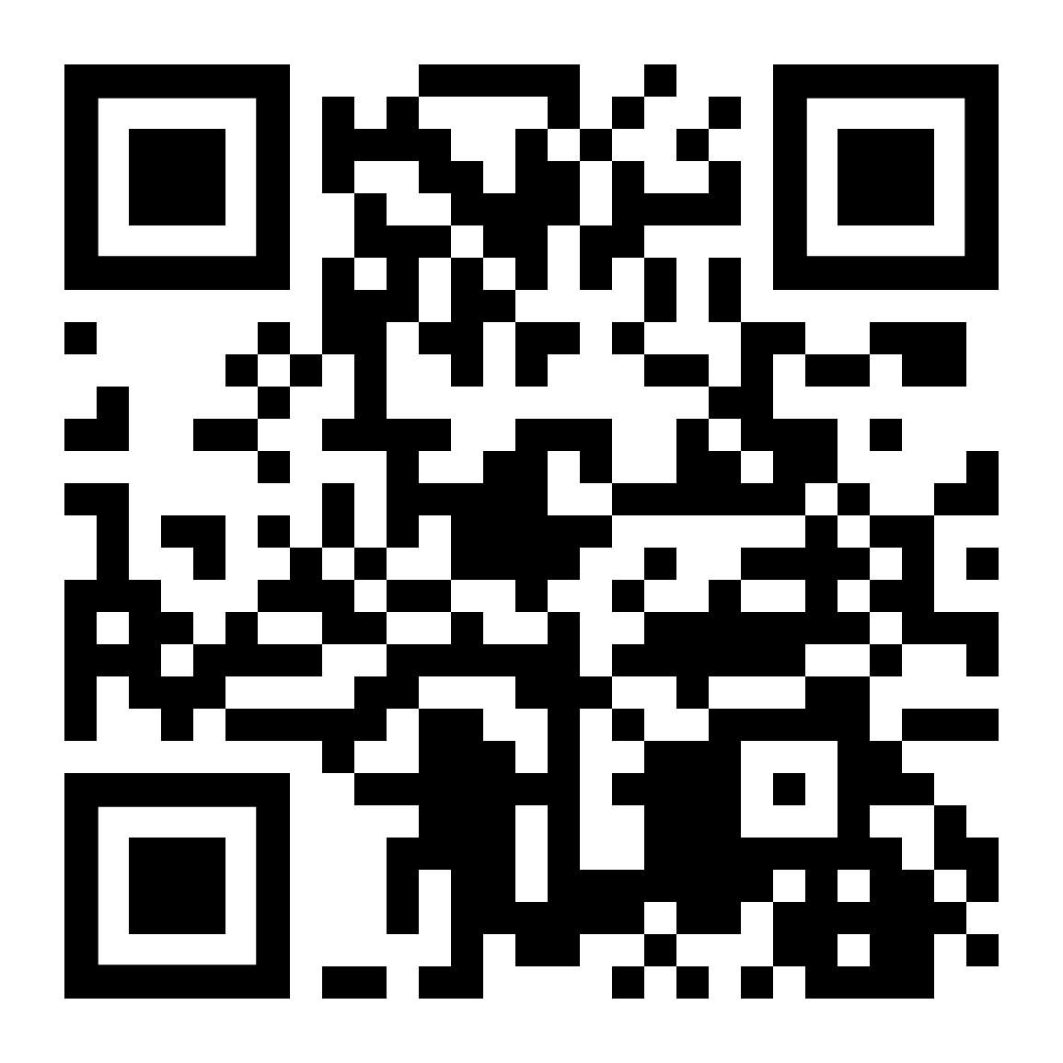
Thank you for attending!
More info at: supportcdconelab.org Or email us at:
grants@ascp.org
Executive Leadership

