Slide 1
At-the-Bench: Clinical Laboratories Feature Terri McElhattan, Alfonso Ortiz, Tom Alexander, Sachin Gupta
Building Bridges Across the Laboratory Community – March 12, 2025

Slide 2
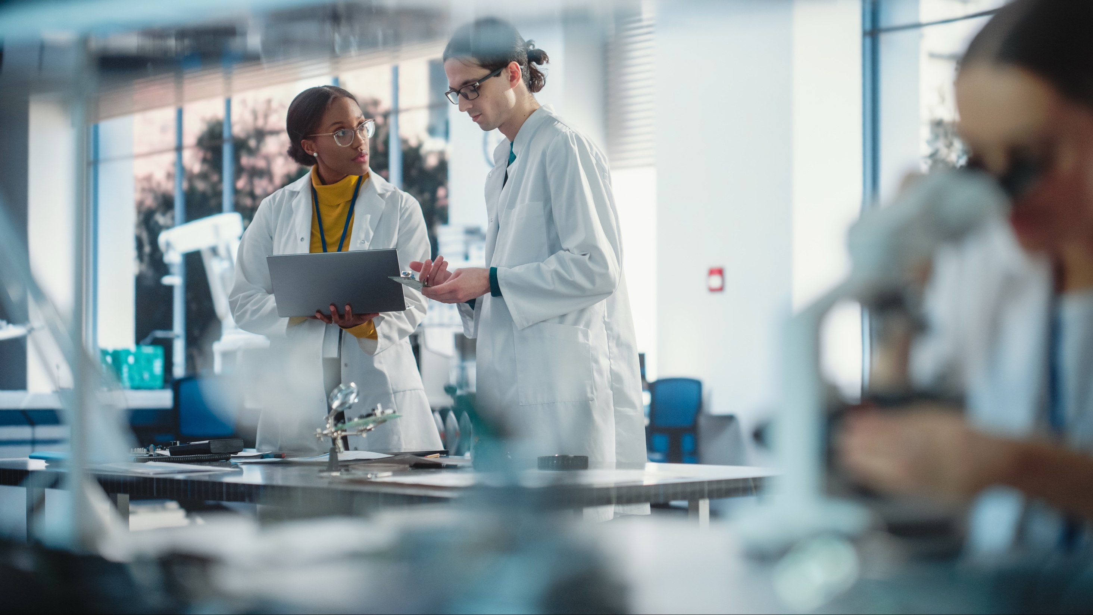
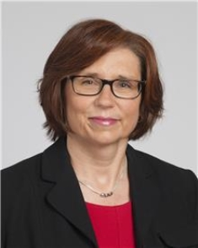
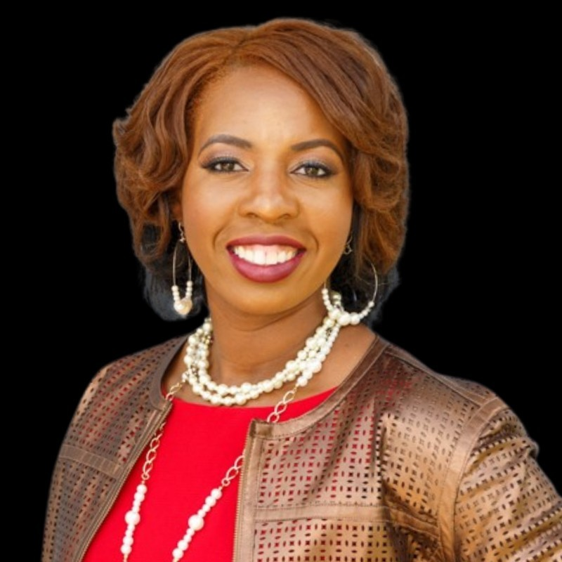
Moderators
Susan Harrington
PhD, D(ABMM), MASCP, MLS(ASCP)^{CM}
Medical Director, Mycobacteriology, Akron General Hospital Microbiology, and the Medical Laboratory Science Program, Cleveland Clinic
Tywauna Wilson
MBA, MLS (ASCP)^{CM}
System Technical Chemistry Laboratory Director, CompuNet Clinical Laboratories

Slide 3
ASCP is proud to support CDC OneLabTM
Learn more about the CDC OneLab Initiative
Sign up for CDC’s free learning management system, OneLab REACH™
Access free ASCP lab training resources
Find out about Workforce Events & Scholarships
Catch-up on Building Bridges webinars

Slide 4
Funding Statement
This project is supported by Cooperative Agreement number CDC-RFA-OE22-2202 (CFDA No. 93.322), funded by the Centers for Disease Control and Prevention. Its contents are solely the responsibility of the American Society for Clinical Pathology and do not necessarily represent the official views of the Centers for Disease Control and Prevention or the Department of Health and Human Services. This project was 100% funded with federal funds to the American Society for Clinical Pathology (NU47OE000107).

Slide 5
Format of Today’s Session
Introduction of Panelists
Terri McElhattan
Alfonso Ortiz
Tom Alexander
Sachin Gupta
Q & A Session
Session Wrap-Up

Slide 6
Sample Career Map
Name
In the 2025 ASCP Building Bridges Across the Laboratory Community series, we focus on highlighting the diverse array of laboratory career pathways and how exposure to formative experiences, often through collaborations, partnerships, and unique training opportunities, can shape these laboratory career trajectories.
Credentials
EDUCATION
Degree, Program University/College
Degree, Program University/College
Degree, Program University/College
Formative Experiences in My Laboratory Career
Opportunity 1
Opportunity 2
Opportunity 3
Year
Current position
Team or Department, Company
How I “Build Bridges” within the Lab Community or Profession
Response 1
Response 2
Response 3
“
Previous position
Team or Department, Company
Career advice quote
Year
Year
Previous position
Team or Department, Company
Training/Career Opportunity 1
Training /Career Opportunity 2
Training /Career Opportunity 3
Year
Previous position
Team or Department, Company
Opportunities of Interest*
CURRENT RESPONSIBILITIES
Responsibility 1
Responsibility 2
Responsibility 3
The 3 Most Valuable Skills (Technical and/or Soft Skills) You Use on a Daily Basis
Skill 1
Skill 2
Skill 3
Notes:
*Please include links to active career or training opportunities relevant to your professional career trajectory. This information is accurate as of its publication.

Slide 7
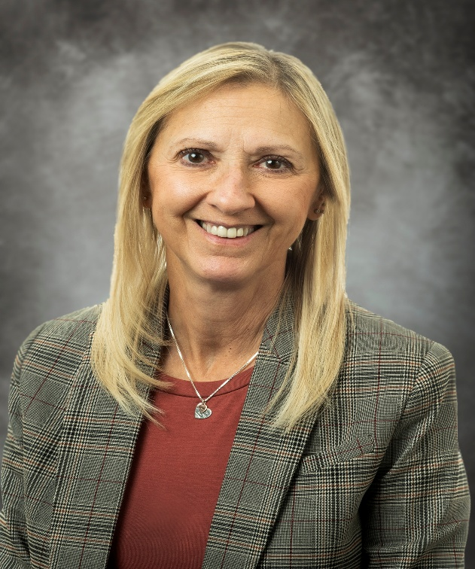
Terri McElhattan
MHA, CLA(ASCP)PBT^{CM}, CLT(HHS), CPI (ACA)
Program Director/Principal Instructor
Geisinger School of Phlebotomy Email: tamcelhattan@geisinger.edu

Slide 8
Terri A. McElhattan
In the 2025 ASCP Building Bridges Across the Laboratory Community series, we focus on highlighting the diverse array of laboratory career pathways and how exposure to formative experiences, often through collaborations, partnerships, and unique training opportunities, can shape these laboratory career trajectories.
MHA, CLA(ASCP)PBT^{CM}, CLT(HHS), CPI (ACA)
EDUCATION
MHA, Healthcare Administration, King’s College
Masters Certificate, Executive Leadership/HCA, King’s College
BS, Biology/Education, College Misericordia
Ashland St. General Hospital for Laboratory Technicians
ASCP MLA and Phlebotomy Exam Committee
NAACLS Program Educator
CLSI Document Development Committee
Health Profession Education Council
Driving phlebotomy practice advancement
Insert
photo
here
Formative Experiences in My Laboratory Career
2009
Program Director/Principal Instructor
Geisinger School of Phlebotomy
“
How I “Build Bridges” within the Lab Community or Profession
HS career days sponsored by Geisinger
Attend career days at high schools/career fairs
Present at laboratory conferences
2000
Medical Laboratory Scientist
Blood Bank/Heme/Coag/Urines
Education is not the learning of facts, but the training of the mind to think-Einstein
2000
Health Science/Phlebotomy Instructor
Allied Medical/Technical Careers
ASCP Career Ambassadors
Geisinger School of Phlebotomy
Geisinger MLS Program
1983
Medical Laboratory Scientist
Blood Bank/Heme/Coag/Urines, WVHCS
Opportunities of Interest*
CURRENT RESPONSIBILITIES
Administrates and coordinates activities for the SOP.
Implement curriculum, instruct students in the SOP.
Phlebotomy Best Team Ops Advisor
Oversees systemwide non-lab phlebotomy training
The 3 Most Valuable Skills (Technical and/or Soft Skills) You Use on a Daily Basis
Communication skills
Organizational Mgmt.
Phlebotomy
Document writing
Notes:
*Please include links to active career or training opportunities relevant to your professional career trajectory. This information is accurate as of its publication.

Slide 9
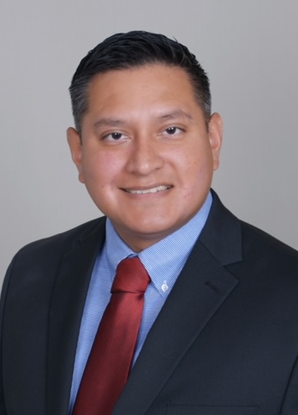
Alfonso Ortiz
MLS(ASCP)^{CM}
Senior Laboratory Manager for Pathology Services
University Health San Antonio

Slide 10
Alfonso Ortiz
In the 2025 ASCP Building Bridges Across the Laboratory Community series, we focus on highlighting the diverse array of laboratory career pathways and how exposure to formative experiences, often through collaborations, partnerships, and unique training opportunities, can shape these laboratory career trajectories.
MLS(ASCP)^{CM}
EDUCATION
Certificate in Applied Project Management, Villanova University
Bachelor of Science, Clinical Laboratory Science, University of Texas Health Science Center at San Antonio
Associate of Science, Medical Laboratory Technology, Laredo Community College
First instrument validation experience with ACL TOP CTS in 2009
First LIS and middleware implementation in 2015
EPIC HIS Implementation in 2020
Insert
photo
here
Formative Experiences in My Laboratory Career
Oct 2024 - Present Assistant Director, Pathology Services University Hospital
Feb 2020 - Oct 2024 Senior Lab Project Manager University Hospital
Oct 2018 – Feb 2020 Project Lab Manager, Pathology Services University Hospital
Jul 2017 – Oct 2018 Lab Manager, Hematology/Coagulation University Hospital
Jan 2015 – Jul 2017 Lab Supervisor, Hematology/Coagulation University Hospital
Feb 2011 – Jan 2015 Sr. Medical Laboratory Scientist University Hospital
May 2007 –Feb 2011 Medical Laboratory Scientist University Hospital
Jun 2005 – Dec 2005 Medical Laboratory Technician, General Laredo Medical Center
ASCP Texas Riverwalk Chapter
ASCP Council of Laboratory Management & Administration
Networking through outreach activities (ASCP Annual Meeting, ASCP KnowledgeLab)
How I “Build Bridges” within the Lab Community or Profession
“
Continuous learning and adaptability are key to success in the lab industry.
Project management - Project Management Certificate | Villanova University
University Health - Management Development Academy
Pryor Learning - Management Seminars and Supervisor Leadership Training
Opportunities of Interest*
CURRENT RESPONSIBILITIES
Oversee pathology service projects to improve workflow
Implement new lab technologies and laboratory information system (LIS) integrations
Ensure compliance with regulatory standards
The 3 Most Valuable Skills (Technical and/or Soft Skills) You Use on a Daily Basis
Technical Skills: Soft Skills:
LIS Implementation Leadership
Project Management Process Improvement
Laboratory Workflow Collaboration Optimization
Notes:
*Please include links to active career or training opportunities relevant to your professional career trajectory. This information is accurate as of its publication.

Slide 11
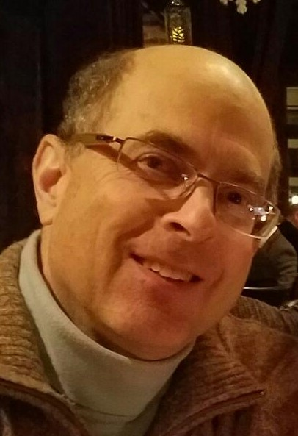
Tom Alexander
PhD, D(ABMLI)
Independent Consultant and Laboratory Director Thomas S. Alexander, PhD., D(ABMLI), LLC
Email: talexander13176@gmail.com

Slide 12
Thomas S. Alexander
In the 2025 ASCP Building Bridges Across the Laboratory Community series, we focus on highlighting the diverse array of laboratory career pathways and how exposure to formative experiences, often through collaborations, partnerships, and unique training opportunities, can shape these laboratory career trajectories.
PhD, D(ABMLI)
EDUCATION
Diplomate, American Board of Medical Laboratory Immunology
PhD., Cell Biology/Immunology, Kent State Univ
MS, Microbiology/Immunology, Colorado State Univ
BA Biology, Northwestern, Univ
Insert
photo
here
Formative Experiences in My Laboratory Career
Developing clinical assays in a research lab (pre CLIA 88!)
The onset of AIDS
Being invited to join the ASCP Immunology exam committee
2019-present
Independent consultant and lab director, various companies
Moving from mouse to human immunology research
Learning clinical testing from the lab staff
Developing MLS immunology curriculum
Formative Experiences in My Laboratory Career
“
1982-2019
Immunologist, Pathology, Summa Health, Akron, OH
1978-1982
Research Associate, Immunology Cleveland Clinic and Summa Health
Career advice:
Treat every specimen as if it belonged to a loved one.
Teaching in the Osler Pathology board review course
Working in Lesotho as part of the PEPFAR program
Expanding the Summa immunology test menu
1975-1978
Research Assistant, Immunology, Harvard School of Public Health
Opportunities of Interest
CURRENT RESPONSIBILITIES
Obtain CLIA Certification and Agency Accreditation for startup labs
Prepare validation plans for new assays
Provide interpretative reports and comments to physicians and patients
The 3 Most Valuable Skills (Technical and/or Soft Skills) You Use on a Daily Basis
Communication
Problem solving
Making a complex subject clear to non-specialists
Notes:
*Please include links to active career or training opportunities relevant to your professional career trajectory. This information is accurate as of its publication.

Slide 13
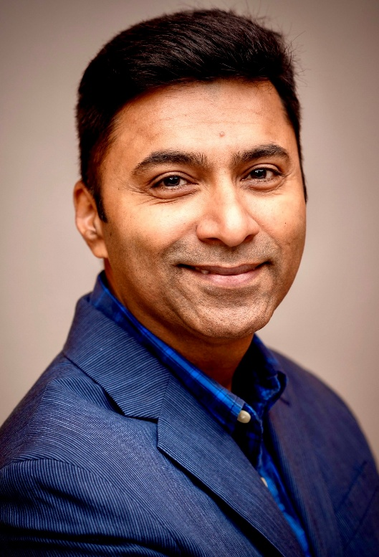
Sachin Gupta
PhD, MBA, MLS(ASCP^{i})MB^{i}, LSSBB, CPHQ
Scientific Director – Center for Quality and Patient Safety (CQPS)
American Society for Clinical Pathology

Slide 14
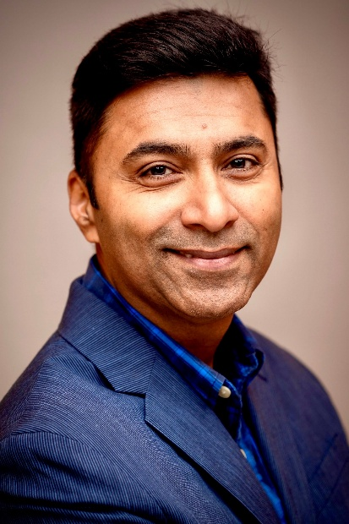
Sachin Gupta
In the 2025 ASCP Building Bridges Across the Laboratory Community series, we focus on highlighting the diverse array of laboratory career pathways and how exposure to formative experiences, often through collaborations, partnerships, and unique training opportunities, can shape these laboratory career trajectories.
PhD, MBA, MLS(ASCP^{i})MB^{i}, LSSBB, CPHQ
EDUCATION
B.S. in Med Lab Technology
Ph.D., Immunopathology
MBA, Health Sector Adm.,
MLS(ASCP^{i})MB^{i}
Lean Six Sigma Black Belt
Certified Professional in Healthcare Quality (CPHQ)
Formative Experiences in My Laboratory Career
ASCP^{i} (Get Credentialed)
MBA
Performance Improvement projects
Data analysis
“
Go to Gemba approach (What is a Gemba Walk and Why is It Important? | SafetyCulture)
Process focus approach
How Labs can add value to improve patient care
2023-Present
Scientific Director
Center for Quality and Patient Safety, ASCP
How I “Build Bridges” within the Lab Community or Profession
See things from others perspective!
Keep learning each and every day!
Be passionate about what you do!
2014-2023
PI Manager / Director – Lab Quality / Data
Laboratories, BayCare Health System
Data analytics training e.g. Power BI, Tableau (Business Intelligence and Analytics Software | Tableau)
Lean Six Sigma certification (Six Sigma Yellow Belt (CSSYB) Certification | ASQ)
2007-2014
Post Doctoral Fellow / Scientist
Miller School of Medicine, University of Miami
Opportunities of Interest*
CURRENT RESPONSIBILITIES
NPQR – Laboratory performance and benchmarking platform (Link: NPQR)
Effective Test Utilization (Link: Effective Test Utilization)
Research
Education and SME
The 3 Most Valuable Skills (Technical and/or Soft Skills) You Use on a Daily Basis
Constructive Disruptor
Logical, Nimble and Passionate
See things from others perspective
Notes:
*Please include links to active career or training opportunities relevant to your professional career trajectory. This information is accurate as of its publication.

Slide 15
Q&A

Slide 16
Next Month’s Webinar: April 16, 11 am – 12:30 pm CT Laboratory Education and Visibility

Slide 17
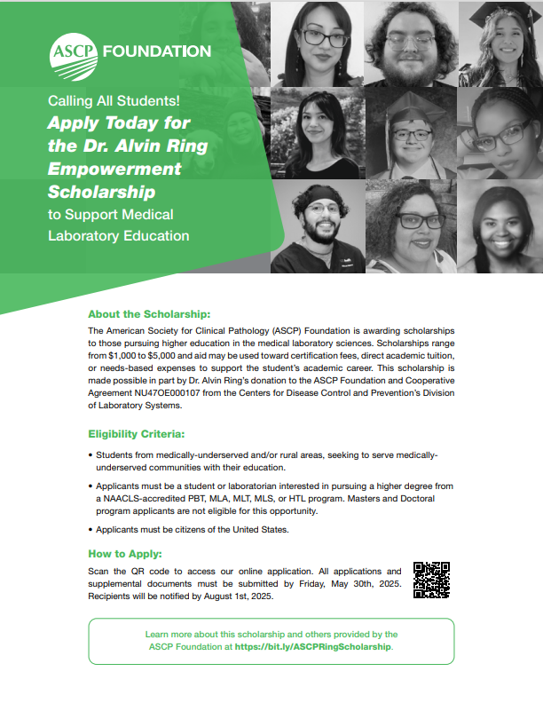
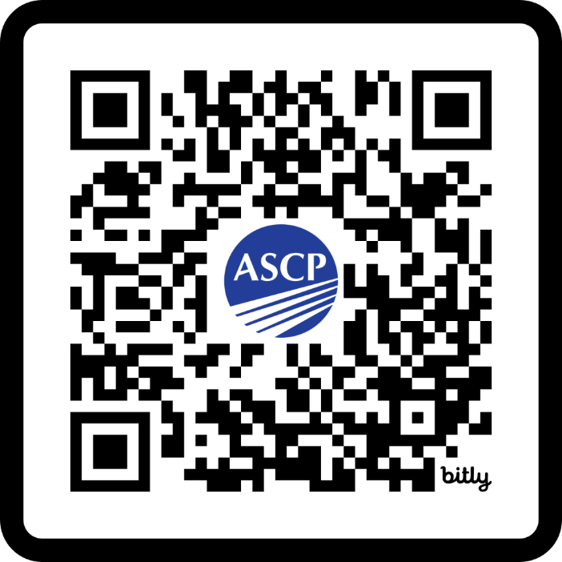
RING Scholarship
Ring Scholarship Now Open!
This scholarship is for students
interested in pursuing
laboratory science education. Encourage a student to APPLY
today and share widely within your NETWORK!
https://bit.ly/ASCPRingScholarship

Slide 18
CMLE Credit Claiming for Today's Webinar
Claim 1.5 CMLE credit for this webinar from the ASCP Store
Instructions will be emailed to live attendees tomorrow 3/13/25 (via Zoom)
Credit claiming is only available within 1-month of the webinar date

Slide 19
OneLab

Slide 20
Free ASCP Continuing Education in Service of CDC OneLab™
Blood Culture Collection Best Practices for Laboratory Professionals
Target Audience: phlebotomists, quality managers, and other clinical lab team members
Objective: increase knowledge, skills, and competence in applying best practices for adult blood culture collection in clinical laboratories
The activity offers 1.0 CME/CMLE credit.
Case-Based Best Practices in Effective Test Utilization for Clinical Laboratories
Target audience: clinical laboratory directors, clinical laboratory managers, residents, fellows, and other clinical lab team members
Objective: increase knowledge, skills, and competence in effective test utilization best practices for clinical laboratory settings.
The activity offers 1.0 CME/CMLE credit.
Find out more about these and other free laboratory resources from ASCP at: supportcdconelab.org

Slide 21
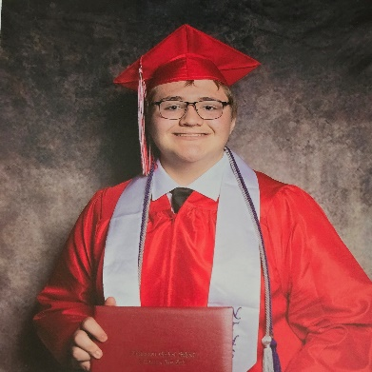
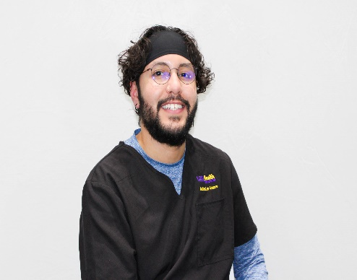
Dr. Alvin Ring Empowerment Scholarship for Laboratory Professionals: Inaugural Year Meet some of the Scholars!
Frances Correa started her Associate’s HTL program at the Community College of Baltimore County this fall.
Aiden Keaton started his MLT program this fall at SUNY Erie Community College.
Xavier Maldonado is currently studying medical
laboratory science at Louisiana State
University New Orleans.
Mia Wattley is currently studying medical laboratory science at Stony Brook University.
2025 Ring Scholarship is NOW OPEN. Encourage a student to apply!
Scan here or get more info at:
https://bit.ly/ASCPRingScholarship

Slide 22
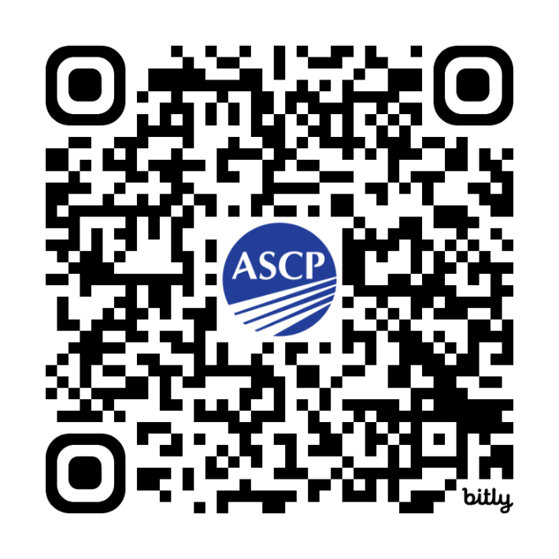
Free, Interactive Logic-Based Quiz for Lab Scientists!
Aligning with Your Lab Team Quiz
Target Audience: laboratory leadership, motivated lab team members
Purpose of the Quiz: Considers self-identified skills and personnel strengths and shares suggestions on supporting laboratory tasks that may be of interest to you
More info at: supportcdconelab.org
Take the quiz at: https://bit.ly/AligningWithYourLabTeamQuiz

Slide 23
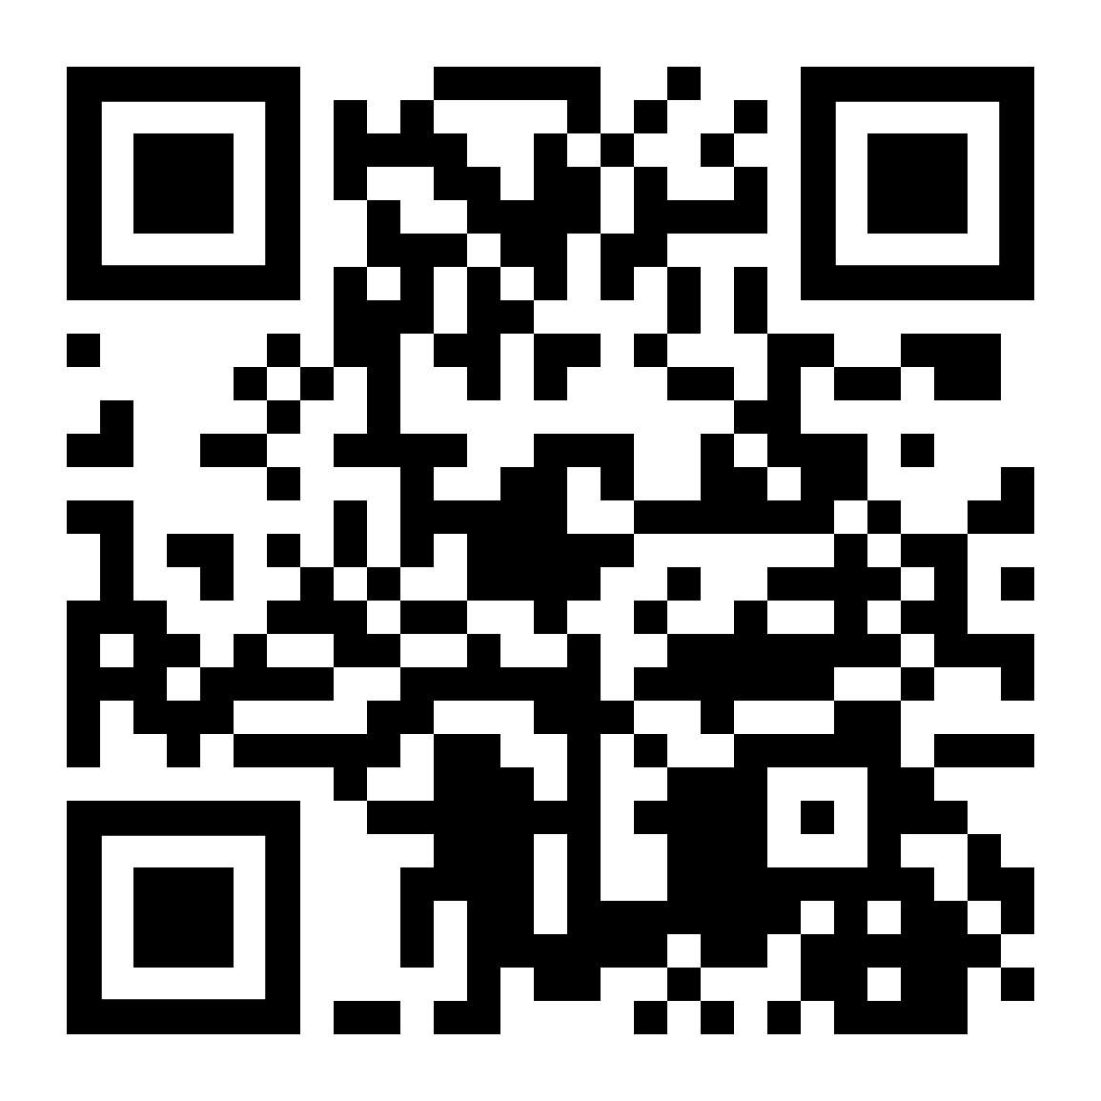
Thank you for attending!
More info at: supportcdconelab.org Or email us at:
grants@ascp.org
At-the-Bench: Clinical Laboratories Feature

