Slide 1
Using Wastewater Surveillance to Understand Infectious Disease Trends
Amy E. Kirby, MPH, PhD
National Wastewater Surveillance System Program Lead
Centers for Disease Control and Prevention
Building Bridges Across the Laboratory Community
June 28, 2023

Slide 2
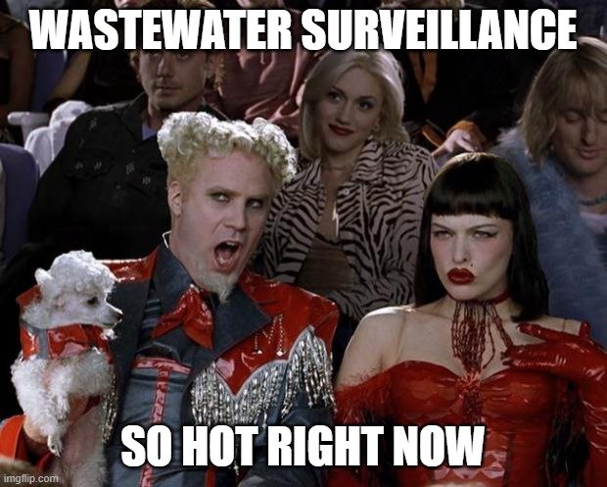
Wastewater surveillance mene

Slide 3
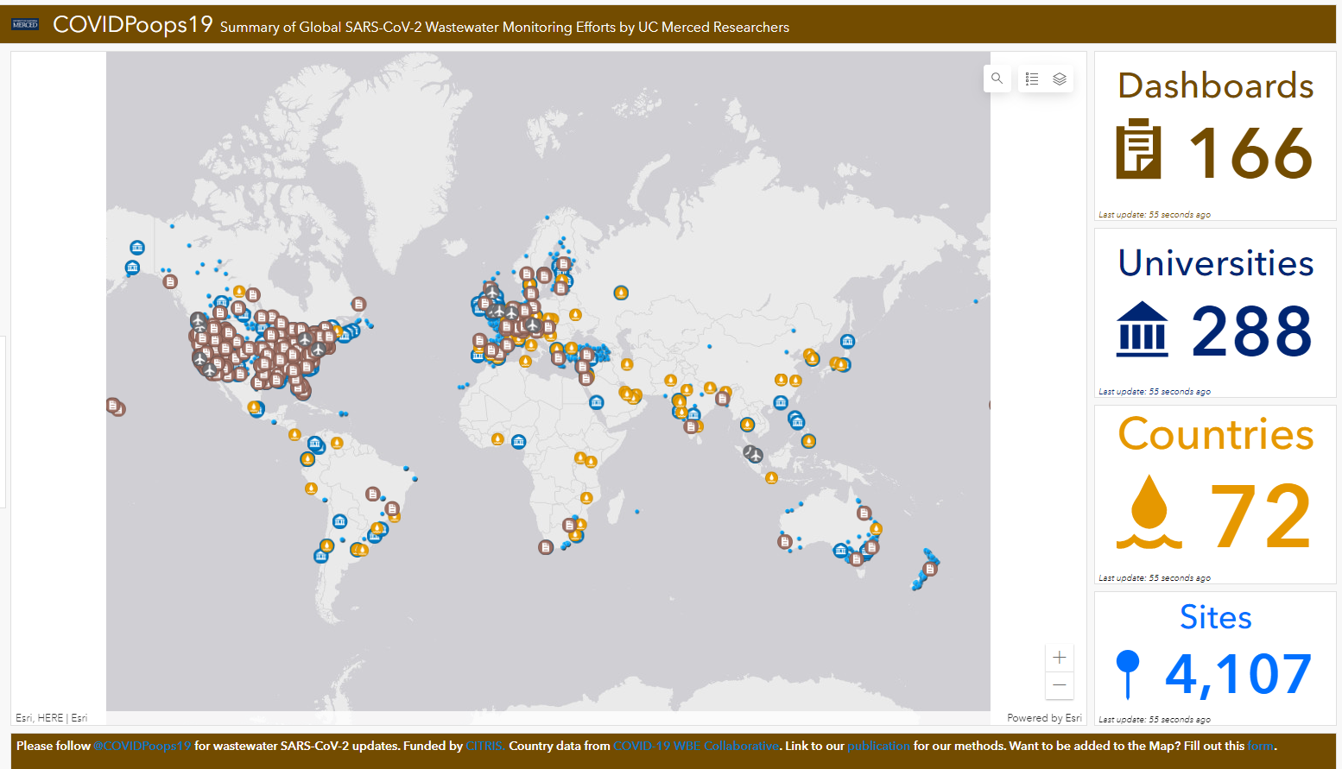
Info data on COVIDPoops19

Slide 4
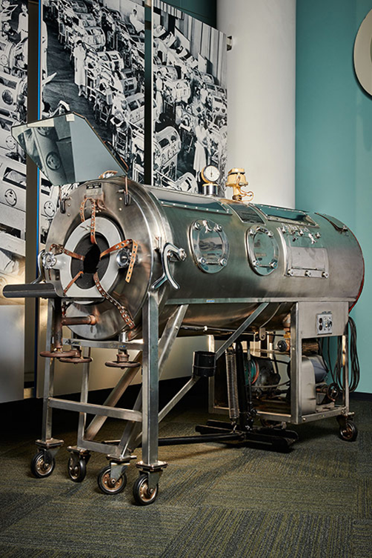
Wastewater surveillance info

Slide 5
Ratio

Slide 6
Ratio pt 2

Slide 7
Ration pt 3

Slide 8
Ratio pt 4

Slide 9
Eradication info
Global Polio Eradication Initiative (GPEI) established
Only 2 countries with endemic wild poliovirus 1; many vaccine-derived poliovirus outbreaks
Sabin Type 2 virus withdrawn from OPV
1988
2015
2016
2019
2022
Wild poliovirus 2 eradicated
Wild poliovirus 3 eradicated

Slide 10
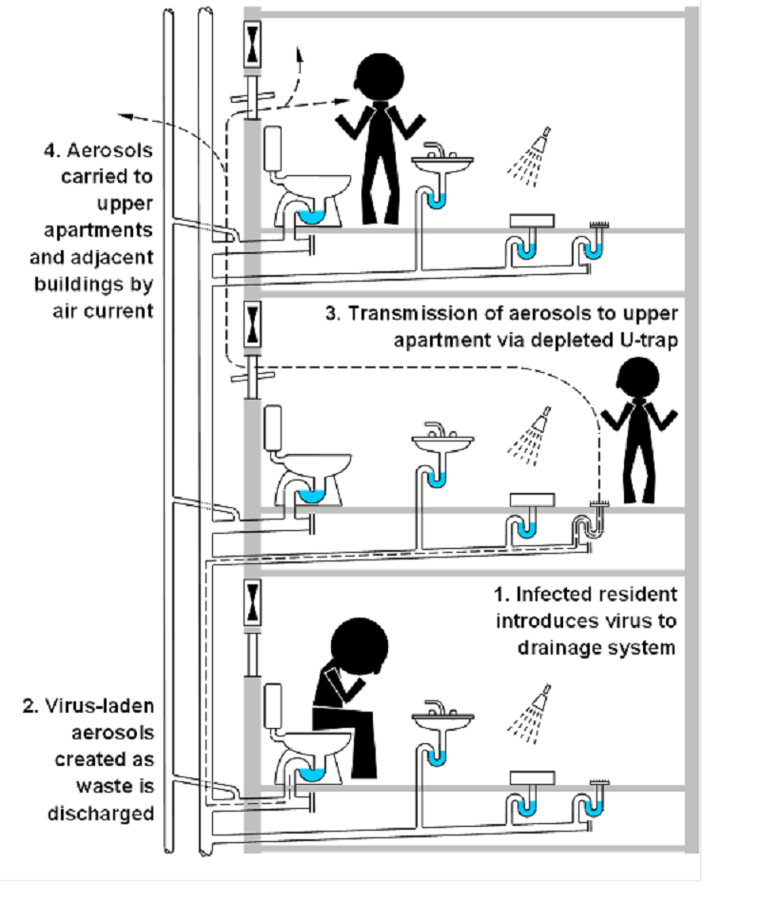
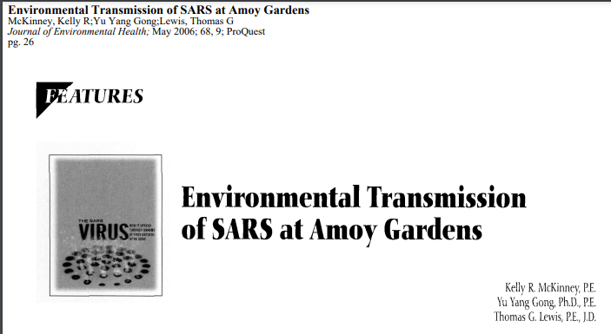
Environmental Transmission info
Gormley et al. 2017

Slide 11
The process of wastewater surveillance
Individuals use toilet on sewer system
At a centralized treatment plant, or sampling point, a grab or composite sample is collected
The sample is processed, concentrated, and genomic material is extracted
RNA, the genomic material of SARS-CoV-2, is then amplified and detected
Raw data is received, analyzed, and visualized
Metrics can be used to inform public health decisions

Slide 12
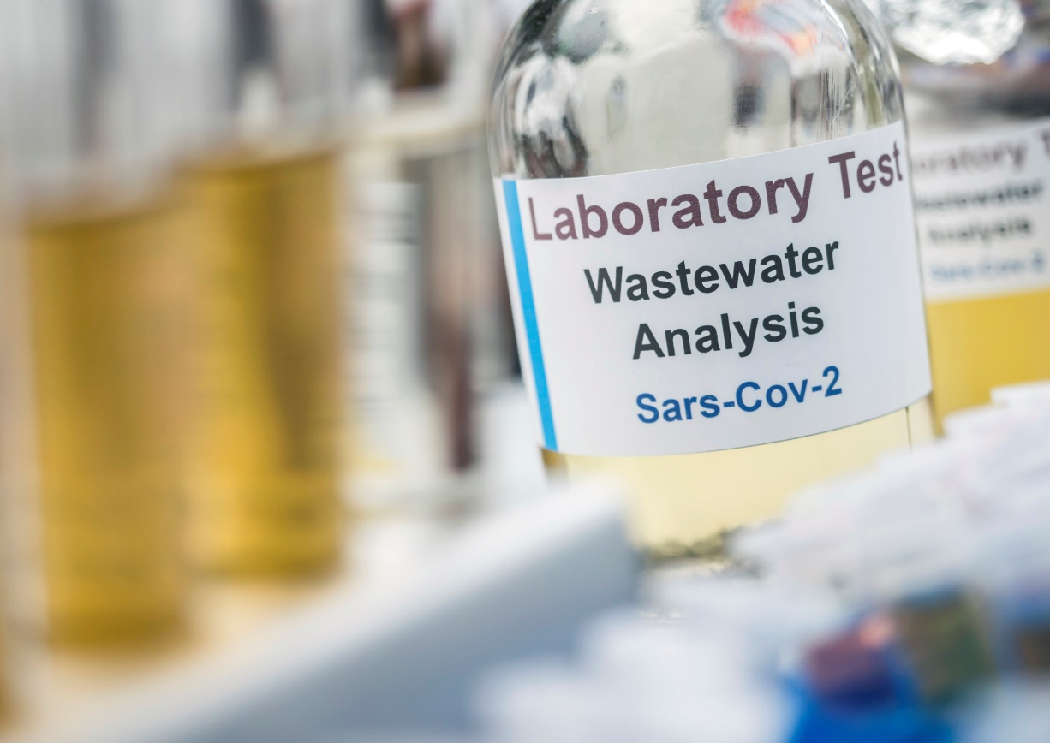
Wastewater data informs public health action
Independent confirmation of true increases or decreases in cases
Use of data for public facing dashboards
Public health messaging
Regularly informing local public health leadership
Distribution, siting of test capacity
Surveillance data in communities where clinical testing is limited or not available
Near-term forecasting of cases or hospital utilization
Detecting the emergence of Variants of Concern

Slide 13
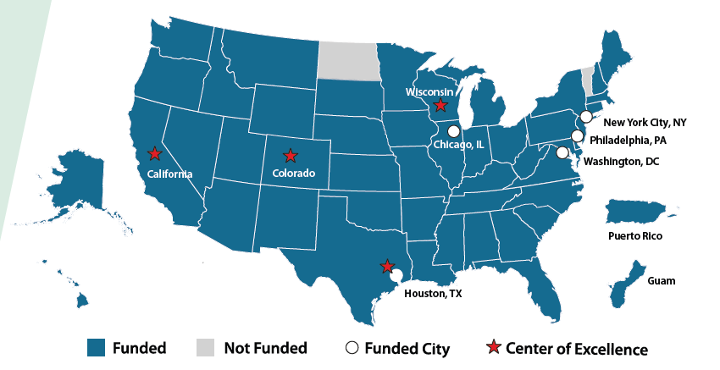
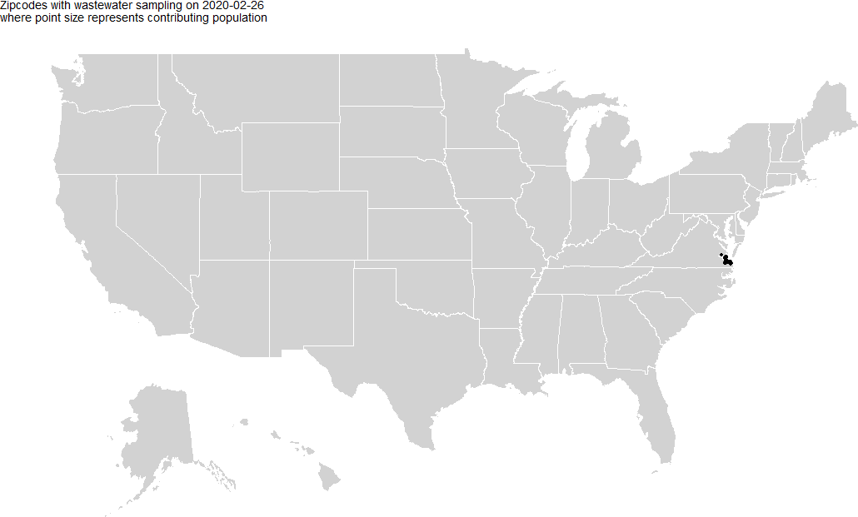
NWSS Implementation | 2020 - 2023
Guam and Puerto Rico sites not shown
48 states, 5 major cities and 2 territories using CDC funds for wastewater surveillance
4 Centers of Excellence
>184,000 unique wastewater samples
>1400 sites in 50 states, 3 territories and 12 Tribal communities
Representing >144M people

Slide 14
DCIPHER dashboard | One-stop shop for implementers
Metric | What does this show us?
Percentiles | Relative levels of virus present in a community over time
Percent Change | Magnitude and direction of virus levels in a community
Detection Proportion | How frequently is the virus detected in a community
Variant Specific Metrics | If a known variant is present, and at what proportion
Also includes-
Resource library
Contact list
Automated QC reports
Automated utility reports
Support forum
Notes:
HH: recommend spelling DCIPHER before using the acronym.

Slide 15
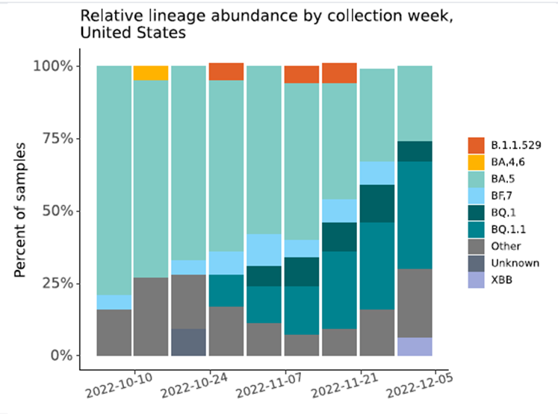
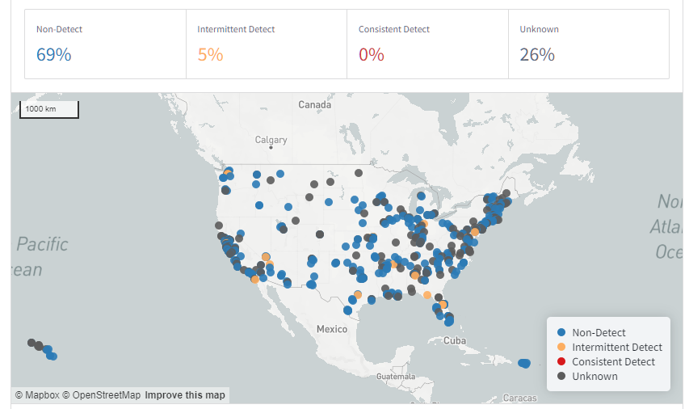
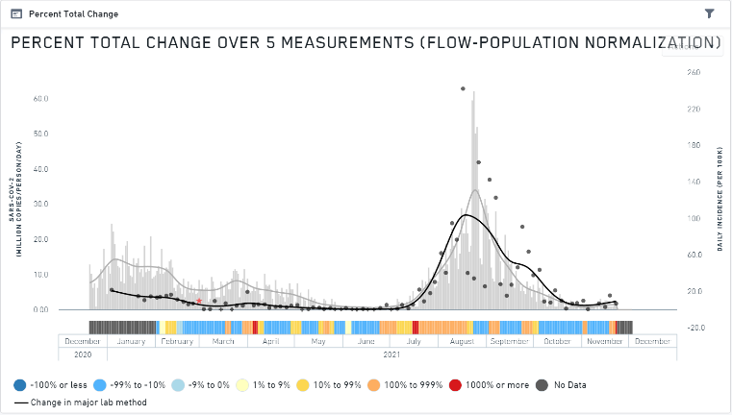
NWSS platform is rapidly adaptable for additional analyses
SARS-CoV-2 Trends
SARS-CoV-2 Variants
Mpox Detections
COVID Data Tracker
Wastewater Surveillance
COVID Data Tracker
Variant Surveillance
Mpox Wastewater Public Data

Slide 16
Summary
Wastewater surveillance has proven to be a valuable component of the COVID-19 pandemic response with increasing importance to understand trends and variants.
Looking forward, a national wastewater surveillance system should be equitable, sustainable, integrated, actionable, and flexible.
CDC should develop a transparent process for prioritizing new targets and work to address privacy concerns.
Predictable and sustained federal funding and coordination/collaboration among many partners will be critical to the effectiveness.
Notes:
HH: very minor – added periods at end of complete sentences.

Slide 17
Implementing wastewater surveillance for Mpox virus

Slide 18
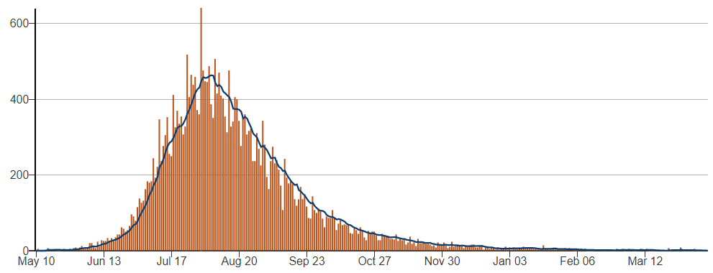
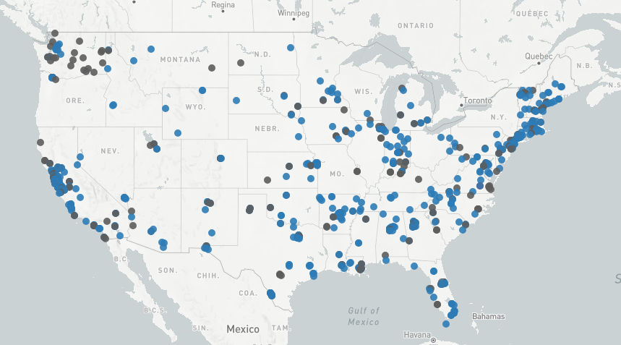
Implementing the unexpected
WastewaterSCAN conducted initial testing confirming utility for Mpox
CDC worked with contractor Biobot to validate Mpox wastewater test
Implemented testing at ~500 sites nationwide in early Oct. 2022
>24,000 samples to date, 2.9% positive
Mpox wastewater data as of 11JUN2023
NWSS began testing wastewater for mpox virus
Number of Cases
Notes:
HH: recommend spelling SCAN before using the acronym.

Slide 19
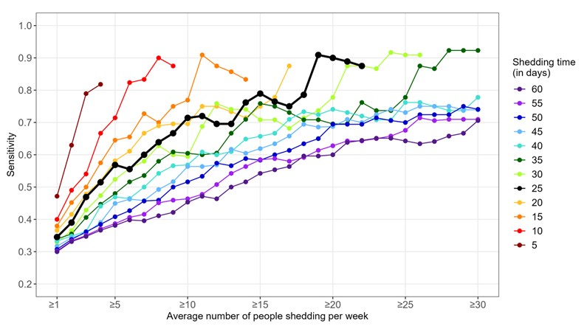
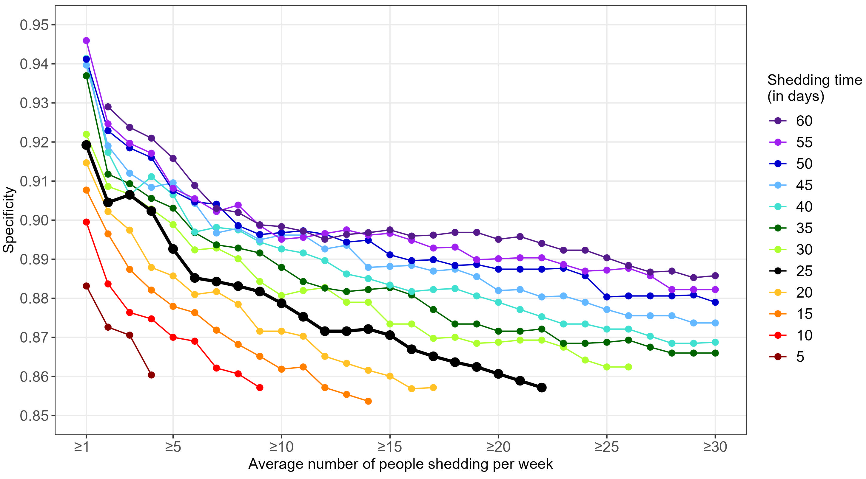
Wastewater surveillance can be very sensitive
Mpox Surveillance Sensitivity
by number of cases and shedding duration
Mpox Surveillance Specificity
by number of cases and shedding duration
50% sensitivity
≤ 10 cases

Slide 20
Continued innovation in wastewater surveillance

Slide 21
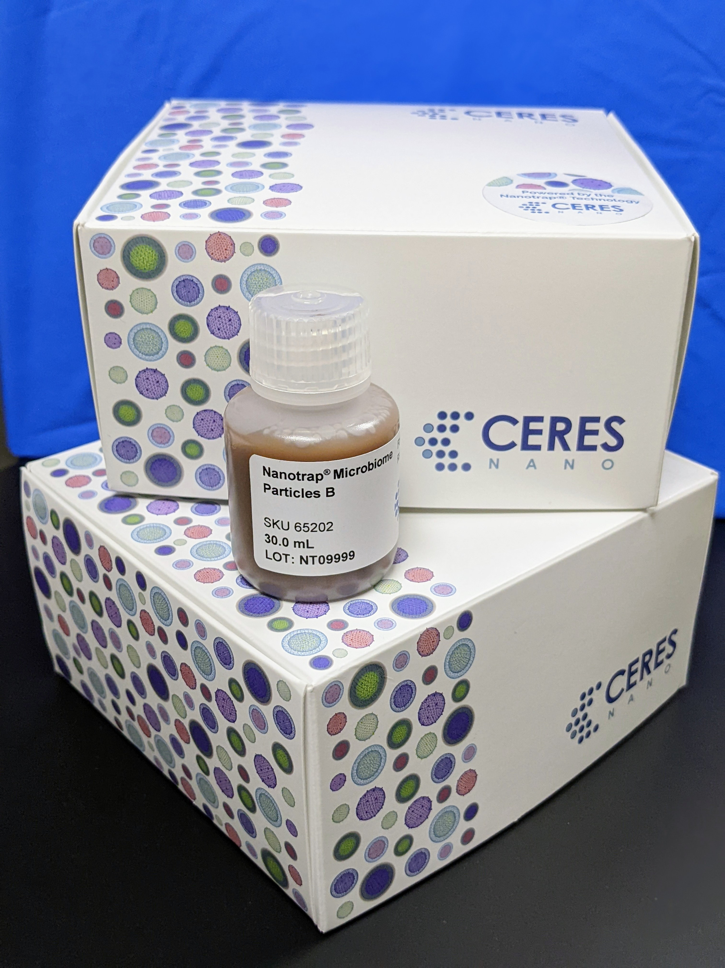
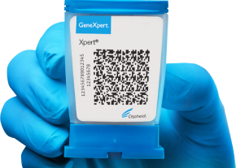
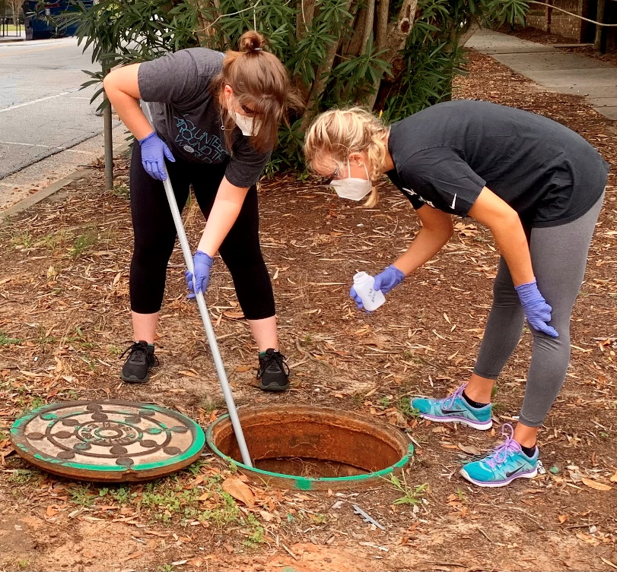
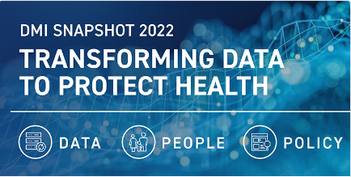
NWSS drives innovation to facilitate equitable implementation
High throughput testing
On-site testing systems
Wastewater sample
preservative
Photo credit: Cepheid
Flexible sampling options
Photo credit: Ceres Nano
Streamlined data submission
Photo credit: Zymo Research
Photo credit: Sean Norman, USC

Slide 22
Phased expansion of NWSS surveillance
Core
Regular surveillance for endemic or common diseases, such as flu or antibiotic resistance genes
Provides regular, consistent, cost-effective surveillance
Emergency
Rapid response for outbreaks, emergencies, natural disasters
Sporadic but expected diseases, such as shigellosis or polio
Rapidly deployable portfolio of validated assays
Pandemic preparedness
Horizon scanning for potential epidemic or pandemic threats
Evaluation of potential rare, unexpected diseases such as Ebola or Mpox
National Biosecurity Strategy Early Warning

Slide 23
Evaluating a New Wastewater Target
Are there meaningful public health actions at the community level?
Is the virus shed into wastewater?
Fecal shedding prevalence, magnitude, duration, and infectivity?
Can clinical assays be adapted for wastewater?
Can virus be recovered and quantified reliably?
Are other, non-specific targets detected (false positives)?
What is the geographic distribution of cases?
Are there enough cases in a sewershed to be detectable?
What is the case ascertainment rate and timing?

Slide 24
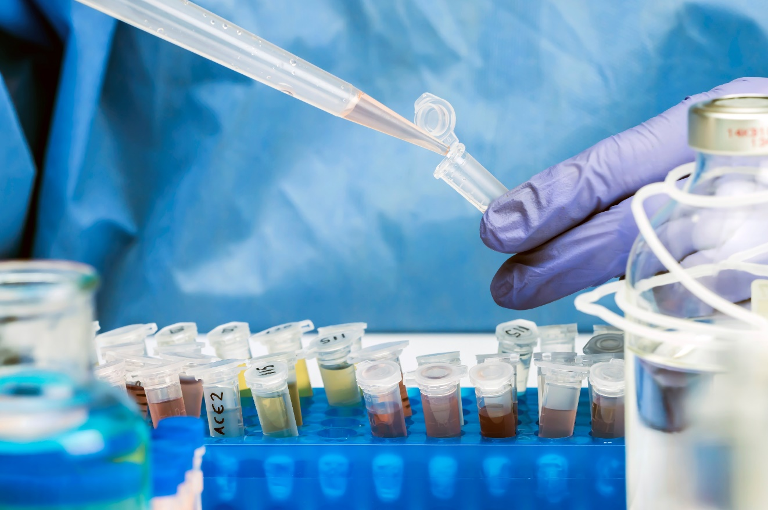
NWSS panel 1.0 for core targets
Normalization and Process Controls
Pepper Mild Mottle Virus
Crassphage
Bovine Coronavirus
Antibiotic resistance genes
Carbapenemases
ESBLs
Colistin resistance
Vancomycin resistance
Pathogen targets
SARS-CoV-2
Influenza A and B
Respiratory Syncytial Virus
Adenovirus 40/41
Shiga toxin-producing E. coli
Campylobacter
Norovirus
Candida auris
Mpox (non-Variola Orthopox)
Timeline
2023
Optimize and validate assays
Early 2024
Pilot in NWSS Centers of Excellence
Integrate data into DCIPHER for real-time access
Develop NWSS dashboard for public data sharing
Summer 2024
Anticipated system-wide rollout
Reviewed annually by CDC Internal NWSS Advisory Committee

Slide 25
Thank you
Visit NWSS webpage for more. https://www.cdc.gov/nwss/wastewater-surveillance/
For more information, contact CDC 1-800-CDC-INFO (232-4636) TTY: 1-888-232-6348 | www.cdc.gov The findings and conclusions in this report are those of the authors and do not necessarily represent the official position of the Centers for Disease Control and Prevention.

Slide 26
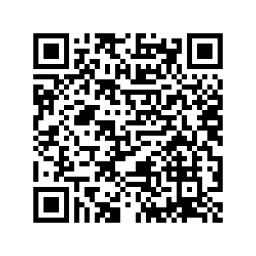
Increasing National Access to mpox Testing by Leveraging Reference Lab Capacity
Building Bridges Across the Laboratory Community – Session 4 Friday, July 28 2023, 11am – 12pm CDT Register here!
Notes:
BB3 – Source Link 5 (Misc)

Slide 27
Join the OneLab Network to engage with fellow lab community members!
https://bit.ly/OneLabNetwork-ASCP

Slide 28
Check out OneLab REACH for free and up-to-date laboratory trainings!
https://bit.ly/OneLabREACH-ASCP

Slide 29
Stay tuned by visiting our new website!!
Building Bridges Supporting References (Recording, Summary One-Pager; Registration for Upcoming Webinars)
Cutting-edge ASCP-developed training materials to support CDC OneLab (coming soon!)
Supply Chain Management Job Aid
Negotiation and Advocacy Toolbox Roadmap
New microlearning course on Effective Test Utilization
Volunteer and Consultant Opportunities
Links to CDC OneLab & OneLab REACH
https://www.ascp.org/SupportCDCOneLab

