Slide 1
3D-Printed Nasal Swabs for the City of Austin’s COVID-19 Response Dr. Juan Gomez, Department of Physics, Texas State University
Building Bridges Across the Laboratory Community – June 9, 2023

Slide 2
Funding Statement
This resource was made possible by cooperative agreement NU47OE000107 from the Centers for Disease Control and Prevention (CDC). Its contents are solely the responsibility of the American Society for Clinical Pathology (ASCP) and do not necessarily represent the official views of the CDC.

Slide 3
Format of Today’s Session
Introduction of Subject Matter Expert(s) & Case Study
Introduce Problem/Challenge Faced
Case Study
Lessons Learned and Best Practices
Q & A
Introduce next month’s case study
Links to OneLab Network and OneLab REACH

Slide 4
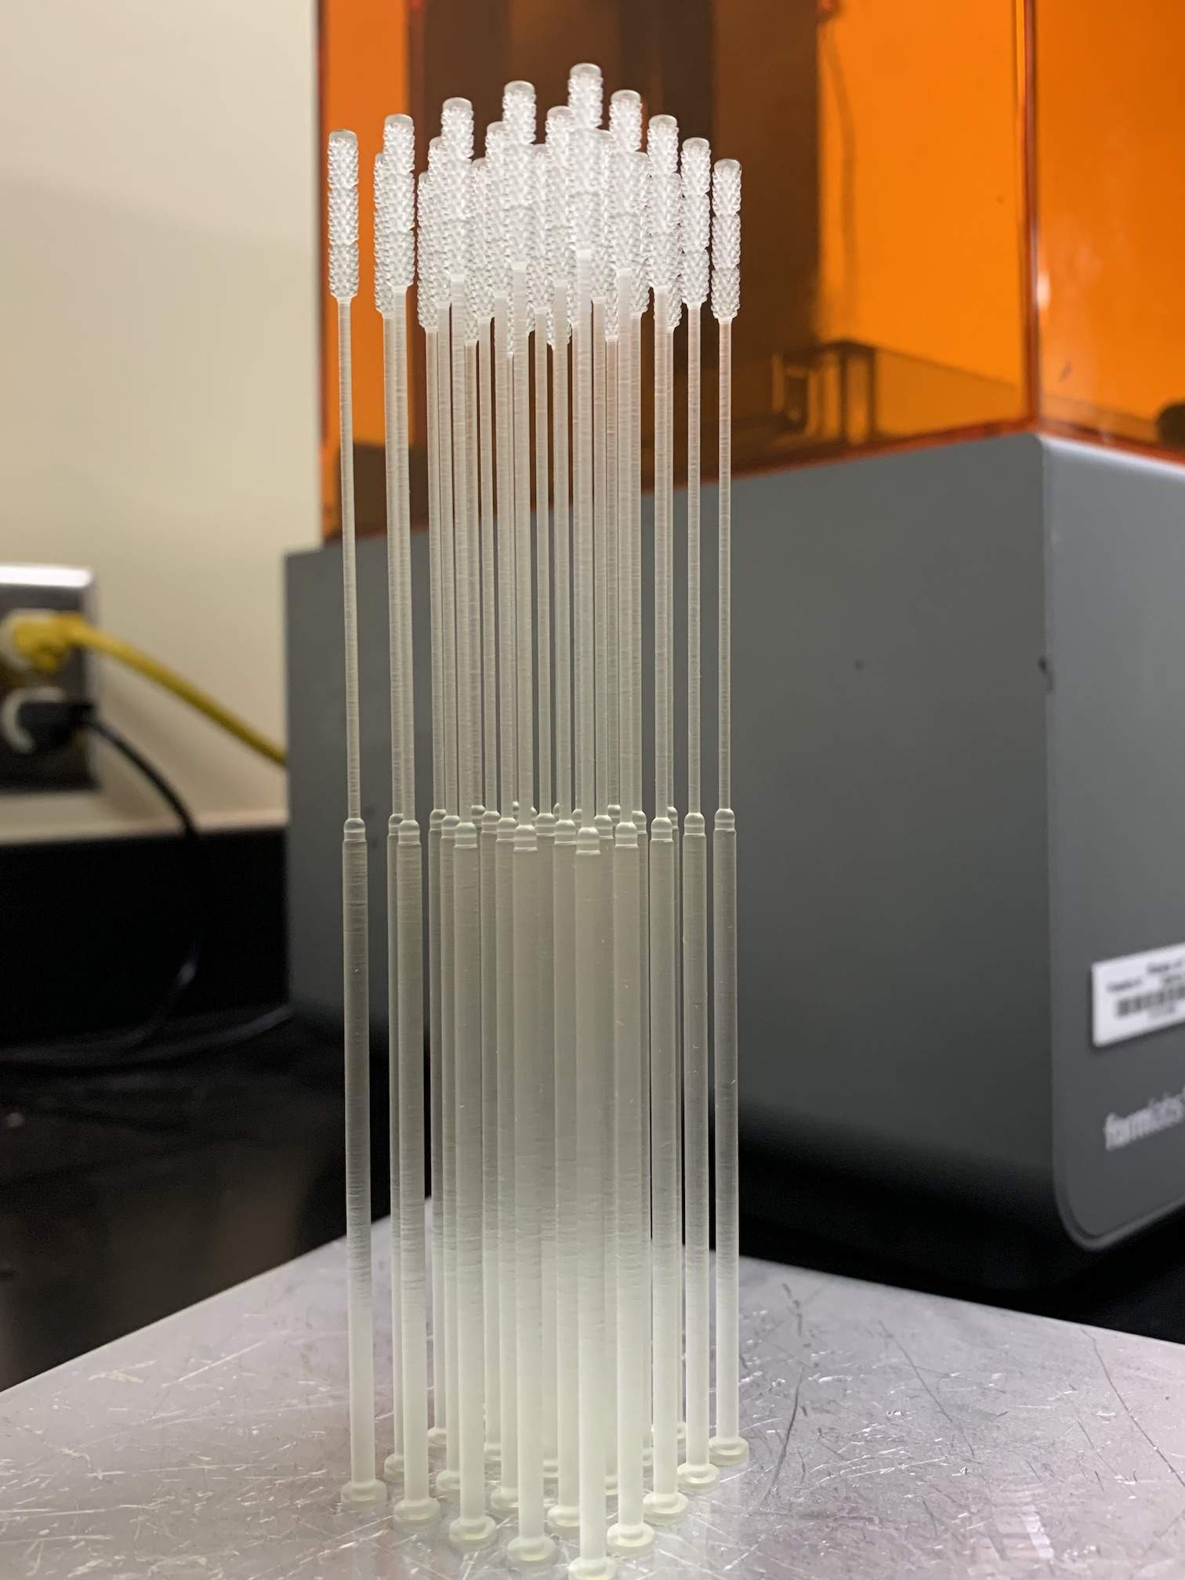
Case Study
COVID-19 in Texas State University
University Response to Global Pandemic
3D Printed Nasal Swab
Challenges and Lessons Learned
Conclusions

Slide 5
COVID-19 in Texas
First case: March 4, 2020
State of disaster: March 13, 2020 [Friday prior to TXST spring break]
State shutdown: March 15, 2020
Texas had the second-highest number of confirmed cases.
Governor Abbot announced the creation of a Supply Chain Strike Force.
Source: CDC Museum COVID-19 Timeline (https://www.cdc.gov/museum/timeline/covid19.html#:~:text=March%2015%2C%202020,the%20spread%20of%20COVID%2D19.)

Slide 6
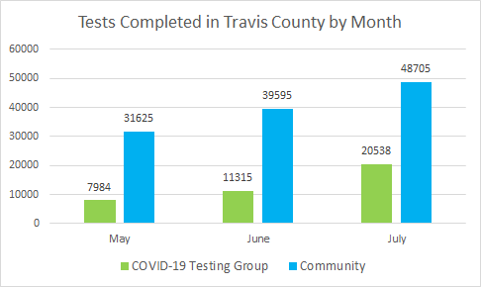
City of Austin – Testing Capacity
Initial testing capacity was 26 tests per month.
Shortages in testing materials and lab personnel limited the city’s capacity.
Increasing testing capacity became one of the top priorities to control the spread of COVID-19
The goal of 60,000 tests per month was achieved in August 2020.
Source: City of Austin – testing goals (https://www.austintexas.gov/news/austin-travis-county-surpasses-covid-19-testing-goals-may-July)

Slide 7
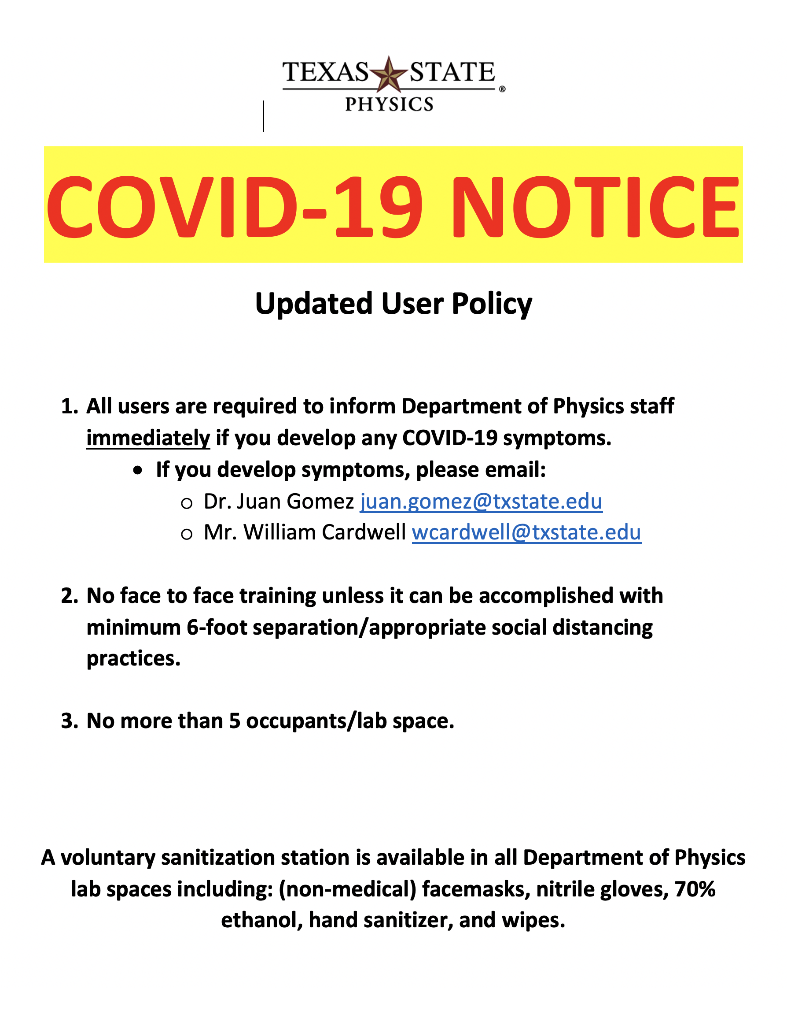
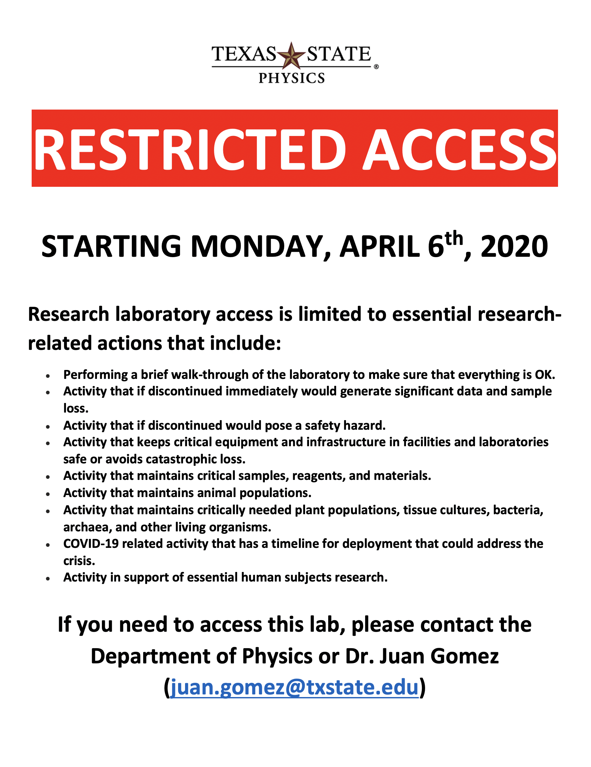
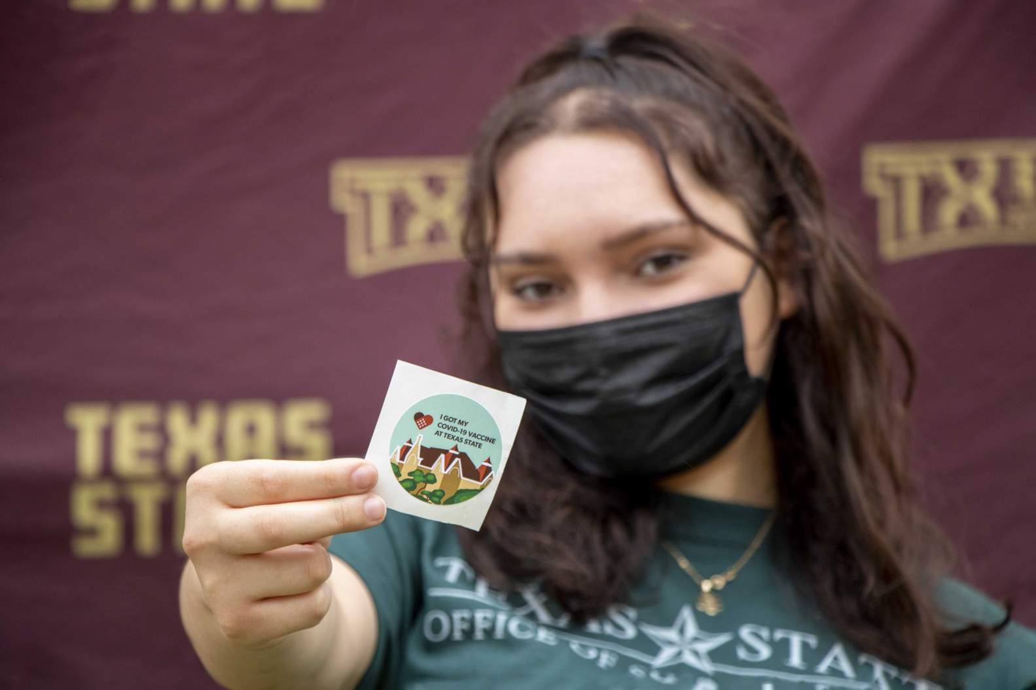
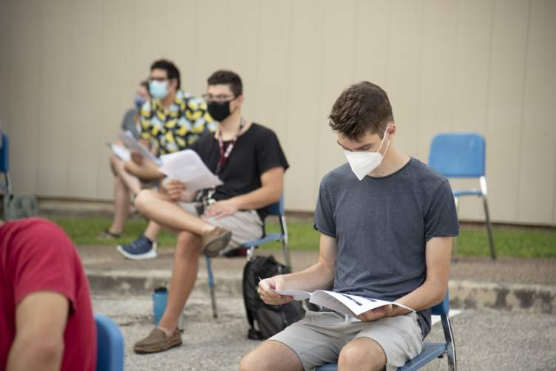
COVID-19 in Texas State University
Travel ban issued to all university faculty and staff.
Spring Break extended to two weeks to prepare for online classes.
All classes to move online
Research activities suspended.

Slide 8
Governor’s Supply Chain Strike Force
Reach area organizations to ascertain whether they have capacity to ramp up production of personal protective equipment (PPE).
There was a considerable concern that Texas would face “New York-like” conditions.
Communities and organizations to assess how and whether they can contribute to address the gaps in supply chain.
Texas State University had the resources and means to contribute.

Slide 9
Driving Force
Governor’s Strike Force
PPE production
Supply chain gaps
City of Austin
Increase testing capacity
Texas State University
PPE for Medical personnel
Test swabs
Test Swabs
Protocols for students
External Support
Sonic Healthcare
Dell Technologies
Government
Academia
Industry

Slide 10
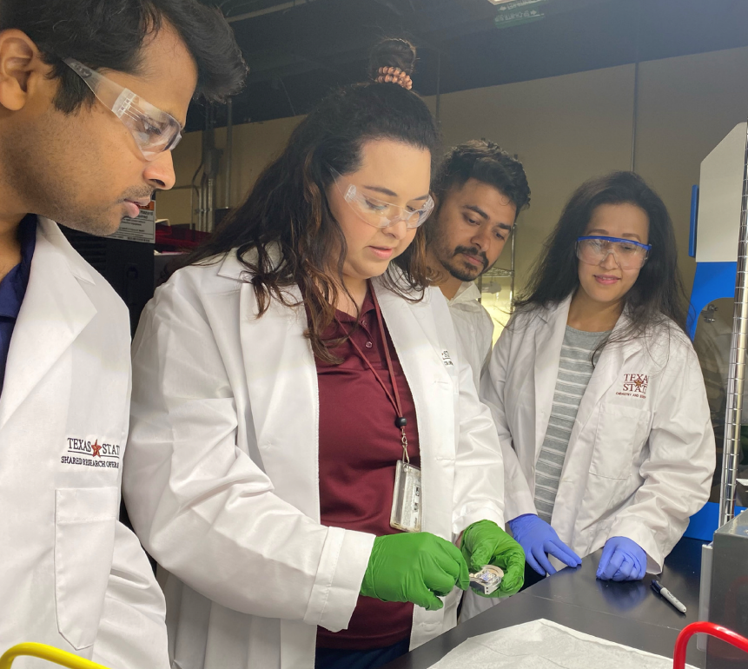
Teams at Texas State University
Department of Physics
One of smallest departments in the College of Science and Engineering.
One of the departments with the highest amount of sponsored research.
Physics Education
Astronomy
Materials Physics
Shared Research Operations
Core laboratories.
Supports a wide variety of scientific research projects across campus.

Slide 11
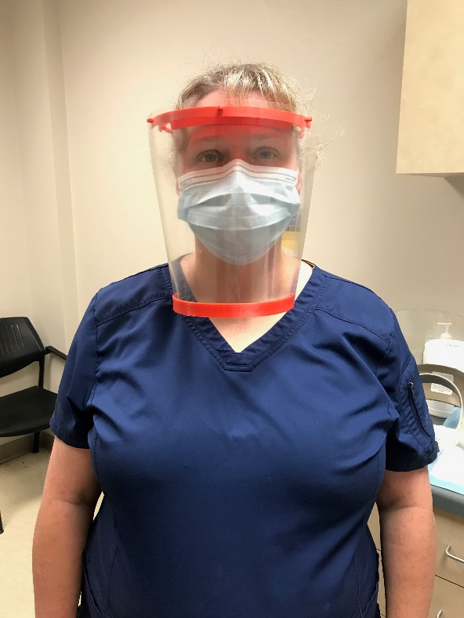
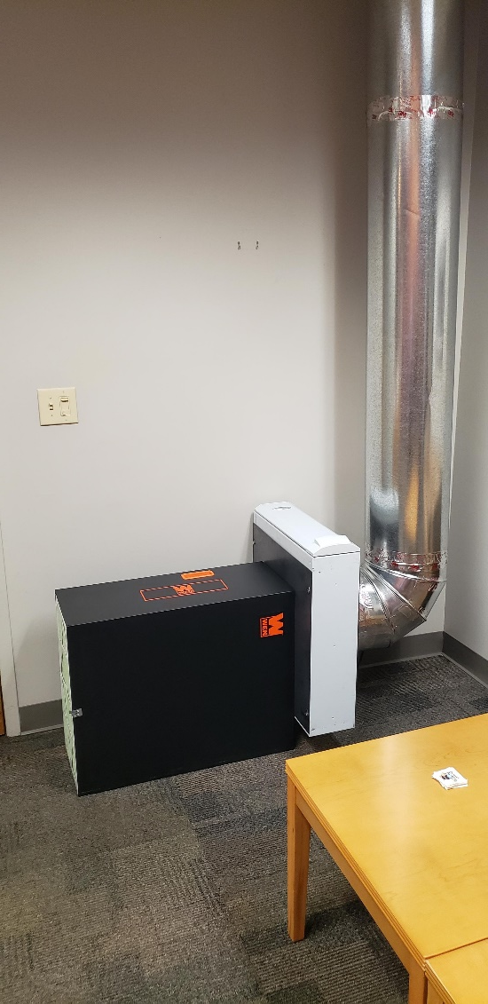
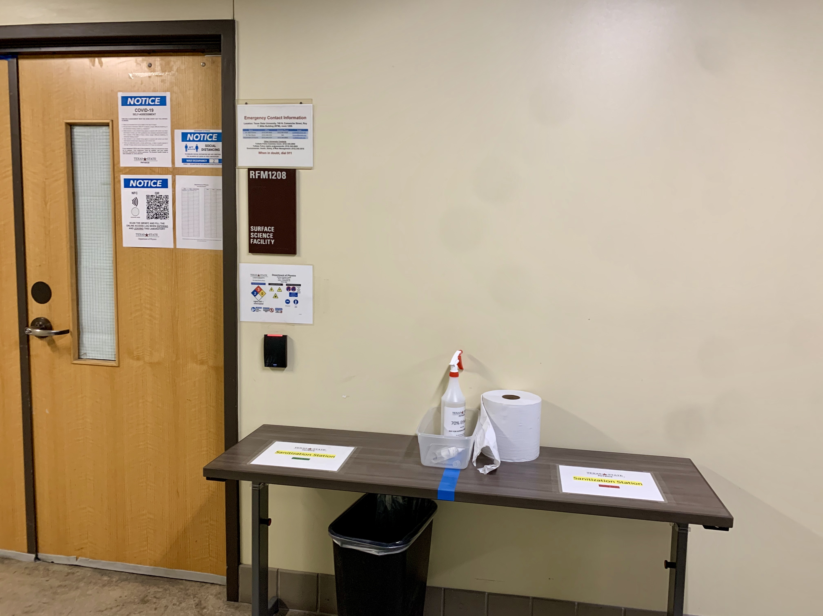
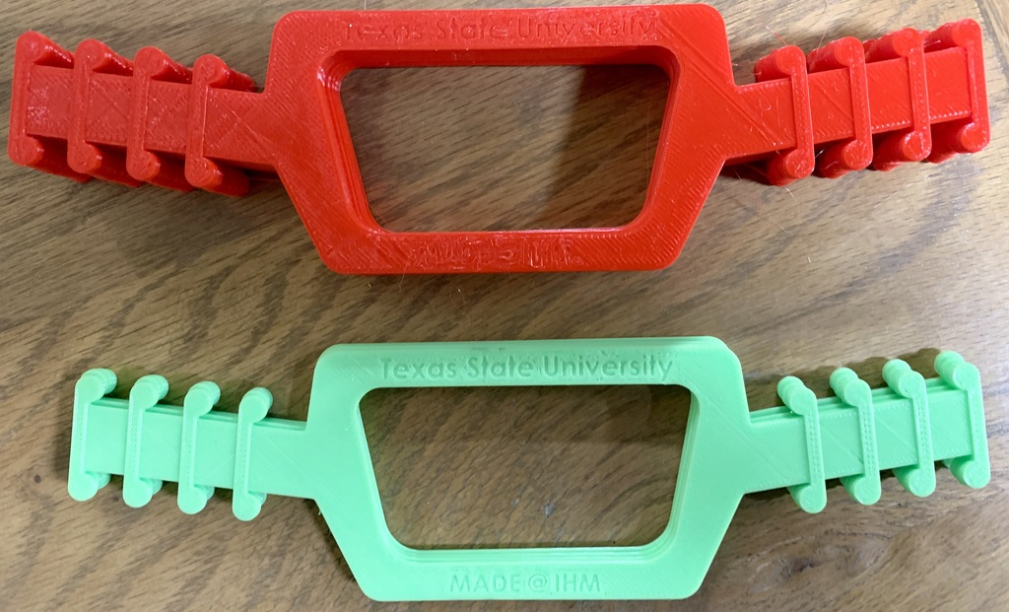
University Response to COVID-19
Ear-savers (3D Printed)
Designed with support of SHC
Face shields (3D Printed)
Air Purifiers
Met CDC guidelines Airborne Infection Isolation Room (AIIR) of ~ 10-12 ACH.
Sanitization Stations & COVID-19 Training
Hand sanitizer
College of Health Professions – masks, gloves, ventilators, and PPE donations
Face Shields
Air purifiers
Sanitization stations
Ear-savers for Student Health Center

Slide 12
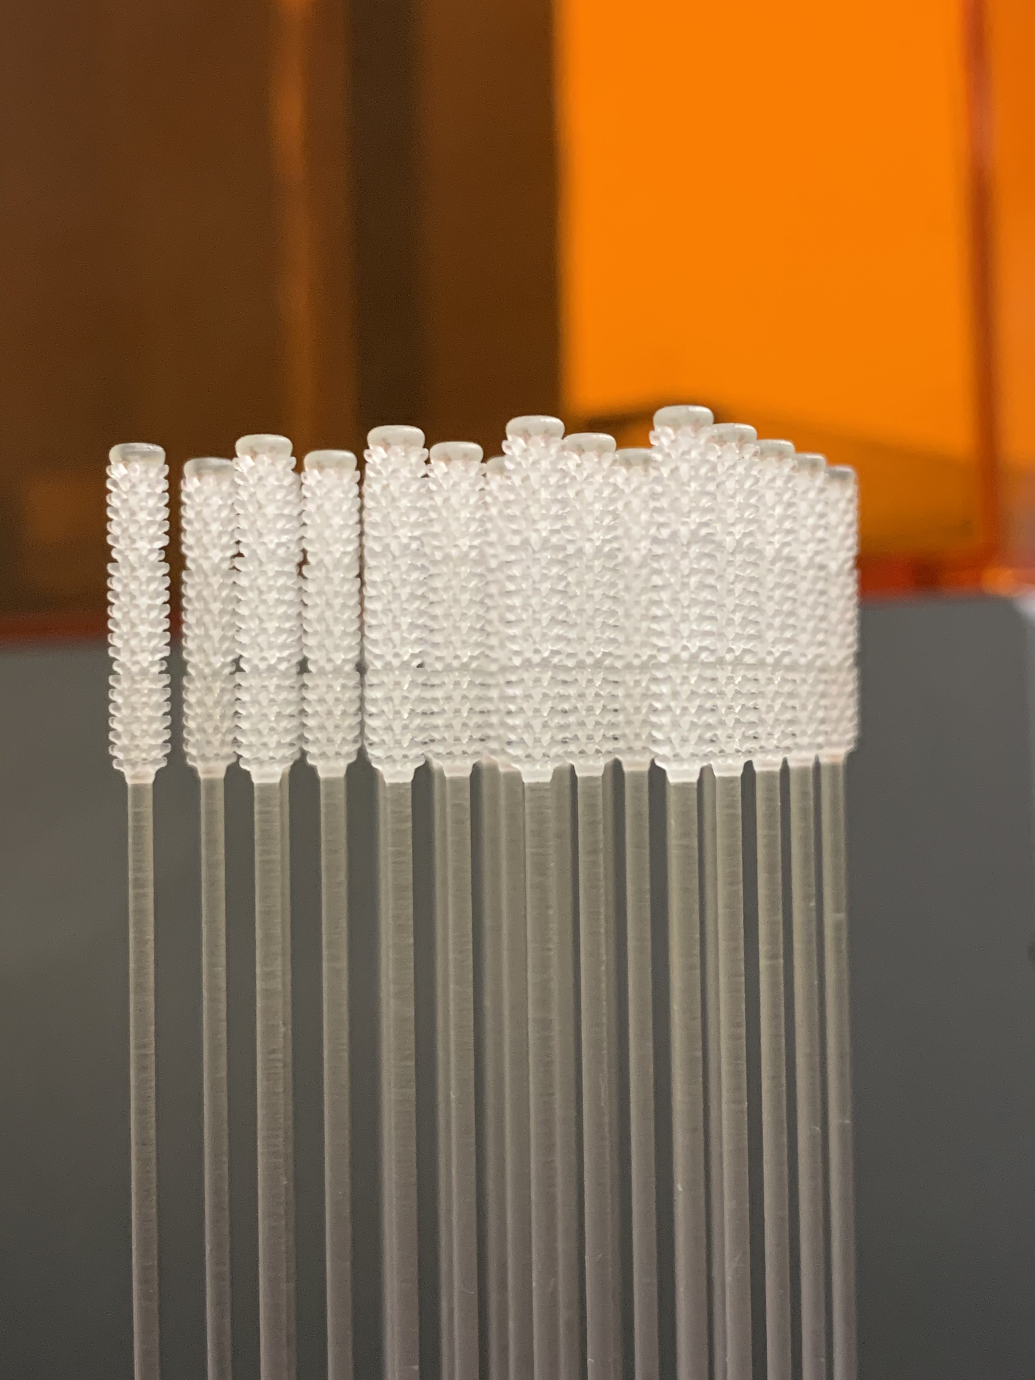
3D Printed Nasal Swab
Nasal swab design
Formlabs – Surgical guide
Testing and production
External support
Increased COVID-19 testing in Austin.

Slide 13
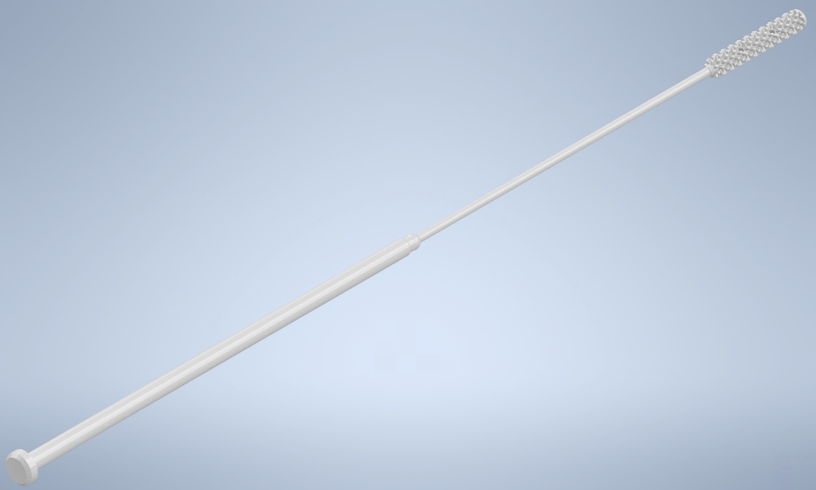
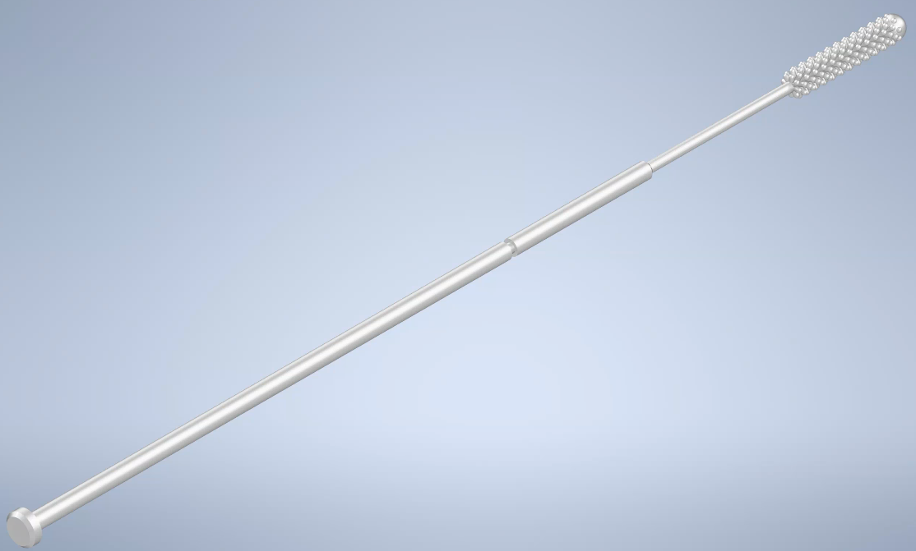
Nasal Swab Design
Northwell Health Design
University of South Florida Design
Test run of 1,000 swabs of each design

Slide 14
Northwell Health Design
Sonic Healthcare USA.
Better flexibility compared to USF design.
Less resin required, improving batch times and increasing production.
Increased viral load
Drawing of the Northwell Health swab – Dimensions are in millimeters

Slide 15
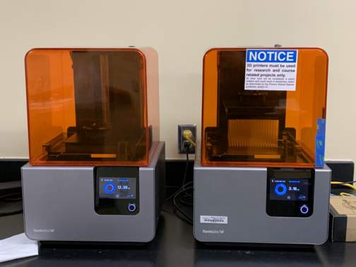
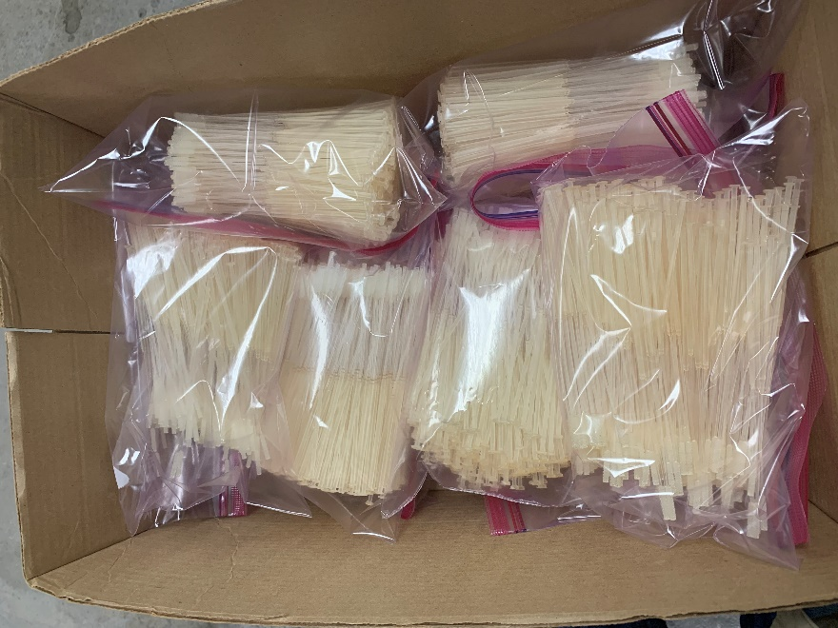
Formlabs – Surgical Guide
Autoclavable, biocompatible resin.
Meets solvent disinfection and autoclave sterilization standards.
Swabs performed equally to standard wooden swabs.

Slide 16
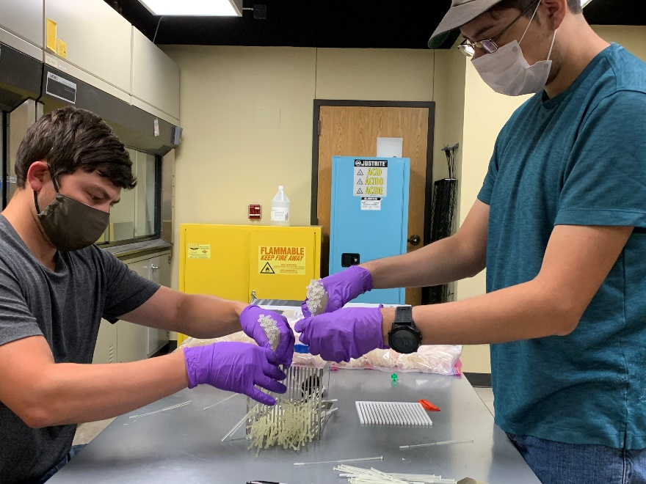
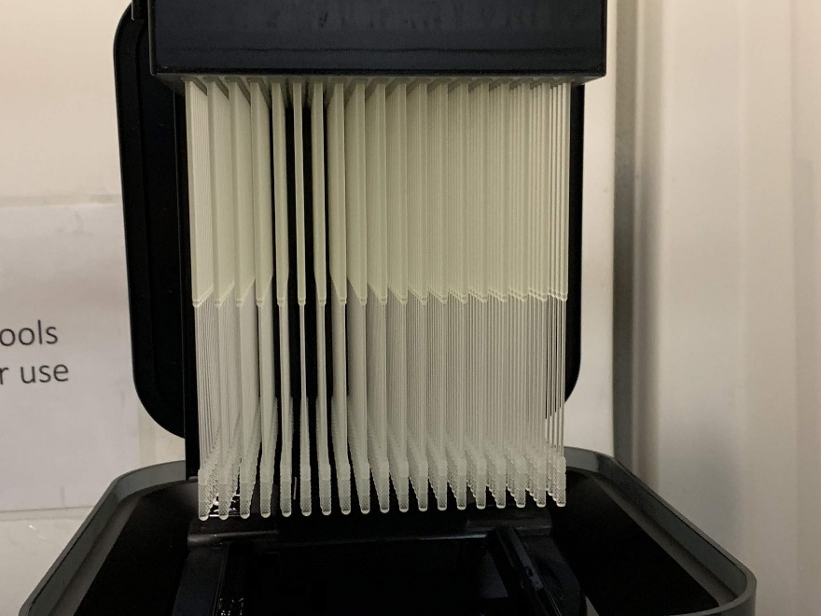
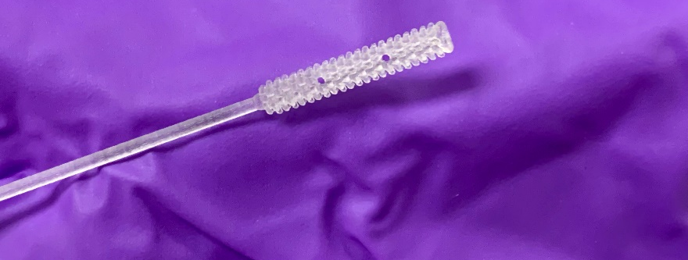
Testing and Production
Quick adaptation was required to meet the City’s demand for testing.
Ramped up weekly production to 7,000 swabs.
Received support from Dell Technologies.

Slide 17
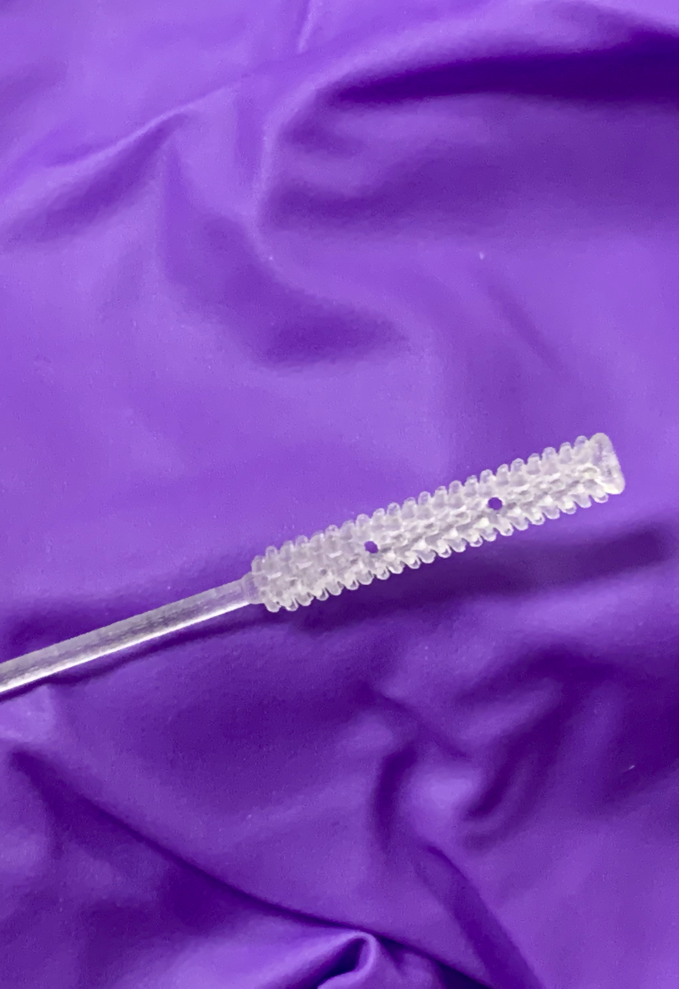
3D Printed Swabs – Summary
7,000 swabs per week.
Shipped to Sonic Healthcare for sanitization and packaging.
Swabs were used for testing at the City of Austin.
Total production of almost 100,000 swabs in over 14 weeks.

Slide 18
Impact
Helped the City of Austin achieve its testing goal.
Improved patient diagnosis and care through swab design optimized for specimen collection and accurate sampling of viral particles
Improved manufacturing process to increase yield.
Raised awareness regarding on-site biosafety and air circulation standards.
Created new collaboration opportunities between academia, businesses, and gov’t

Slide 19
CHALLENGES
Access to research spaces when campus was closed.
Shortage of 3D printing supplies (resin, tanks, etc.)
Ensuring safe practices to prevent COVID-19 transmission to the team.
Maintaining the quality of the raw material and the finished product.
General uncertainty related to the pandemic.

Slide 20
LESSONS LEARNED
The importance of being able to quickly identify the need.
Ability to work with numerous entities.
The value of empowered leadership to quickly make decisions.
Optimization of manufacturing process.
Crisis management
Administrative barriers

Slide 21
CONCLUSIONS
Physics/SRO was able to step up and help the community.
Public health agencies can reach out to Universities and other community organizations to meet needs during a crisis.
Removal of administrative barriers was a key element to the success of this project.
Never underestimate the willingness of people to help-out in times of crisis.

Slide 22
COLLABORATORS
Dr. Thomas Myers, Texas State University
Dr. Mark Holtz, Texas State University
Dr. Rodney E. Rohde, Texas State University
Dr. Emilio Carranco, Texas State University
Matthew Candelas, Texas State University
Aaron Gonzalez, Texas State University
Dean Koehne, Texas State University
Dr. Casey Smith, Texas State University
Andrea Hankins, Texas State University
Dr. Ted Lehr, City of Austin
Chris Torres, Dell Technologies
Donnie Strybos, Dell Technologies
Joel Roseman, Bossard, LLC
Leisel Hickey, Sonic Healthcare USA
Aviel Tanzer, Formlabs
Gustavo Barroso, Formlabs

Slide 23
Q&A

Slide 24
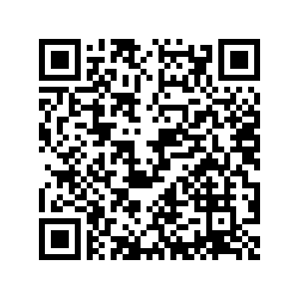
Using Wastewater Surveillance to Understand Infectious Disease Trends
Building Bridges Across the Laboratory Community – Session 3 Wednesday, June 28 2023, 11am – 12pm CDT Register here!
Notes:
BB3 – Source Link 5 (Misc)

Slide 25
Join the OneLab Network to engage with fellow lab community members!
https://bit.ly/OneLabNetwork-ASCP

Slide 26
Check out OneLab REACH for free and up-to-date laboratory trainings!
https://bit.ly/OneLabREACH-ASCP

Slide 27
Stay tuned by visiting our new website!!
Building Bridges Supporting References (Recording, Summary One-Pager; Registration for Upcoming Webinars)
Cutting-edge ASCP-developed training materials to support CDC OneLab (coming soon!)
Supply Chain Management Job Aid
Negotiation and Advocacy Toolbox Roadmap
New microlearning course on Effective Test Utilization
Volunteer and Consultant Opportunities
Links to CDC OneLab & OneLab REACH
https://www.ascp.org/SupportCDCOneLab

