Slide 1
Increasing National Access to mpox Testing by Leveraging Reference Laboratory Capacity
Suzanne E. Dale, PhD, D(ABMM)
Discipline Director, Molecular Microbiology and Molecular Infectious Diseases
Labcorp - Burlington, North Carolina

Slide 2
Orthopoxviruses: mpox
Monkeypox (MPOX) is a smallpox-like viral zoonotic disease caused by an Orthopoxvirus
Family: Poxviridae
Poxviruses are brick or oval-shaped with large dsDNA genomes
Relatively stable viruses
Genetically, mpox is classified into 2 Clades
Clade I (Congo Basin clade) is mostly clustered in the Central-South Cameroon region till DRC.
Clade I infections typically more severe with case fatality rates >10%.
Current outbreak is related but divergent from Clade II (West African clade)
Clade II infections are typically less severe
Lead to description of Clade III mpox
Ranjan S, Vashishth K, Sak K, Tuli HS. The Emergence of Mpox: Epidemiology and Current Therapeutic Options. Curr Pharmacol Rep. 2023;9(3):144-153. doi: 10.1007/s40495-023-00318-y. Epub 2023 May 5. PMID: 37213566; PMCID: PMC10160711.
©2023 Laboratory Corporation of America® Holdings All rights reserved.

Slide 3
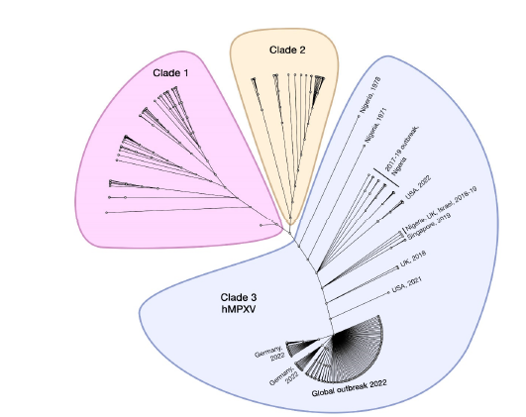
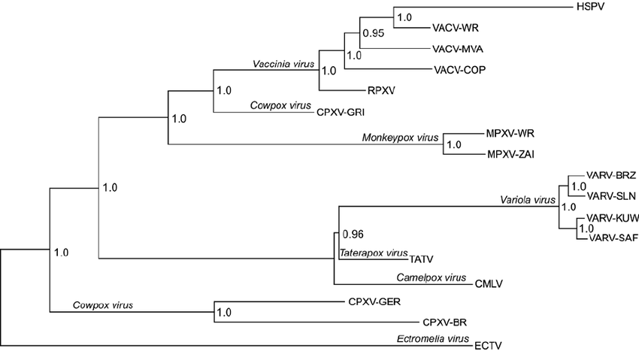
Phylogenetics of Current mpox Outbreak
Clade III likely represents adaptation to humans
Human to human transmission
Control/Vaccination Material
Smallpox
Harapan H, Ophinni Y, Megawati D, Frediansyah A, Mamada SS, Salampe M, Bin Emran T, Winardi W, Fathima R, Sirinam S, Sittikul P, Stoian AM, Nainu F, Sallam M. Monkeypox: A Comprehensive Review. Viruses. 2022 Sep 29;14(10):2155. doi: 10.3390/v14102155. PMID: 36298710; PMCID: PMC9612348.

Slide 4
Clinical Features and Transmission of Monkeypox
Incubation period is usually 7-14 days, but can range from 5-21 days
Symptoms are similar to smallpox, but milder and begins with:
Fever, headache, muscle ache, malaise, lymphadenopathy
Within 1-3 days of symptoms, the rash appears and progresses through stages
Macules
Papules
Vesicles
Pustules
Scabs
Localized rash distribution may be mistaken for HSV, VZV or secondary syphilis
Illness usually lasts 2-4 weeks; patient is infectious until lesions have healed
Can spread person to person, via fomites or from an infected animal
Respiratory transmission may occur – requires “prolonged” face to face contact
Mitjà O, Ogoina D, Titanji BK, Galvan C, Muyembe JJ, Marks M, Orkin CM. Monkeypox. Lancet. 2023 Jan 7;401(10370):60-74. doi: 10.1016/S0140-6736(22)02075-X. Epub 2022 Nov 17. Erratum in: Lancet. 2022 Dec 3;400(10367):1926. PMID: 36403582; PMCID: PMC9671644.

Slide 5
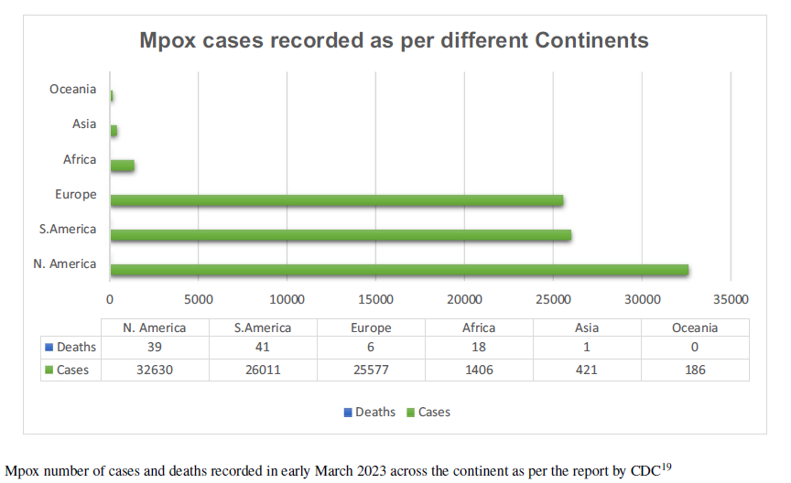
Global Emergence of mpox: 2022
Prior to 2022, cases outside of Africa were rarely reported and usually associated with travel
First cases associated with 2022 outbreak detected in UK
Announced on May 7th in a traveler returning from Nigeria
May 14th → reports of two cases in patients with no travel history
May 16th → report of four additional patients who identify as gay, bisexual or men who have sex with men
Additional cases in Europe and Americas reported in subsequent weeks
Public Health Emergency of International Concern (PHEIC) declared by the World Health Organization (WHO) in July 2022
Ranjan S, Vashishth K, Sak K, Tuli HS. The Emergence of Mpox: Epidemiology and Current Therapeutic Options. Curr Pharmacol Rep. 2023;9(3):144-153. doi: 10.1007/s40495-023-00318-y. Epub 2023 May 5. PMID: 37213566; PMCID: PMC10160711.

Slide 6
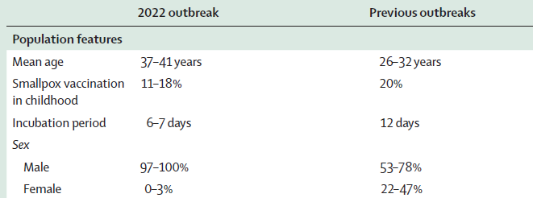
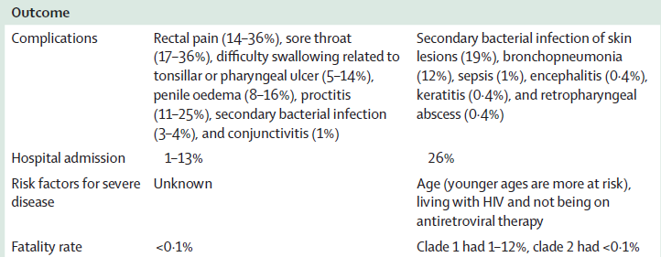
Comparison of 2022 mpox Outbreaks to Previous Outbreaks
Mitjà O, Ogoina D, Titanji BK, Galvan C, Muyembe JJ, Marks M, Orkin CM. Monkeypox. Lancet. 2023 Jan 7;401(10370):60-74. doi: 10.1016/S0140-6736(22)02075-X. Epub 2022 Nov 17. Erratum in: Lancet. 2022 Dec 3;400(10367):1926. PMID: 36403582; PMCID: PMC9671644.

Slide 7
Emergence of mpox in May 2022: United States
First U.S. Case was reported to CDC on May 17, 2022 by Massachusetts State Public Health Laboratory
Patient presented with an anogenital rash on May 4, 3 days after returning from international travel
Swabs were collected and were positive for Orthopoxvirus DNA
PCR testing at CDC on May 18 confirmed presence of the West African clade of mpox virus
Almost concomitantly, a returning traveler from NYC presented with an oral lesion and perianal rash
NYC Department of Health and Mental Hygiene contacted
Positive result from Orthopoxvirus DNA
Current ability to detect Orthopxviruses via Laboratory Response Network allowed for detection of first U.S. cases
https://www.cdc.gov/mmwr/volumes/71/wr/mm7123e1.htm

Slide 8
CDC Non-Variola Orthopoxvirus (NVO) Assay
Detection of the E9L gene
Will detect other members of the NVO family
Mpox, Cowpox, Ectromelia, Camelpox, etc.
Received 510K designation initially in 2005
Received clearance again in 2018 to reflect an update to labeling and use of reagents
Performance of the assay restricted to the Laboratory Response Network (LRN)
Significant LRN laboratory capacity existed at the beginning of the 2022 mpox outbreak
©2023 Laboratory Corporation of America® Holdings All rights reserved.
8

Slide 9
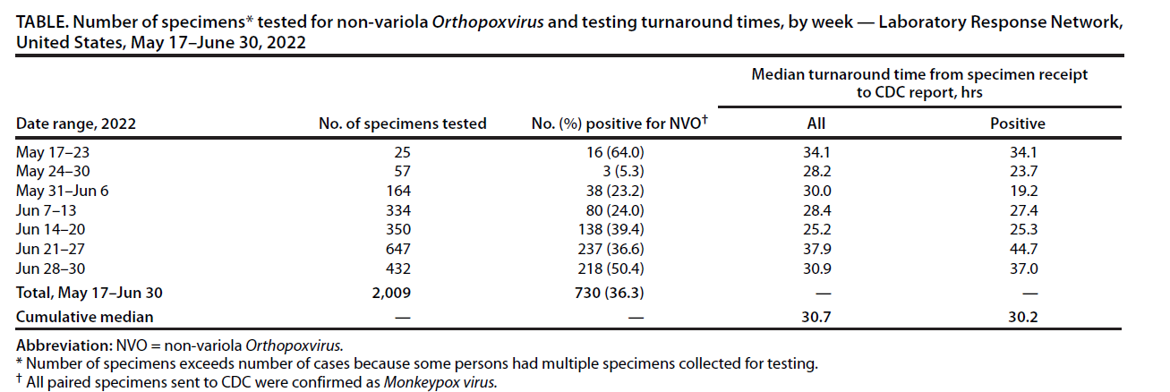
Morbidity & Mortality Weekly Report
Estimated LRN capacity for NVO testing was 8,000 test per week
Initial capacity limitations were due to reagent availability and requirement for manual DNA extraction
LRN increased capacity by bringing on additional laboratories and implementing operational changes
Extra shifts, extra personnel and shifting testing priorities
https://www.cdc.gov/mmwr/volumes/71/wr/mm7128e1.htm

Slide 10
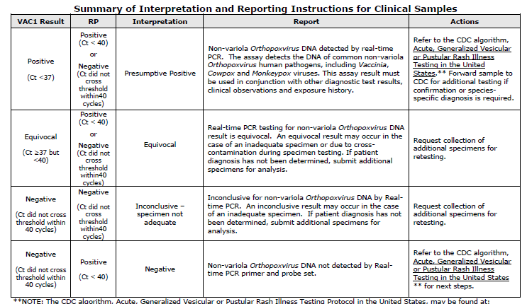
CDC 510K NVO Assay Overview
Assay based on TaqMan® Chemistry
Detection of the conserved E9L gene (VAC)
Incorporates a specimen collection control → Human RNase P (RP)
Four potential result outputs:
CDC 510K NVO Assay, Package Insert

Slide 11
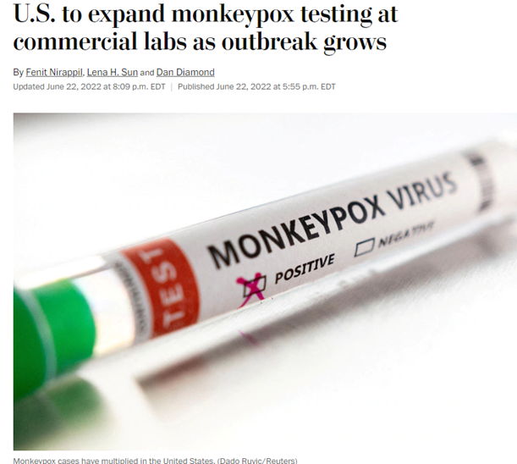
Expansion of mpox Testing to Commercial Labs: June 2022
Mid-June 2022:
CDC and FDA initiate expanded use of the NVO to commercial laboratories
Labcorp, Quest Diagnostics, Sonic Healthcare, Mayo Medical Laboratories and Aegis Sciences
The goal was to increase overall U.S. testing capacity to > 10,000 samples per week per laboratory
Required establishment of validated, higher throughput protocols
Each laboratory worked on generating validation data to support increasing testing capacity for mpox
Weekly/biweekly meetings held between CDC/FDA and commercial labs to report on progress
Incorporation of assay modifications to increase throughput were allowed via FDA Enforcement Discretion
Protocols / SOPs were shared on ACLA Microsite

Slide 12
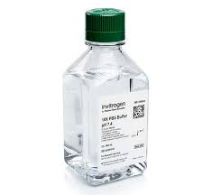
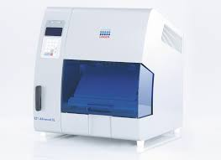
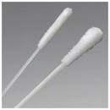
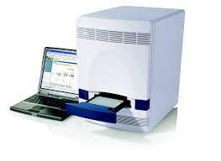
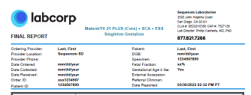
Overview of Original NVO Assay Workflow
Swab lesion
(dry swab preferred)
Extract DNA
Elute lesion material
Report Results
Perform PCR

Slide 13
CDC/LRN Support of Commercial Labs Adopting the NVO Assay
Close coordination between CDC / LRN Labs and Commercial Labs to train staff on performance of NVO Assay
Real world experience shared from the NYS Department of Health, Wadsworth Center
Training sessions were organized and delivered via internet training
Focus on biosafety and training / competency + assay performance
Appropriate PPE
Proper use of Biosafety Cabinet
Documented training of assay performance
Ongoing competency assessment per regulatory requirements
Post-training, laboratories initiated assay verification work
Submitted documentation to CDC of verification study
Launched testing at Labcorp on July 6, 2022….

Slide 14
Expanding Commercial Laboratory Capacity for the NVO Assay

Slide 15
Commercial Laboratory Response to the 2022 mpox Outbreak
Labcorp has a long history of working with the CDC and other public health labs in response to threats from infectious diseases
Recent support of the national response to the COVID-19 pandemic
Infrastructure in place to mobilize quickly to support mpox testing
Rapidly scaled daily testing capacity
Launched testing across multiple platforms in multiple laboratories located throughout the United States (and abroad)
Achieved multiple Emergency Use Authorizations for COVID-19 and COVID-19/FluA/FluB and RSV Testing
Supported clinicians, individual patients, vaccine and therapeutics manufacturers
Enhanced private-public relationships across all levels of the organization
Improve access to mpox testing for clinicians who may not liaise with LRN laboratories
Simplify ordering and results reporting
Access to testing supplies

Slide 16
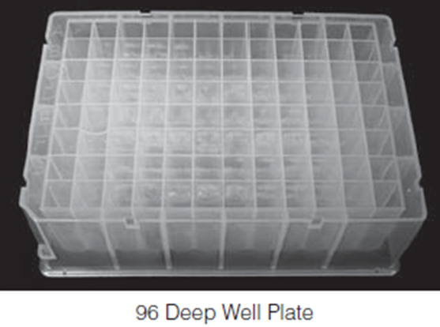
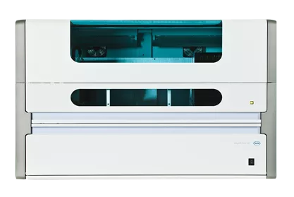
Addressing Two Bottlenecks in the NVO Assay Process
96 Well Plate
MagNA Pure ® 96
Dry Swab Processing
Increase from a single swab to elution in a 96 well plate
DNA Extraction Capacity
Migrate from Qiagen® EZ1 to MagNA Pure 96
Swab lesion
Elute lesion material
Extract DNA
Report Results
Perform PCR

Slide 17
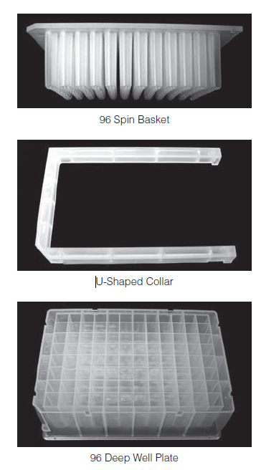
Increasing Extraction Throughput: Dry Swab Elution
The initial preferred sample type was a dry swab of lesion fluid
Recommendation to submit two swabs
Pros:
No dilution of the lesion material into a liquid transport
Established stability
Drawbacks:
Potential for the two swabs to collect a homogenous sample
All sample was consumed in the testing protocol, if repeat testing was required.
Elution of material from dry swabs became a bottleneck
Initial protocol used a S.E.T.S. tube (Roche)
Allowed for processing of a single sample at a time
Incorporated the use of the Promega SlicPrep™ plate to process specimens
Slicprep™ 96 Device Cat.# V1391

Slide 18
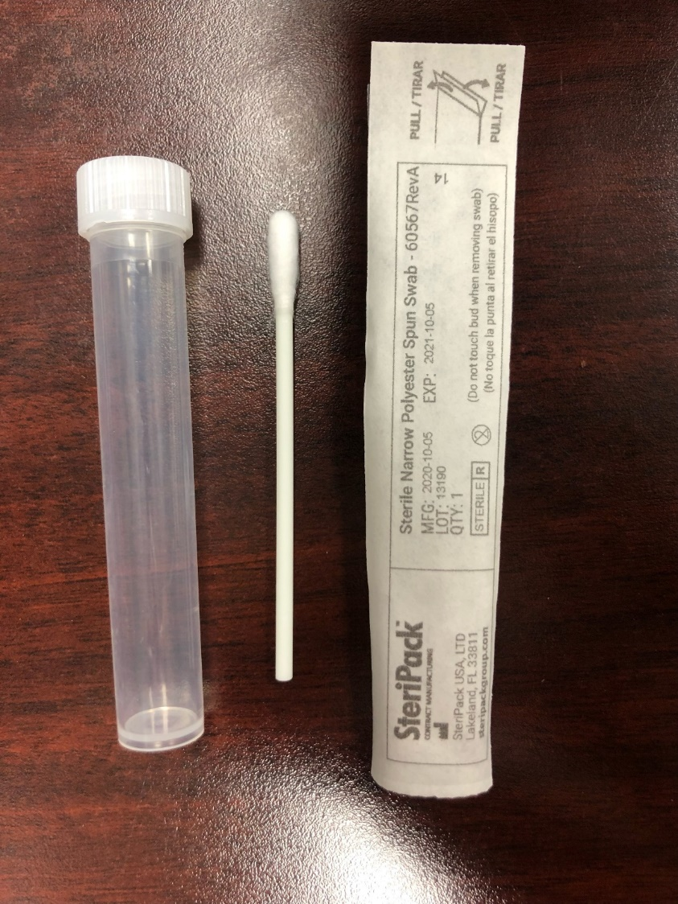
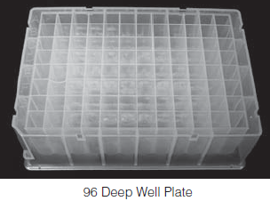
SlicPrep™ Processing
Allowed for 90 samples to be processed per plate
Drawbacks:
Swab tips needed to be cut for processing
Multiple pairs of scissors required and scissors required disinfection with bleach and ethanol between samples
Some swabs submitted were too large to fit into the wells
These needed to be processed via S.E.T.S tubes or rejected
Initial protocol called for adding PBS to elute by pipetting over the swabs
We validated placing dry swabs in the well and eluting into the bottom plate for 10 minutes to avoid pipetting over
All manipulations performed using BSL 2+ precautions
Biosafety cabinet, disposable gown, N95, double gloves

Slide 19
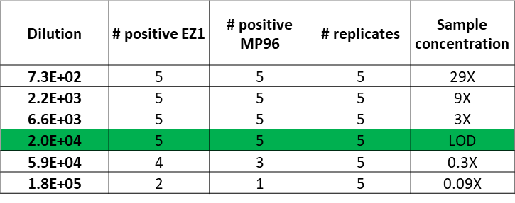
Increasing Extraction Throughput
Automation of Extraction using MagNA Pure® 96: Small Volume Kit
SlicPrep™ preparation allowed us to proceed directly to a 96 well extraction pathway
Incorporated an off-board lysis to deactivate samples
Established comparable LoD to Qiagen ® EZ1
Labcorp Internal Data; submitted to CDC to support use of MagNA Pure 96 in NVO assay

Slide 20
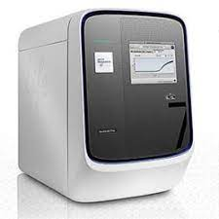
Expanding PCR Detection Capability
QuantStudio™ 7 Flex
Leveraged instrument capacity throughout the Labcorp network that was built to support COVID-19 testing
Staff familiar with the technology; ability to interface directly to LIS
Allowed for defined, locked down protocols (i.e. thresholds)
Provided flexibility to potentially move to 384 well capacity
Developed a Standardized Operating Procedure
Needed to show equivalence to ABI 7500 Dx performance

Slide 21
NVO Assay: QuantStudio™ 7 Flex Performance
Limit of detection using a quantitative genomic control (Vaccinia virus) is equivalent
Strong correlation between QS7 Flex and 7500 Dx for VAC1
Copies per uL | # 7500 Positive Replicates | # QS7 Positive Replicates | # Replicates | Relationship to LOD
9 cp/uL | 20 | 20 | 20 | 3X LOD
3 cp/uL | 20 | 20 | 20 | LOD
1 cp/uL | 11 | 12 | 20 | 0.3X LOD
0.33 cp/uL | 1 | 1 | 20 | 0.09X LOD
Labcorp Internal Data; submitted to CDC to support use of QS7 in NVO assay

Slide 22
Implementing SlicPrep™, MagNA Pure ® (and QS7 Flex)
Supported by FDA Letters sent to CDC indicating Enforcement Discretion on assay modifications
Excerpt:
CDC Enforcement Discretion Letter, Dated July 4, 2022 from FDA to CDC.

Slide 23
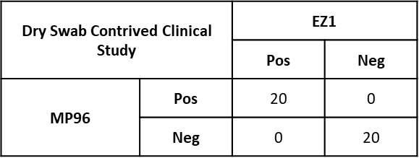
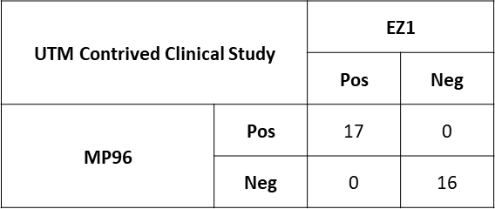
Dry Swab vs. Wet Swab Equivalence
As volumes continued to increase in July 2022, elution of the dry swabs was still a bottleneck
Validating the use of standard Universal Transport Media (UTM) was pursued
Samples were contrived by spiking swabs with Vaccinia virus +/- Human Extracted DNA
Spiked swabs were eluted using the SlicPrep™ method or placed into a negative clinical UTM matrix
Extractions performed on MagNA Pure ® 96 or EZ1
Offered wet swabs (VTM and UTM) in late July

Slide 24
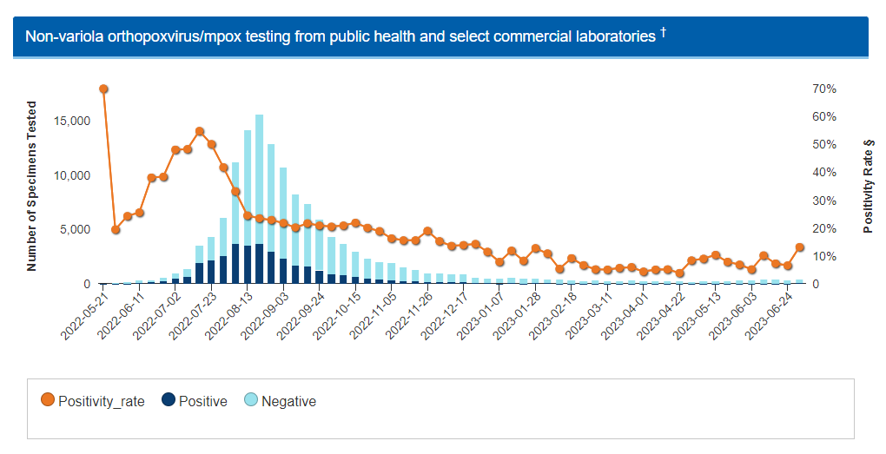
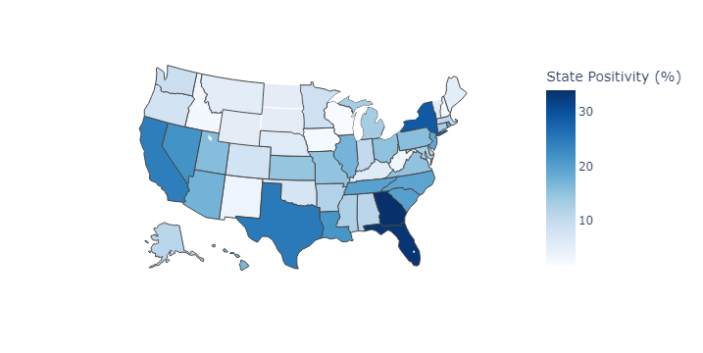
Commercial Laboratory Impacts to mpox Test Availability
Labcorp™ Metrics through 2022
https://www.cdc.gov/poxvirus/mpox/response/2022/2022-lab-test.html; Accessed 7/3/2023
Labcorp Internal Data

Slide 25
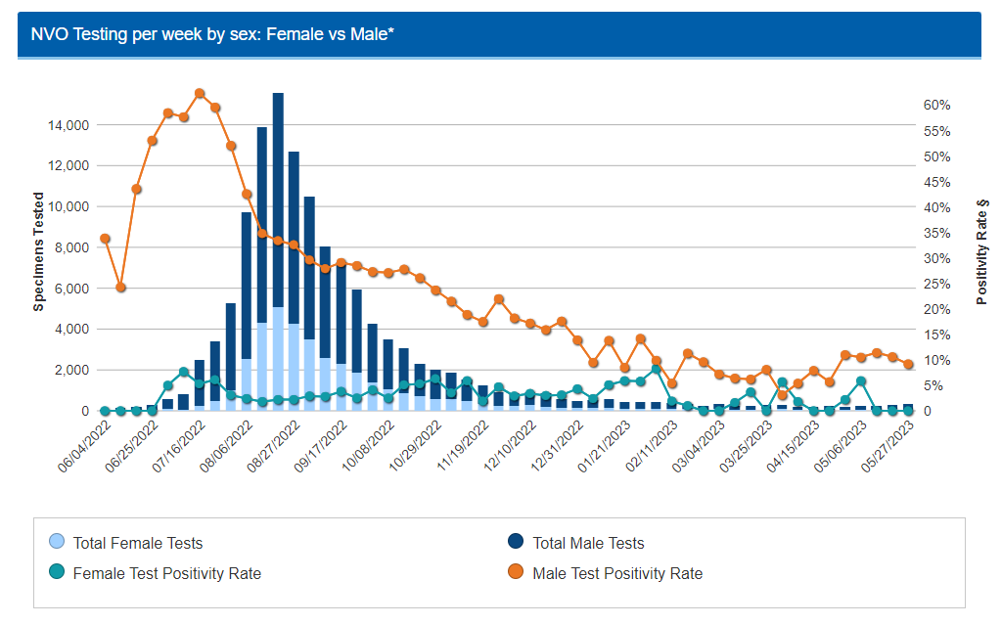
Challenges Associated with High Volume mpox Testing early
Early in the outbreak, it was apparent that women and children were low risk for mpox infection
8/23/2022: CDC Issues a Lab Advisory to provide guidance to mitigate false positive results
Multiple observations of likely false positive results in pediatric patients
Recommendation to repeat testing (from extraction) to confirm samples with high Cts
Labcorp had implemented this process in early August in pediatric patients < 14 years of age
Ma A, Bradley BT. Clinical testing of pediatric mpox specimens: Unique features and challenges in a low prevalence population. J Clin Virol. 2023 Jun;163:105447. doi: 10.1016/j.jcv.2023.105447. Epub 2023 Apr 12. PMID: 37068452; PMCID: PMC10089974.
Minhaj FS, Petras JK, Brown JA, Mangla AT, Russo K, Willut C, Lee M, Beverley J, Harold R, Milroy L, Pope B, Gould E, Beeler C, Schneider J, Mostafa HH, Godfred-Cato S, Click ES, Borah BF, Galang RR, Cash-Goldwasser S, Wong JM, McCormick DW, Yu PA, Shelus V, Carpenter A, Schatzman S, Lowe D, Townsend MB, Davidson W, Wynn NT, Satheshkumar PS, O'Connor SM, O'Laughlin K, Rao AK, McCollum AM, Negrón ME, Hutson CL, Salzer JS; CDC Monkeypox Emergency Response Team; CDC Monkeypox Emergency Response Team. Orthopoxvirus Testing Challenges for Persons in Populations at Low Risk or Without Known Epidemiologic Link to Monkeypox - United States, 2022. MMWR Morb Mortal Wkly Rep. 2022 Sep 9;71(36):1155-1158. doi: 10.15585/mmwr.mm7136e1. PMID: 36074752; PMCID: PMC9470221.
https://www.cdc.gov/poxvirus/mpox/cases-data/lab-data.html; Accessed 7/3/2023

Slide 26
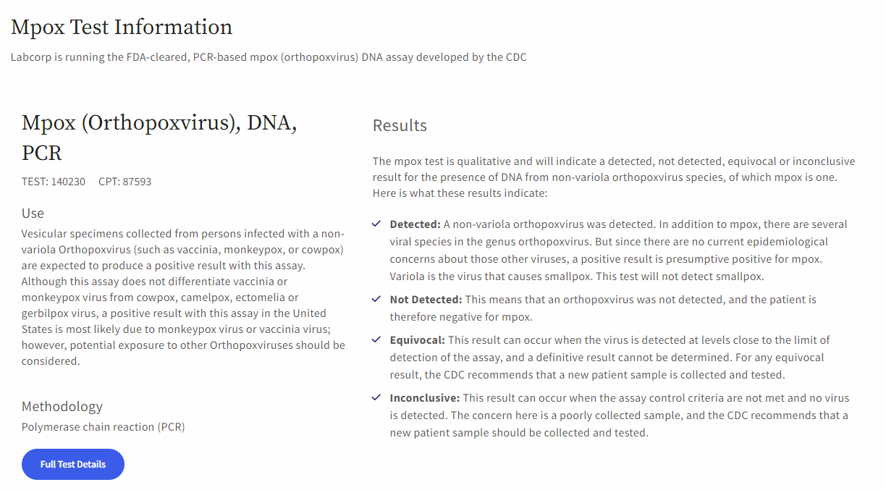
Challenges Associated with High Volume mpox Testing equivocal vs inconclusive
Significant education required on the interpretation of “Equivocal” vs. “Inconclusive”
Equivocal = specimens with a VAC1 Ct > 37 and < 40
Inconclusive – specimens with no VAC Ct detected and no RNase P detected
Likely represents an inadequate collection
Communicated broadly via test comments on reports and Labcorp™ mpox Microsite
https://www.labcorp.com/infectious-disease/mpox

Slide 27
Challenges Associated with High Volume mpox Testing
Providers interpreted testing information on the CDC Website as being true for all laboratories performing mpox testing
Attempted to harmonize specimen requirements as much as possible but diverged slightly:
Labcorp validated Universal Transport Media as an alternate collection device
Labcorp does not accept non-swab specimens (lesion crusts, unpreserved exudates)
https://www.cdc.gov/poxvirus/mpox/clinicians/prep-collection-specimens.html

Slide 28
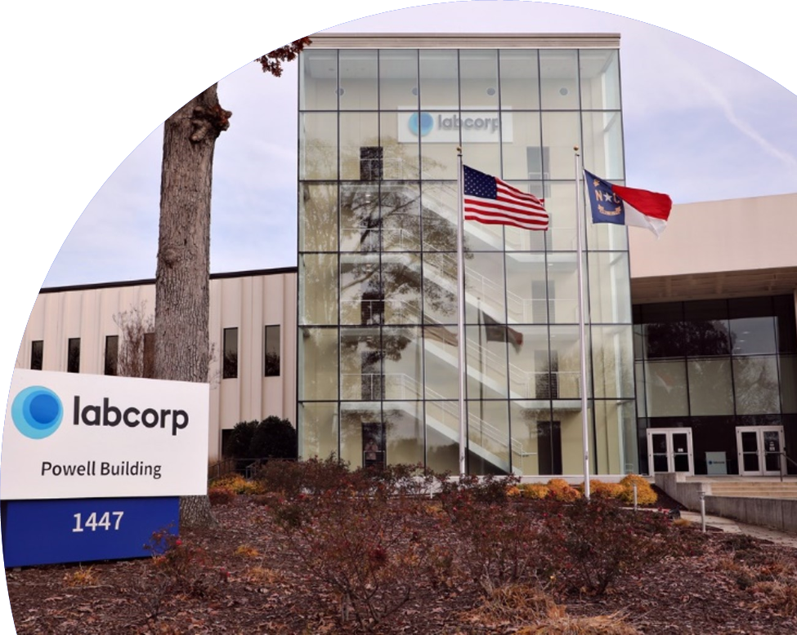
Current State of mpox Testing
Commercial laboratories continue to support U.S. mpox response
Modest uptick in testing and positivity rate
Ability to generate and share real world data on laboratory testing performance
Demographics of test populations
Co-infection rates
Patients that fail to clear infection
Greater desire to test for other infections that present with lesions
VZV, HSV and Syphilis
Public/private partnerships continue… what’s next??

Slide 29
Acknowledgements
Labcorp Team
External Parners
Marcia Eisenberg, PhD
Debbie Boles, PhD
Jon Williams, PhD
David Alfego, PhD
Tien Le
Will Sibbett
Ayla Burns
Thomas Urban, PhD
Minoli Perera, PhD
Mindy Nye, PhD
Phyllis Davis
Bryan Butt
Tim Staton
Jennifer Hunt
Technical Staff at Center for Esoteric Testing
FDA, Center for Devices and Radiologic Health
CDC, Division of Preparedness and Emerging Infections
American Clinical Laboratory Association
NYS Department of Health, Wadsworth Center
Colleagues at Quest, Mayo, Aegis and Sonic Labs

Slide 30
Thank you

